Slide 1
CS 551
Spring 2025

Slide 2
Generics and Traits
There are several ways to make use of generics and traits
Trait bounds were the one we mostly discussed
They can get a bit annoying
There are certain situations here they can be difficult to express
There are some situations where you don’t really care about the concrete type at compile and are just interested in an abstract type
I.e., we want to return something with a given trait

Slide 3
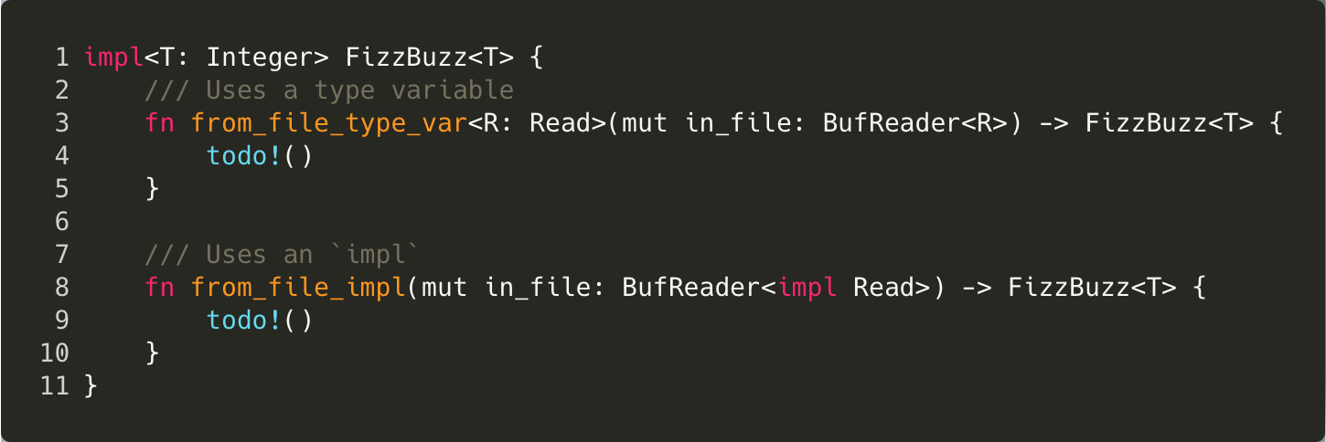

Slide 4
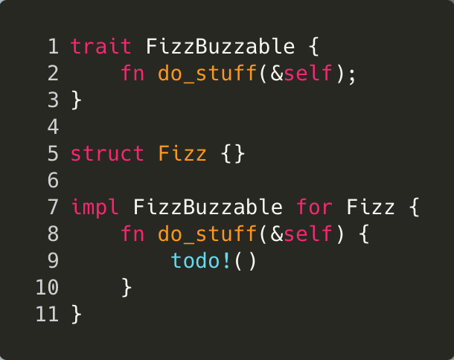

Slide 5
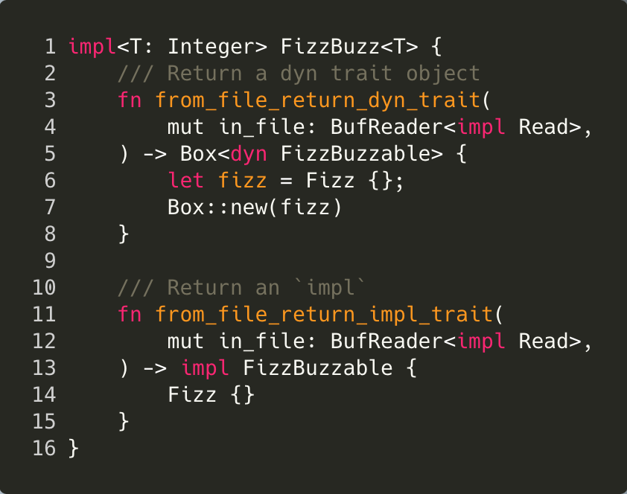

Slide 6
Potential performance concerns. Why?

Slide 7
Potential performance concerns. Why?

Slide 8
Potential performance concerns. Why?

Slide 9
The Box<dyn Stuff>
https://doc.rust-lang.org/reference/items/traits.html#dyn-compatibility

