Slide 1
CS 551
Spring 2025

Slide 2
We built a simple echo server

Slide 3
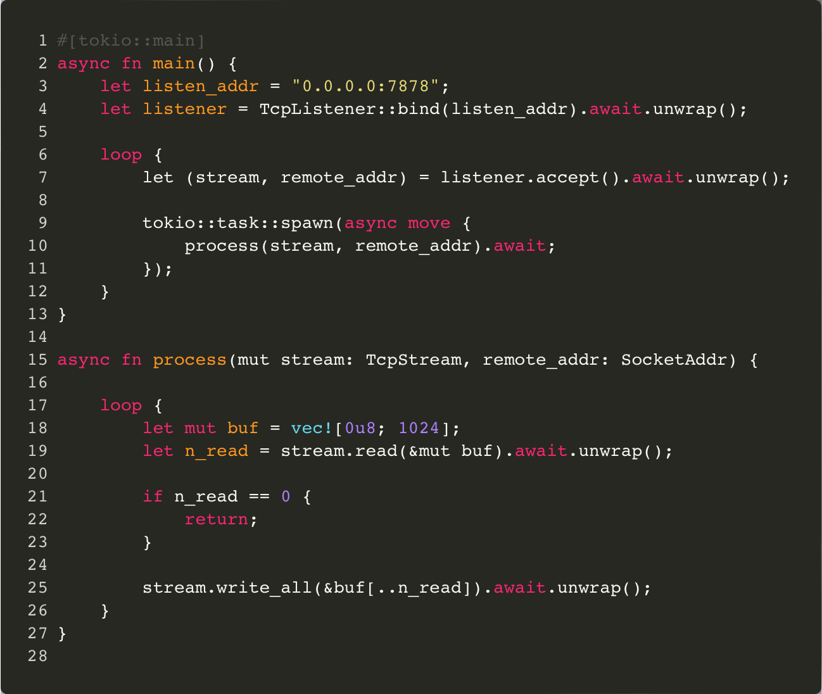
We built a simple echo server

Slide 4
We built a simple echo server
Directive that starts up a tokio runtime.
Can also use a single threaded runtime #[tokio::main(flavor = "current_thread")]
Or manually set up the runtime.

Slide 5
We built a simple echo server
Only async functions and blocks can call async function

Slide 6
We built a simple echo server
We await the result of a future, which will (eventually) produce a value

Slide 7
We built a simple echo server
We spawn a new task, which is like spawning a thread, but it takes an async closure.

Slide 8
Now let’s build a simple chat server
Our chat server is going to be super simple!
Line based
Broadcast only functionality
We will just use telnet as a client right now.

Slide 9
Echo server → Chat server
Our echo server is not that far off from a chat server
We are reading in lines and then sending them back over the network
It already works with multiple clients
What else do we need?
Clients are currently totally isolated
We need a way to be able to have data from one client get to other clients
Should we build a higher level connection abstraction?
How would we manage multiple clients?

Slide 10
Let’s think about some structs
Server struct?
Connection struct?
Some sort of struct that manages all the connection?

Slide 11
Broadcasting messages?
We want to broadcast messages between connections
Each connection is running in its own task
Anything we’ve seen that makes sense for communicating between tasks
Recall that tasks are similar to threads…
What about a channel?
Tokio has a broadcast channel even!
https://docs.rs/tokio/latest/tokio/sync/broadcast/index.html

Slide 12
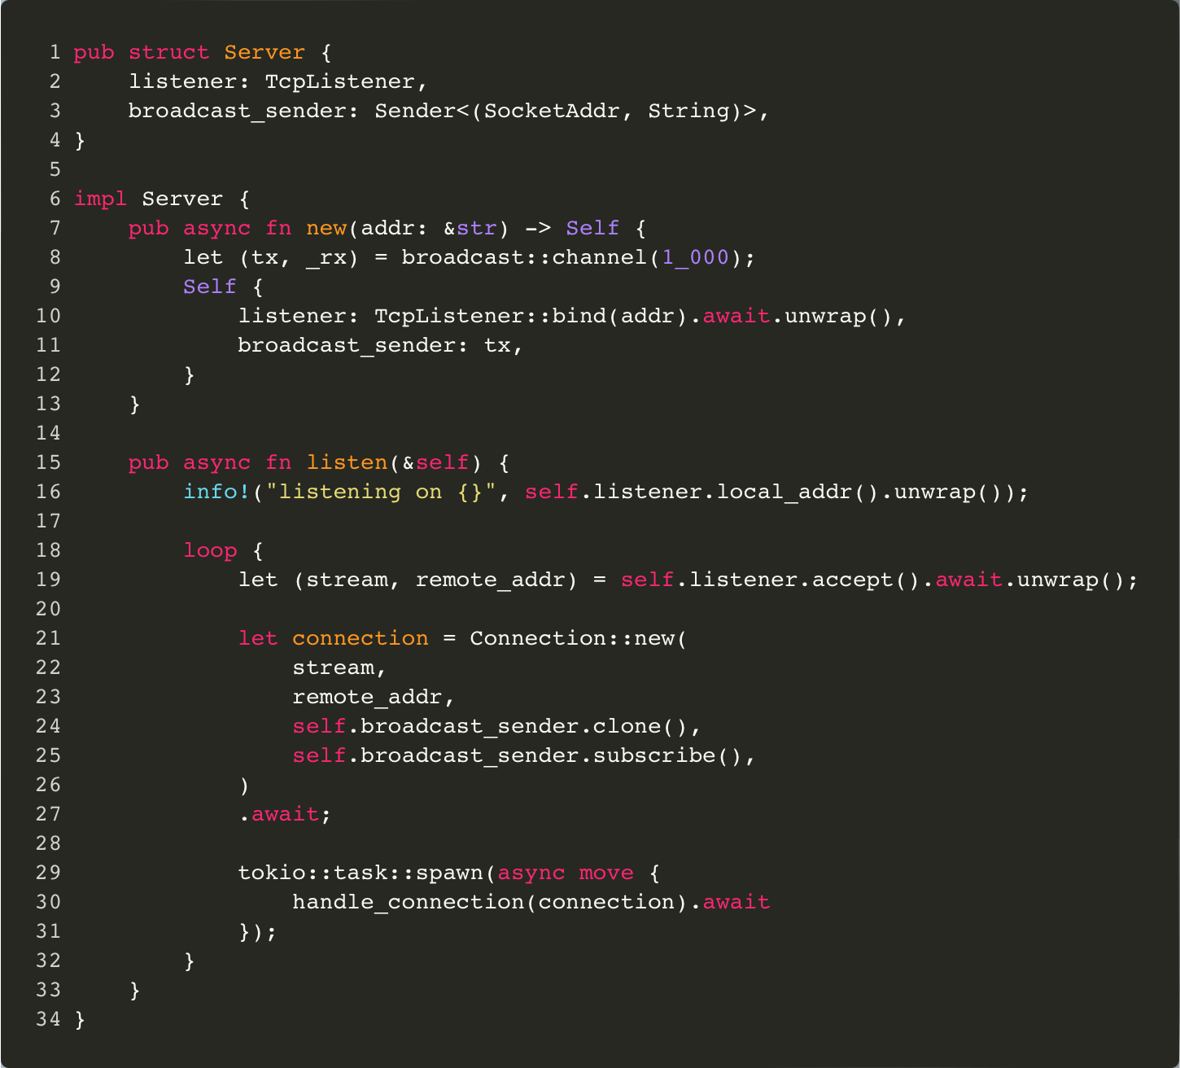

Slide 13
Our server is going to listen to things, so we need a TcpListener

Slide 14
We are also going to have the send end of a broadcast channel
(look at broadcast channel docs)

Slide 15
When sending messages, we want to know who the message is from and what the message is

Slide 16
Just setting things up in our constructor as we’ve seen before

Slide 17
We’ll come back to this, but it’s mostly similar to our basic echo server example

Slide 18
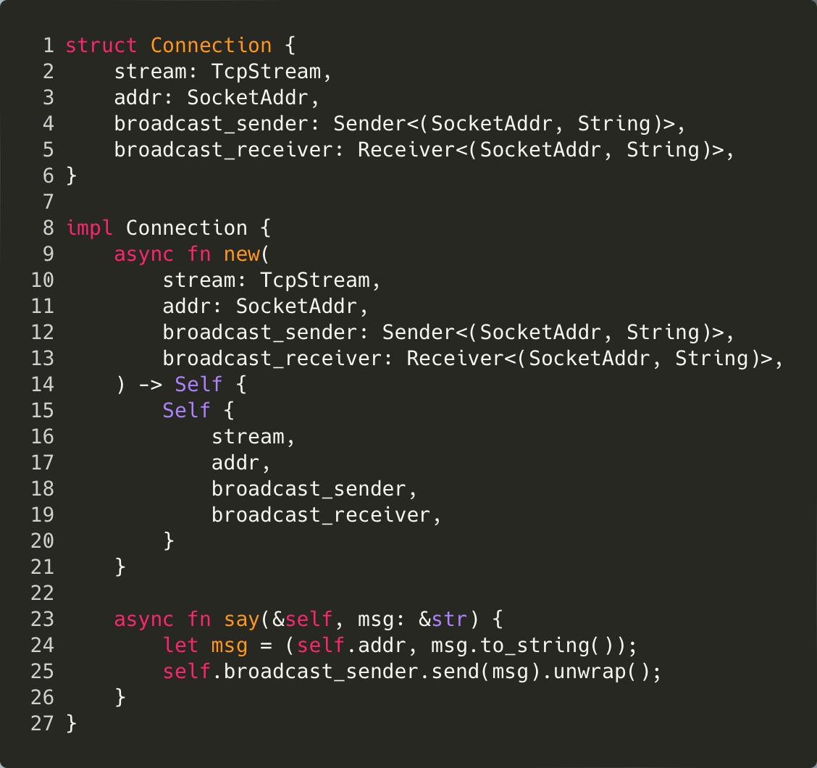

Slide 19
We need a Connection to have a stream to read/write from, it needs to know its (remote) address, and it needs to be able to broadcast and receive messages

Slide 20
Very simple constructor

Slide 21
A simple helper method that actually sends a message across to other Connections on the broadcast channel.

Slide 23
Once we have a new remote connection, we then want to spawn a new task to actually deal with it

Slide 24
How do we handle the connection?
Echo server was simple
Wait for data to come in, send it back out to the client, repeat
We are more complicated now…
We need to listen for data coming in over the connection
We also need to listen to things that are coming over the broadcast channel!
How do we do it?
We could use a bunch of channels that are living in their own task…

Slide 25
The select! macro
This is actually a pretty typical problem
We might often have a bunch of futures that we want to wait on concurrently, and then deal with them when they finish evaluating
I.e., we want to await multiple futures at the same time
Tokio has a macro called select! that makes this easy for us!

Slide 26
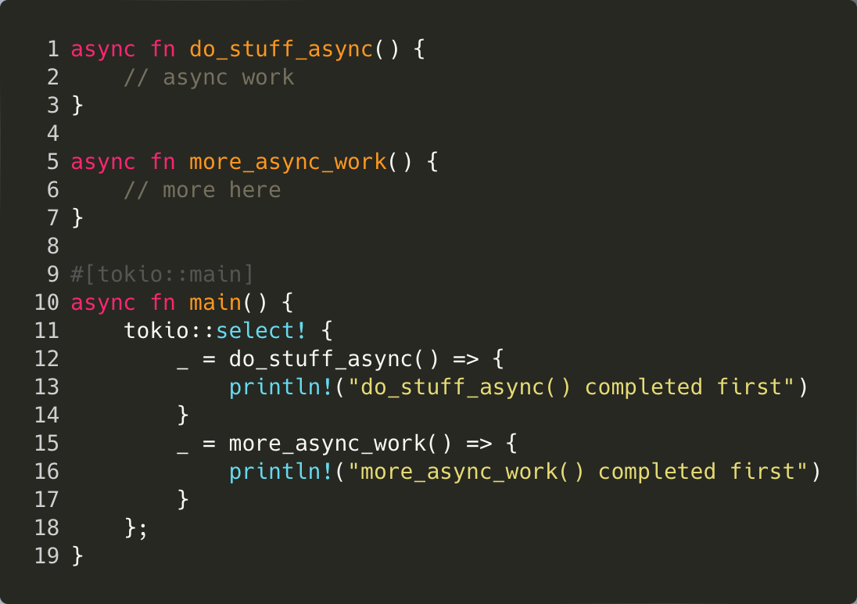

Slide 27
It looks a lot like a match statement!

Slide 28
Returns when a single awaited computation finishes

Slide 29
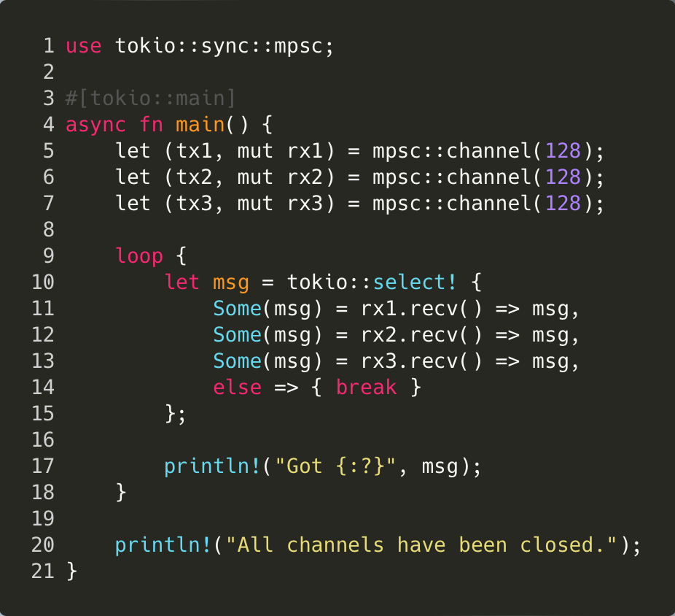

Slide 30
You can use select! In a loop.
Very common usage…

Slide 31
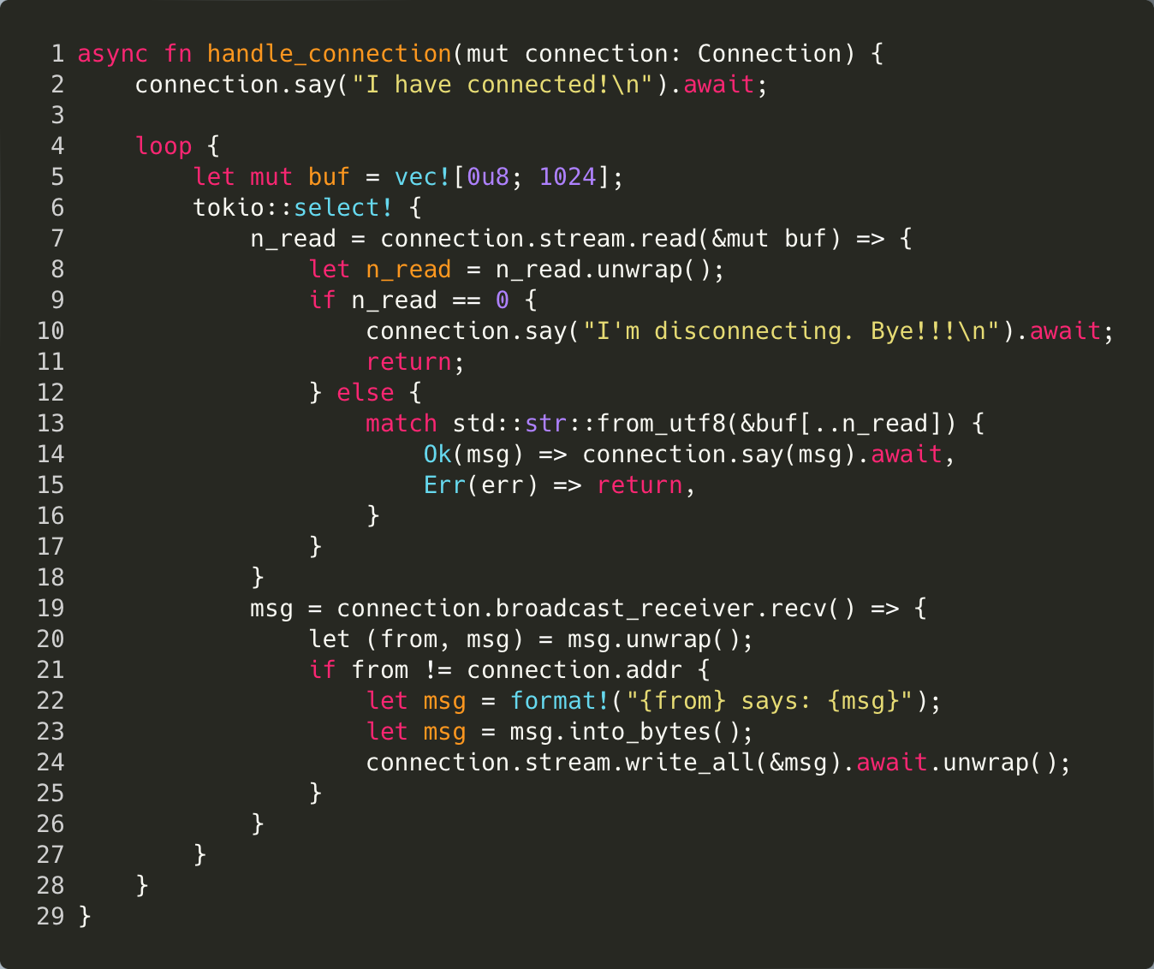

Slide 32
This branch waits for some data to come in from the remote user

Slide 33
There are cases where we might get bytes from the client that can’t be interpreted as utf8; we’ll just drop connections that do that.

Slide 34
This branch handles when we receive a message over our broadcast channel.
I.e., a chat message from another user

Slide 35
Issues with our implementation?

