Slide 1
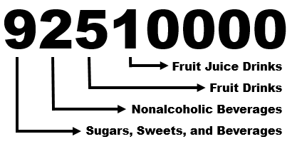
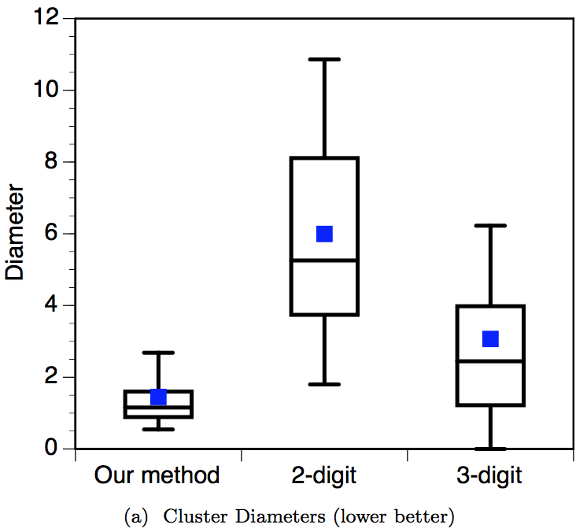
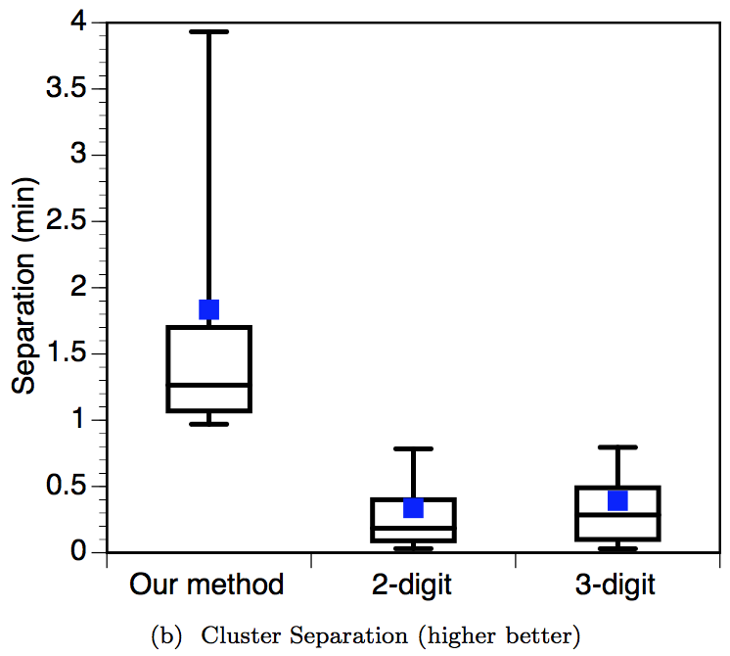
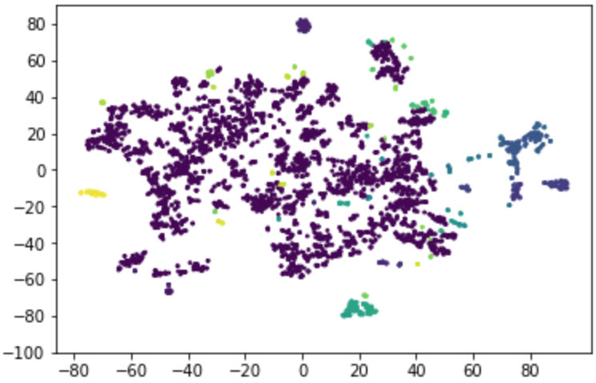
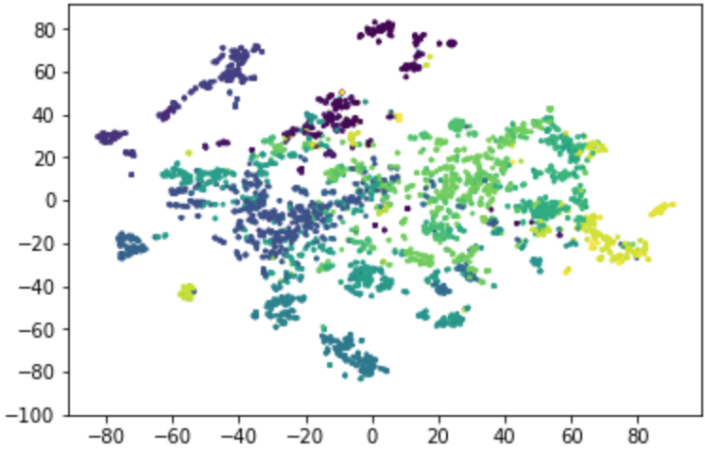
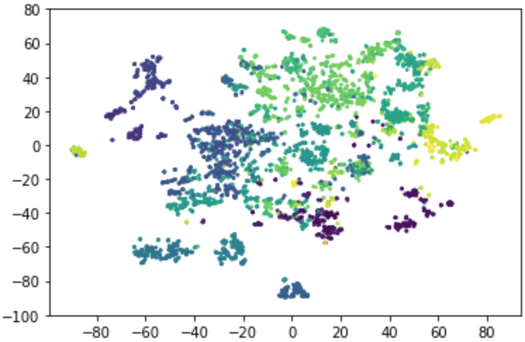
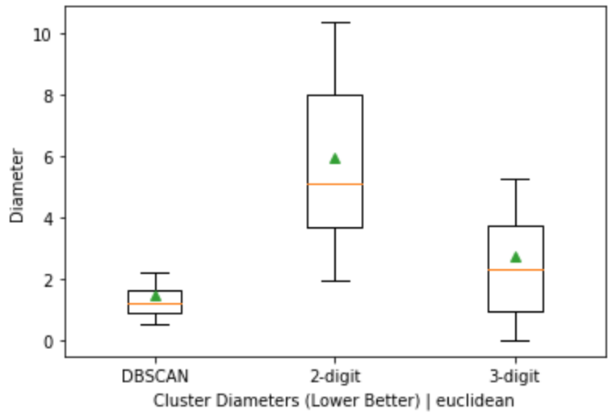
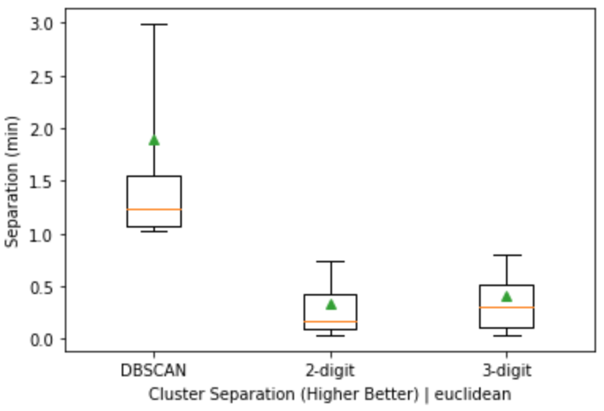
Food Group Classification Based On Micro-and Macro-nutrient Content
Students: Ahmad Hariri, Ankush Saini
Advisor: Michela Taufer
Motivation
Background
USDA food groups are based on categories (mislead patients when advised with dietary restrictions)
For ex., “take more calcium”, but USDA codes not based on nutrient data
We provide a meaningful (objective) food groups classification based on nutritional data
We use parallel approach to cluster food groups based on the objective approach and compare it with USDA approach
We reproduce the work of (Wyatt’s, Johnston, Papas, and Taufer 2016^{[1]}) to validate the results
USDA codes are categorical, not nutrient-driven,
Structure of Dietary Data Item,
<143672, 92510000, 3, 0, 8:15am, 7, 3, 10.1, 4, 3.45, 10, 178, …>
Participant ID
USDA Food Code
Meta Data
Macronutrients
Micronutrients
Can we validate the food classification based on nutrient data, initially proposed by Wyatt’s et al. 2016^{[1]} work, rather than the traditional USDA classification?
Our Objective
Problem Definition
Related Work
Results (figures) from Wyatt’s et al. 2016^{[1]} paper
There is a lack of standard food groups in dietary studies, in which food group are subjective (based on: dietary trends, human expertise, etc. )
Then, bad results occurs when using subjective food group for dietary studies.
Therefore, the solution: ( objective food groups ), in which objective ( based on: nutrient content ) to become a standard
With the objective food groups, scalable methods can be applied to identify the groups
Cluster Diameters (Lower Better)
Cluster Separation (Higher Better)
1
Use NHANES dataset based on USDA food codes
2
Create food groups based on first 2 ,3 digits of USDA food codes
3
Measure inter- and intra-cluster distances
4
Plot values in boxplots to replicate related work
Our Methodology
(1) DBSCAN:
# food items: 60.05%
# food clusters: 92
(2) 2-digit USDA:
# food items: 60.05% # food clusters: 46
(3) 3-digit USDA:
# food items : 60.05%
# food clusters: 192
(1)
(2)
(3)
Average diameter
DBSCAN: 1.48
2-digit USDA: 5.95
3-digit USDA: 2.76
Results
Average separation
DBSCAN: 1.89
2-digit USDA: 0.33
3-digit USDA: 0.41
Conclusion
Wyatt’s et al. 2016^{[1]} approach classify food groups based on nutrient content which help in advising patients with dietary restrictions
Our results match with Wyatt’s et al. 2016^{[1]} results.
Wyatt’s et al. 2016 work is reproducible and trusted since we were able validate their work.
Diameter
Separation (min)
Cluster Diameters Euclidean | (Lower Better)
Cluster Separation Euclidean | (Higher Better)
[1] M. Wyatt, T. Johnston, M. Papas, and M. Taufer. Development of a Scalable Method for Creating Food Groups Using the NHANES Dataset and MapReduce. In Proceedings of the ACM Bioinformatics and Computational Biology Conference (BCB), pp. 1 - 10. Seattle, WA, USA. October 2 - 4, 2016.

