Slide 1

Food Group Classification Based On Micro-and Macro-nutrient Content
Ahmad Hariri, Ankush Saini, and Michela Taufer
University of Delaware

Slide 2
Table of Contents
Motivation
Background
Our Work Question
Problem Definition
Related Work
Methodology
Results
Summary
Conclusions

Slide 3
Motivation
USDA food groups are based on categories (mislead patients when advised with dietary restrictions)
  For ex., “take more calcium”, but USDA codes not based on nutrient data
We provide a meaningful (objective) food groups classification based on nutritional data
We use parallel approach to cluster food groups based on the objective approach and compare it with USDA approach
We reproduce (Wyatt’s, Johnston, Papas, and Taufer 2016^{[1]}) work (trust/validate results)

Slide 4
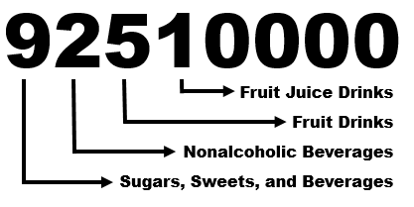
Background
USDA codes are categorical, not nutrient-driven,
Structure of Dietary Data Item,
<143672, 92510000, 3, 0, 8:15am, 7, 3, 10.1, 4, 3.45, 10, 178, …>
Participant ID
USDA Food Code
Meta Data
Macronutrients
Micronutrients

Slide 5
DBSCAN (Clustering Algorithm)
Wyatt’s et al. 2016^{[1]} work use DBSCAN algorithm over K-Means and Hierarchical because is DBSCAN features:
  Resource efficient
  Noise Insensitive
  Outlier Detection
  Spheroid Clusters
  Non-Spheroid Clusters
  Undefined Cluster Count
While other clustering algorithms support some of these features but not all them.

Slide 6
Our Work Question?
Can we trust/validate a food classification based on nutrient data, initially proposed by Wyatt’s et al. 2016 work, rather than traditional USDA classification?

Slide 7
Problem Definition
There is a lack of standard food groups in dietary studies, in which food group are subjective (based on: dietary trends, human expertise, etc. )
Then, bad results occurs when using subjective food group for dietary studies.
Therefore, the solution: ( objective food groups ), in which objective ( based on: nutrient content ) to become a standard
With the objective food groups, scalable methods can be applied to identify the groups

Slide 8
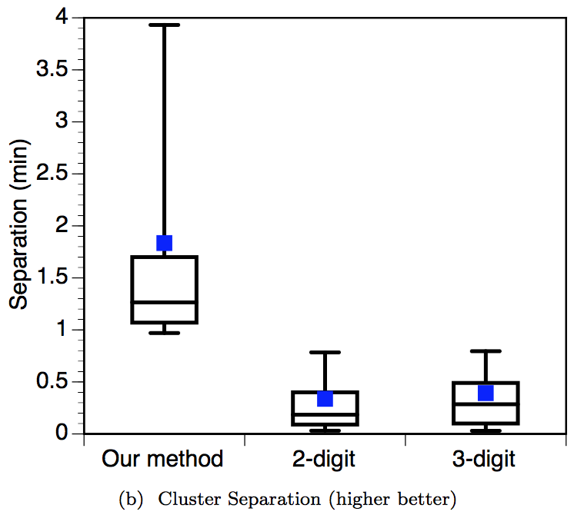
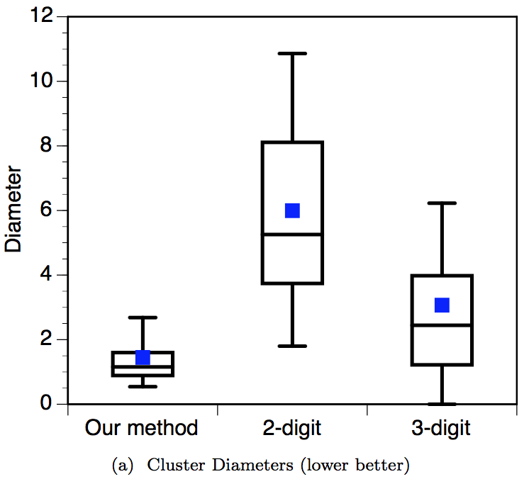
Related Work
Wyatt’s et al. 2016^{[1]} work achieved these results (figures), in which our work is reproduce these figures.

Slide 9
Related Work
Wyatt’s et al. 2016^{[1]} work used a dataset that is well-known and broadly used data format called NHANES
NHANES: National Health and Nutrition Examination Survey:
  Demographic, and dietary records
  Available open-source for free to the public
  Uses subjective food groups provided by USDA
  Dietary intake of 64,653 Americans
  1,587,750 food entries
  7,494 unique food items
  46 nutrient features for each food item
    Macronutrients (fats, carbohydrates, etc.)
    Micronutrients (vitamins, minerals, etc.)

Slide 10
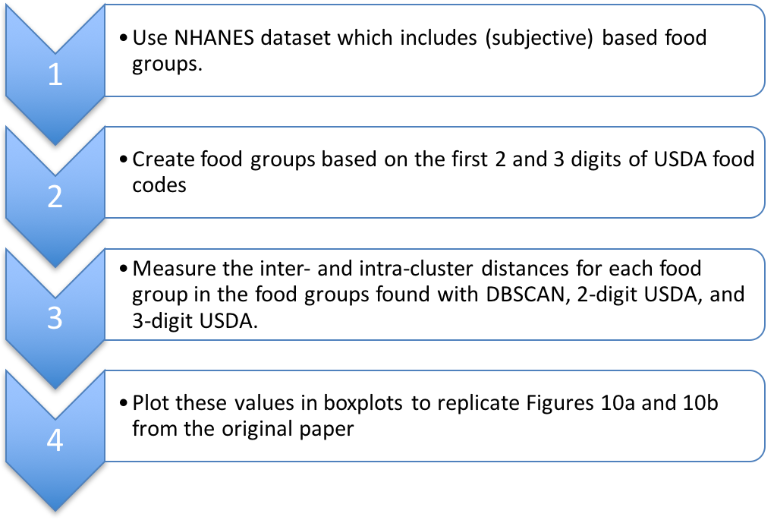
Methodology

Slide 11
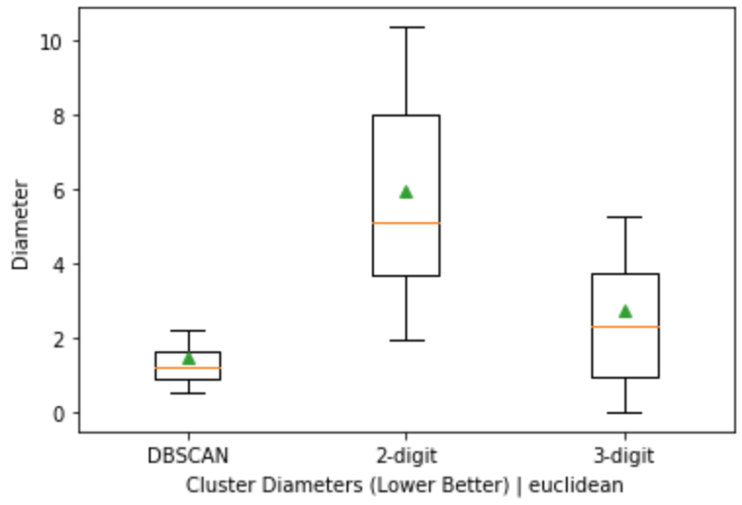
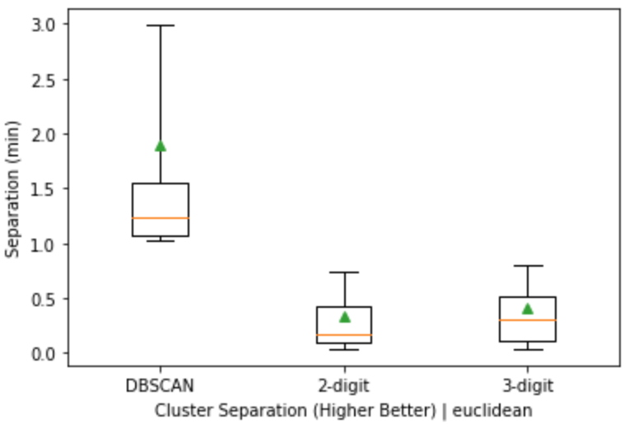
Results
Diameter
Separation (min)
Cluster Diameters (Lower Better) | Euclidean
Cluster Separation (Higher Better) | Euclidean
Average diameter:
DBSCAN: 1.48
2-digit USDA: 5.95
3-digit USDA: 2.76
Average separation:
DBSCAN: 1.89
2-digit USDA: 0.33
3-digit USDA: 0.41

Slide 12
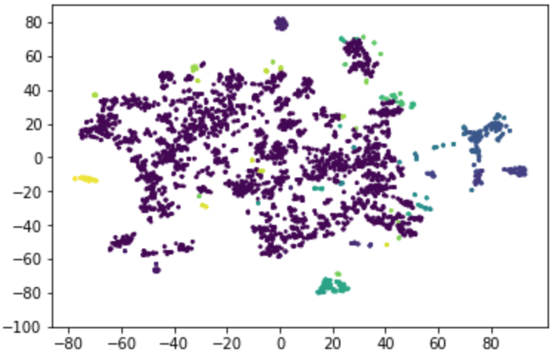
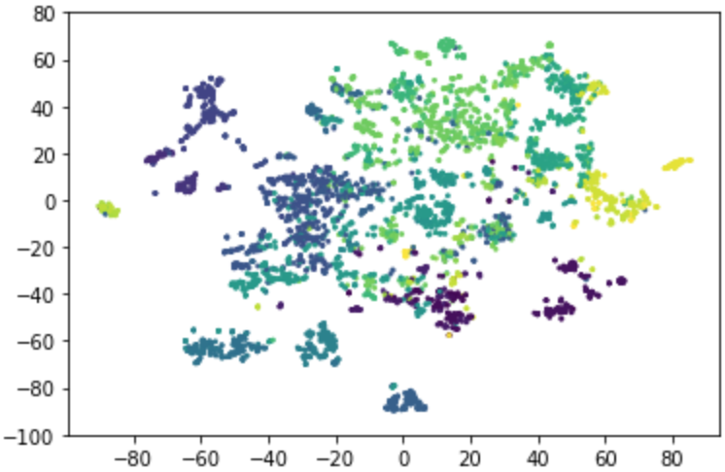
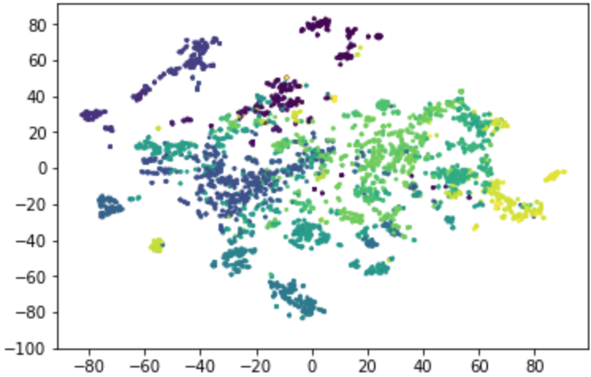
Results
DBSCAN:
Food items clustered: 60.05% Number of food clusters: 92
3-digit USDA: Food items clustered: 60.05% Number of food clusters: 192
2-digit USDA: Food items clustered: 60.05% Number of food clusters: 46

Slide 13
Summary
We used NHANES dataset which include (subjective) based food groups
Defined (objective) based food groups, then parallelize using ( Apache Spark ) our method to the dataset
Compare the results of our objective food groups and the subjective food groups
Results shows: our objective food groups is better than the subjective, and the results are reproduced from Wyatt’s et al. 2016^{[1]} work.

Slide 14
Conclusions
Using USDA classification of food groups is misleading and can poorly advise patients with health issues
Wyatt’s et al. 2016^{[1]} method is to clusters food items based on nutritional content
Wyatt’s et al. 2016^{[1]} method is based on MapReduce and results are better than USDA food groups
  Denser cluster diameter: (DBSACN) 1.45, (2-digit) 5.99, and (3-digit) 3.07
  Better separated cluster separation: (DBSACN ) 1.83, (2-digit) 0.34, and (3-digit) 0.39
Wyatt’s et al. 2016^{[1]} approach classify food groups based on nutrient content which help in advising patients with dietary restrictions
Our results matches Wyatt’s et al. 2016^{[1]} results. Therefore, Wyatt’s et al. 2016 work is reproducible and trusted since we were able validate their work.

Slide 15
References
[1] M. Wyatt, T. Johnston, M. Papas, and M. Taufer. Development of a Scalable Method for Creating Food Groups Using the NHANES Dataset and MapReduce. In Proceedings of the ACM Bioinformatics and Computational Biology Conference (BCB), pp. 1 - 10. Seattle, WA, USA. October 2 - 4, 2016.

