Slide 1
Insurance Premium Prediction
By-Aniket Dumbre

Slide 2
Objective
To build a cloud web app/API using ML algorithms to predict insurance premium and automate it using AI Ops pipeline.

Slide 3
Data Sharing Agreement
Client need to upload prediction file in same manner shared for training.
Below are key points to ensure-
Number of Columns
Column names
Column data type

Slide 4
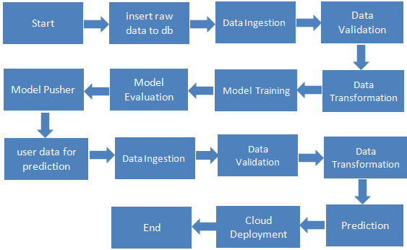
Architecture

Slide 5
Data insertion into db
Read the dataframe file and convert it to json format and then dumb it
to Mongodb Atlas.
Database Creation and connection –
Create a database with the name “ipp” and collection name “insurance”.
If the database and collection is already present then it will not created,
only new files are inserted into already present collection.
Export this data for model training

Slide 6
Training Pipeline
1. Data Ingestion
Import collection data as pandas data frame.
Replace na values with NAN if present in dataset.
Save updated dataset to ‘feature_store ’ folder.
Split dataset into train and test data and save it into ‘dataset’ folder.
Save these folders in ‘artifact’ folder.

Slide 7
Training Pipeline
2. Data validation
Null values- Drop the columns which have missing values more than specified threshold.
Data-type – If required change data type of columns.
No of columns -Validate the number of columns present in the files.
Data Drift-Check whether new dataset is having major data drift or not. Save the report.yml in artifact folder.

Slide 8
Training Pipeline
3. Data Transformation
Pipeline used for data pre processing. Create two pipelines for transforming input and target features.
One hot encoding – Encode categorical columns using one hot encoder.
Handling missing values- Use imputation techniques to impute missing values in columns eg. Simple imputer, KNN imputer etc.
Feature Scaling- Try Standard scaler, min max scalar or robust scaler for scaling.
Outlier handling-Use inter-quantile range method to handle outlier/robust scaler.
Imbalanced data- Use SMOTETomek technique to handle imbalanced data.
Save input feature transformation as transformer.pkl, target feature as transformer_target.pkl, train data as train.npz and test data as test.npz in artifact folder.

Slide 9
Training Pipeline
4. Model Training
There are two approaches for model training
Using single algorithm
Multimodal system
We adapted multimodal approach where model is being trained on multiple algorithms and selected one which gives high accuracy after hyper parameter tuning.
Hyper parameter tuning:
Hyper parameter tuning was done by using Grid search algorithm.
Test model for under fitting or over fitting.
Save in best trained model in pickle format artifact folder as model.pkl.

Slide 10
Training Pipeline
5. Model Evaluation
While re-training check whether current model performance with previous model.
6. Model Pusher
Save trained model and transformed feature files in saved_models directory which will used during model evaluation.
.

Slide 11
Prediction Pipeline
1. Data Ingestion
Import data frame file from db storage.
Replace na values with NAN if present in dataset.
2. Data Validation
Null values- Drop the columns which have missing values more than specified threshold.
Data-type – If required change data type of columns.
No of columns -Validate the number of columns present in the files.
Data Drift-Check whether new dataset is having major data drift or not. Save the report.yml in artifact folder.

Slide 12
Prediction Pipeline
3. Data Transformation
Use saved transformation pipeline for data transformation
4. Prediction
Predict the target feature and saved it in directory in .csv format.

Slide 13
Q & A:
Q1) What’s the source of data?
The data for training is provided by the client in csv file.
Q 2) What was the type of data?
The data was the combination of numerical and Categorical values.
Q 3) What’s the complete flow you followed in this Project?
Refer slide 4th for better Understanding
Q 4) After the File validation what you do with incompatible file or files which didn’t pass the validation?
Files like these are moved to the artifact folder and a list of these files has been
shared with the client.

Slide 14
Q & A:
Q 5) How logs are managed?
We are using different logs as per the steps that we follow in validation and
modeling like File validation log , Data Insertion ,Model Training log , prediction log etc.
Q 6) What techniques were you using for data pre-processing?
1.Removing unwanted attributes
2.Visualizing relation of independent variables with each other and output variables
3.Checking and changing Distribution of continuous values
4.Removing outliers
5.Cleaning data and imputing if null values are present.
6.Converting categorical data into numeric values.
7.Scaling the data

Slide 15
Q & A:
Q 7) How training was done or what models were used?
Before model training data pre processing done and then model train on various ML algorithms like LR, SVM, Random Forest, Xg Boost, Gradient Boost, Decision Tree etc. Based on accuracy Random forest mode is used for prediction.
Q 8) How Prediction was done?
Prediction was done using flask app.

