Slide 1
COLLABORATORS

Slide 3
Introduction
ORCA: Observability framework
Low overhead tracing
Scales to 4096+ ranks

Slide 4
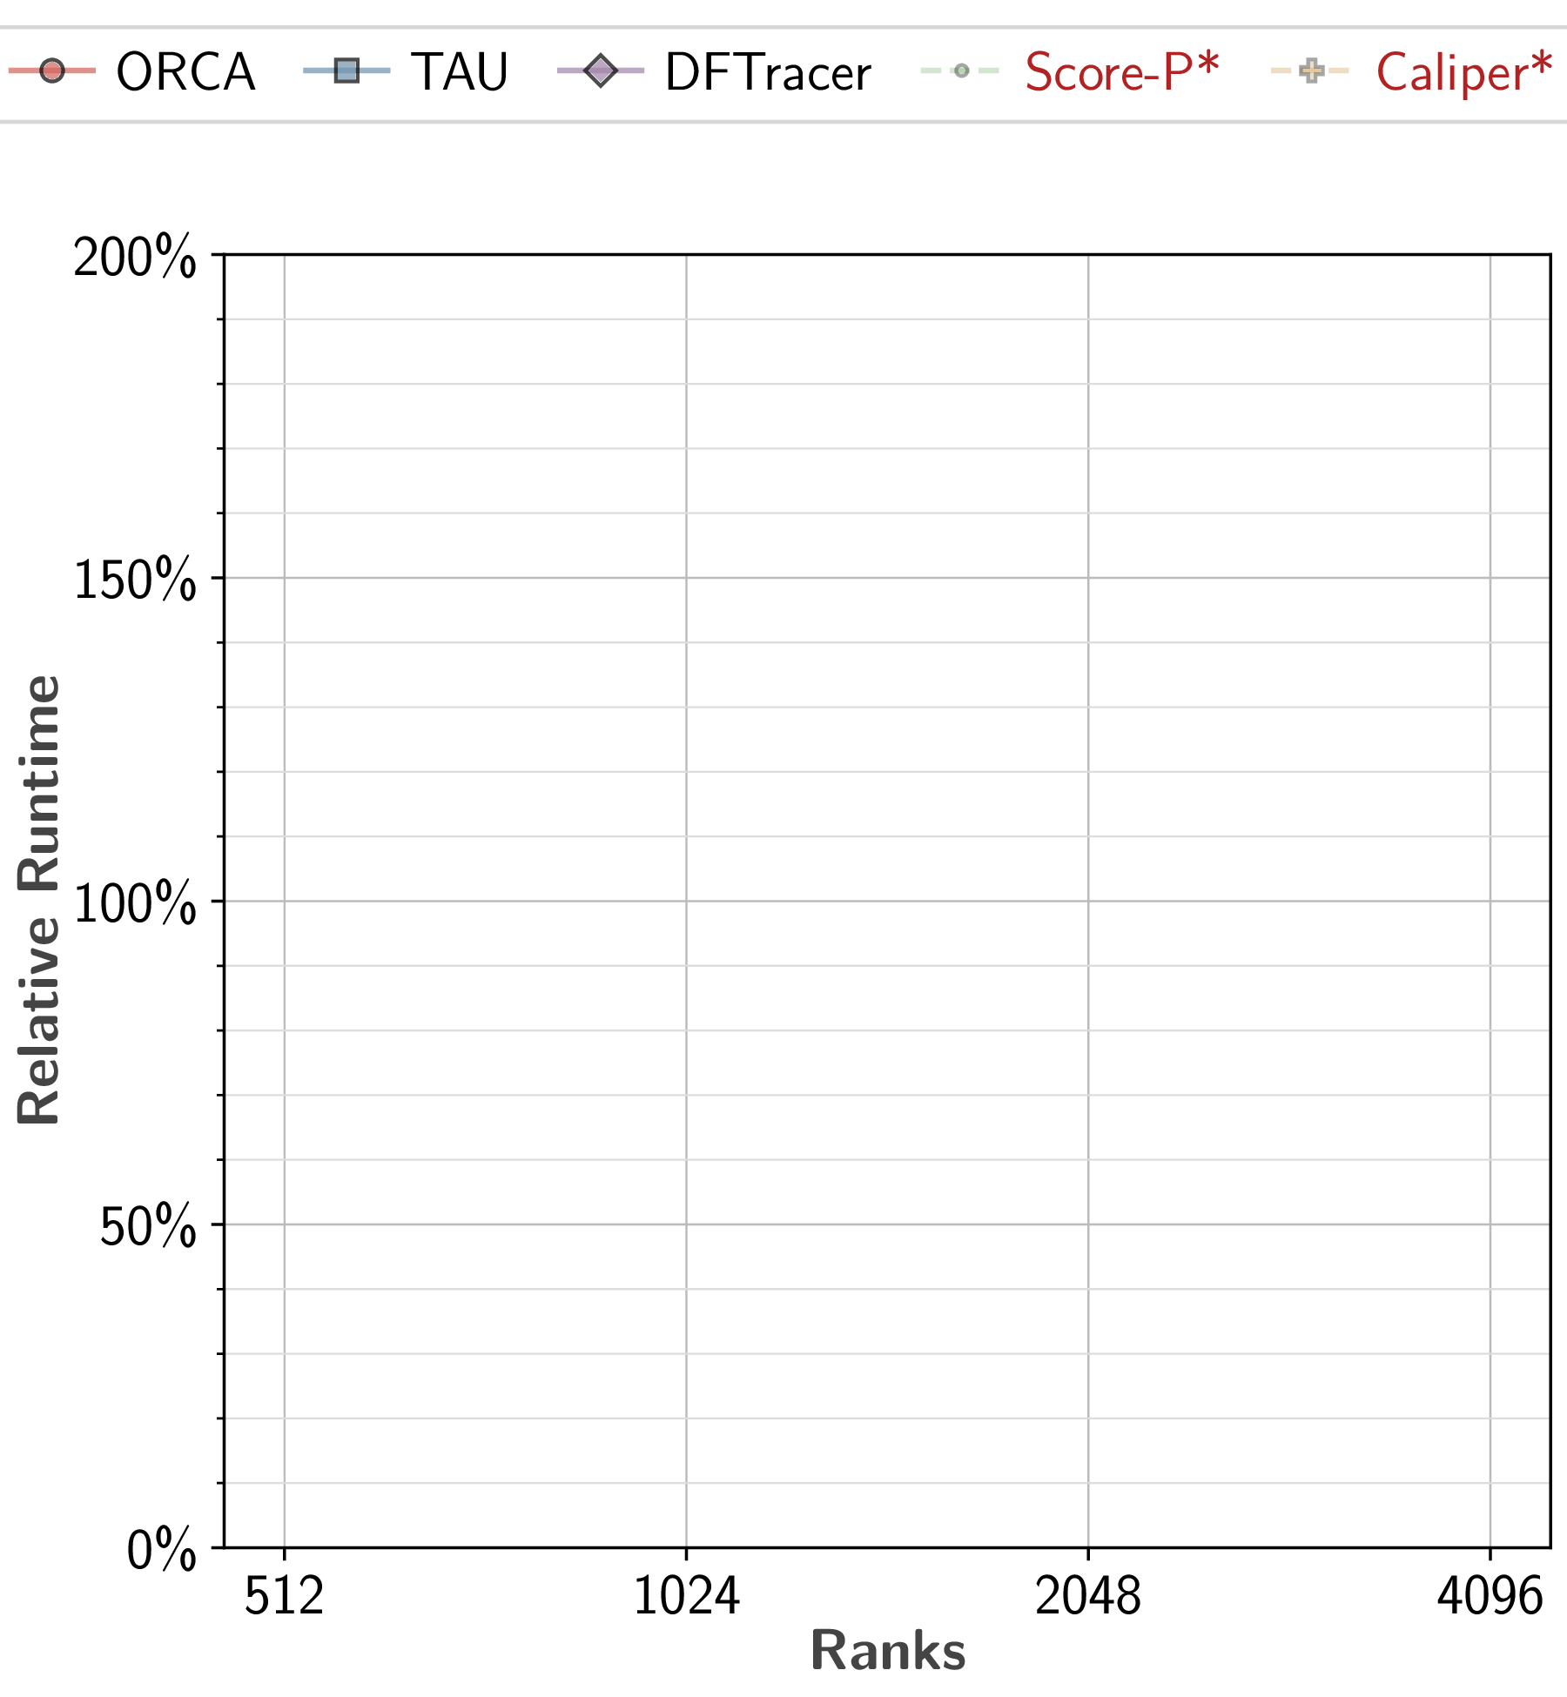
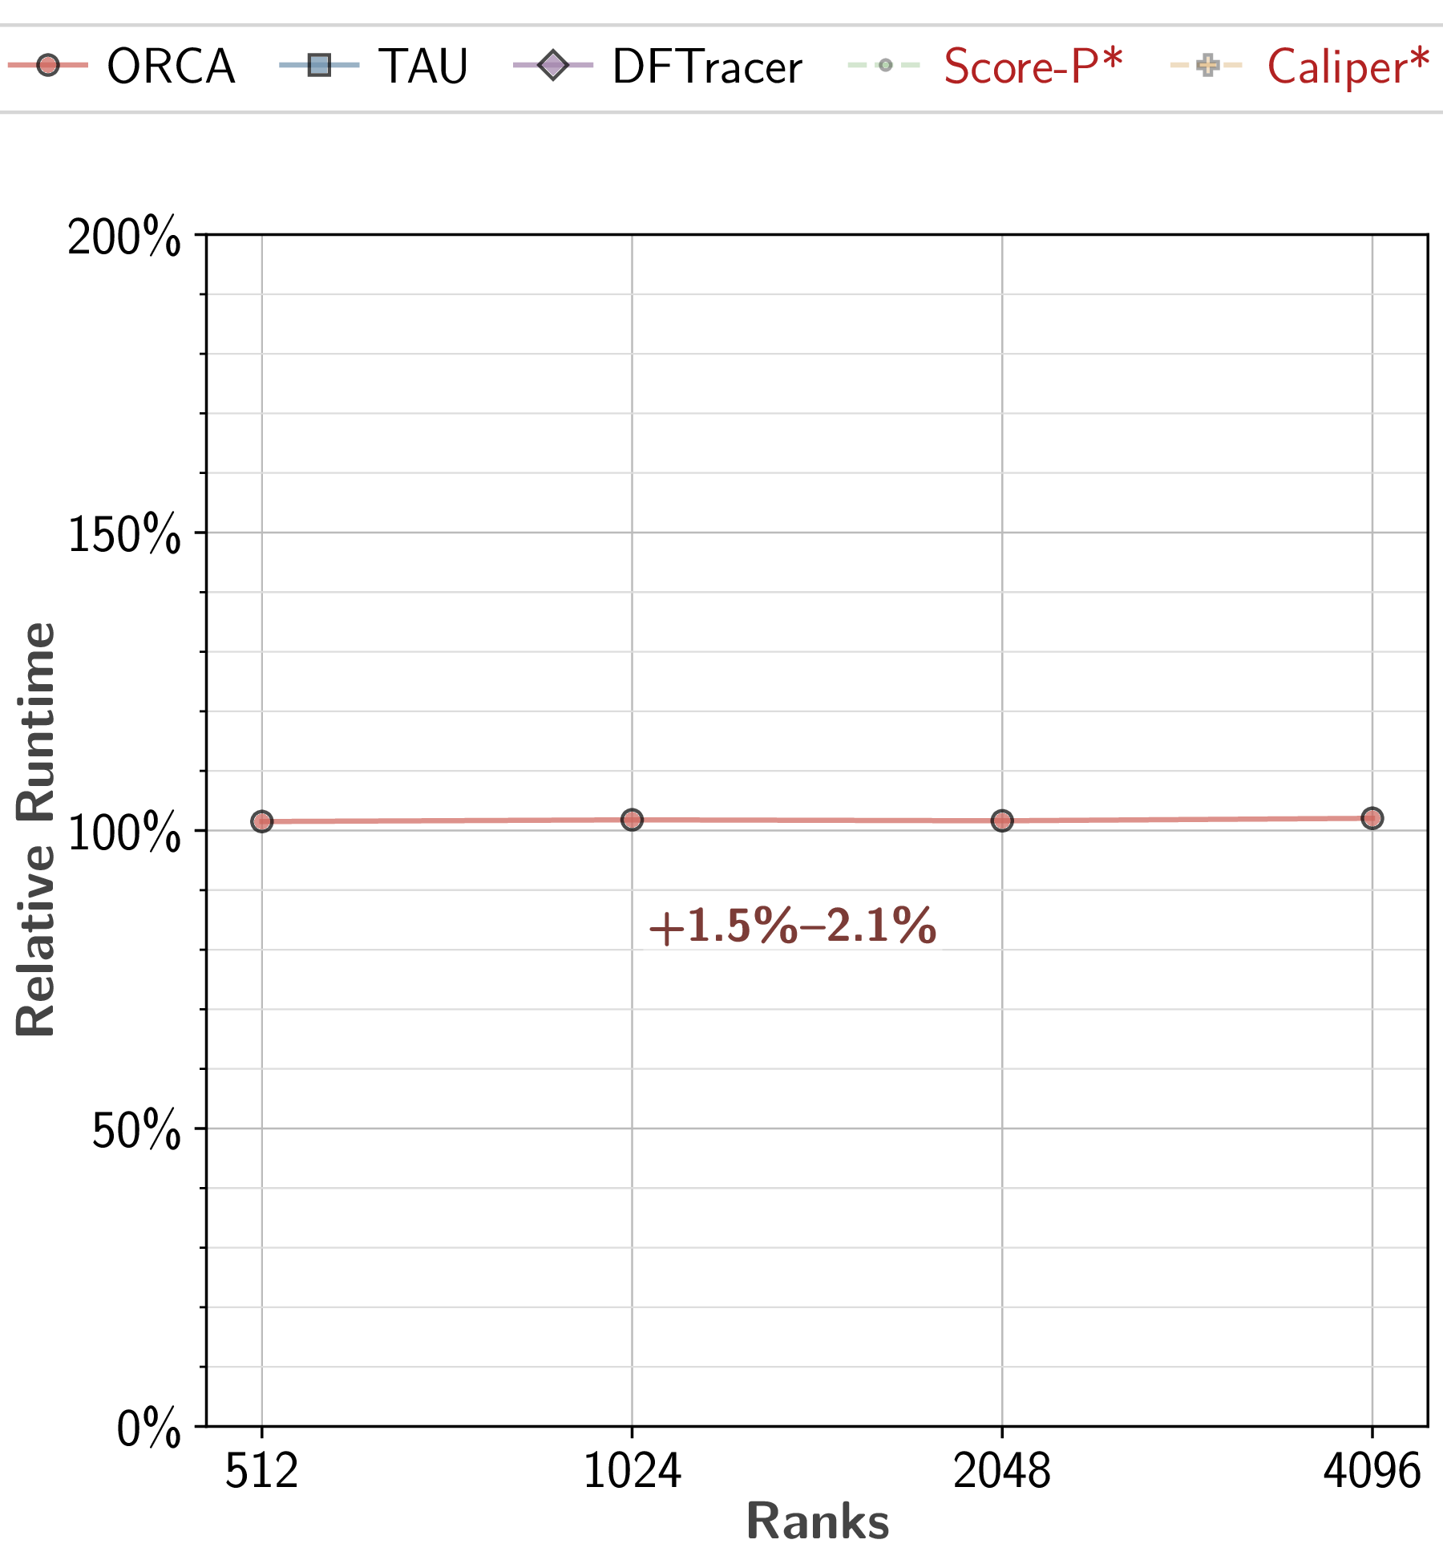
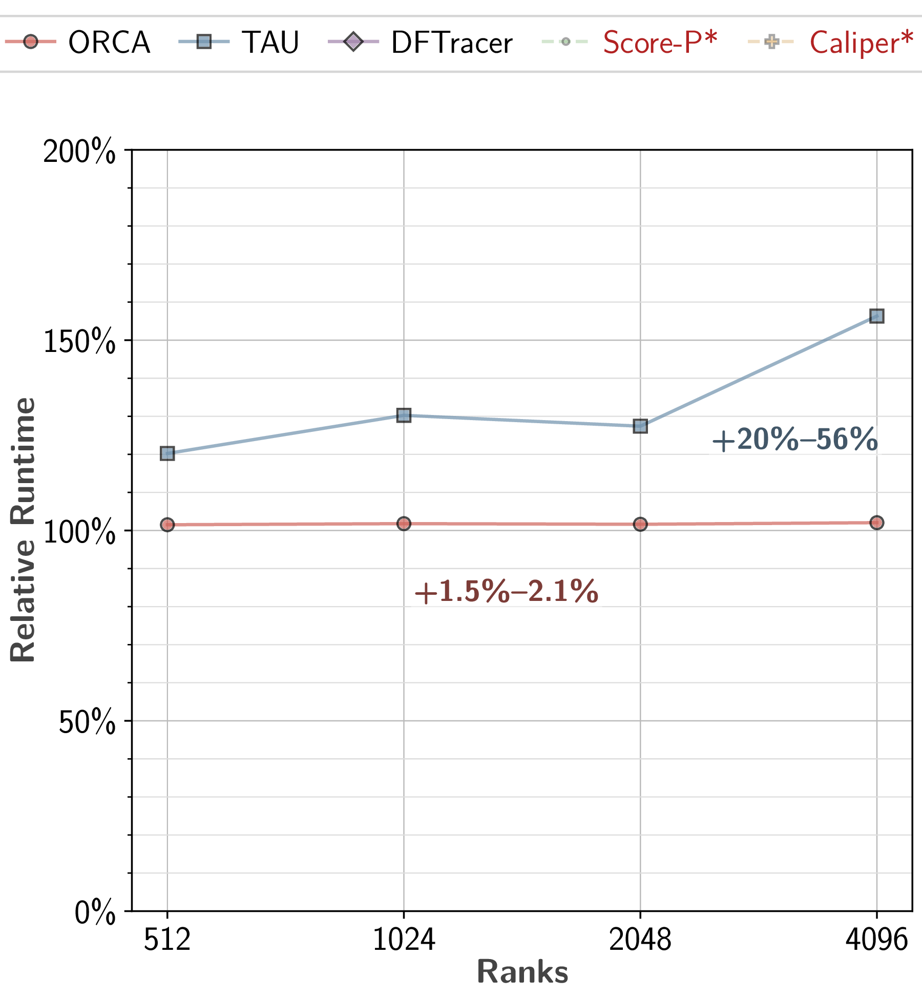
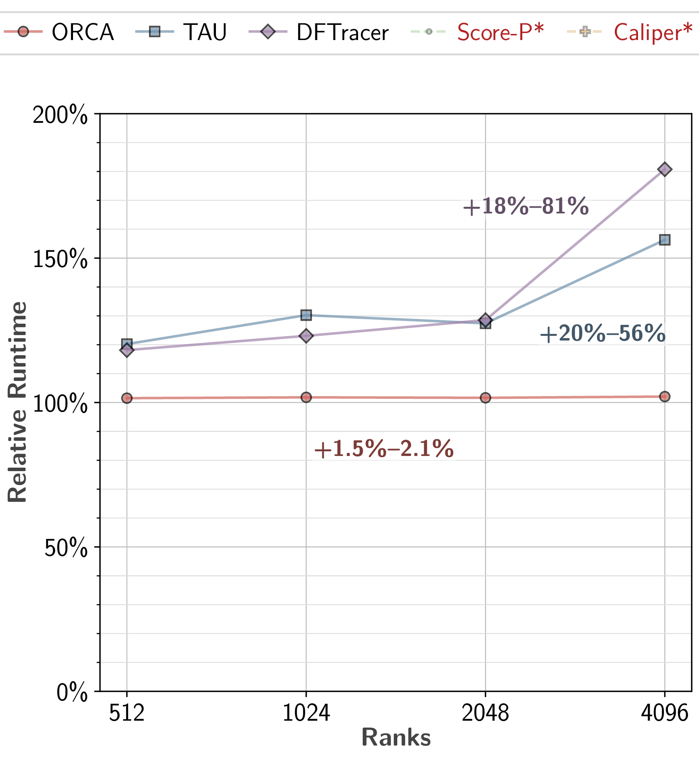
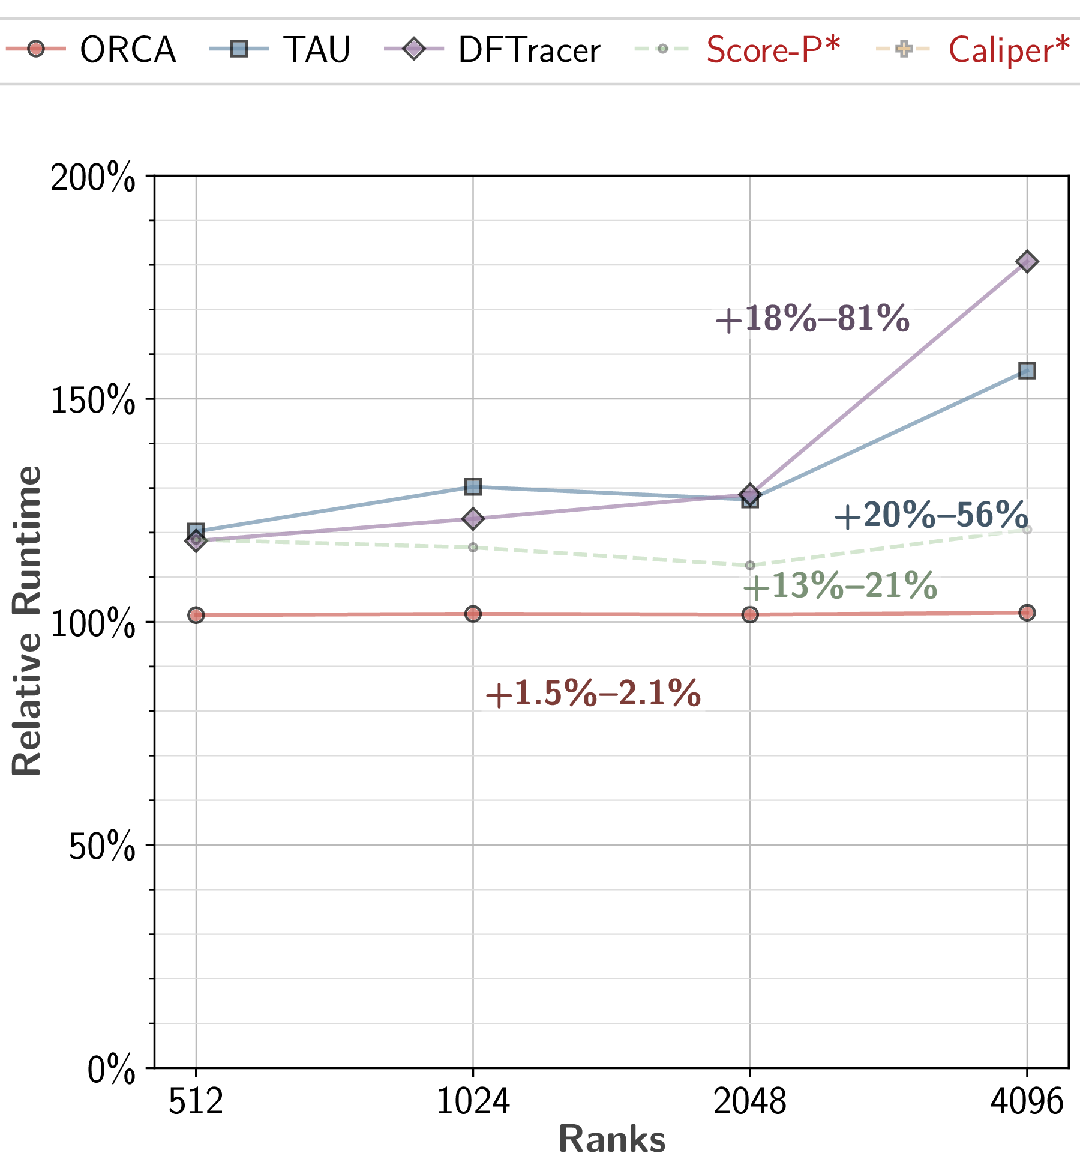
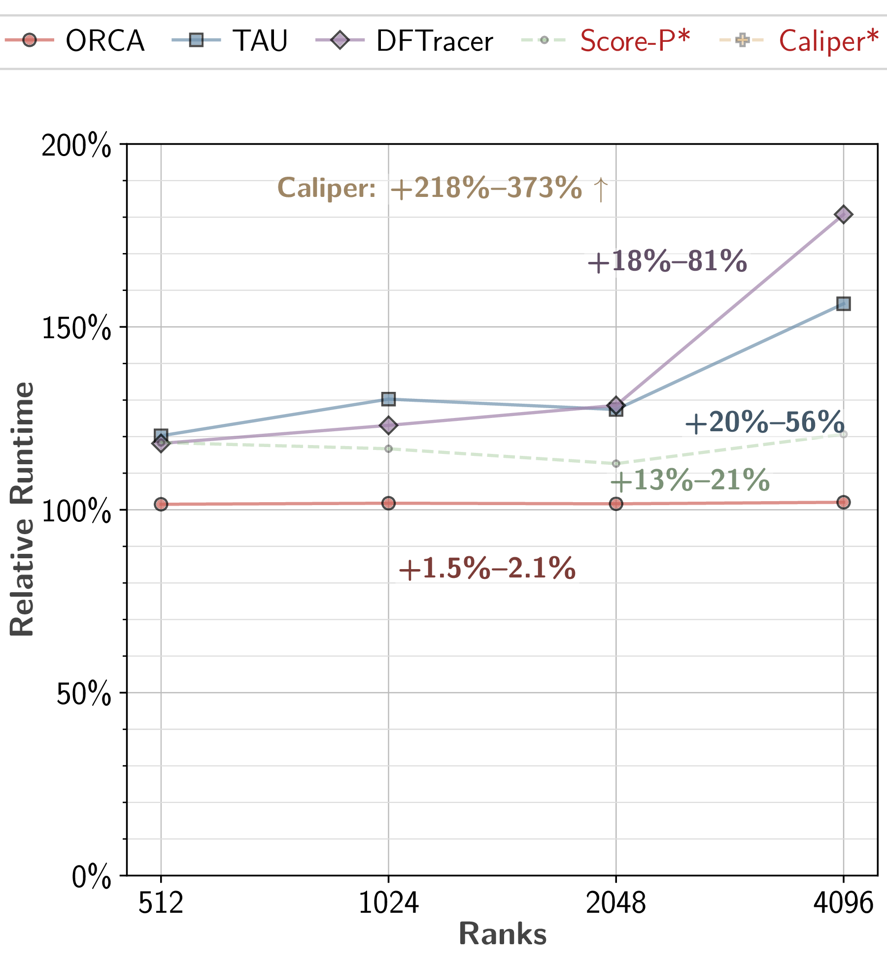
Runtime Overhead
Compare with TAU, DFTracer, Score-P, Caliper
Measure relative runtime
512 to 4096 ranks

Slide 5
Objects Demo
Main content area
Positioned text box

