Slide 1
A Unified Approach to Bulk Synchronous Parallel Observability Using Relational Dataflows
ANKUSH JAIN
PARALLEL DATA LABORATORY
Carnegie Mellon University

Slide 2
This Work: BSP Efficiency
Bulk-Synchronous Parallel (BSP) is big and important
Applications: HPC and ML
BSP is hard. Efficiency challenges on compute and data paths.
  Data path: speeding up ingestion to insight
  Compute path: cluster utilization and performance
Our work:
  HPC: CARP (data path), AMR performance (compute path)
  HPC + ML: ORCA: unifying lessons from the two
Notes:
Intro slide. Precursor for thesis-level background

Slide 3
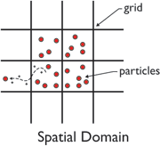
BSP: Hardware and Application Archetypes
Particle Codes
(HPC)
Control (Frontend) Network
1Gbps (200 Gbps)
Backend Fabric
400 Gbps, RDMA or similar
Computation Unit
O(10K) Compute Nodes
8 GPUs/node
Mesh Codes
(HPC)
Computation Unit
Mesh
Shared Storage
Parallel Filesystem (Lustre)
Object Store (DAOS)
…
Data Parallel
(ML)
Mini
Batch
Mini
Batch
Mini
Batch
…
Computation Unit
Training Data

Slide 4
BSP Execution and Challenges
0
1
…
O(10k) ranks
Long-running (weeks)
Data Management Challenges
Ingesting and analyzing checkpoints for insight
  (Not typically not analyzed in ML)
In-situ analytics an active research area
  In-situ visualization for live feedback
  In-situ indexing to speed up queries
Worker 0
(Rank 0)
Worker 1
(Rank 1)
Work
Work
Checkpoint Epoch
Work
Work
Global Sync
Timestep
Work
Work
Global Sync
Wallclock Time
….
….
Global Sync
Compute Efficiency Challenges
One straggler can derail all workers
Load imbalance/variability extremely expensive
Understanding bottlenecks is hard
  Telemetry ~ data management challenge
Checkpoint
to shared storage
Work
Work
Global Sync
Global Sync
….
….
Ankush Jain © August 2025
Notes:
8 buildouts
1. Task schedule
2. Repeats
3. --
4.
5. Time
6. Mesh change
7. Continues
<Transition> - Simplify and start focusing on one timestep

Slide 5
Initial Work: Systems for Compute and Data Paths
SC ‘24
CARP: Range-Query Optimized Indexing for Streaming Data
Challenge: skewed and dynamic key distributions
Approach: reconstruct global histograms to steer shuffling
No runtime overhead, ~optimal query performance
CLUSTER ’25
Lessons from Profiling and Optimizing Placement in AMR
AMR: adaptive mesh codes with load-balancing challenges
Our work: telemetry collection + analysis + tuning + placement
Lesson: solutions idiosyncratic, need real-time observability
Notes:
ABCD

Slide 6
ORCA: Programmable, Real-time Observability
ORCA: Observability with Realtime Control and Aggregation
Status Quo: unstructured traces + postprocessing for insight
  OTF2 in HPC, Kineto traces (JSON) in Pytorch
  Expensive to collect, parse and analyze, delayed feedback
ORCA: tree-based overlay + SQL-based columnar analytics
  Planning, collection, aggregation optimized for BSP timesteps
  Control semantics for online steering of views
  Analogy: eBPF at cluster-scale
Notes:
ABCD

Slide 7
Thesis Statement
This thesis argues that:
persistent efficiency bottlenecks
in Bulk Synchronous Parallel (BSP) systems
are fundamentally visibility problems,
stemming from an inability to
reconstruct global views from distributed local state
in real time,
and proposes a programmable, query-driven
observability and control plane
to fill this gap.
Notes:
ABCD

Slide 8
Talk Outline

Slide 9
CARP: Continuous, Adaptive Range Partitioner

Slide 10
AMR

Slide 11
ORCA Motivation: Lessons from AMR Work
BSP efficiency hinges on real-time reconstruction of global views
  Bugs, system tuning, algorithm selection, algorithm tuning...
  Need spatial and temporal proximity between collection and analysis
Columnar analytics 1-2 OOM faster than JSON/OTF2
  Custom schemas and programmable aggregations via declarative interfaces
Can we enable dynamic always-on observability workflows for BSP?

Slide 12
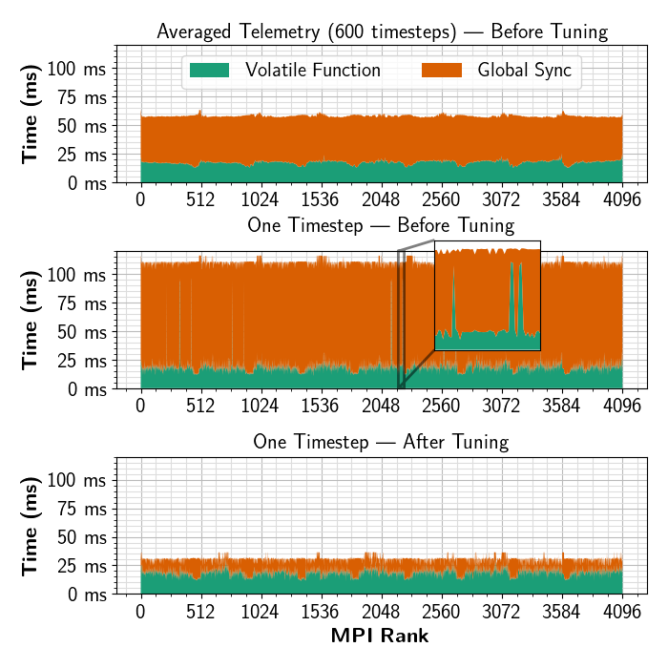
Status Quo (Aggregates/Tracing) Is Inadequate

Slide 13

Case Study: Pytorch Kineto Ecosystem
Dynolog CLI
C
collect_traces(100s)
write to /nfs/trace_{rank}.json
HTA is single-node pandas/python scripts
Pandas is a columnar format, HTA parses JSON
It is slow: we found Parquet 18X faster (also offline)
GPU nodes
0
1
…
If analytics are columnar, emission can be too
Chrome TraceEvent JSON was designed for visual timelines
Can not visually inspect 1000-node bottlenecks
Buffer traces in memory for 100s
Serialize to JSON and write to disk
Holistic Trace Analysis
Parse and analyze traces using HTA

Slide 14
Why Do Timeseries DBs Not Work?
Optimized for timestamped metrics, BSP telemetry needs a GROUPBY
Need a proxy to ingest from 100k processes
  ORCA is a “smart” proxy optimized for BSP timesteps
Can not support pushdowns or control semantics
Not optimized for HPC fabrics
Experimental paradigm: need query plan access
Timestep | Rank | Timestamp | Function | Duration (ms)
0 | 0 | 100 | foo | 10
0 | 0 | 110 | MPI_Barrier() | 10
0 | 1 | 100 | foo | 19
0 | 1 | 119 | MPI_Barrier() | 1
Notes:
Pt 3: passive entity vs active requirements

Slide 15
ORCA: A TBON for Aggregation and Broadcast
TBON: Tree-based Overlay Network
Overlay addressing: ovid (int32)
Direct destinations: ovid::mpi(0)
Special destinations: ovid::mon, ovid::bcast
Controller (CTL)
Orchestrator, planner, root aggregator
Aggregators (AGG)
Scale-out collection tier
Receive rank-partitioned Arrow data
Mercury RPCs
(RDMA if available)
MPIREP ranks (optional)
Intermediate fan-in reduction
Leaves (BSP ranks)
Collect telemetry as Arrow
Flush every timestep

Slide 16
Orca Flow: DSL With Nodes and Sinks
sinks:
anomalies_sink:
from: phase_anomalies
type: grafana
phase_trace_sink:
from: phase_trace
type: parquet
nodes:
phase_trace:
inputs: [mpi_trace]
map:
map_fn: classify_events
partition_by: [rank]
phase_anomalies:
inputs: [phase_trace]
sql: |
SELECT phase FROM phase_trace
WHERE duration > 100 ms
Distributed Planning
(Controller, using Apache Datafusion)

Slide 17
Distributed Query Planning
Datafusion etc

Slide 18




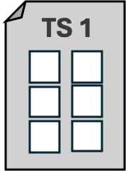
Aggregation: Multi-Tier, Multiple Sinks
Distributed Planning
(Controller)
Parquet (Sink)
timestep and rank-partitioned
Live Dashboard
stream: mpitrace, timesteps: 0-10
FlightSQL
Embedded DuckDB
(Sink)
CTL
AGG
MPIREP
MPI

Slide 19
Collection Preserves Ordering and Partitioning
Partition count configured at bootstrap (~local parallelism)
Never repartitioned or shuffled
  In-memory pipeline fragile, should persist ASAP
  Postprocessing for subsequent stages
Unit of reduction: timestep dataframe
hash-partitioned on “rank”
Incoming data may arrive out of order
Tail
Rank
Leaf ranks emit one table as partitioned data
Aggregator Queue
Timestep
Head
2. Intermediate nodes compute partition-preserving reductions
Collected data is yielded in timestep order
OOM risk, managed using flow control

Slide 20
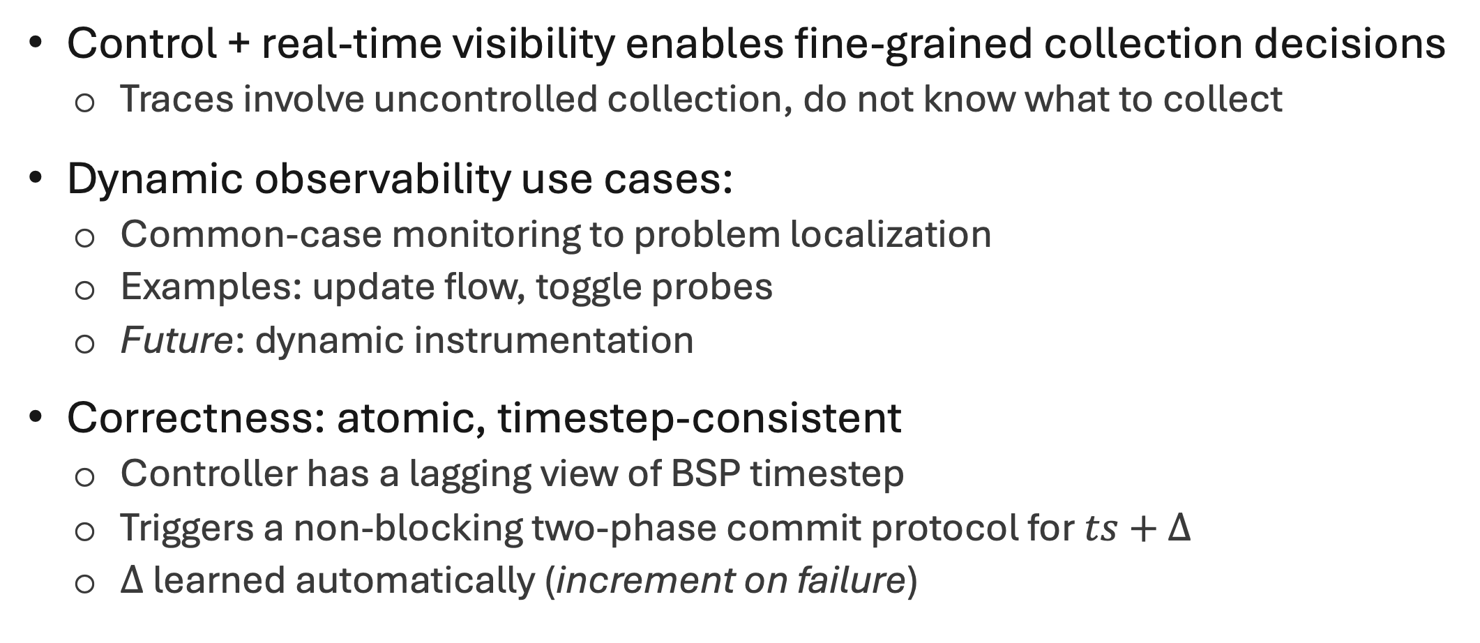
Control: Async, Timestep-Consistent 2PC
Control + real-time visibility enables fine-grained collection decisions
  Traces involve uncontrolled collection, do not know what to collect
Dynamic observability use cases:
  Common-case monitoring to problem localization
  Examples: update flow, toggle probes
  Future: dynamic instrumentation
Correctness: atomic, timestep-consistent
  Controller has a lagging view of BSP timestep
  Triggers a non-blocking two-phase commit protocol for$ts+∆$
  $∆$ learned automatically (increment on failure)

Slide 21
TS2PC Cases

Slide 22
Potential Use Cases
High-fidelity, real-time performance observability
Targeted collection of telemetry for offline analysis
Visibility over any application state expressible as SQL
  Real-time visualization of energy histograms using software sketches
  Real-time visualization of mesh state
  Unify disparate in-situ visualization tools
  Challenge: non-relational analyses, open planner allows escape hatches
TrainCheck (OSDI 2025): example DLT use case beyond performance
  Uses reconstructed application state to flag correctness errors in training
  Amenable to ORCA semantics

Slide 23
Implementation Status and Eval. Roadmap
Codebase: ~30k LOC, C++ and Rust
Milestone | Details
Single aggregator, local query execution | Implemented, tested, tuned Up to 3GB/s on 40 Gbps Infiniband
Multiple aggs. + distributed planning | Overlay tested, found functional Query planning + integration completed End-to-end tuning and testing pending
Pytorch Kineto integration | Ongoing
Evaluation Planned
Synthetic stress tests, scale vs throughput, impact of pushdowns, application jitter
Runtime overhead vs tracing for 4096-core AMR, smaller data-parallel DLT job

Slide 24
Graduation Timeline

Slide 25
Conclusion: BSP Efficiency Needs BSP O11y
Think of the minimum data necessary to reconstruct a distributed view
  ORCA provides a programmable substrate to enable such a reconstruction
BSP is different: scale, lockstep execution, homogeneity
  Distributed tracing paradigms: designed around microservices/request IDs
  ORCA is built around the BSP timestep and runtime environment
HPC and OLAP have traditionally not intersected
  Apache Arrow, Parquet, and Datafusion can potentially change that
  Concurrent effort: pushing down Substrait plans on the query path

Slide 26
Notes For Self
Intro
CARP
AMR
ORCA
Pending Work and Conclusions

Slide 27
Outline - Intro
BSP is important and very different
Applications: scientific simulations, ML training
Our work:
  First, two case studies (along compute and data paths)
  (Targeting scientific simulations)
  Then, lessons unifying them into a common framework
  (Planned scope includes observability for ML training)

Slide 28
BSP: Common Challenges
A general tool for solving problems that need a lot of compute
Model: problem decomposition + execution in lockstep
Failure model: checkpoint and restart
Runtime behavior: compute, checkpoint, compute, checkpoint, …
Compute path problem: stragglers
Data path problem: lots of data generated in sync

Slide 29
Basic Table
Habit | Frequency | Duration
Getting up | Daily | 5 minutes
Going to sleep | Daily | 10 minutes

Slide 30
Basic Code Snippet
def greet(name):
return f"Hello, {name}!"

Slide 31
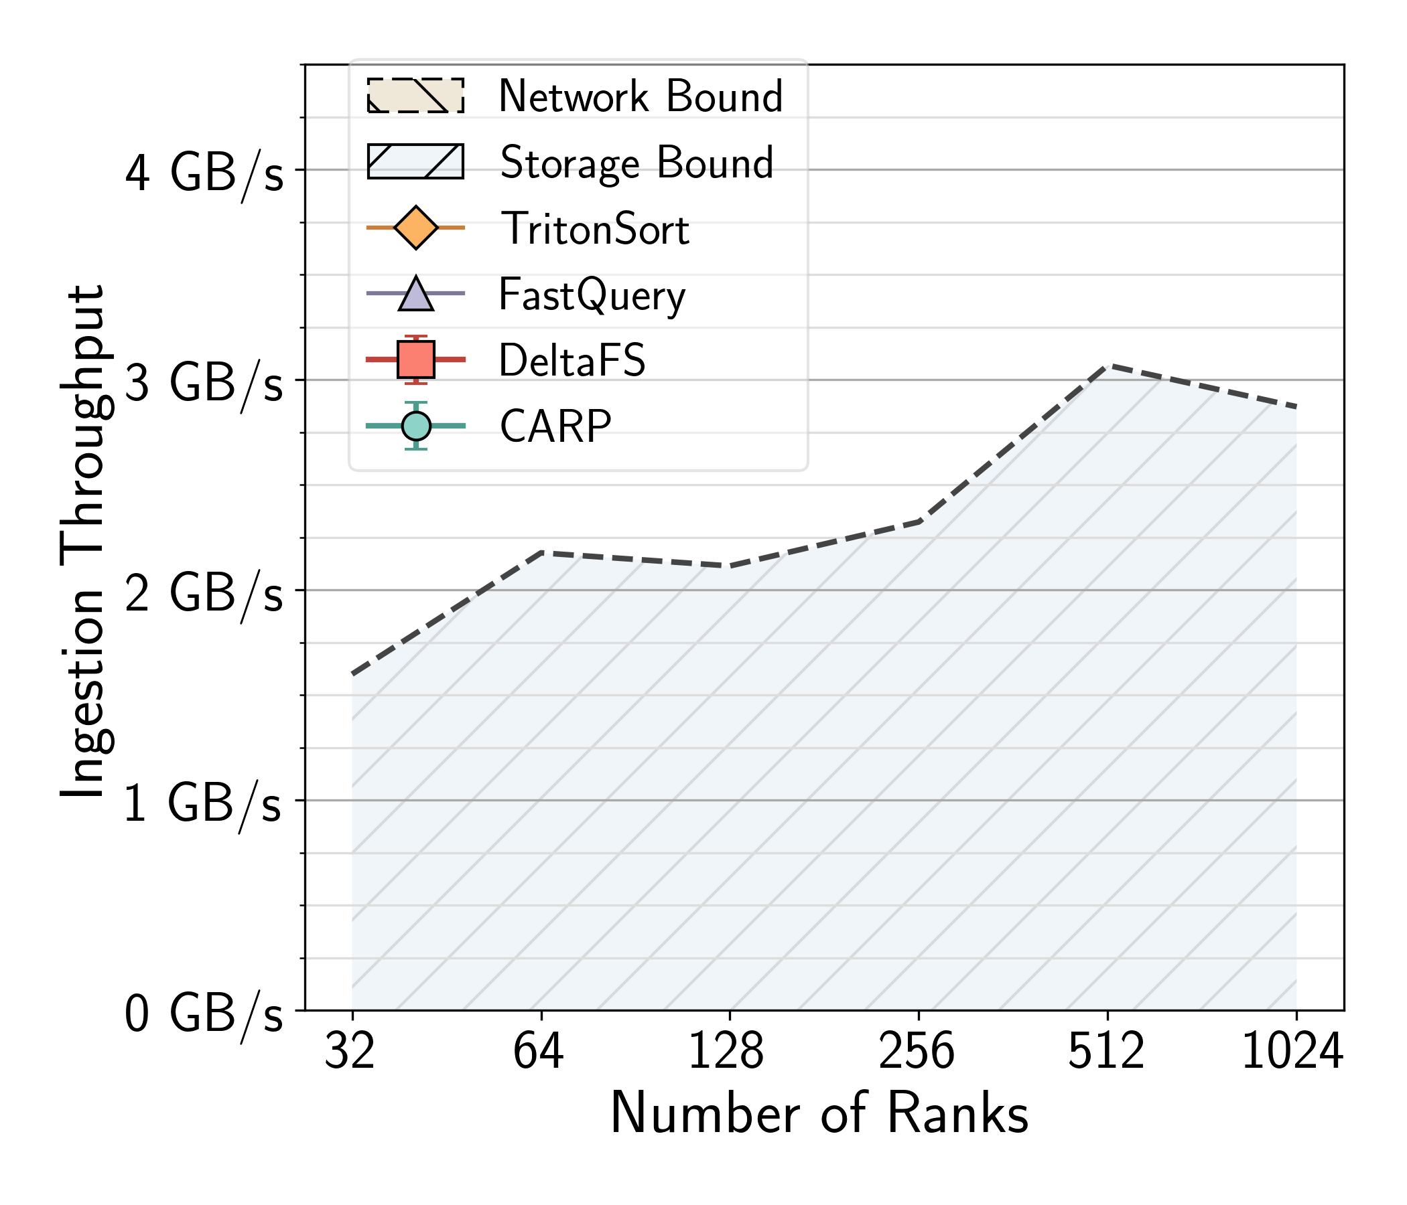
Figures and Columns
yo

Slide 32
BSP: Hardware and Application Archetypes
Control (Frontend) Network
1Gbps (200 Gbps)
Backend Fabric
400 Gbps, RDMA or similar
Particle Codes (HPC)
Computation Unit
O(10K) Compute Nodes
8 GPUs/node
Mesh Codes (HPC)
Shared Storage
Parallel Filesystem (Lustre)
Object Store (DAOS)
…
Data Parallel (ML)

Slide 33
nodes:
phase_trace:
inputs: [mpi_trace]
map:
map_fn: classify_events
partition_by: [rank]
phase_anomalies:
inputs: [phase_trace]
sql: |
SELECT phase FROM phase_trace
WHERE duration > 100 ms
sinks:
anomalies_sink:
from: phase_anomalies
type: grafana
phase_trace_sink:
from: phase_trace
type: parquet

Slide 34
PARQUET
Part. 0
Part. 1
Part. 2
Part. 3
Tier
stream: mpitrace, timesteps: 0-10
Root Aggregator
TierPlan ( )
TS
Tier Plan
Flow Plan
Tier Plan
Tier Plan
Tier Plan

