Slide 1

The Generative AI Revolution
www.edquest.io
Mail: info@edquest.io
Day 4: 21 May 2024

Slide 2

π
Agenda
Impact of GenAI across different Industry
Task performed by GenAI and Impact
Concern about AI
Responsible AI
Opportunity created by AI

Slide 3
π
“AI is impacting various industries by automating the entire job or part of job.”

Slide 4
π
Impact of GenAI across Industry
01
Technology [$240 - 460B]
Software development and testing
Cybersecurity
Web Development and design etc.
02
Retail [$240 - 390B]
Customer experience and service
Marketing and sales
Supply chain and inventory management etc.
03
Banking [$200 - 340B]
Customer service [Chabot and virtual assistant]
Risk management and compliance
Credit score and lending
04
Healthcare
Diagnostic and imaging
Drug discovery and development
Patient care and monitoring
05
Education
Personalized learning
Curriculum development
Education administration
Source: McKinsey Report

Slide 5
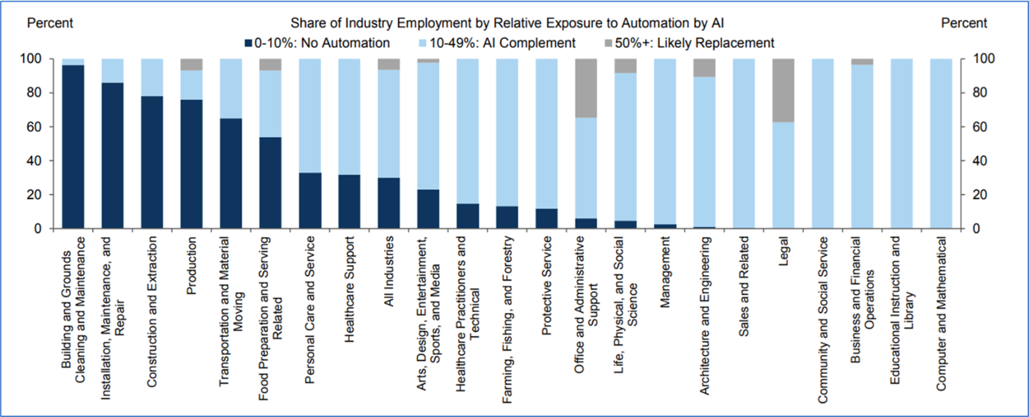
π
Impact of GenAI across Function
Source: Goldman Sachs Report

Slide 6
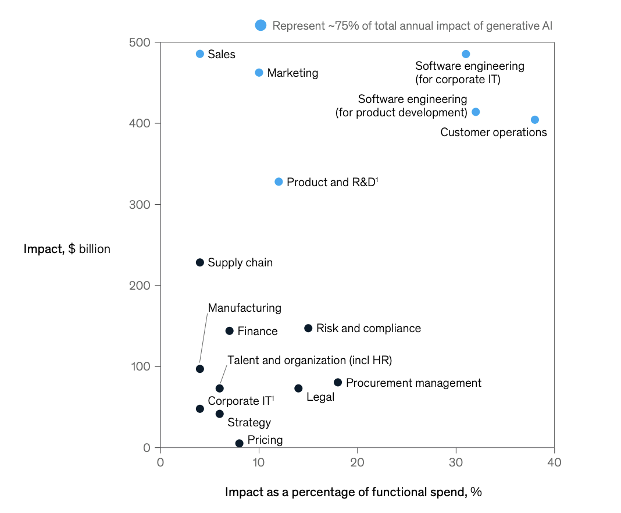
π
Impact of GenAI across Function
Source: McKinsey Report

Slide 7
π
Task Performed by Generative AI
Generation
Translation
Summarization
Search or Extraction
Classification or Tagging
Editing or Re-writing
Analysis or Interpretation

Slide 8
π
Task: Generation
Text Generation
Image Generation
Video Generation
Code Generation

Slide 9
π
Text Generation
Product description
Website write-up
Brand communication
Generate policy
Product document

Slide 10
π
Image Generation
Generate image for product portfolio
Marketing creative
Advertisement
Product design
E-commerce

Slide 11
π
Image Generation: LLM/Tool
DALLE-3
Midjourney
Adobe Firefly
Google Bard

Slide 12
π
Task: Summarization
Summarize large piece of text or document into smaller piece by retaining the key point:
Summarize email, documents and meeting notes
Summarize complex legal, policy and regulation documents
Summarize feedbacks, description and report

Slide 13
π
Task: Search or Extraction
Search for or extract relevant text, numbers or data from a large corpus of text:
Extract customer journey and life-cycle for product
Extract relevant information from knowledge base
Extract relevant piece of information from large document

Slide 14
π
Task: Classification or Tagging
Classify, tag of cluster text or documents as per your defined categories:
Classify review
Classify news and blog
Classify product

Slide 15
π
Task: Editing or Rewriting
Edit or re-write existing piece of text in such a way that suit your requirements:
Edit text to correct the grammar
Re-write to change the style and tone
Edit or re-write campaign for personalize touch in marketing

Slide 16
π
Task: Analysis or Interpretation
Analyse or interpret a large piece of text to get the relevant insight:
Analyse customer call and feedback to find customer issue
Analyse and interpret financial data
Analyse code for root cause and automation

Slide 17
π
Concern about AI
Amplifying humanity's worst impulses
Job loss like radiologist
Human extinction

Slide 18
π
Dimensions of Responsible AI
Fairness: Ensure AI does not amplify biases
Transparency: AI decisions should be understandable
Privacy: Protect user data and ensure confidentiality
Security: Safeguard AI systems from malicious attacks
Ethical Use: Ensuring AI is used for beneficial purpose

Slide 19
π
Opportunity Create by AI
Prompt Engineering
Generative AI Developer
AI-assisted Designer
Digital Artist
Content Creator using AI

