Slide 1


π
The Generative AI Revolution: A Month-Long AI Exploration
Impact of Generative AI
Business and Society
π
Week 2 Day 1: 10th Feb 2024

Slide 2
π
Recap
Introduction to Generative AI
Generative AI Software Applications
Impact of Generative AI
Prompt Engineering
High Level Overview of Shop Assistant Project

Slide 3





π
Agenda
Project Overview of Shop Assistant
Shop Assistant :- System Design
Stage 1, Stage 2, Stage 3, Stage 4
Hello World with Gemini Pro (Hands-on)
Tools

Slide 4


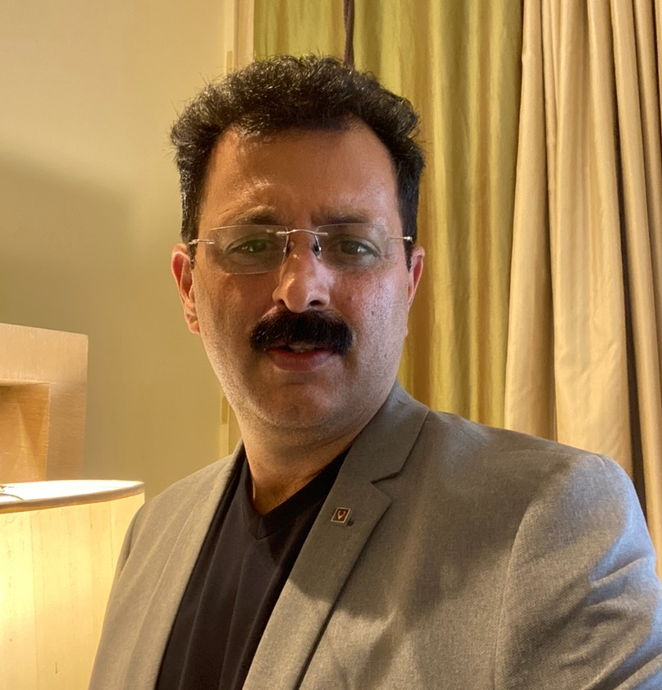
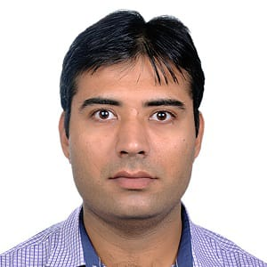
π
Our Team
Mokarbeen Ansari
www.linkedin.com/in/mokarbeenansari/
Raman Chopra​
www.linkedin.com/in/raman-chopra/
Vinit Narula
www.linkedin.com/in/vinitnarula/
Dinesh Chopra
www.linkedin.com/in/dinesh-chopra/
Email: mentors@edquest.co.in

Slide 5
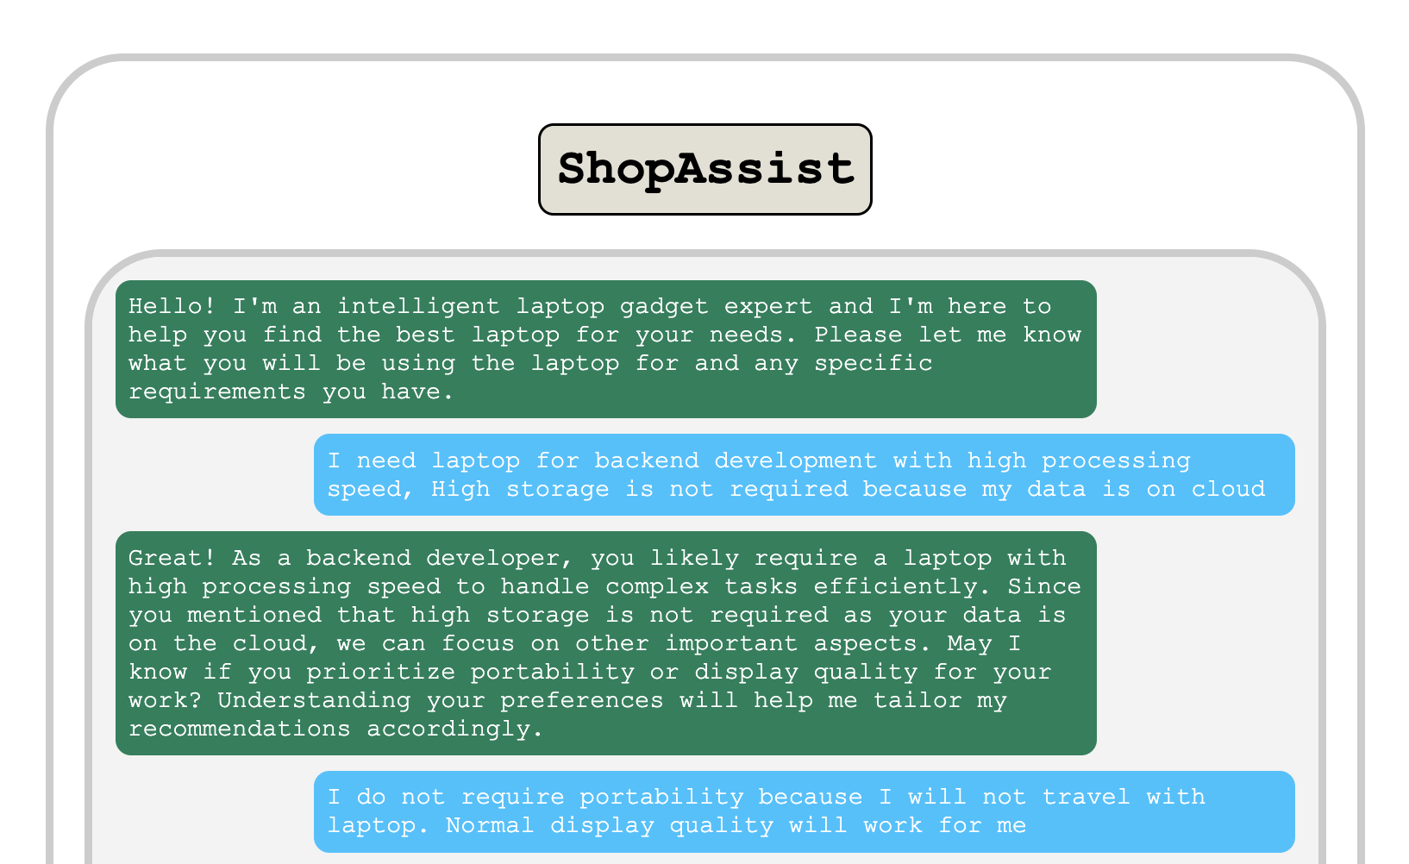
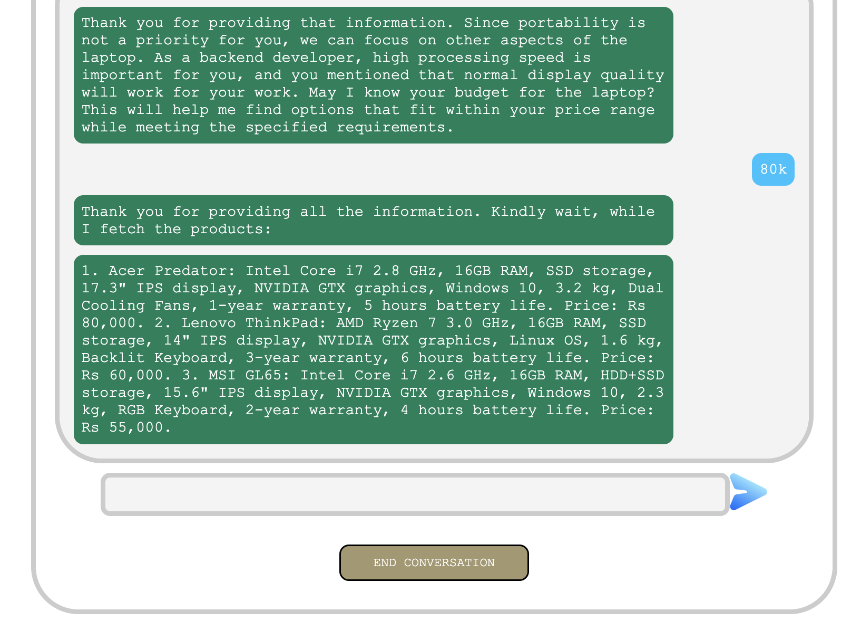
π
Project Overview of Shop Assistant

Slide 6
π
Shop Assistant
π

Slide 7
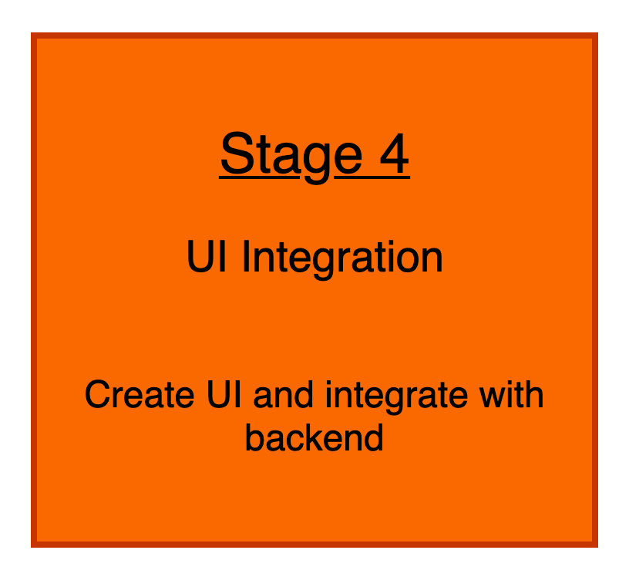
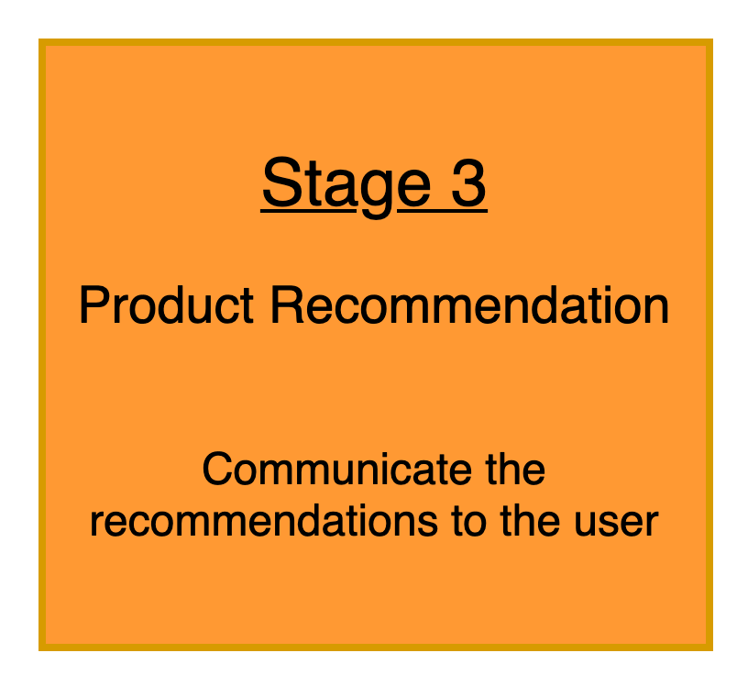
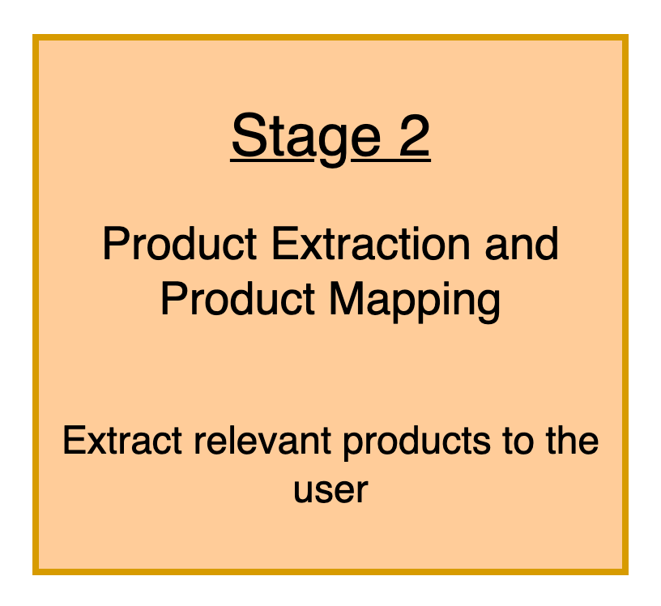
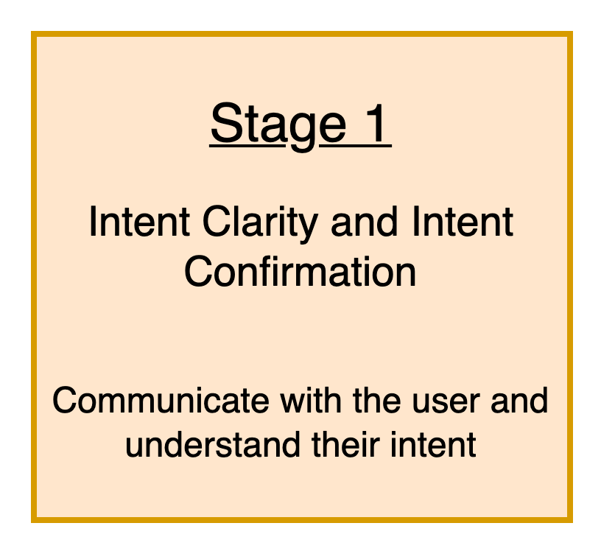
π
Shop Assistant : System Design

Slide 8
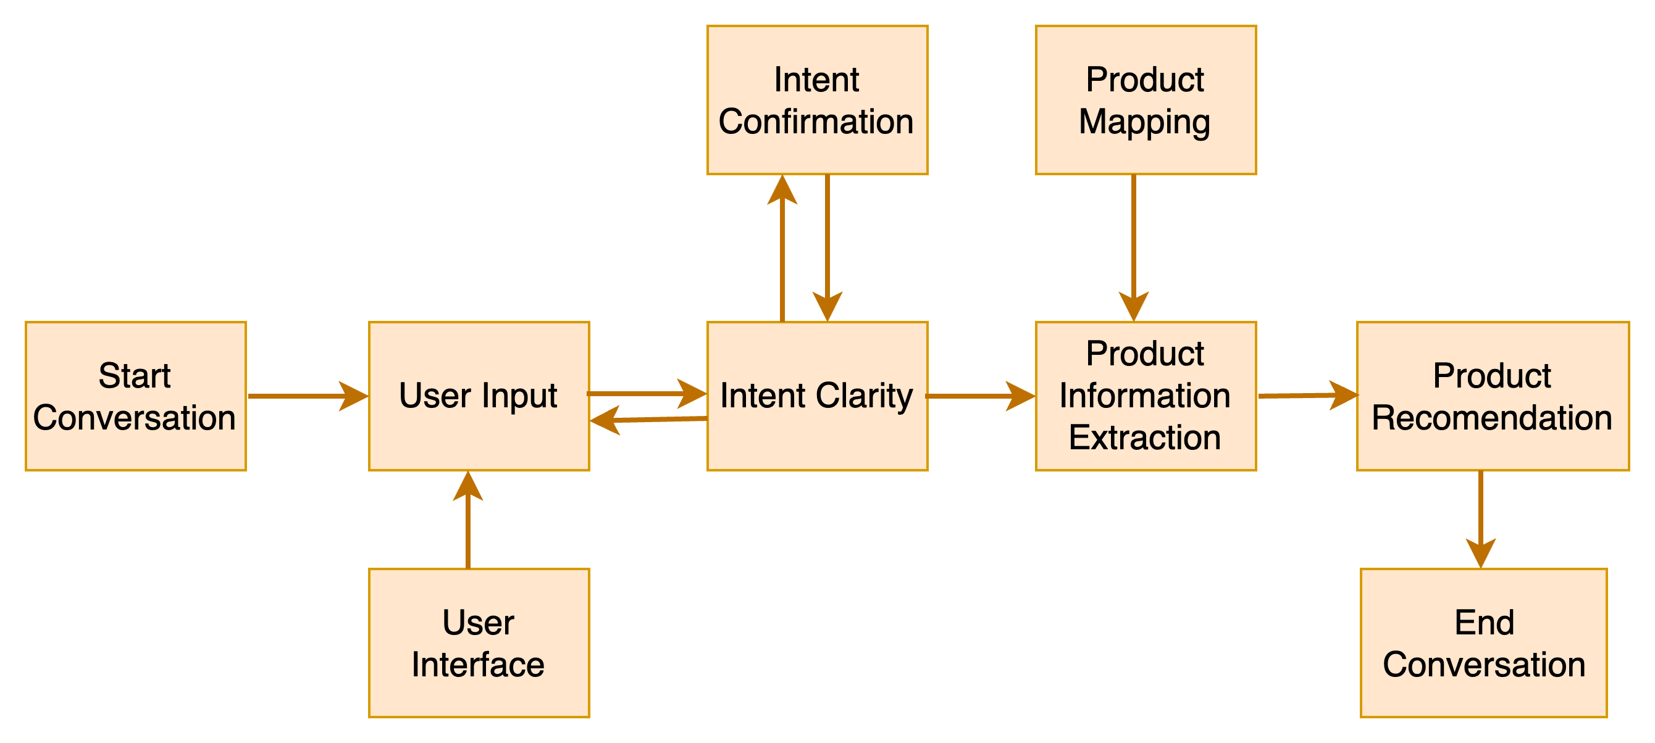
π
Shop Assistant: High Level Design

Slide 9
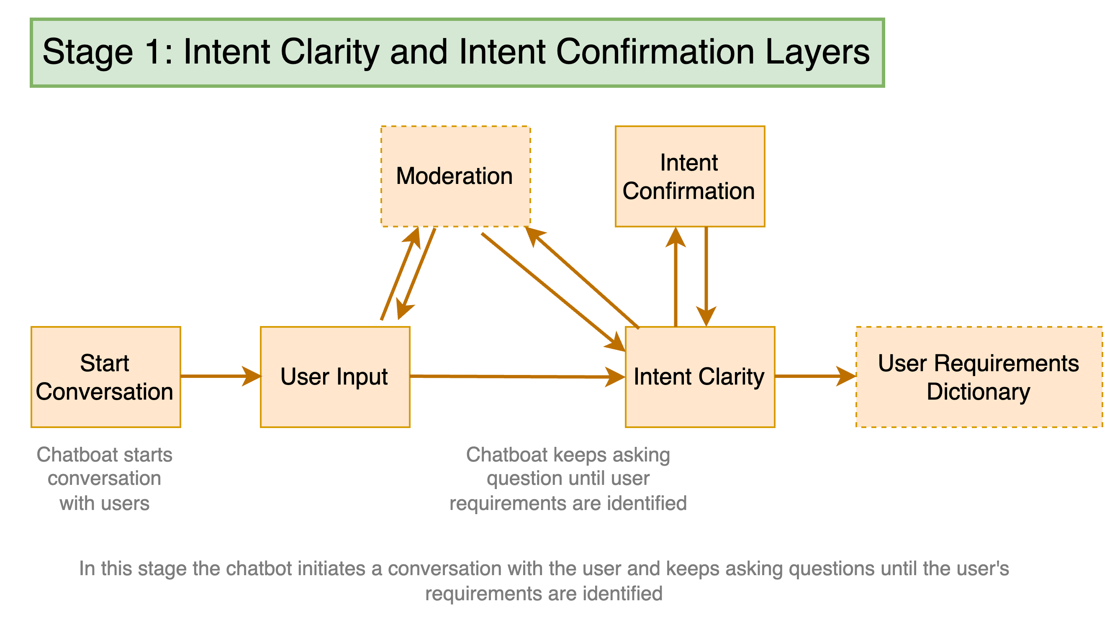
π
Shop Assistant: Stage-1

Slide 10
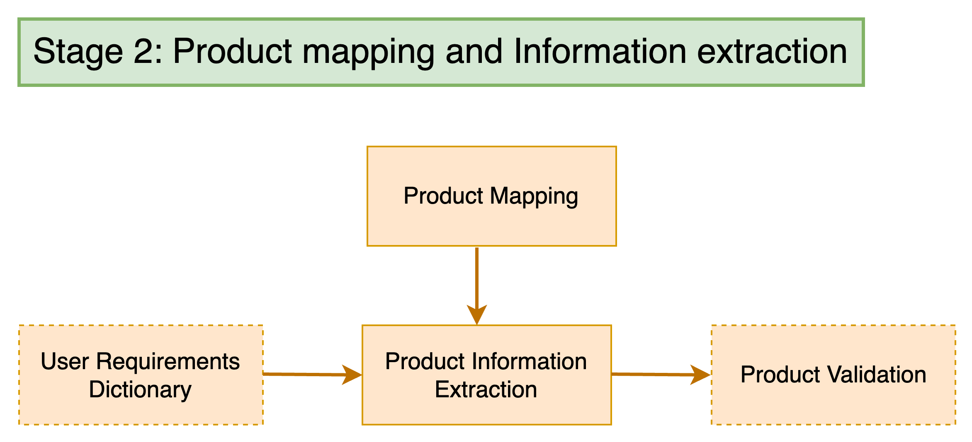
π
Shop Assistant: Stage-2

Slide 11
{'gpu intensity': 'medium', 'display quality': 'medium', 'portability': 'medium', 'multitasking': 'high', 'processing speed': 'medium'}
{'gpu intensity': 'high', 2
'display quality': 'high',
'portability': 'low',
'multitasking': 'low': 0,
'processing speed': 'high'}
{'gpu intensity': 1,
'display quality': 1,
'portability': 1,
'multitasking': 2,
'processing speed': 1}​
{'gpu intensity': 'high',
'display quality': 'high', 'portability': 'low',
'multitasking': 'high',
'processing speed': 'high'}
{'gpu intensity': 'high', 'display quality': 'high', 'portability': 'low', 'multitasking': 'high', 'processing speed': 'high'}
{'low': 0, 'medium': 1, 'high': 2}

Slide 12
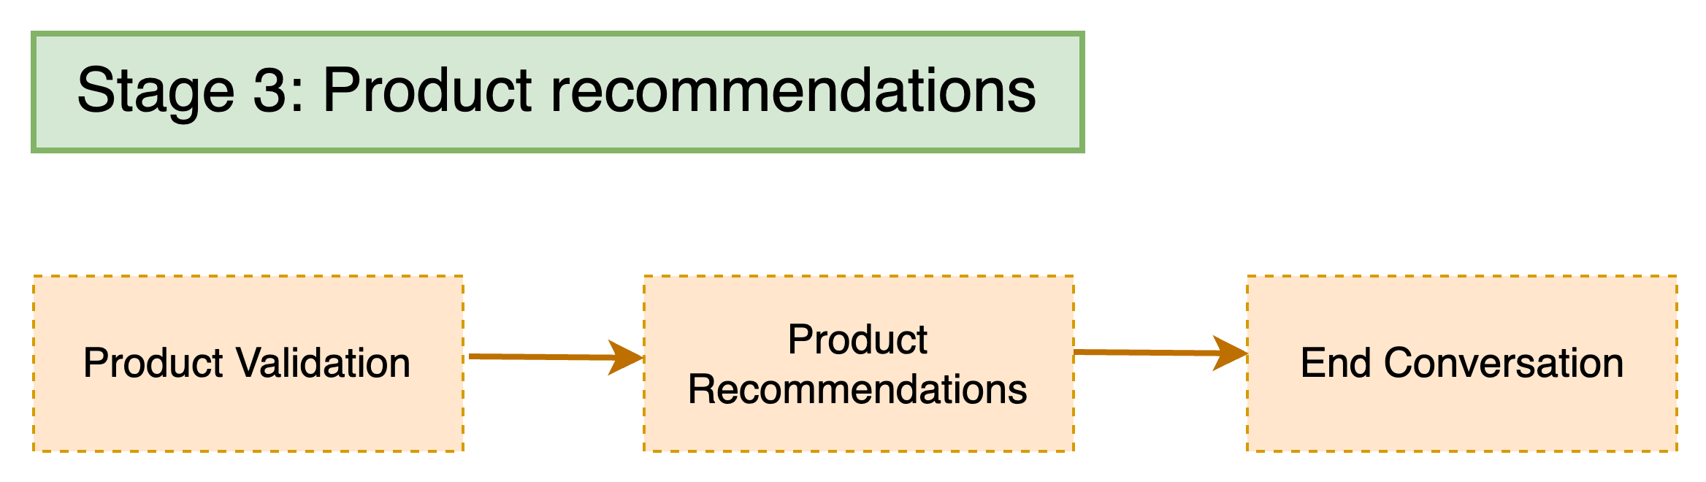
π
Shop Assistant: Stage-3

Slide 13
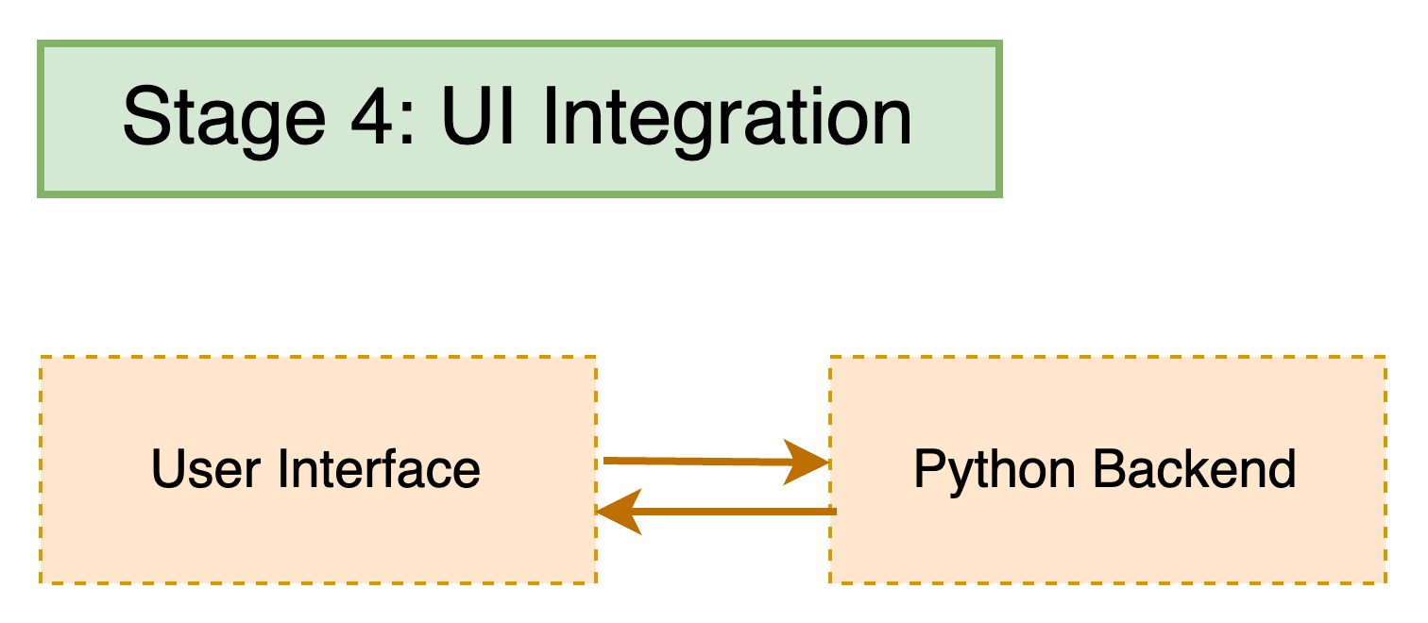
π
Shop Assistant: Stage-4

Slide 14
π
Hello World with Gemini Pro
π

Slide 15
π
Thank You !

