Slide 1


π
The Generative AI Revolution: A Month-Long AI Exploration
Impact of Generative AI
Business and Society
π
Week 3: 16th March 2024

Slide 2
π
Laptop Genie
π

Slide 3
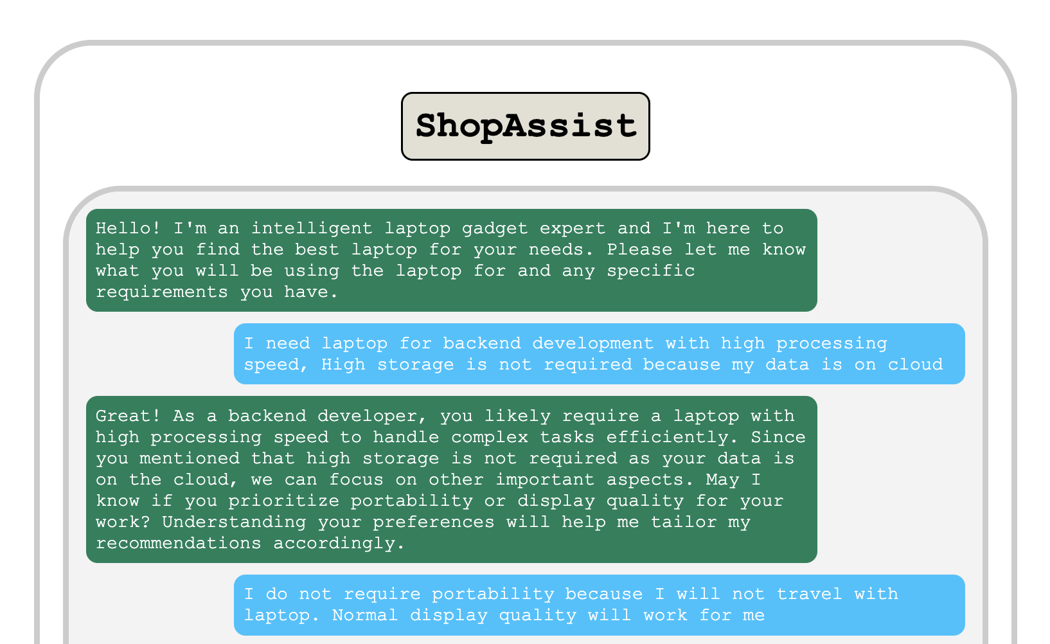
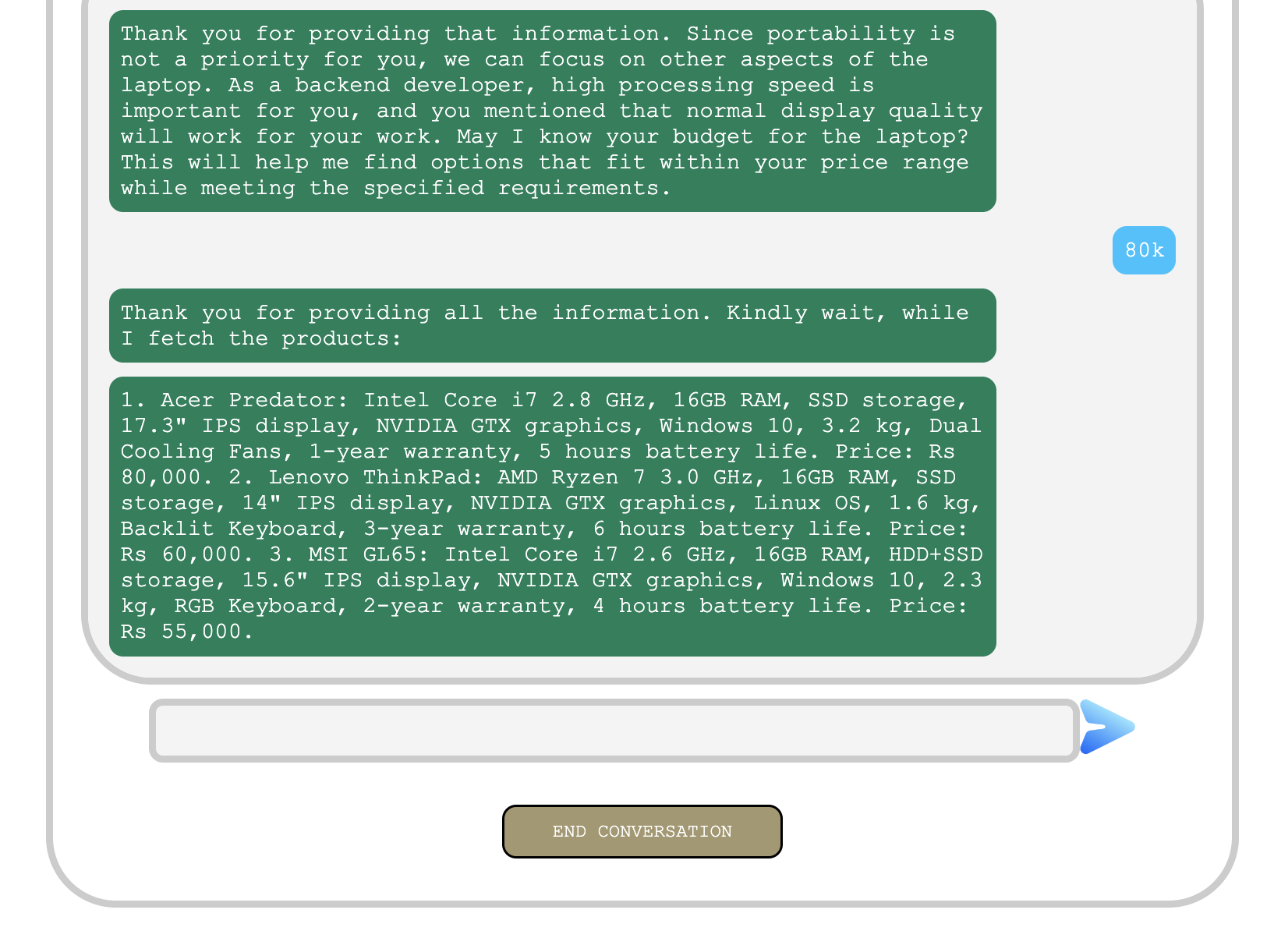
π
Project Overview of Shop Assistant
Scenario: Let's say you are going to any digital or electronic store to purchase a laptop, whether it be Chroma or Reliance Digital. You are a graphic designer and not very tech-savvy. You have limited knowledge about laptop specs. You will need a salesman or any store guy with good knowledge about it. The salesman will first understand your needs and suggest a few laptops that match your requirements.
Goal: Bot to replace the salesman

Slide 4
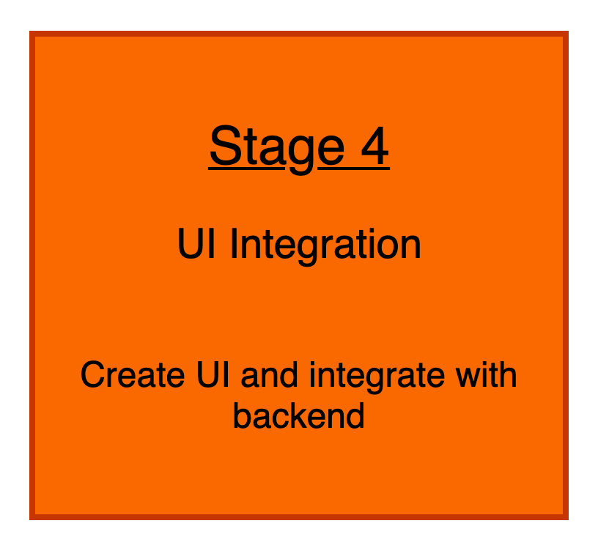
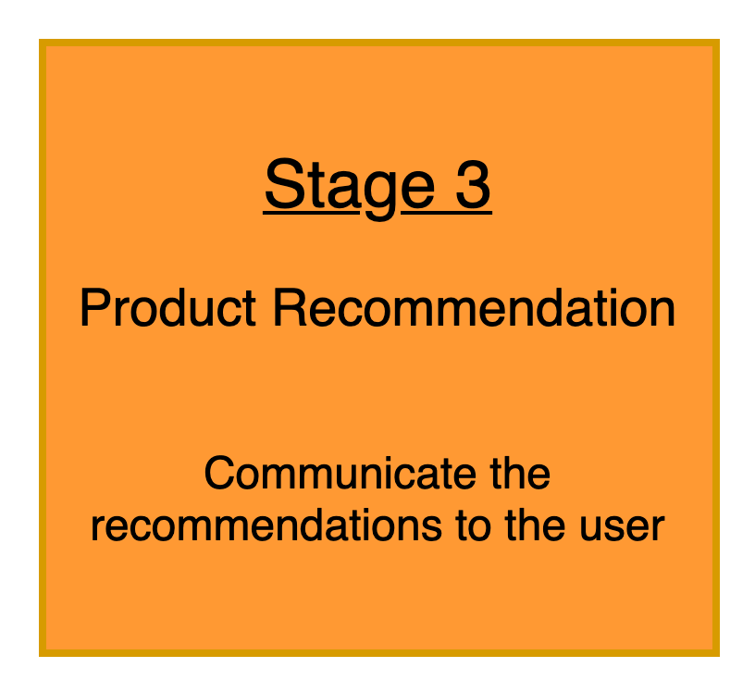
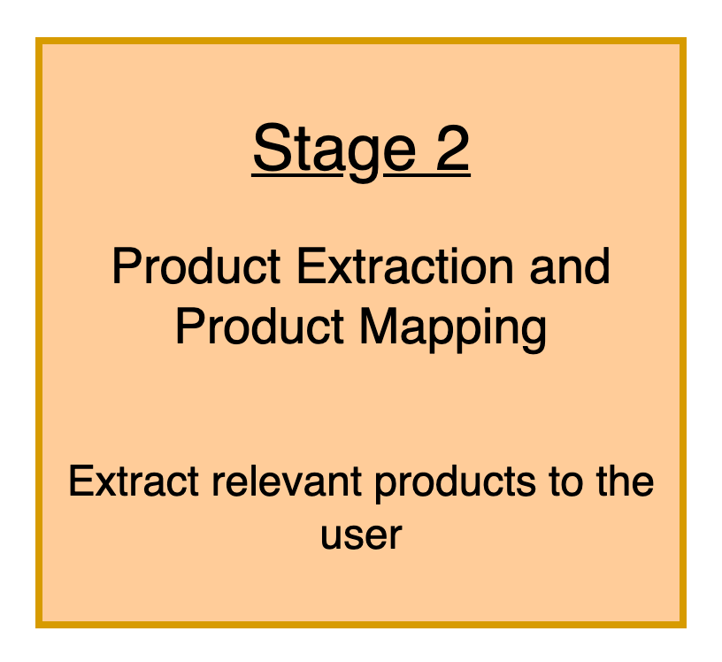
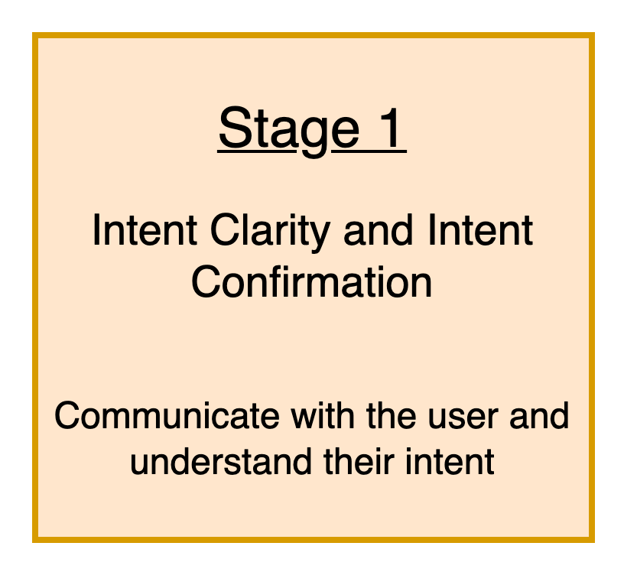
π
Shop Assistant : System Design

Slide 5
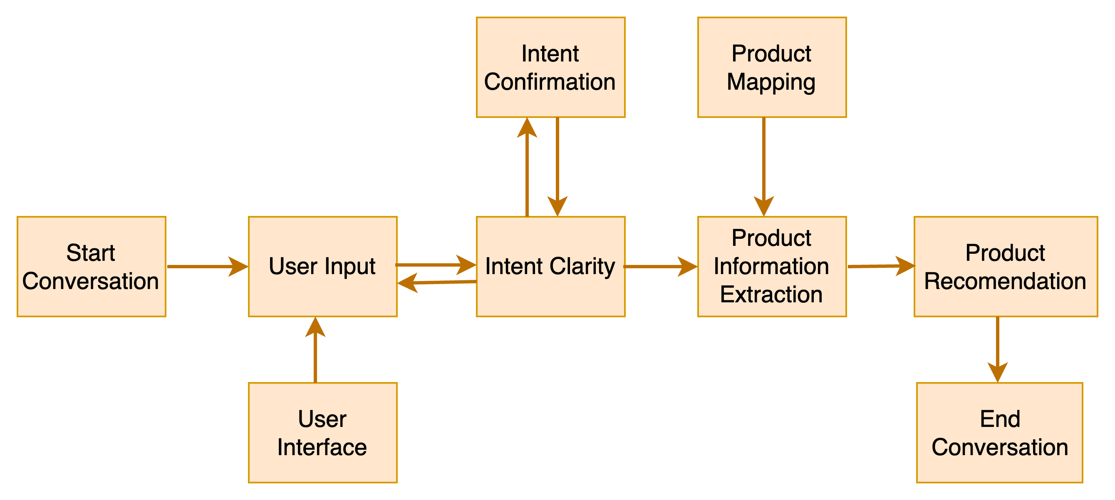
π
Shop Assistant: High Level Design

Slide 6
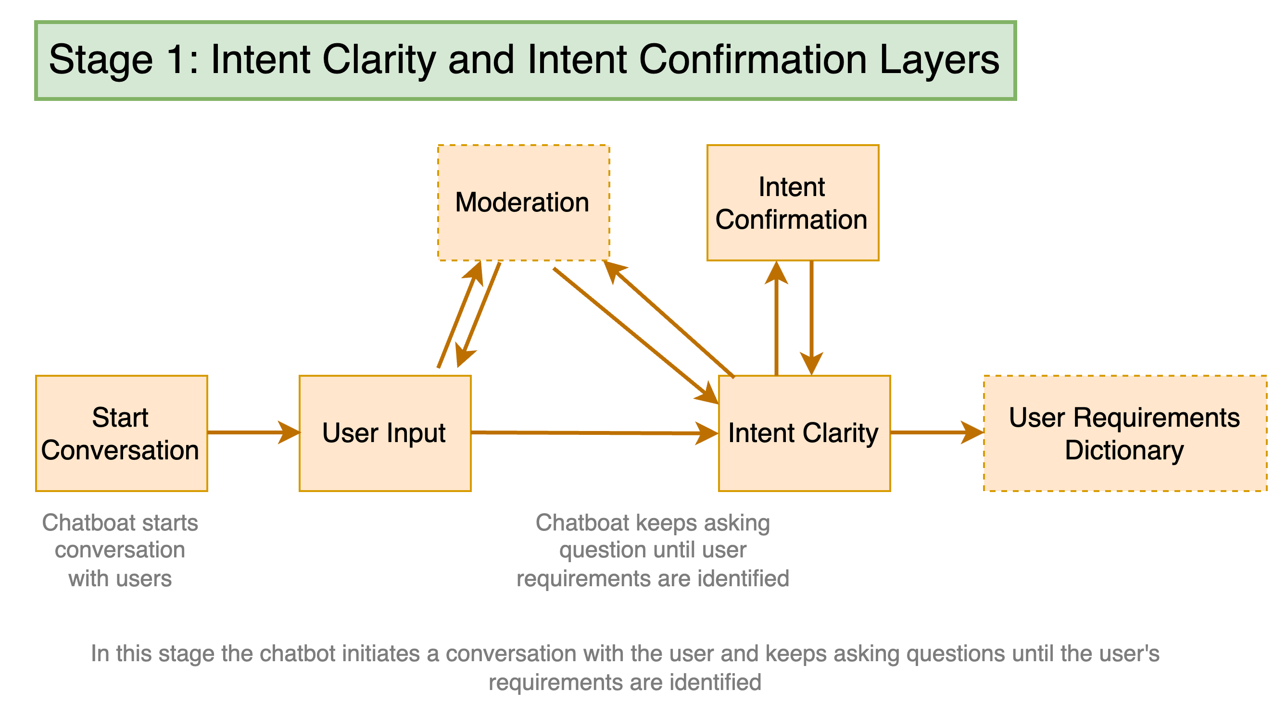
π
Shop Assistant: Stage-1

Slide 7
π
Stage 1 overview
Initialize conversation
Initialize_conversation()
Start user conversation
Get_chat_model_completions()
Moderation Check
moderation_check()
Intent Confirmation Layer
intent_confirmation_layer()
Dictionary Present
dictionary_present()

Slide 8
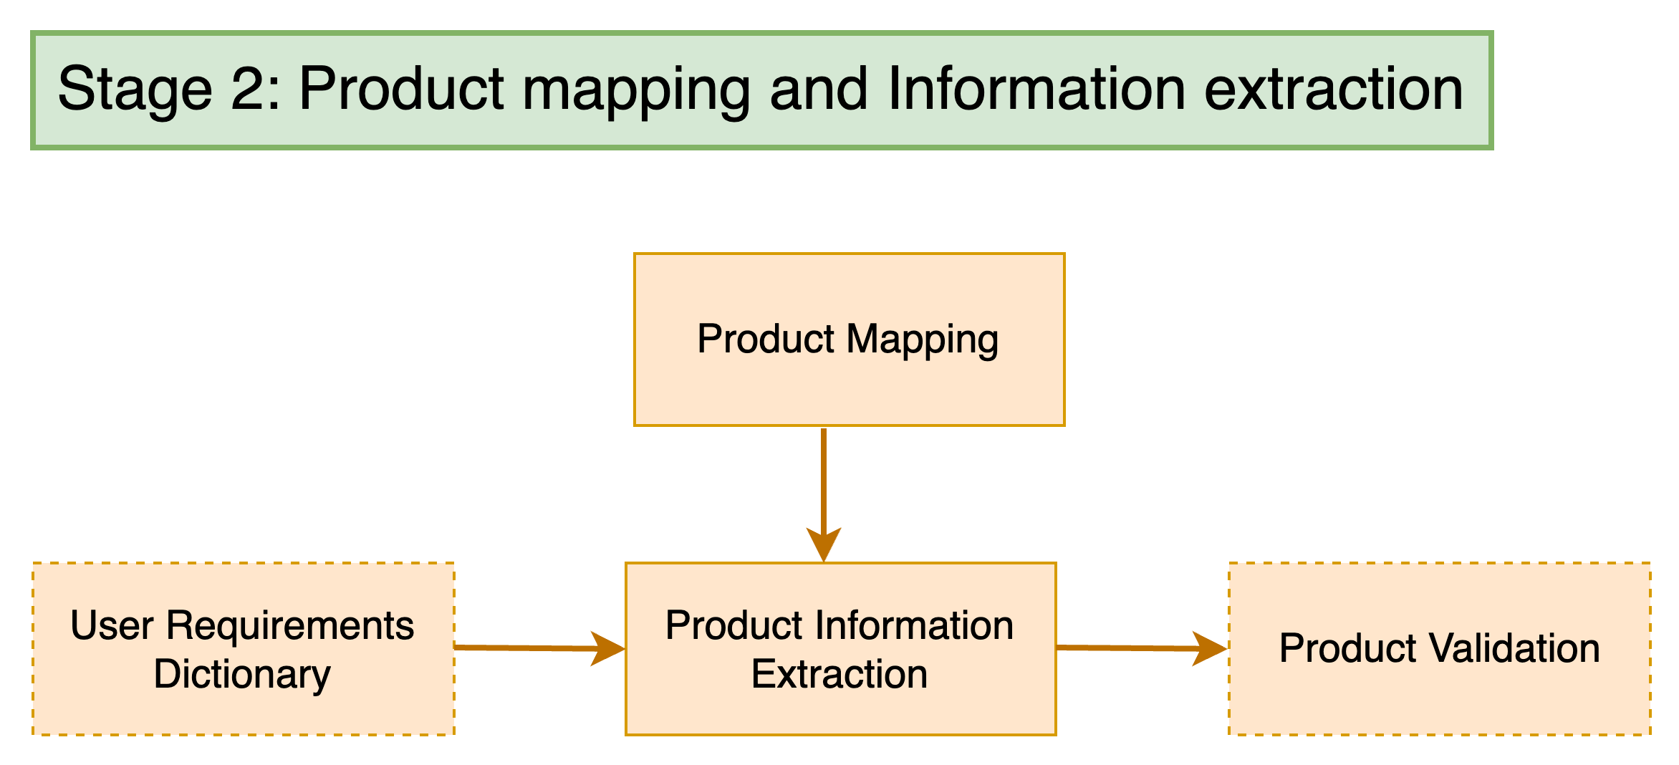
π
Shop Assistant: Stage-2

Slide 9
π
Stage 2 overview
Product mapping
product_map_layer
Extract Dictionary from string
extract_dictionary_from_string
compare_laptop_with_users
Validate Recommendations
recommendation_validation

Slide 10
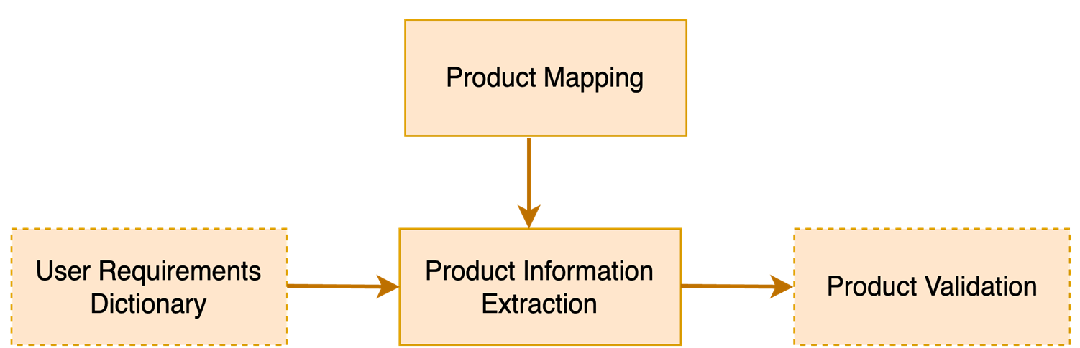
π
Shop Assistant: Stage 2: Step 1
The Dell Inspiron… Intel Core i5 processor clocked at 2.4 GHz,… With 8GB of RAM and an SSD, …sports a vibrant 15.6" LCD display with a resolution of 1920x1080, …Weighing just 2.5 kg, …Intel UHD GPU …one-year warranty and a battery life of up to 6 hours, …affordable price of 35,000
{‘gpu intensity': 'medium’, ‘display quality': 'medium',
‘portability': 'medium',
‘multitasking': 'high',
‘processing speed': 'medium’ }

Slide 11
π
Shop Assistant: Stage 2: Example 2
{‘gPU intensity': 'medium’, ‘display quality': 'medium’, ‘portability': 'medium’, ‘multitasking': 'high’, ‘processing speed': 'medium’ }
Input
{
‘gpu intensity': 'medium’,
‘display quality': 'medium',
‘portability': 'medium',
‘multitasking': 'high',
‘processing speed': 'medium'
}
extract_dictionary_from_string()
Output
Python function

Slide 12
π
Shop Assistant: Stage 2: Example 1
The Dell Inspiron… Intel Core i5 processor clocked at 2.4 GHz,… With 8GB of RAM and an SSD, …sports a vibrant 15.6" LCD display with a resolution of 1920x1080, …Weighing just 2.5 kg, …Intel UHD GPU …one-year warranty and a battery life of up to 6 hours, …affordable price of 35,000
{‘gpu intensity’: ‘medium (1)',
‘display quality’: medium (1)',
‘portability’: medium (1)',
‘multitasking': 'high (2)',
‘processing speed’: medium (1)'
Sample Laptop from dataset
mapping
{'low': 0, 'medium': 1, 'high': 2}
Comparison
Total Score >= 2 Laptop will be forwarded as recommendation
{‘gpu intensity’: ‘low (0)',
‘display quality’: high (2)',
‘portability’: low (0)',
‘multitasking’: high (2)',
‘processing speed’: medium (1)'
Total Score = 1+ 0+ 1+ 1+ 1= 4
User Requirement

Slide 13
π
Shop Assistant: Stage 2: Example 2
{‘gpu intensity’: ‘low (0)',
‘display quality’: ‘low (0)’,
‘portability’: ‘medium (1)’,
‘multitasking': ‘low (0)’,
‘processing speed’: ‘low (0)’,
‘budget’: 35000'}
The Lenovo IdeaPad… Intel Core i3 processor running at 2.1 GHz, … 8GB of RAM and an HDD, … sports a 15.6" TN display with a resolution of 1366x768, … Intel UHD GPU Weighing 2.2 kg,… battery life of up to 5 hours, Priced at 25,000, it offers affordability
Sample Laptop from dataset
mapping
{'low': 0, 'medium': 1, 'high': 2}
Total Score >= 2 Laptop will be forwarded as recommendation
{‘gpu intensity’: ‘low (0)',
‘display quality’: ‘high (2)',
‘portability’: ‘low (0)’,
‘multitasking’: ‘high (2)’,
‘processing speed’: ‘medium(1)’,
‘budget’: 90000'}
Total Score = 1+ 0 + 1 + 0 + 0= 2
User Requirement

Slide 14
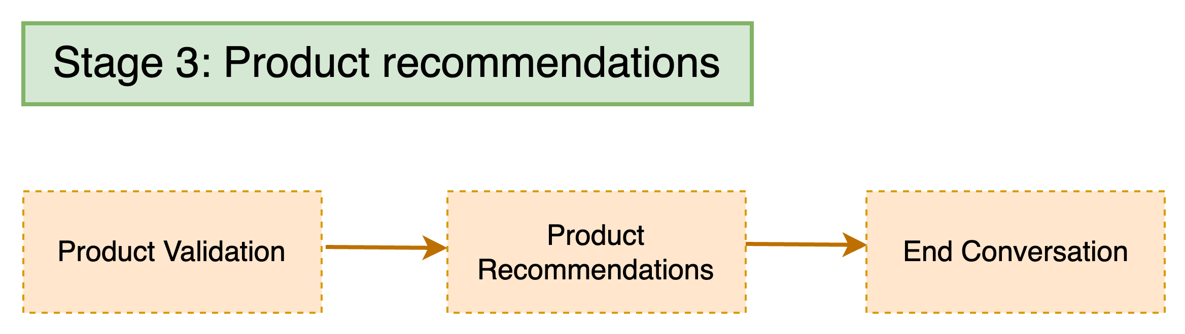
π
Shop Assistant: Stage-3

Slide 15
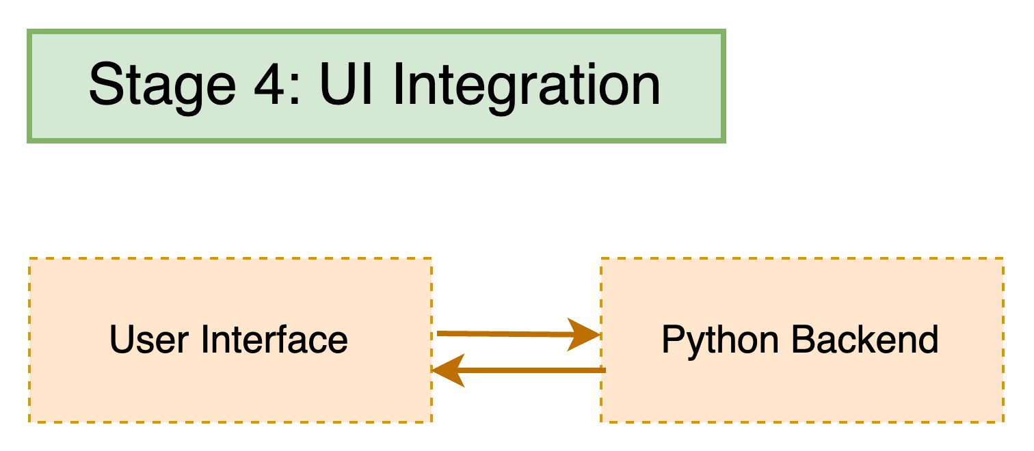
π
Shop Assistant: Stage-4

Slide 16
π
Thank You !

