Slide 1


π
The Generative AI Revolution: A Month-Long AI Exploration
Impact of Generative AI
Business and Society
π
Week 3: 18th Feb 2024

Slide 2


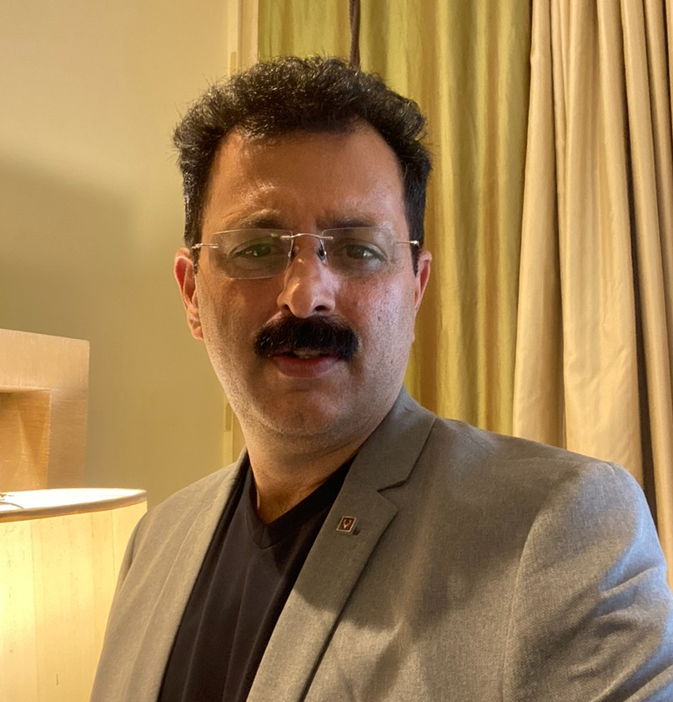
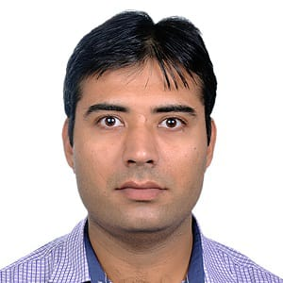
π
Our Team
Mokarbeen Ansari
www.linkedin.com/in/mokarbeenansari/
Raman Chopra​
www.linkedin.com/in/raman-chopra/
Vinit Narula
www.linkedin.com/in/vinitnarula/
Dinesh Chopra
www.linkedin.com/in/dinesh-chopra/
Email: mentors@edquest.co.in

Slide 3
π
Shop Assistant
π

Slide 4
π
Recap
Introduction to Generative AI
Generative AI Software Applications
Impact of Generative AI
Prompt Engineering
High Level Overview of Shop Assistant Project
Stage 1: Intent clarity & Intent confirmation

Slide 5
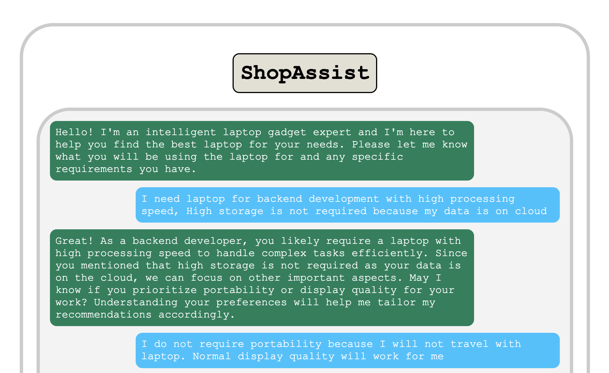
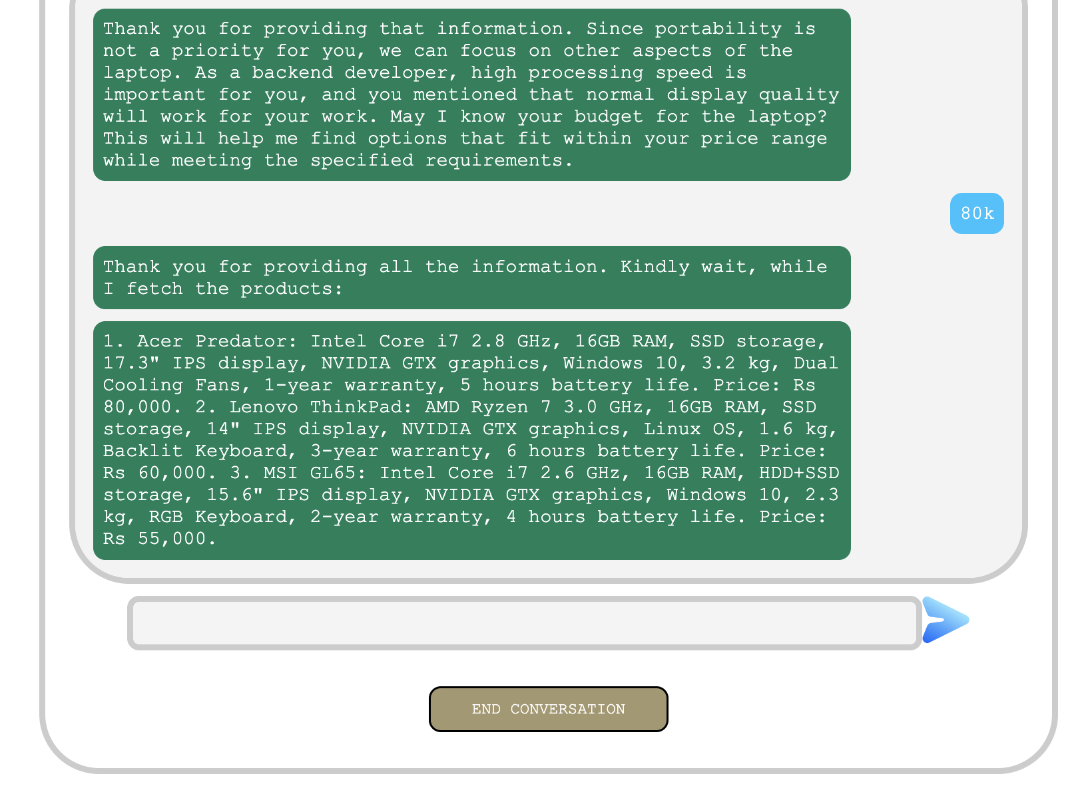
π
Project Overview of Shop Assistant

Slide 6
π
Agenda
Recap
Questions or blockers if any
Stage 2
Product mapping
Extract dictionary from string
Validate recommendations

Slide 7
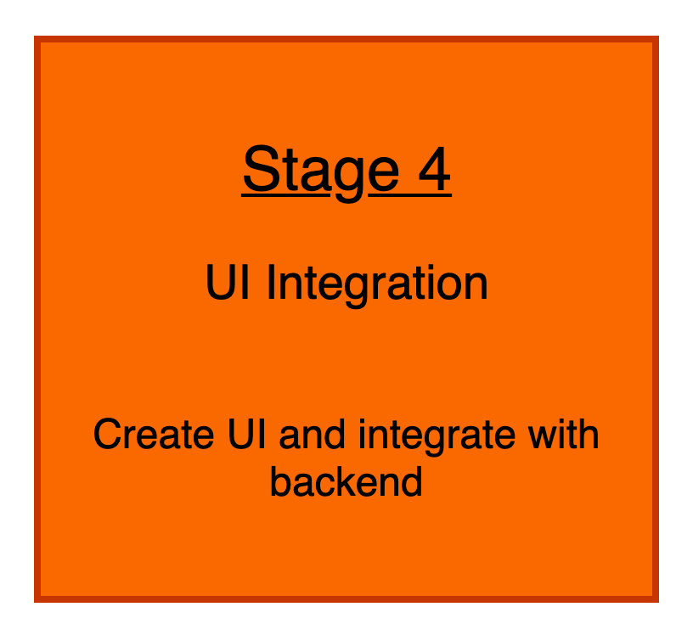
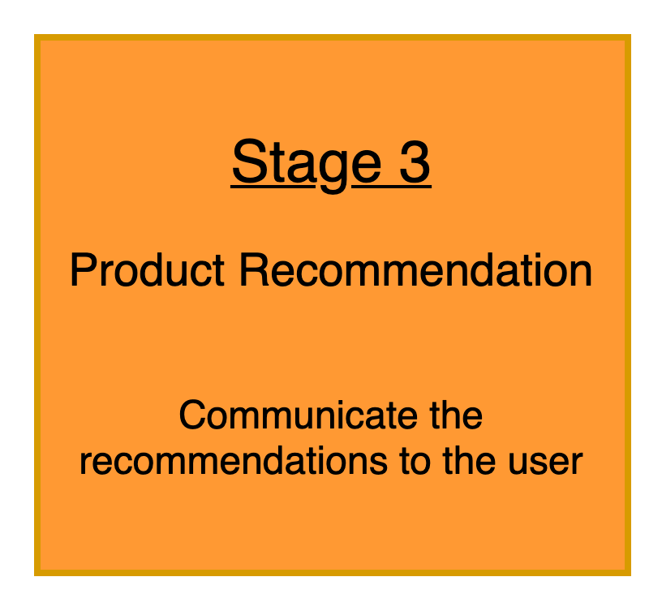
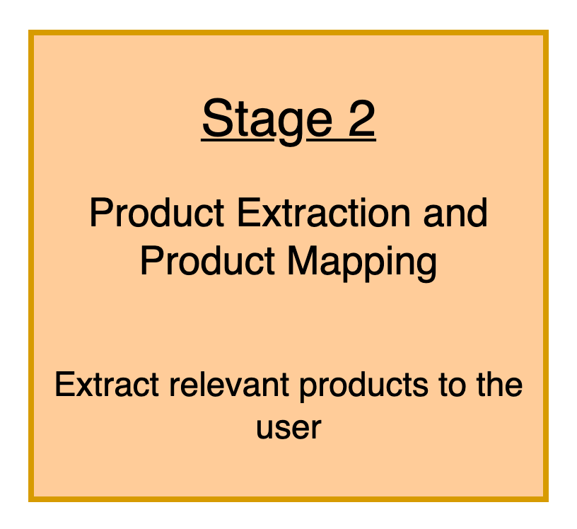
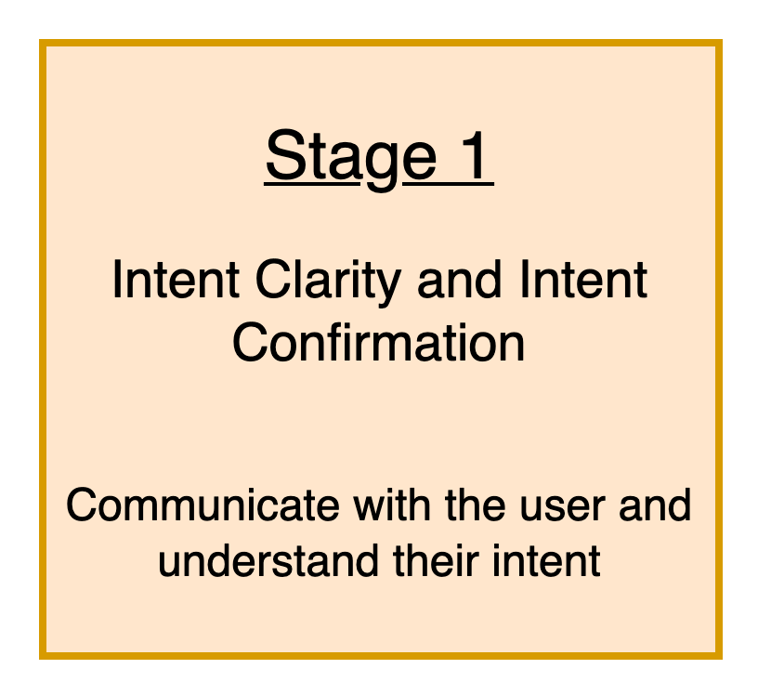
π
Shop Assistant : System Design

Slide 8
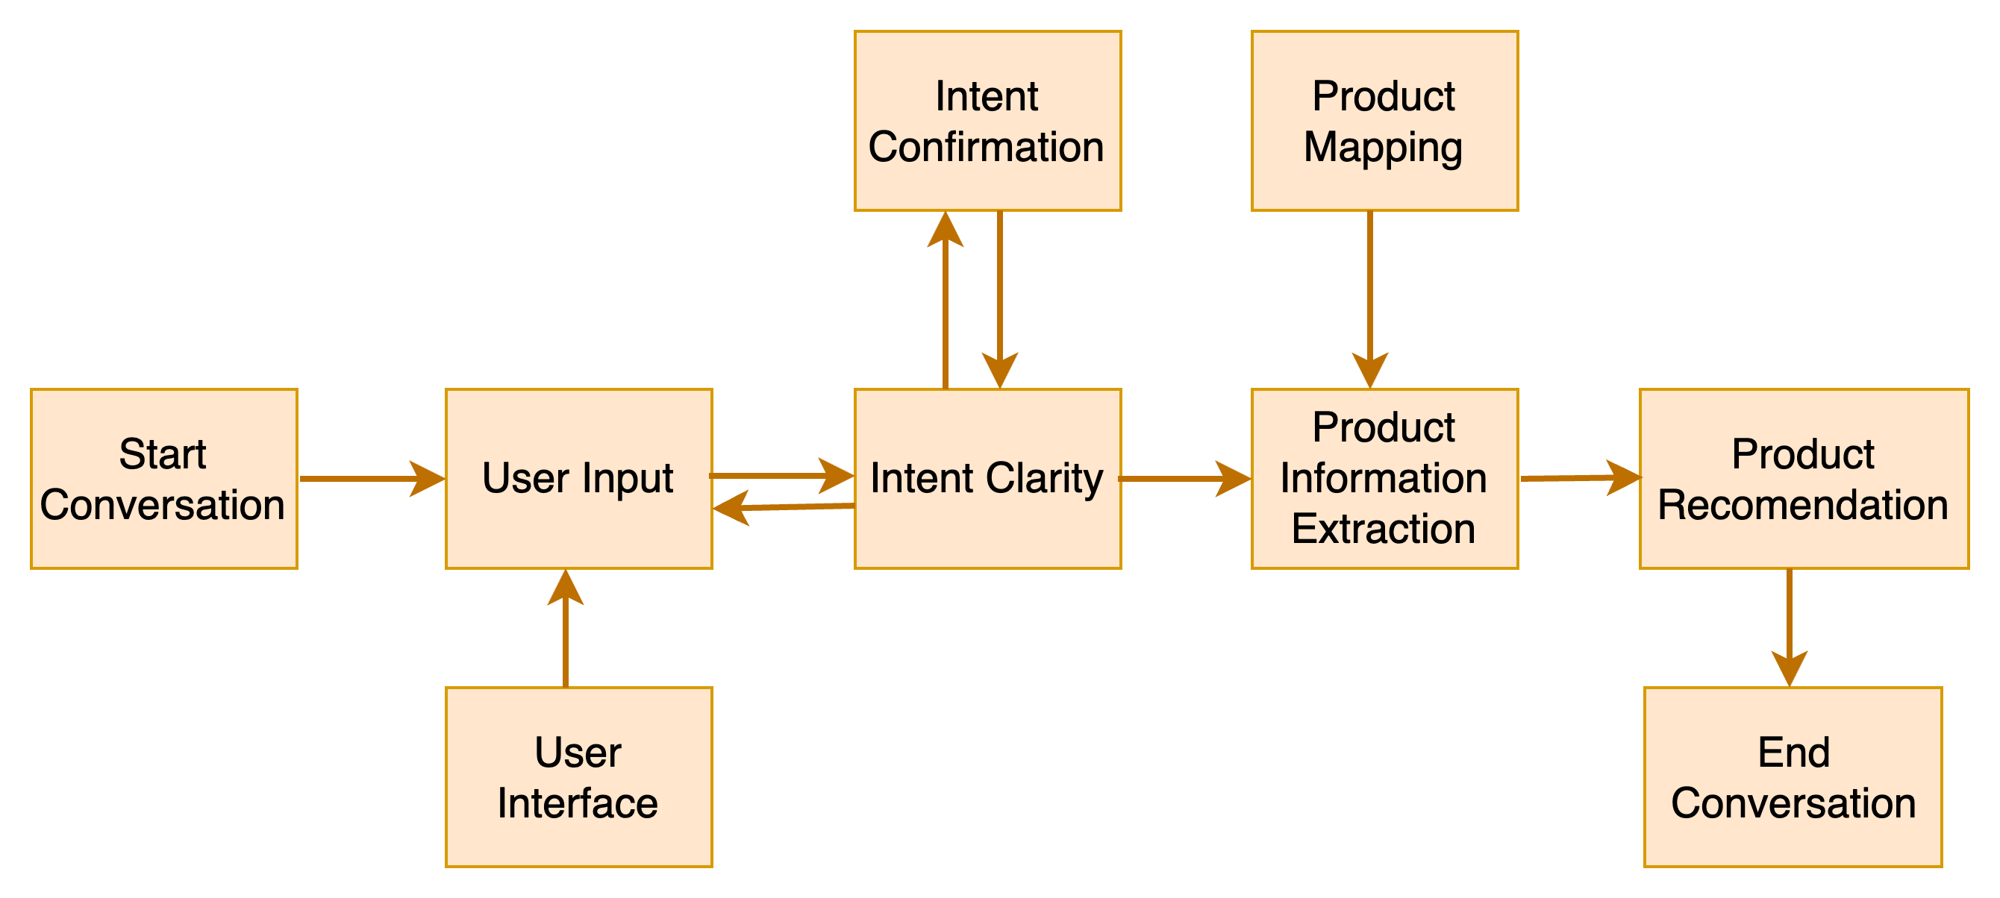
π
Shop Assistant: High Level Design

Slide 9
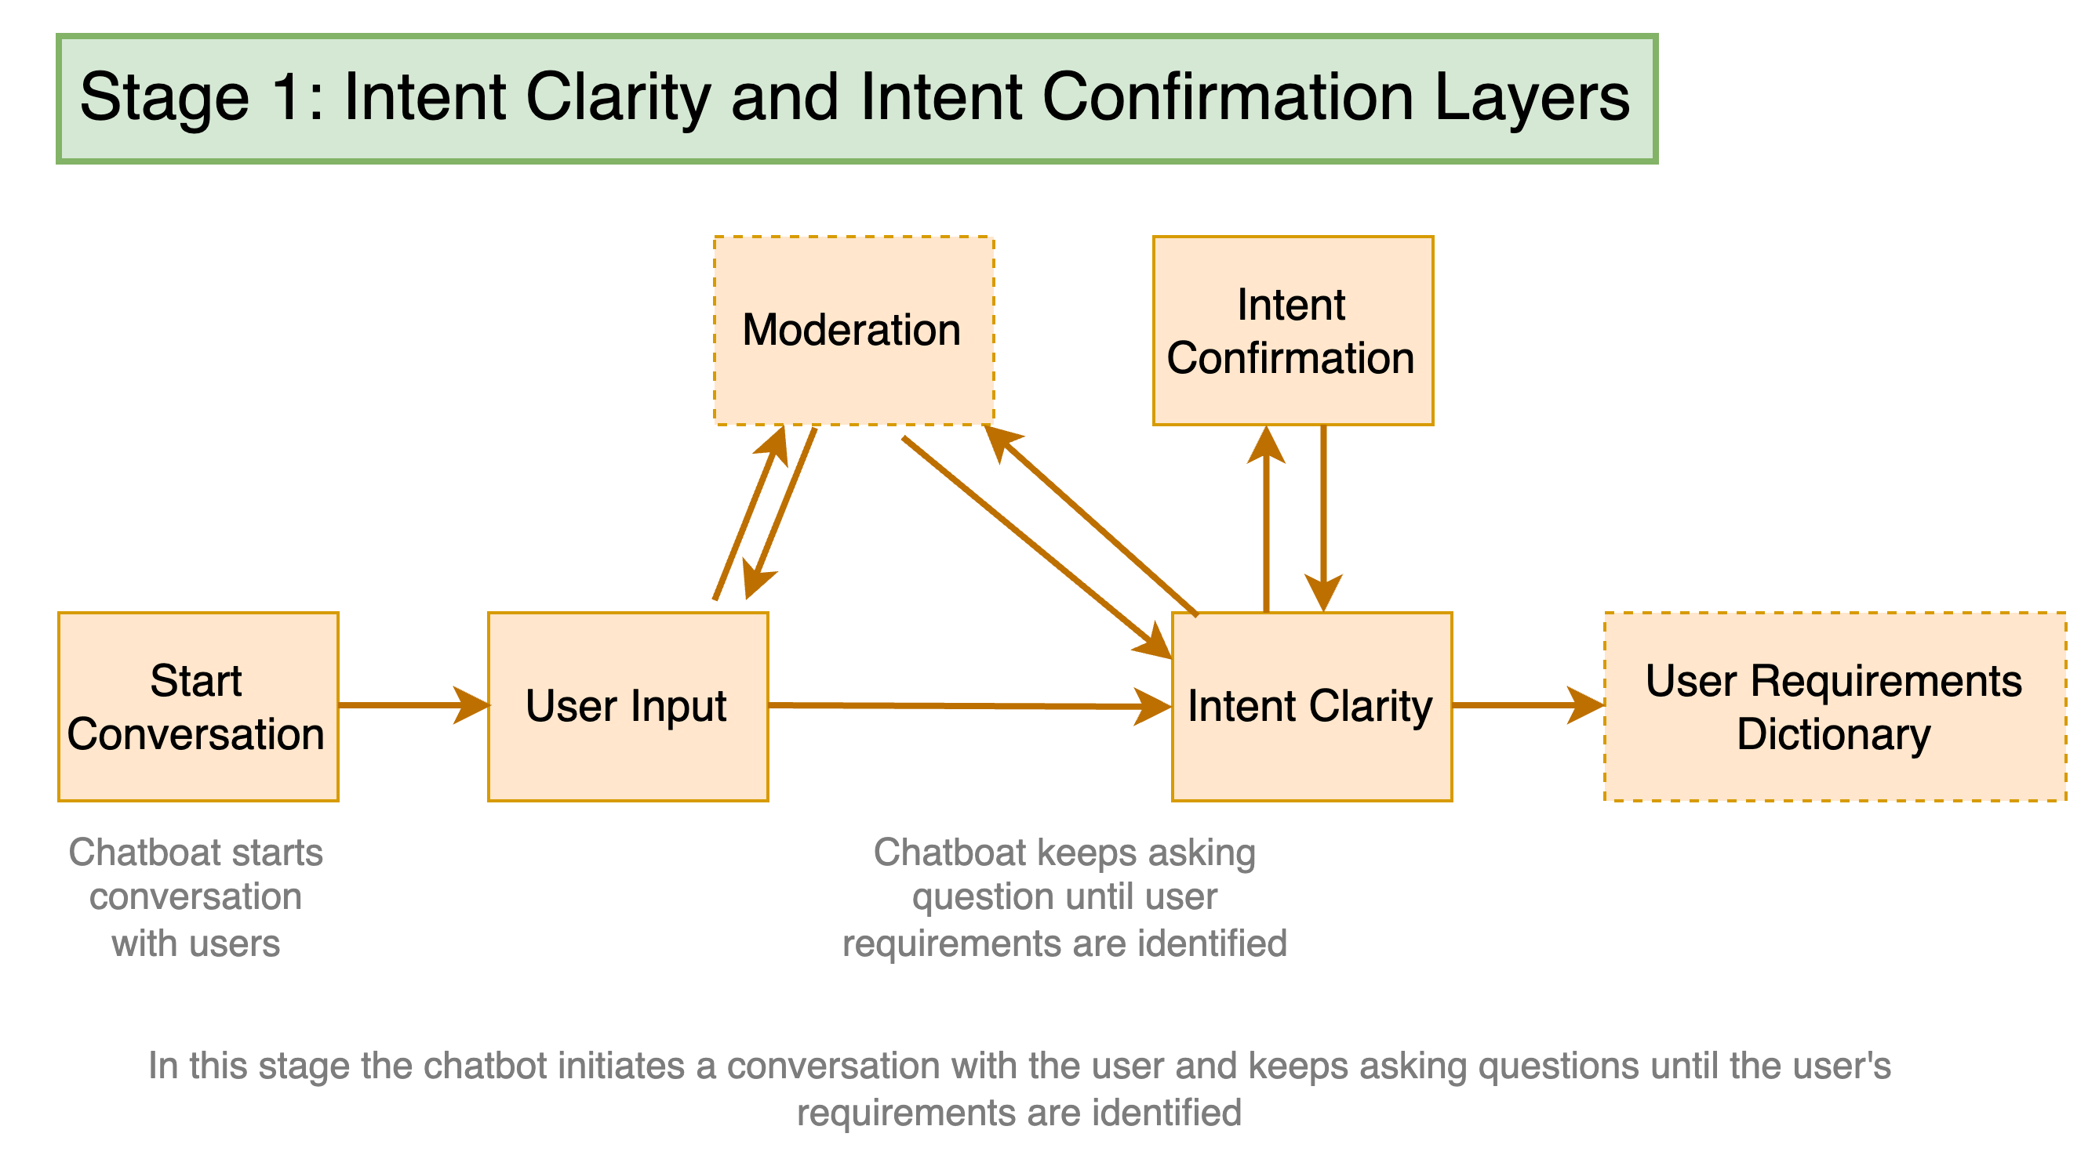
π
Shop Assistant: Stage-1

Slide 10
π
Stage 1 overview
Initialize conversation
Initialize_conversation()
Start user conversation
Get_chat_model_completions()
Moderation Check
moderation_check()
Intent Confirmation Layer
intent_confirmation_layer()
Dictionary Present
dictionary_present()

Slide 11
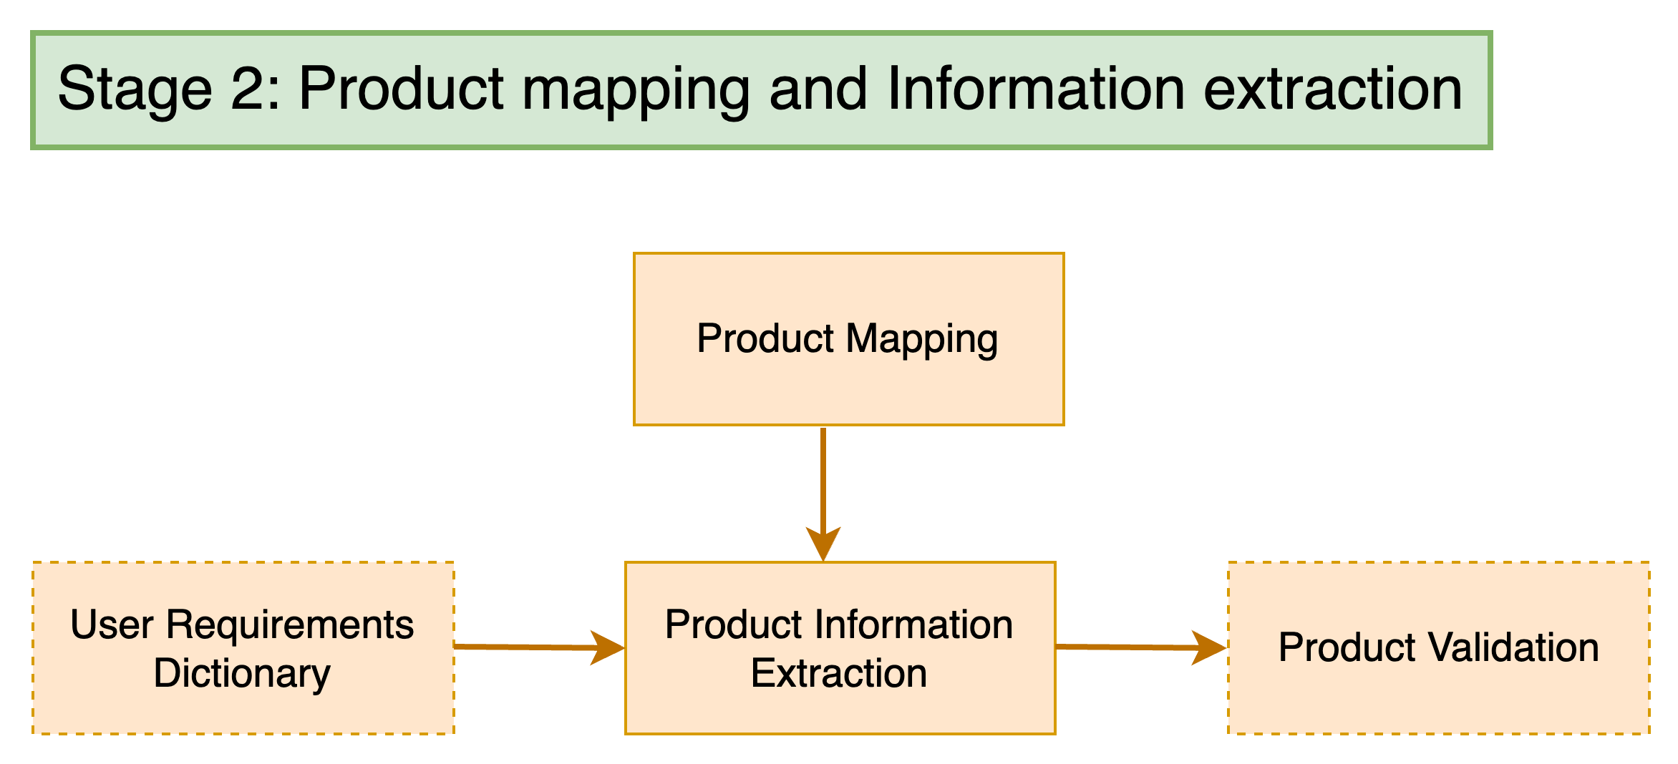
π
Shop Assistant: Stage-2

Slide 12
π
Stage 2 overview
Product mapping
product_map_layer
Extract Dictionary from string
extract_dictionary_from_string
compare_laptop_with_users
Validate Recommendations
recommendation_validation

Slide 13
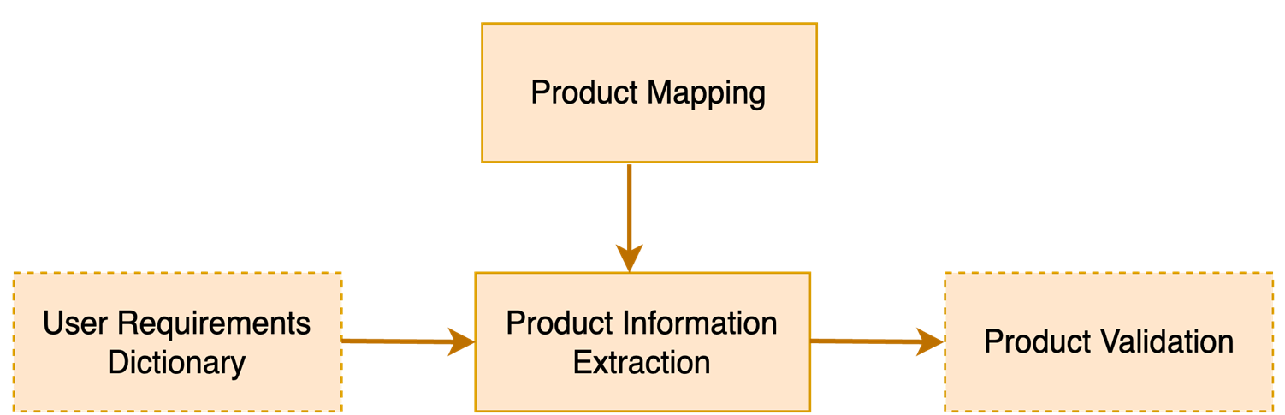
π
Shop Assistant: Stage 2: Step 1
The Dell Inspiron… Intel Core i5 processor clocked at 2.4 GHz,… With 8GB of RAM and an SSD, …sports a vibrant 15.6" LCD display with a resolution of 1920x1080, …Weighing just 2.5 kg, …Intel UHD GPU …one-year warranty and a battery life of up to 6 hours, …affordable price of 35,000
{‘gpu intensity': 'medium’, ‘display quality': 'medium',
‘portability': 'medium',
‘multitasking': 'high',
‘processing speed': 'medium’ }

Slide 14
π
Shop Assistant: Stage 2: Example 2
{‘gPU intensity': 'medium’, ‘display quality': 'medium’, ‘portability': 'medium’, ‘multitasking': 'high’, ‘processing speed': 'medium’ }
Input
{
‘gpu intensity': 'medium’,
‘display quality': 'medium',
‘portability': 'medium',
‘multitasking': 'high',
‘processing speed': 'medium'
}
extract_dictionary_from_string()
Output
Python function

Slide 15
π
Shop Assistant: Stage 2: Example 1
The Dell Inspiron… Intel Core i5 processor clocked at 2.4 GHz,… With 8GB of RAM and an SSD, …sports a vibrant 15.6" LCD display with a resolution of 1920x1080, …Weighing just 2.5 kg, …Intel UHD GPU …one-year warranty and a battery life of up to 6 hours, …affordable price of 35,000
{‘gpu intensity’: ‘medium (1)',
‘display quality’: medium (1)',
‘portability’: medium (1)',
‘multitasking': 'high (2)',
‘processing speed’: medium (1)',
‘budget’: 35000'}
Sample Laptop from dataset
mapping
{'low': 0, 'medium': 1, 'high': 2}
Comparison
Total Score >= 2 Laptop will be forwarded as recommendation
{‘gpu intensity’: ‘low (0)',
‘display quality’: high (2)',
‘portability’: low (0)',
‘multitasking’: high (2)',
‘processing speed’: medium (1)',
‘budget’: 90000'}
Total Score = 1+ 0+ 1+ 1+ 1+ 1= 5
User Requirement

Slide 16
Product Mapping
User Requirements Dictionary
Product Information Extraction
Product Validation

Slide 17
π
Shop Assistant: Stage 2: Example 2
{‘gpu intensity’: ‘low (0)',
‘display quality’: ‘low (0)’,
‘portability’: ‘medium (1)’,
‘multitasking': ‘low (0)’,
‘processing speed’: ‘low (0)’,
‘budget’: 35000'}
The Lenovo IdeaPad… Intel Core i3 processor running at 2.1 GHz, … 8GB of RAM and an HDD, … sports a 15.6" TN display with a resolution of 1366x768, … Intel UHD GPU Weighing 2.2 kg,… battery life of up to 5 hours, Priced at 25,000, it offers affordability
Sample Laptop from dataset
mapping
{'low': 0, 'medium': 1, 'high': 2}
Total Score >= 2 Laptop will be forwarded as recommendation
{‘gpu intensity’: ‘low (0)',
‘display quality’: ‘high (2)',
‘portability’: ‘low (0)’,
‘multitasking’: ‘high (2)’,
‘processing speed’: ‘medium(1)’,
‘budget’: 90000'}
Total Score = 0+ 0+ 1+ 0+ 0+ 1= 2
User Requirement

Slide 18
{'gpu intensity': 'medium', 'display quality': 'medium', 'portability': 'medium', 'multitasking': 'high', 'processing speed': 'medium'}
{'gpu intensity': 'high', 2
'display quality': 'high',
'portability': 'low',
'multitasking': 'low': 0,
'processing speed': 'high'}
{'gpu intensity': 1,
'display quality': 1,
'portability': 1,
'multitasking': 2,
'processing speed': 1}​
{'gpu intensity': 'high',
'display quality': 'high', 'portability': 'low',
'multitasking': 'high',
'processing speed': 'high'}
{'gpu intensity': 'high', 'display quality': 'high', 'portability': 'low', 'multitasking': 'high', 'processing speed': 'high'}
{'low': 0, 'medium': 1, 'high': 2}

Slide 19
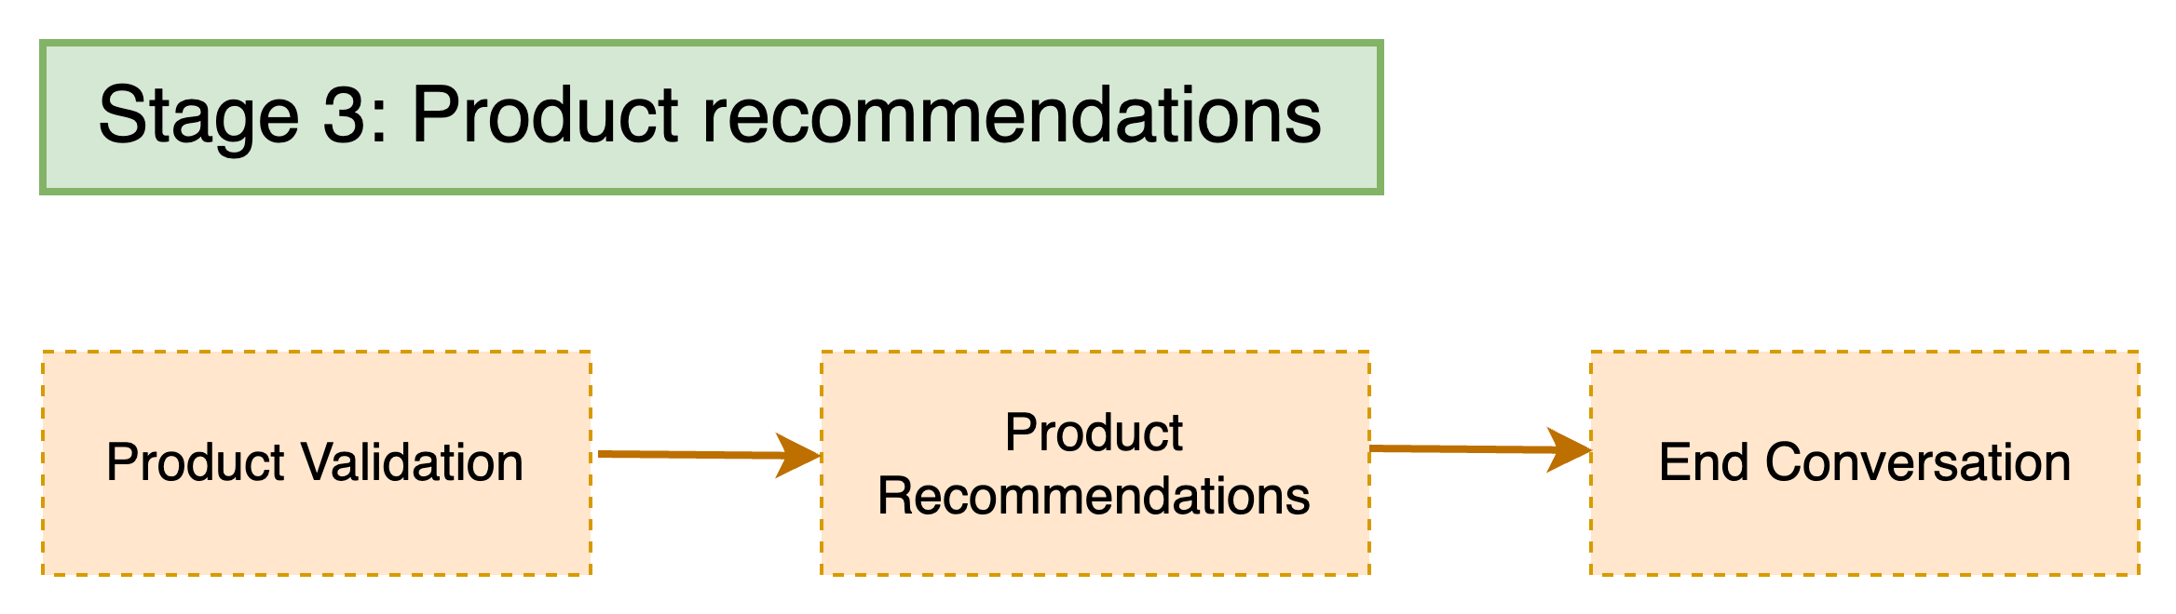
π
Shop Assistant: Stage-3

Slide 20
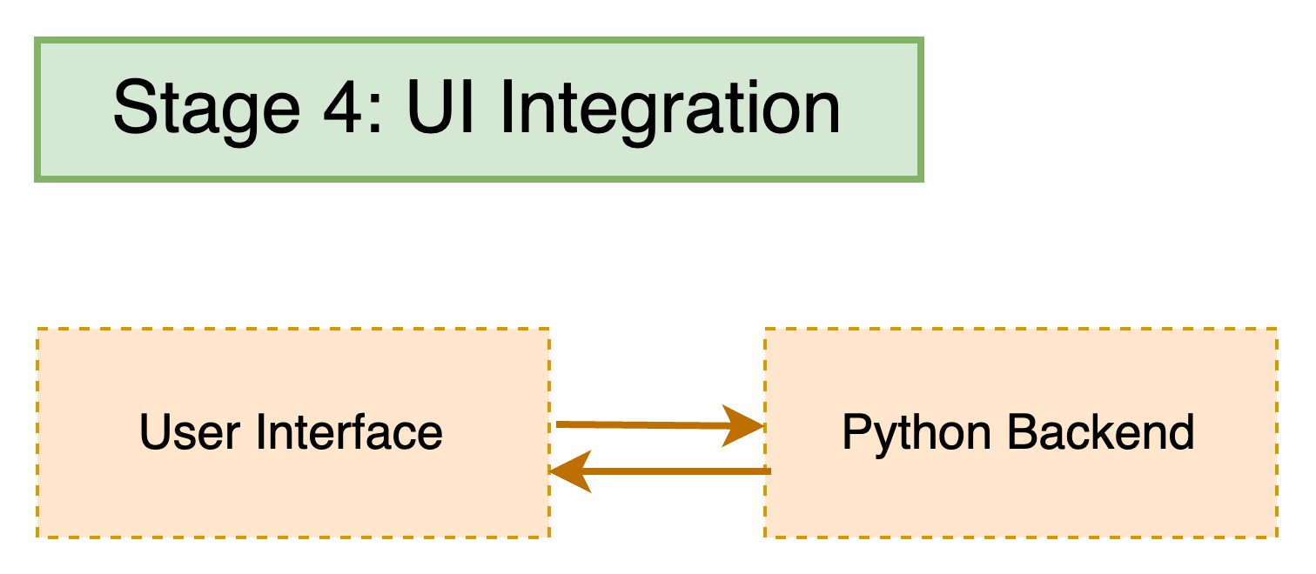
π
Shop Assistant: Stage-4

Slide 21
π
Hello World with Gemini Pro
π

Slide 22
π
Thank You !

