Slide 1

The Generative AI Revolution: A Month-Long AI Exploration
Level 2 | Apr 2024 | Week 1 Day 1

Slide 2

π
Generative AI Cohort April 2024
π

Slide 3
π
Recap of GenAI(Beginners) Level-1
Introduction to Generative AI
Generative AI in Software Applications
Impact of Generative AI
Prompt Engineering
Hands-on Projects:
Student Assistant
YouTube Summary and QnA
Financial Assistant
Burger Order bot
Laptop Genie bot

Slide 4
π
Agenda for GenAI (Professionals) Level-2
Generative AI Journey
Prompt Engineering
RAG
Fine Tuning
Re-Training
Limitations of Prompt Engineering
RAG - Retrieval Augmented Generation
Hands-on Projects
Policy Assistant Bot by using RAG
YouTube Playlist QnA Bot by using LangChain
Wikipedia QnA Bot by using LLaMA Index

Slide 5

π
Tools We will cover?

Slide 6
π
Limitations of Prompt Engineering
What is Prompt Engineering:
Prompt engineering involves crafting specific input instructions or prompts to guide the output generation of AI models.
Limitations of Prompt Engineering:
Token Limitation
Hard to give detailed instructions in a small space.
AI might misunderstand or make things too simple, creating wrong or unhelpful stuff.
Knowledge Cutoff
At Risk from Tricky Inputs
Mean prompts can fool the AI into making bad or biased stuff.
We need strong ways to stop and fix these sneaky attacks.

Slide 7
π
Retrieval Augmented Generation
What is RAG ?
High Level Design
Step by Step Approach
What Problems RAG can resolve
π

Slide 8
π
RAG – What is RAG?
It's a technique that improves the accuracy and reliability of large language models (LLMs) by allowing them to access and leverage information from external knowledge sources.

Slide 9
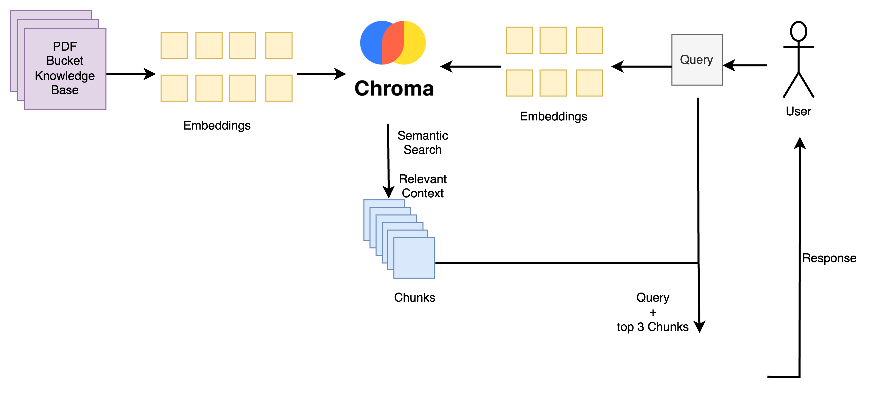

π
RAG – High Level Design

Slide 10
π
RAG – Step by Step Approach
Chunking
Embedding
Vector DB
Semantic Search
Generative Search

Slide 11
π
RAG – What problems RAG can Resolve?
Prompt Token Limitation
Knowledge Cut off limitation
Cost
Accuracy

Slide 12



π
Communications Channels
WhatsApp: https://whatsapp.com/channel/0029VaOManvEKyZMoPCtPU24
Discord: https://discord.gg/r4pNVqcpCr
LinkedIn: https://www.linkedin.com/company/edquestofficial/

Slide 13


π
Q & A

