Slide 1
Description & Function: Exhaust Aftertreatment System Analysis (Tech Tool operation 2589-08-03-18)
Purpose: To have a series of routines in Premium Tech Tool (PTT) to effectively evaluate and diagnose the NOx sensors, Urea dosing system and SCR efficiency. The routine is also captured in a .csv file and can be downloaded from Product History Viewer for later review if necessary. This document includes the list of DTCs that, when following GD, will list this operation as a step. This document will outline key details that the technician should be aware of when performing the operation. Currently this operation is only available for EM-USA17 11 & 13L VGT engines. EMS SW PN 23766686. For these engines, the NOx Conversion test (2549-08-03-03) is replaced by this operation (2589-08-03-18), the NOx conversion test will remain available for all other variants except EM-USA17 turbo compound.

Slide 2
Background:
The concept of the Exhaust Aftertreatment System analysis can allow for evaluation of the NOx sensors, Urea dosing system and the SCR, without removing engine components and by testing the components as a system, and under more controlled operating conditions.
The current operation consists of 4 sub-tests, prior to these tests, there is a warm-up step to ensure proper exhaust/aftertreatment temperatures and that the NOx sensors are warmed-up/enabled:
1) AHI system (if initial AHI sub-test fails, first step is to un-check it and re-run the operation) – this additional subtest helps bring temperatures up faster
2) NOx sensors
3) DEF dosing system (verify DEF flow / valve / pump function)
4) SCR efficiency (provide objective evaluation of SCR efficiency under controlled / repeatable conditions)
These routines can be run separately or in combination, by default, all the subtests are enabled. Typical time to run all 4 sub-tests is 25-45 minutes, depending on many factors – such as engine/coolant temperature, ambient temperature and other variables.

Slide 3
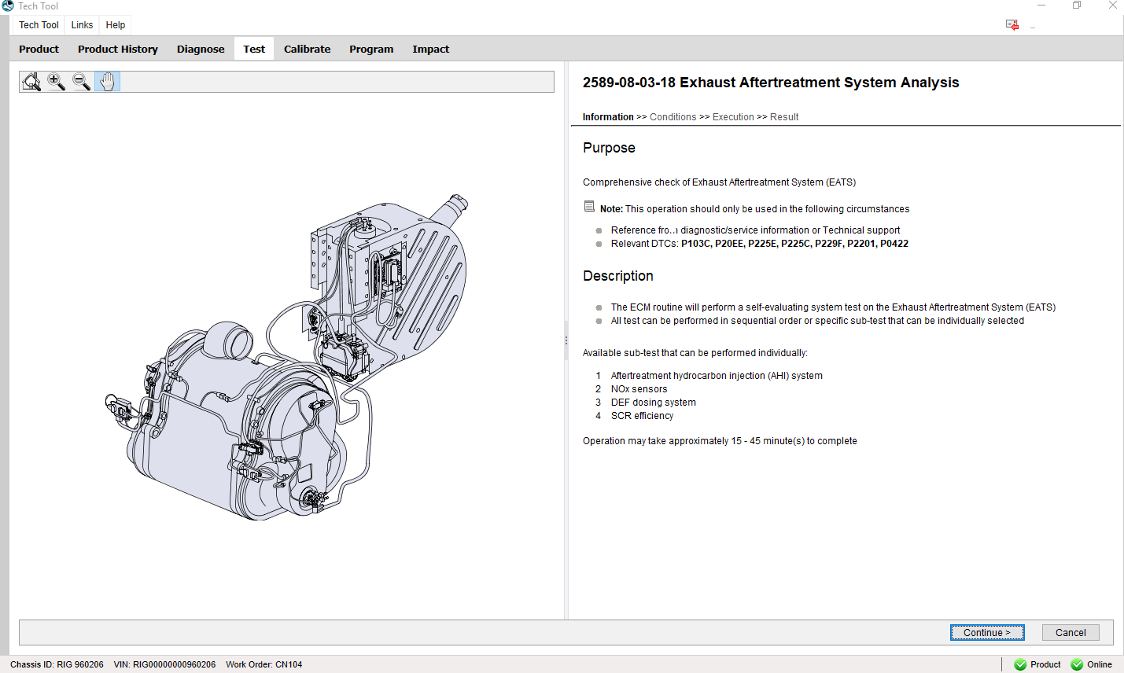
Operations screens for PTT

Slide 4
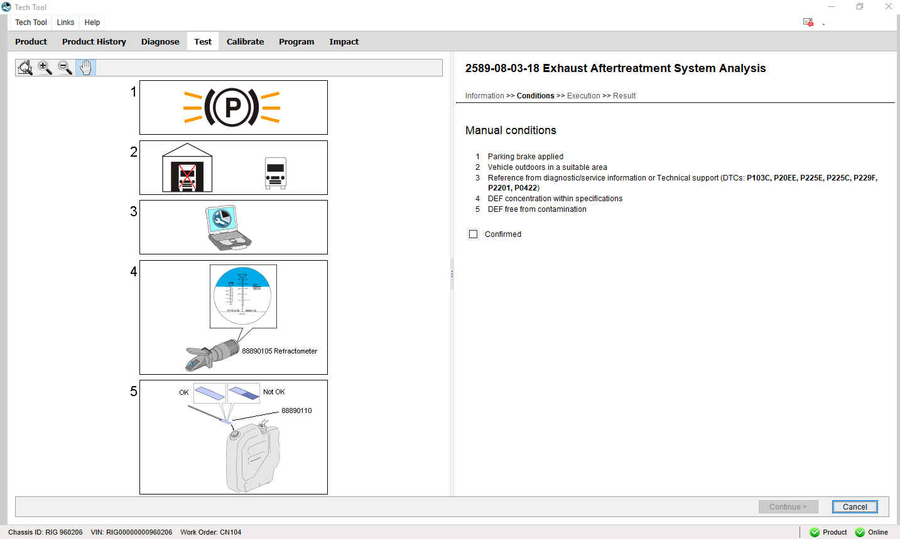
Operations screens for PTT
Condition Step – DEF quality / Concentration Check

Slide 5
Related DTCs and GD:
The GD trees for the following DTCs will be updated to reflect this operation:
P20EE00 – SCR NOx Catalyst Efficiency Below Threshold Bank 1
All subtests should be performed
P103C00 – SCR Nox Catalyst Efficiency Inducement
All subtests should be performed
P042200 – Catalyst 2 Efficiency Below Threshold Bank 1 (DPF NMHC conversion efficiency)
All subtests should be performed (only when DTC is confirmed)
P225E00 – NOx Sensor Performance – Signal Stuck High Bank 1 Sensor 2 (NOx outlet)
All subtests should be performed (only when DTC is confirmed)
P220164 – NOx Sensor Circuit Range/Performance Bank 1 Sensor 1 / Signal Plausibility Failure (NOx inlet)
Only the NOx sensors subtest should be performed
P225C00 - NOx Sensor Performance – Signal Stuck High Bank 1 Sensor 1 (NOx inlet)
Only the NOx sensors subtest should be performed
P229F64 - NOx Sensor Circuit Range/Performance Bank 1 Sensor 2 / Signal Plausibility Failure (NOx outlet)
Only the NOx sensors subtest should be performed

Slide 6
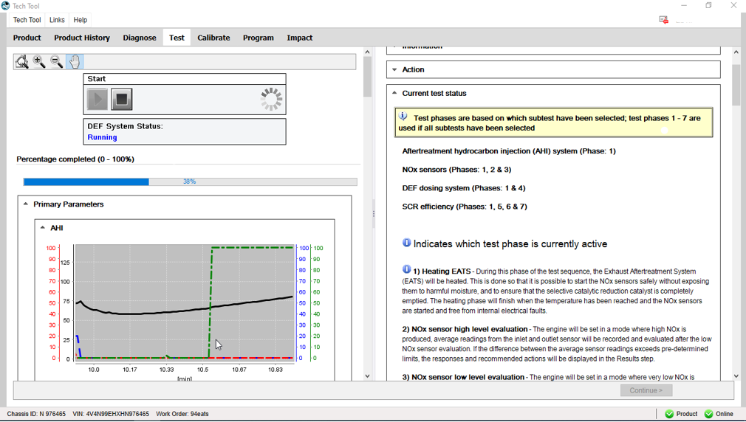
Operation information – Heating EATS phase (warmup):
Next pages explains the step in detail

Slide 7
Operation details – Heating EATS phase and AHI subtest:
During the Heating EATS phase (sometimes referred to as “warmup”) the engine enters a state similar to regeneration and will vary engine rpm between 1200 – 1250 rpm and control VGT position to reach target engine exhaust temperatures (T1). This phase will occur during all of the selected sub-tests.
AHI dosing will occur whether or not the AHI subtest is selected, this is to meet target DOC outlet (T2) and SCR average temperatures and bring the NOx sensors online faster.
When the AHI system subtest is selected, it adds AHI dosing at 3 fixed dosing rates for 2 minutes at each step. When the AHI subtest is selected and when the Engine exhaust temperature (T1) reaches 527 °F (275 °C), AHI dosing will begin.
During AHI dosing subtest, if any of the 3 measured temperatures exceed 914 °F (490 °C) the test will abort for over-temperature, in this case the first recommended action is to uncheck the AHI system test and proceed. The following conditions will result in a “test failed” status for the AHI subtest results, however the operation will complete:
If T2 fails to reach 464 °F (240 °C), after the first 2 minutes of AHI dosing
If T2 fails to reach 626 °F (330 °C), after the second 2 minutes of AHI dosing
If T2 fails to reach 734 °F (390 °C), after the third 2 minutes of AHI dosing
Purpose of the warmup phase is the stabilize temperatures, bring NOx sensors online and clear the SCR buffer, the AHI subtest has the advantage of adding more heat to the system and aids in clearing the SCR buffer faster.
(continued on page 8)
Next page (8) details the primary enable conditions and thresholds to exit the Heating EATS phase

Slide 8
Operation information – Heating EATS phase and AHI subtest (continued):
The primary thresholds / enable and exit conditions are listed below:
Allowable ambient temperature range: - 12 °C to + 40 °C (10.4 °F to 104 °F)
Max allowable DPF soot load to start routine: 69%
Minimum DEF tank level to start routine: 10%
Minimum coolant temp to exit warmup and enter NOx sensor evaluation: 60 °C (140 °F)
System will target a minimum T2 (DOC outlet) temp of 390 °C (734 °F)
SCR average temp (calculated temp) must reach 360 °C (680 °F) for 2 minutes
When coolant and SCR average temp requirements are satisfied, and if NOx sensors have not come online, the routine allows 4 minutes for NOx Inlet and 5 minutes for NOx outlet to come online before it will abort test for NOx sensor quality (bad).
Test abort due to NOx Inlet or Outlet sensor quality bad is an unlikely scenario, however if this exception occurs, it is advisable to re-run test 1 more time.
Additionally, if the NOx sensors are the last to come online, there is a 60 second delay before it will enter the NOx sensor evaluation.
If the conditions are not met within 1800 seconds (30 minutes) the test will abort.
EGR position is commanded to zero (full-closed) for warmup and currently every phase of the operation

Slide 9
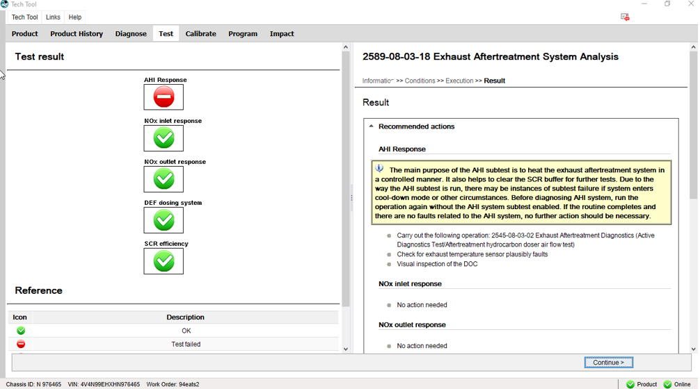
Operation information – Recommended actions in the event of AHI subtest failure

Slide 10
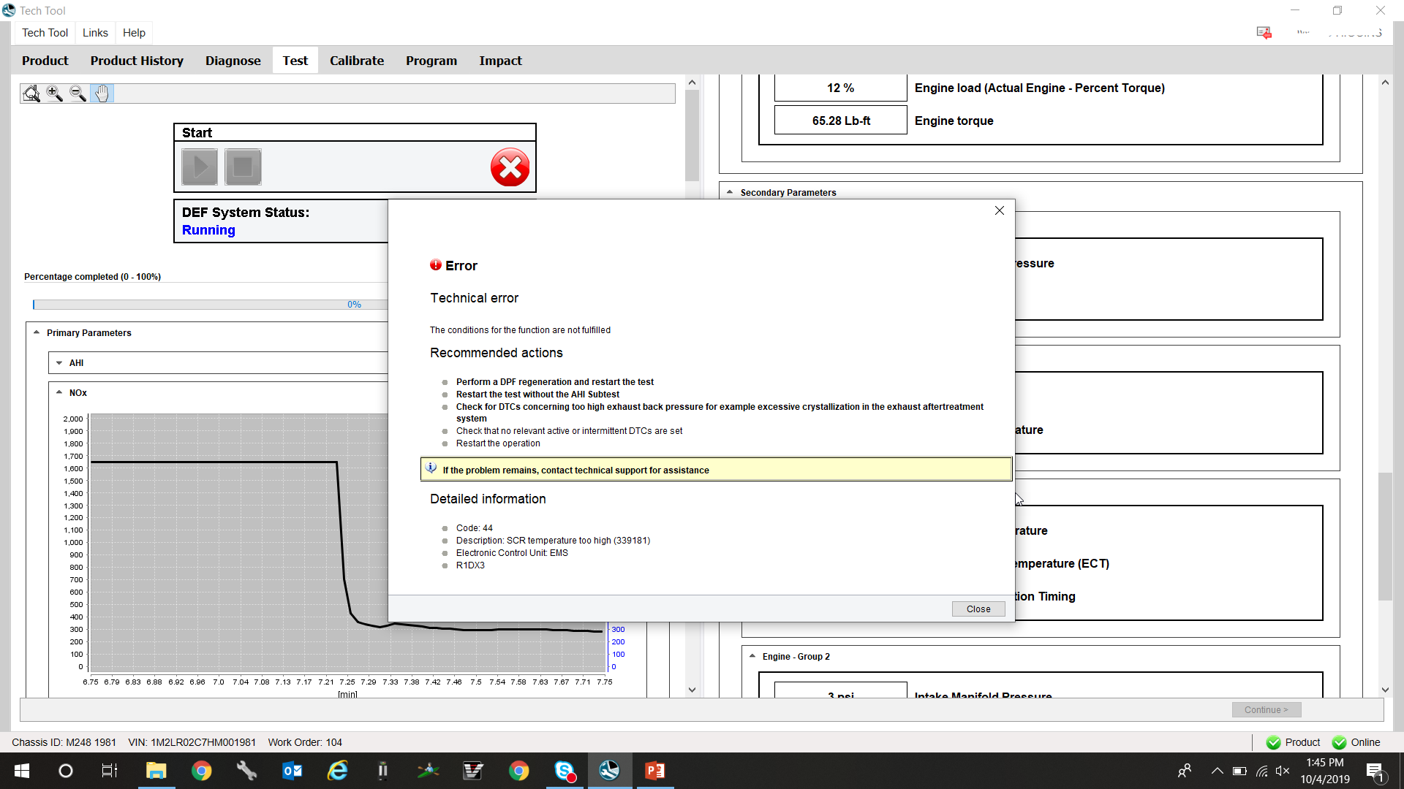
Recommended actions if operation aborts at “Heating EATS phase”:
The screen shot shows the current recommended actions for the scenario where the T3 exceeded 914 °F (490 °C) during the AHI subtest
First recommended action, specifically if the unit did not have NOx sensor DTCs – is to rerun the test.

Slide 11
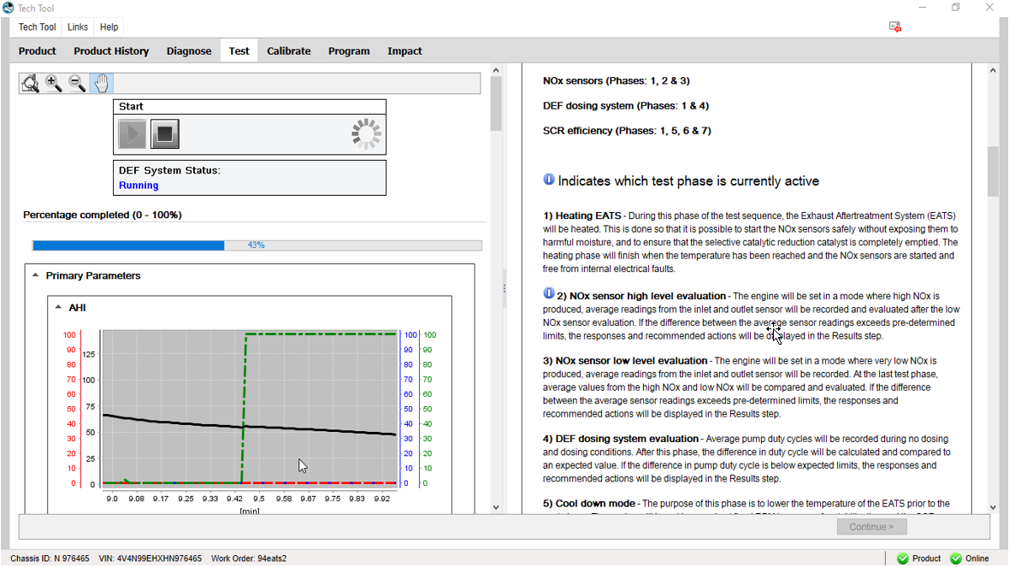
Operations screens – NOx sensor high level evaluation
See page 13 for details on this phase

Slide 12
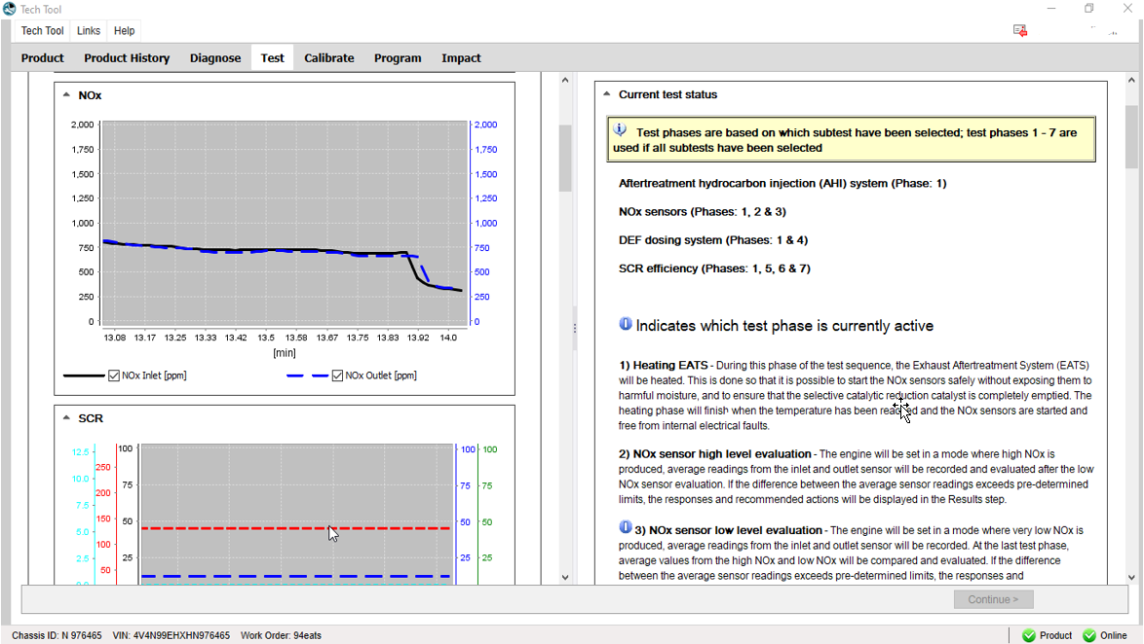
Operations screens – NOx sensor low level evaluation
See page 13 for details and recommendations on the NOx sensor high and low level evaluation phases

Slide 13
Operation information – NOx sensor high level and Nox sensor low level phases:
After conditions are satisfied for the warmup state, the routine enters the NOx sensor high and low evaluation phases. This phase replaces the current NOCO test. These steps serve several purposes:
Test conditions:
NOx sensor high evaluation -
Engine rpm will drop to 1050 (for 11 L), or 1100 (for 13L)
VGT position will be 10% (for 11L), or 7% (for 13L)
Injection timing will be 5° BTDC (both 11 and 13L)
Fans will turn on to full-speed / max engagement
Routine will stabilize for 40 seconds and then average NOx sensor reading for 20 seconds before entering NOx low evaluation
NOx sensor low evaluation -
Engine rpm will hold 1050 (for 11 L), or 1100 (for 13L)
VGT position will be 25% for both 11 and 13L
Injection timing will drop to 0° (TDC) (both 11 and 13L)
Fans will remain on full-speed / max engagement
Routine will stabilize for 40 seconds and then average for 20 seconds
IMPORTANT NOTE: in the rare case that there are enough crystals in the urea injection pipe to sublimate during the warmup – NOx outlet will read significantly lower than NOx inlet during the last part of the Heating EATS phase, typically when the DPF temp (T3) is above ~626 °F (~330 °C); as T3 drops, which should occur during NOx sensor high and low evaluations, NOx outlet may rise as less sublimation occurs. This could cause the routine to abort immediately after the Heating EATS phase, or cause the NOx sensor evaluation to fail – if this is suspected, a crystal sublimation should remedy the problem.
Limits & Purpose:
NOx sensor high phase - the max allowable difference between NOx inlet and outlet is 100 ppm
NOx sensor low phase - the max allowable difference between NOx inlet and outlet is 50 ppm
The primary purpose for the NOx high and low phase evaluation is to verify the plausibility of the sensors at two points in the measurement range where the readings should be within the manufacturers specified accuracy – with the SCR buffer cleared, the readings should be within the “allowable difference” tolerance and the NOx level is not expected to exceed the Max / Min limits.

Slide 14
Operation information – DEF dosing system evaluation:
After conditions are satisfied for the NOx high and low steps, the routine enters the DEF dosing system check:
Test conditions:
Engine rpm will drop to 1000 rpm (11 & 13L)
VGT position will ~10% for both 11 & 13L
Injection timing will be 20° BTDC (both 13 and 11L)
This step lasts ~30 seconds, during which it will evaluate average urea pump DC during “no dosing” state at 900 kPa pressure (131 psi), it will then command .8 g/s urea flow (urea dosing valve duty cycle ~41%) for 10 seconds, and evaluate the change in pump duty cycle to maintain pressure.
Limits & Purpose:
The allowable change in urea pump duty cycle at .8 g/s commanded flow is 8-12% (averaged over 10 seconds)
This range allowance, while appearing narrow is actually quite wide, based on test data, typical pump DC change is ~9-10%
The primary purpose for the urea dosing system check is to verify urea flow prior to evaluation of the SCR efficiency. While this test can be performed separately, and has the advantage over the flow test in that there is no dis-assembly – for some cases it may be good practice to also perform the standard dosing valve test, especially in any case when SCR replacement is considered. This would allow for visual inspection of the urea injection pipe for excessive crystal buildup. In any cases where excessive crystal buildup is observed, it may be advisable to perform a crystal sublimation and then re-run the operation.
Operation information – Cool down mode:
After conditions are satisfied for the UDS check, the routine enters the Cooling step:
Test conditions:
Engine rpm 1600 rpm (11 & 13L)
VGT position and injection timing will vary (not fixed)
Step time is currently set to 30 seconds
Limits & Purpose:
No established limits during this phase
The primary purpose for the cooling phase is to bring exhaust / SCR temperatures lower in order to expedite the stabilization step, although seemingly counter-intuitive, the target SCR temperature for the stabilization and SCR efficiency low evaluation steps is relatively low (270±5 °C, or 518±9 °F) , compared to the temperature targets reached during warmup step, and the SCR temperature reacts significantly slower than the other temperatures, and is usually elevated well above the target temperature for SCR evaluation from the previous steps.

Slide 15
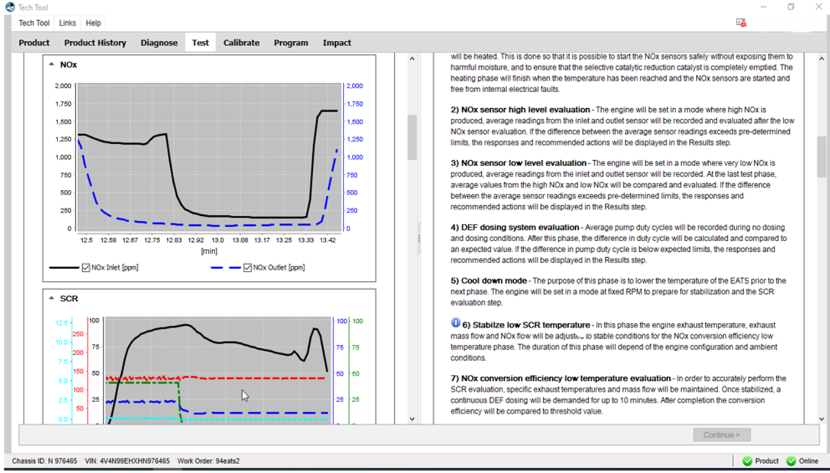
Operations screens – Stabilize low SCR temperature phase
See page 17 for details on this phase

Slide 16
Operation information – Stabilize low SCR temperature:
After the cooling step, the routine enters the Stabilize low SCR temp step:
Test conditions:
Engine rpm will decrease to 1550 rpm (11 & 13L)
VGT position will start at 18% for both 11 & 13L
Intake Throttle Valve position will close from 87% to 20%
After ~5 seconds, Injection timing will retard from 20° BTDC to control NOx flow at .40 ±.01 g/s (.052 to .054 lb/min)
After ~1 minute, the routine will evaluate the exhaust temperature and exhaust mass flow – routine will adjust the VGT to raise or lower the exhaust temperature between 270 - 280 °C (518 - 536 °F) and RPM may be increased or decreased in 30 rpm intervals if required to maintain exhaust mass flow between .21 to .26 kg/s (27.8 to 34.4 lb/min)
After the target exhaust mass flow and engine temperatures are reached, the routine will wait until the SCR average temperature falls within range 265 - 275 °C (509 - 527 °F) for 30 seconds to begin the SCR efficiency low step
Additional condition for exiting stabilize low is the difference between NOx inlet and outlet doesn’t exceed 150 ppm (this is to ensure any SCR buffer accumulated during the UDS check is clear)
Routine will timeout if target temperatures and exhaust flow are not met within 1800 seconds.
Limits & Purpose:
Allowable rpm change over the stabilization period is 150 rpm
Allowable VGT change is 10% from the start position
The purpose of the stabilization step is to stabilize the SCR temperature, exhaust mass flow and NOx flow to begin the SCR efficiency evaluation. In the rare case that conditions are not met before the 1800 second timeout period, consider contacting technical support to evaluate possible causes.
Also note that both the NOx flow and Exhaust mass flow are recorded in the csv file and displayed in the results of the test – these are not displayed during the test.
See page 19 for the results pages in PTT

Slide 17
Operation information – NOx conversion efficiency low temperature evaluation:
After the stabilize low SCR temperature conditions are satisfied, the routine enters the NOx conversion efficiency low temperature evaluation:
Test conditions:
Maintain SCR temperature between 265 - 275 °C (509 - 527 °F)
Maintain exhaust mass flow between 27.8 – 34.4 lb/min (.21 - .26 kg/s)
Maintain NOx flow between .052 - .054 lb/min (.39 - .41 g/s)
Begin urea dosing at .8 g/s
Purpose:
The purpose for SCR efficiency evaluation is to evaluate SCR performance, and assist in determination of whether the SCR is failed or still serviceable.
LIMITS:
SCR efficiency that meets or exceeds 85% within the first 5 minutes of evaluation can be considered a “pass” and test should stop
SCR efficiency that does not exceed 85% within 5 minutes of evaluation will continue dosing for 5 more minutes, if SCR efficiency fails to reach 77% after 10 minutes – it will be recorded as a failed SCR, in cases where the efficiency is borderline (within 3-4% above or below the limit) consult the notes below and if there are extenuating circumstances, consult technical support.
NOTE 1: There are some cases of aged SCRs that will finish the evaluation step a few percent below the failure limit after 10 minutes of evaluation, but may not warrant SCR replacement, these should be handled on a case-by-case basis. Cases when SCR evaluation is border line or slightly below the limit, but replacement may not be necessary are vehicles that don’t show frequent SCR related faults and may operate in extreme enough conditions to allow average exhaust temperatures greater than 300 °C (572 °F).
NOTE 2: Conversely, there may be cases when the vehicle has a history of SCR related faults (P20EE), but the results of the operation show a “passing” status – this could result from circumstances in which the on-board diagnostic occurs during lower temperature operation than the conditions set during the TT operation, such as a lot of transient or light-load operation.
NOTE 3: In all cases where the SCR shows efficiency at or below the passing limit, the following checks should always be done prior to SCR replacement:
Check DEF quality with refractometer and test strips, and perform visual inspection of the tank for any contaminants
Inspect SCR inlet for excessive crystal buildup, also inspect the SCR inlet for any indications of contaminants – e.g. – oil in exhaust from component failure upstream

Slide 18
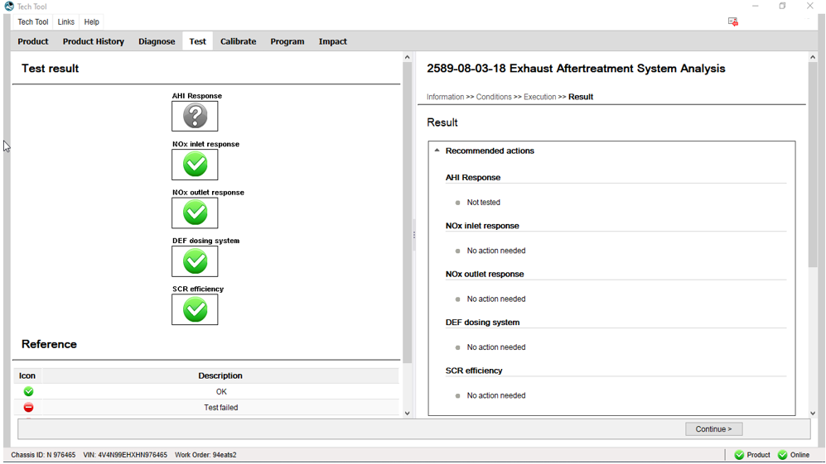
Operations screens – Post-test results screens w/ recommend actions
The “Not tested” response is the result of un-checking the AHI subtest

Slide 19
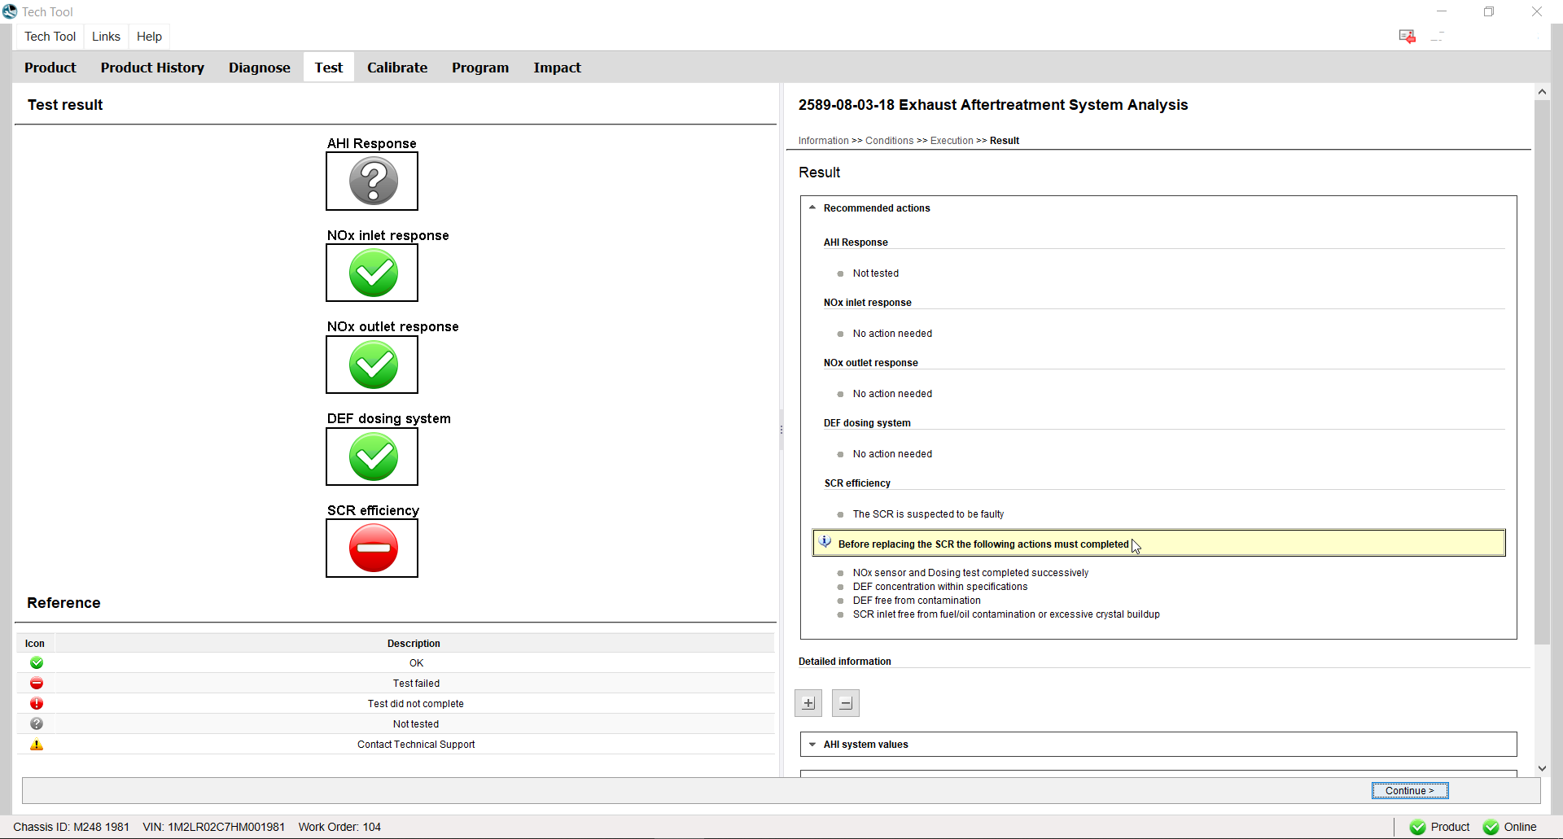
Operations screens – Post-test results screens w/ recommend actions
The “Not tested” response is the result of un-checking the AHI subtest, and this screen shows results if the SCR efficiency is below limits, next page shows the sensor values test results

Slide 20
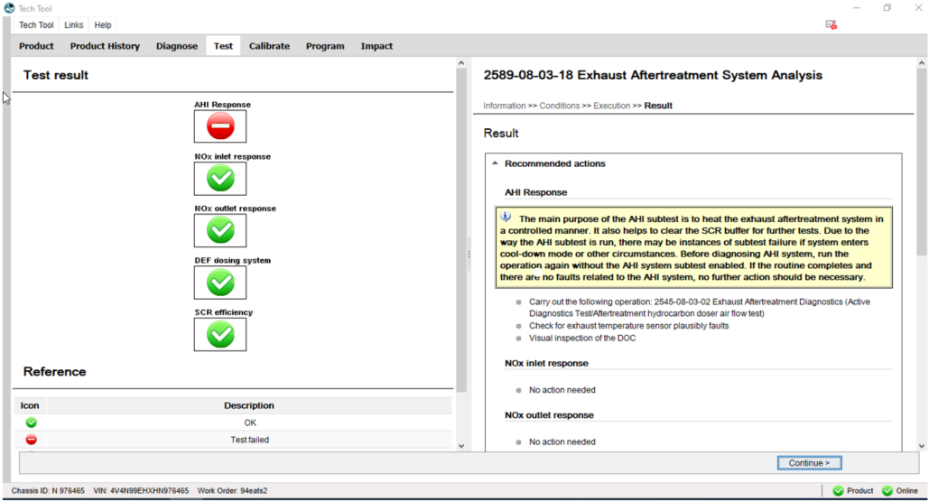
Operations screens – Post-test results screens w/ recommend actions
Typically failure of the AHI subsystem test can be caused if T2 does not reach the specified minimum temperature for each of the 3 steps, see page 7 for the limits, also if the engine out temperature falls below 527 °F after AHI dosing starts. While this can occur during 10-20% of tests, this subtest has the advantage of adding heat to the exhaust system and SCR faster than standard warm-up
Notes:
Not Reliable response from the routine, the AHI subtest is not stable. Sometimes it passes and sometimes it fails.

Slide 21
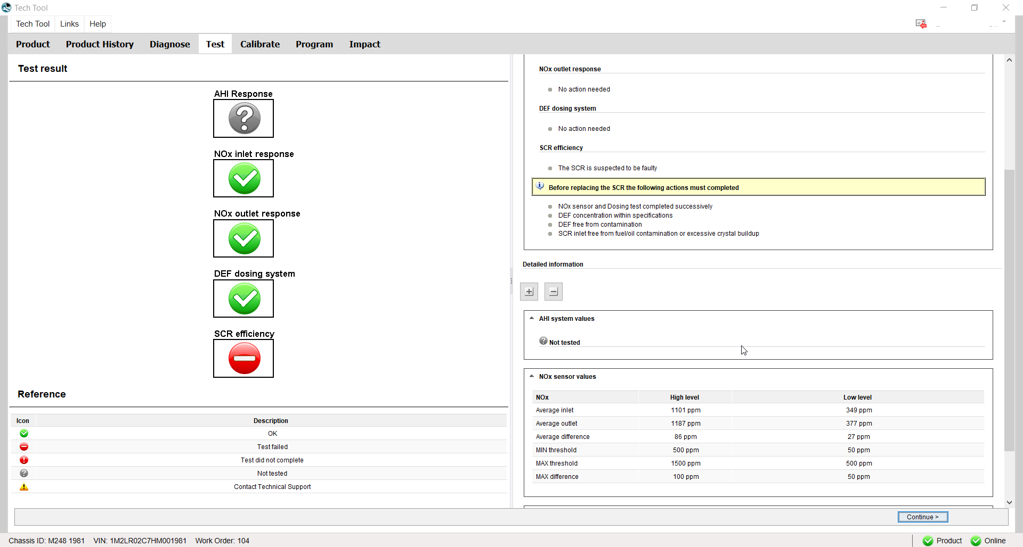
Operations screens – Post-test results screens w/ sensor values
NOx sensor evaluation results – shows both High and Low phases w/ the difference and average value

Slide 22
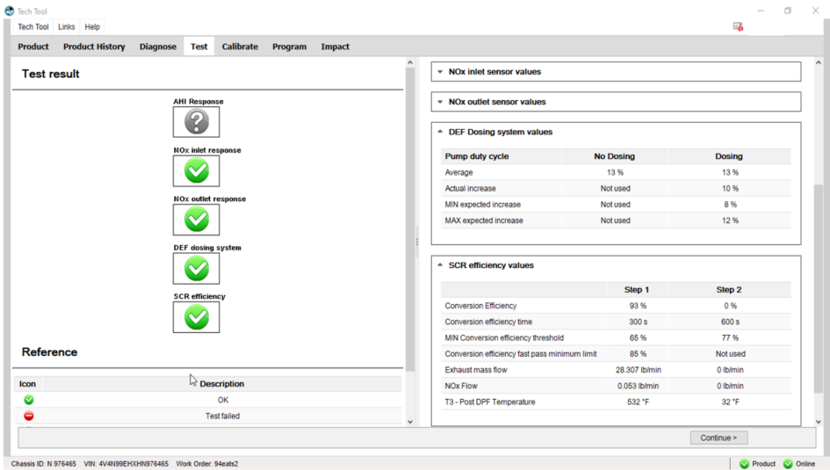
Operations screens – Post-test results screens w/ sensor values
DEF Dosing system and SCR evaluation phases – Step 2 conversion efficiency not shown because the “fast pass” limit is 85%, when conversion efficiency reaches or exceeds 85% in first 5 minutes, test passes and stops

Slide 23
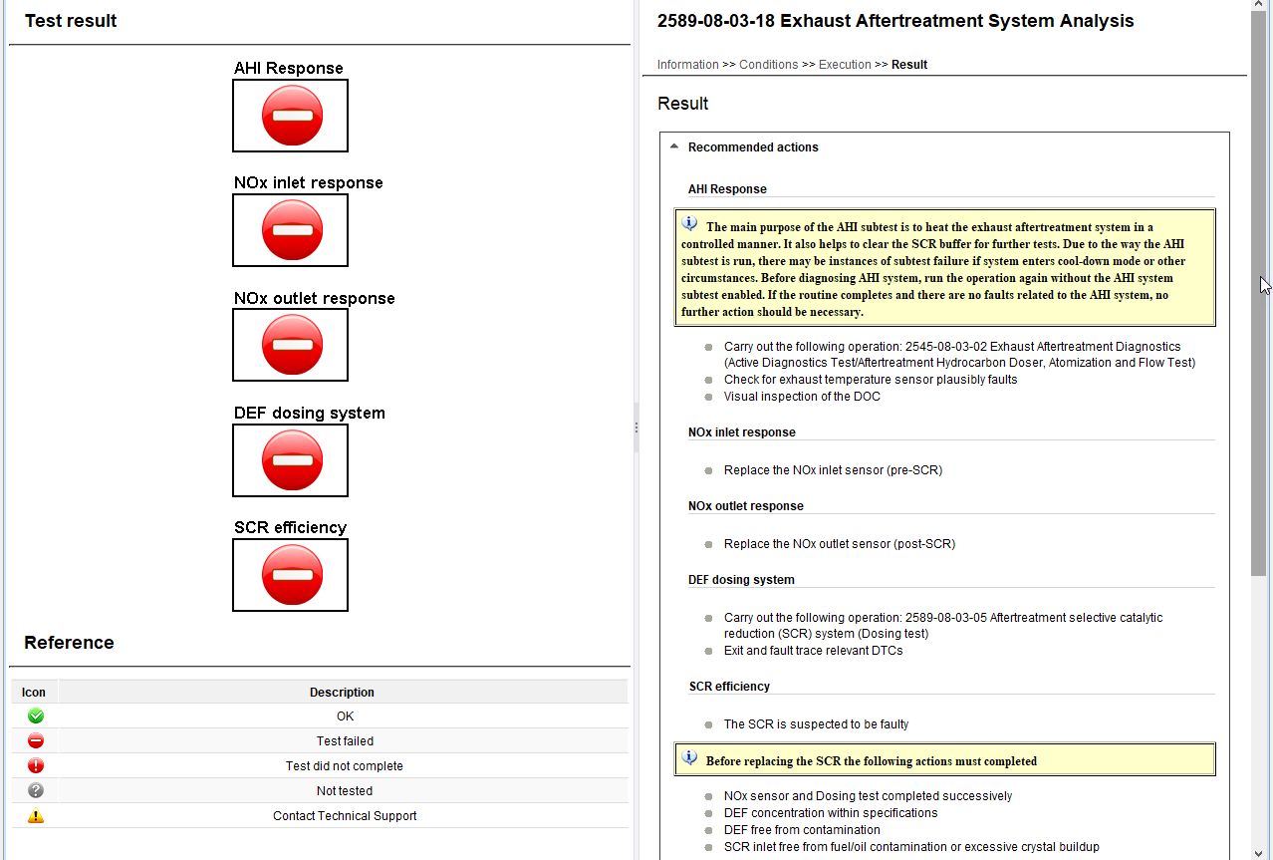
Recommended Actions screens - samples
Notes:
Simulation of all subtest with “Not Reliable” response

Slide 24
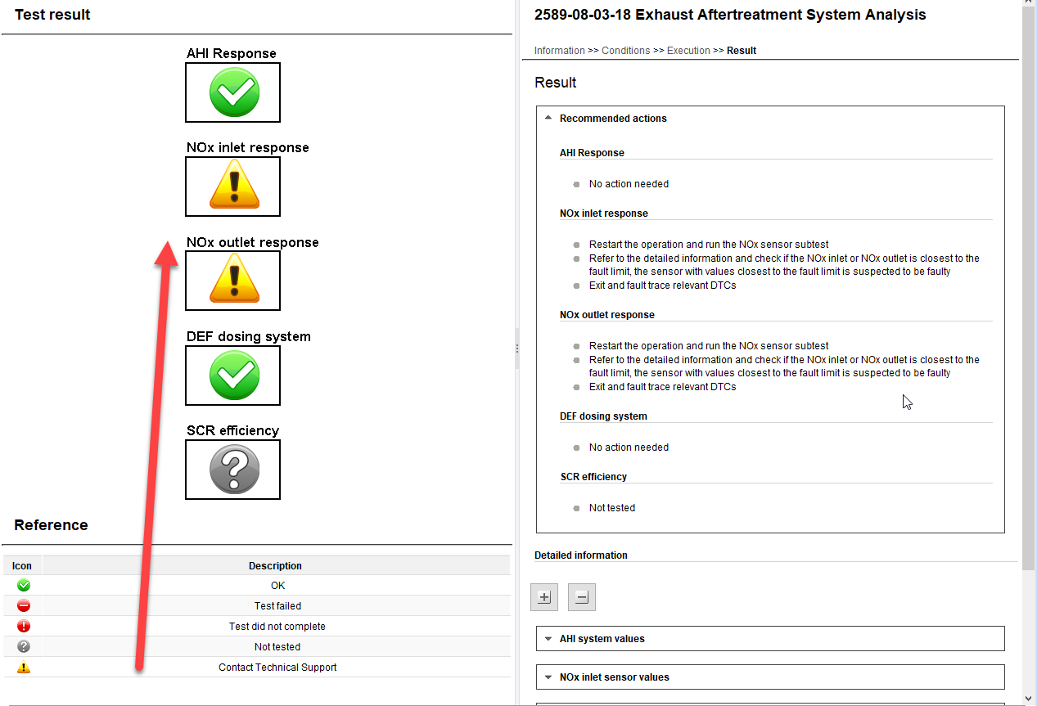
Recommended Actions screens - samples
This shows the rare scenario when one or both sensors fail to reach a minimum value and also exceeds the allowable difference between the sensors, in this case it is advisable to review the data in the .csv file
Notes:
Simulation of the Unknown response from both NOx sensors. The decision from the global Red Card team was to use this icon. Contact Tech Support for further instructions.

Slide 25
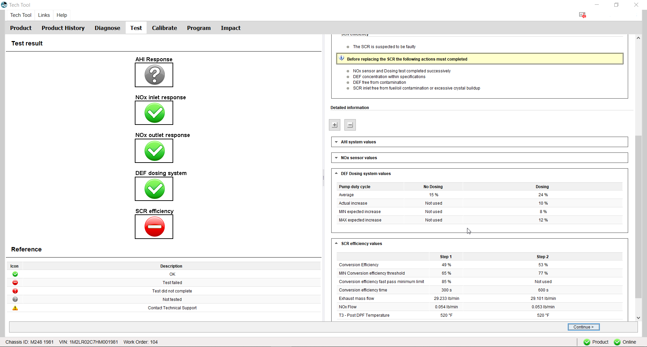
Operations screens – Post-test results screens w/ sensor values
DEF Dosing system and SCR evaluation phases – Step 2 conversion efficiency failed to reach efficiency limits in both steps of SCR evaluation.

