Slide 1
CUBENTS
Comprehensive Utility Board for EquatioN Text and Shapes
Under the Guidance of Mr. Avinash Awate and Mr. Rajnikanth Jangir

Slide 2
Group Members
ABHIJIT ROY (IIT Patna)
AKASH SINGH (NIT Warangal)
ANKUR SINGH (IFHE)
SURBHI INANI (Carnegie Mellon University)
ARUN NAINWAL (NIT Silchar)
RUCHITA PARMAR (Mumbai University)
BHAGYASHREE RAWAL (SCET)

Slide 3
Topics to be covered
OBJECTIVES
METRICS
FEATURES
DEMONSTRATION
CHALLENGES & LEARNINGS
FUTURE SCOPE

Slide 4
Objectives
To make an all purpose utility board where
Teachers can create educational content from textbooks
Students can view the content
To make the application user-friendly

Slide 5
METRICS
AREA | NUMBER OF LINES
EDITOR VIEW: FRONT END | 4270
LEARNER VIEW: FRONT END | 1760
BACKEND | 2292
TOTAL CODE LINES | 6344
SERVELETS USED | 3

Slide 6
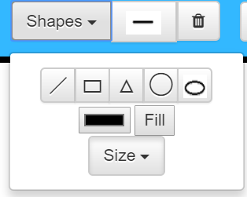
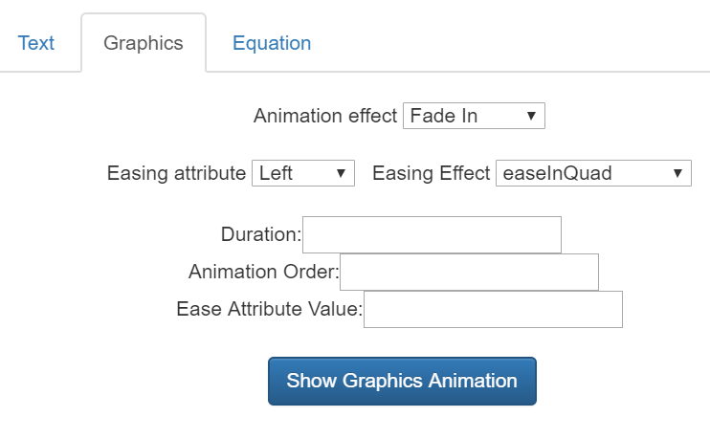
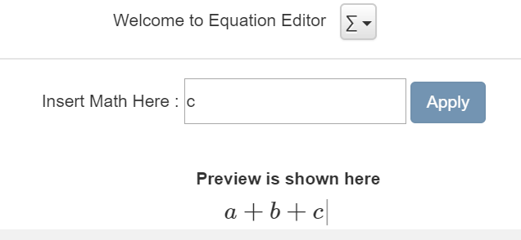
Features
Consists of three layers: text, equations and graphics
Inbuilt equation parser makes typing equations extremely easy
Colour, shape, size of elements can be modified
Animation effects can be given to elements
Hints can be associated with elements
Created content can be stored and played on the Viewer side

Slide 7
Demonstration
Video prepared about making a tutorial in CUBENTS
Live Tutorials on other topics being played

Slide 8
Challenges & Learnings
FRONT END
HTML, JavaScript, CSS
JavaScript Libraries
Fabric.js
CKEditor
MathJax
BACK END
MySQL
Java
AJAX
JSP
JDBC
Building the Equation Parser and making it user-friendly
Integrating the Graphics, Equations and Text into one Web Application

Slide 9
Future scope
Additional layer for graphs and charts
Timed quizzes and assessment mechanism
User registration and login system
Method to support other types of inputs like ASCIIML, L ATEX
Mechanism to embed CUBENTS in any web page or application
Mechanism to use CUBENTS as a browser plugin

Slide 10
THANK YOU

