Slide 1
Improvement of Operations in Healthcare using AI/ML
Ankur Arya
Senior Data Scientist
Memorial Sloan Kettering Cancer Center, NY

Slide 2
Outline
Healthcare Operations
AI/ML Solutions
Case Study
Real World Challenges

Slide 3












Improvement using AI/ML Solutions
Data Collection
Data Storage
System Availability
Analysis
AI/ML Models
Inference
Insights
Process
Change
Improved Patient
Outcome
Better Patient
Satisfaction
HealthCare
Operations

Slide 4








Operation Challenges: Waiting Times
Lobby
Staff
Treatment
Arrival
Queue
Labs
Pharmacy
Bed

Slide 5



HealthCare Operation : An Example
Inpatient Hospital
Admission
Discharge
Arrival
Services
Departure

Slide 6



Discharge Process
Equipment
Patient
Discharge
Inpatient
Rounding
Discharge
Order
Discharge
Activities
Pharmacy
Bed
Clean Up
Transport

Slide 7

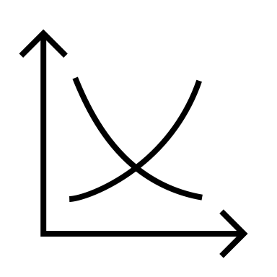
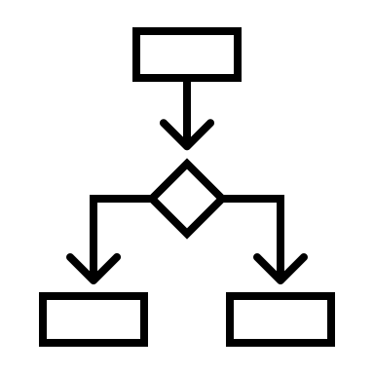



Improving Discharge Process using AI/ML
Process
Mapping
Inference,
Sensitivity Analysis
Actionable
Insights
Data
AI/ML Model
Feasibility

Slide 8
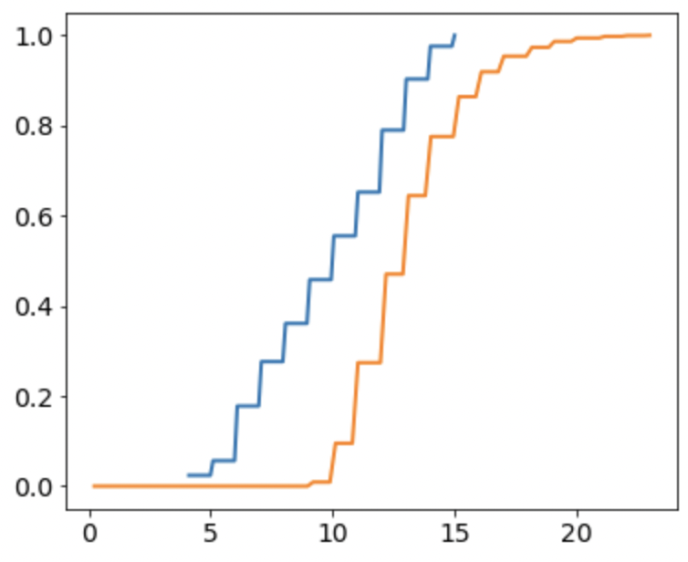
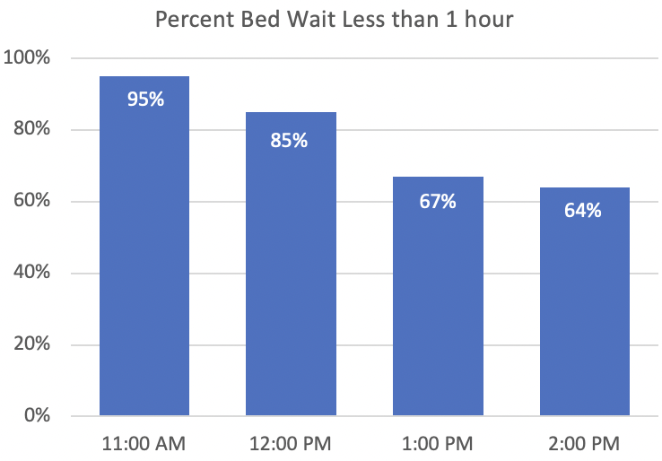
Synthetic Dataset
Early
Discharge
Late
Discharge
Cumulative Probability Density
% Patients with Bed Wait < 1 hour
Admission
Discharge
Hour of the Day
Avg Discharge Time Upper Limit

Slide 9
AI Model
Fully Connected Neural Network
Hidden Layers
Neurons in Hidden Layer: 20
Num of Hidden Layers: 5
Hidden Activation: relu
Hidden Initializer: Xavier Uniform
Output Activation: sigmoid
Loss Function: Binary Cross Entropy
Optimizer: SGD
Batch Size: 8
output y₀
x₀
1
x₁
y₀
Inputs
0.5
x₂
0
weighted mean of
last hidden layer
Given set of inputs X, the model predicts if the discharge is Early (before 1pm) or Late (after 1pm)

Slide 10
Discharge Process Revisit
Equipment
Patient
Discharge
Inpatient
Rounding
Discharge
Order
Discharge
Activities
Pharmacy
Bed
Clean Up
Transport

Slide 11
Model Inputs
Category | Variables
Workload | Number of Discharges
Staff Count | Number of MDs, APPs, Nurses, Other Staffs
Types of Cases | Number of Case Managements, Equipment, Transport, Pharmacy
Rounding | Rounding Start Time

Slide 12
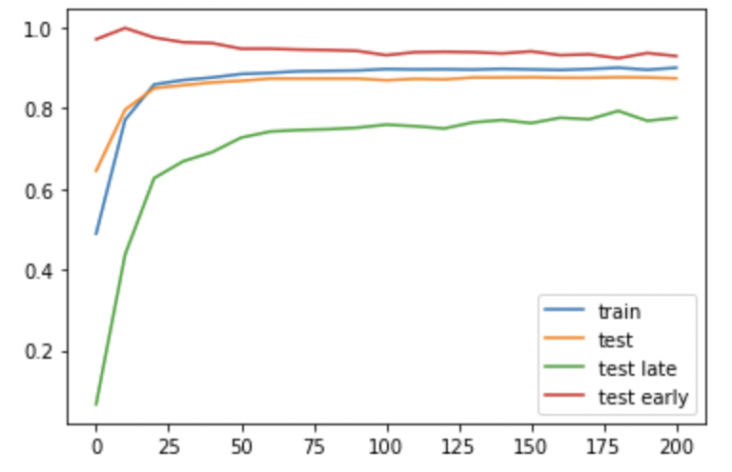
Model Training and Evaluation
Epochs = 200
Input Features | Training Accuracy | Test Accuracy
 | Overall | Overall | Early Discharge | Late Discharge
number of discharges, staff | 90% | 87% | 93% | 78%
Accuracy
Training Epochs

Slide 13
Model Training and Evaluation
Epochs = 200
Input Features | Training Accuracy | Test Accuracy
 | Overall | Overall | Early Discharge | Late Discharge
number of discharges, staff | 90% | 87% | 93% | 78%
+ case manage, equipment, transport cases | 91% (+1%) | 88% (+1%) | 92% (-1%) | 80% (+2%)

Slide 14
Model Training and Evaluation
Epochs = 200
Input Features | Training Accuracy | Test Accuracy
 | Overall | Overall | Early Discharge | Late Discharge
number of discharges, staff | 90% | 87% | 93% | 78%
+ case manage, equipment, transport cases | 91% | 88% | 92% | 80%
+ rounding start time | 95% (+4%) | 90% (+2%) | 94% (+2%) | 84% (+4%)

Slide 15
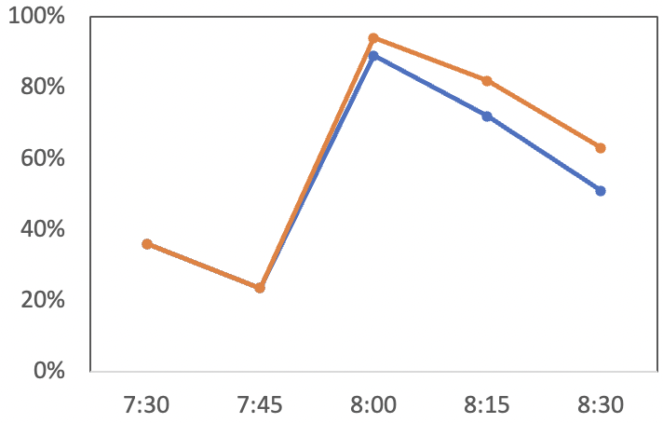
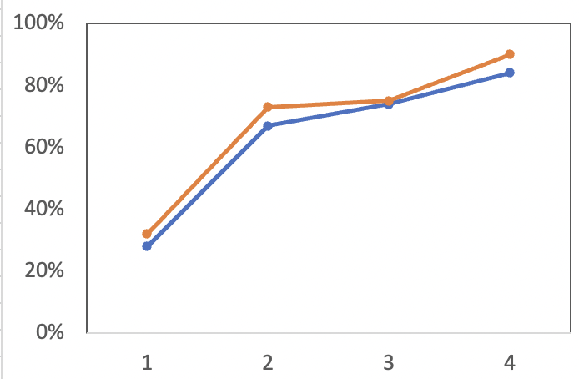
Actionable Insights
Data (Test)
Model Prediction
Data (Test)
Model Prediction
% Early Discharges
% Early Discharges
Round Start Time
Number of Discharge MDs

Slide 16
Real World Operation Challenges
Data Collection
Data Accuracy
Complex Interactions
Immeasurable Dependencies
Uncontrollable Measurements
Explainability
Change Adoption

Slide 17
Thank You! Questions ?
source code: https://github.com/ankur-arya

