Slide 1

NAME – ANKUR MISHRA
REPRESENTATED TO – NOVEXA TECHNOLOGIES

Slide 2

Customer Shopping Behavior Analysis
Uncovering insights from 3,900 purchases to guide strategic business decisions

Slide 3

Dataset Overview
3,900
18
37
Total Purchases
Data Columns
Missing Values
Comprehensive transaction data
Customer demographics & behavior
Only in Review Rating column

Slide 4
Data Preparation Process
01
02
03
Data Loading
Initial Exploration
Missing Data Handling
Imported dataset using pandas
Structure check and summary statistics
Imputed Review Rating with median values
04
05
Feature Engineering
Database Integration
Created age groups and purchase frequency
Connected to PostgreSQL for analysis

Slide 5
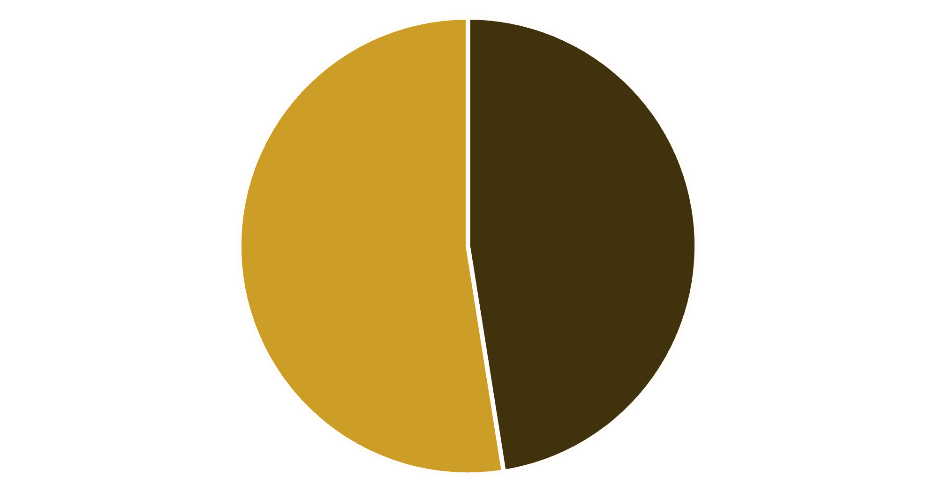

Revenue by Gender Analysis
Key Insight
Female customers generate slightly higher total revenue than male customers
Gender-based marketing strategies could optimize revenue streams
Male
Female

Slide 6

High-Value Discount Users
Customers using discounts while spending above average
Smart Shoppers
High spenders who maximize value with discounts
Strategic Opportunity
Target premium customers with exclusive offers

Slide 7



Top-Rated Products
5
5
4
Blouse
Dress
Shirt
Highest customer satisfaction
Consistently excellent reviews
Strong customer approval

Slide 8

Shipping Preferences Impact
Express Shipping
Standard Shipping
$65
$58
Average purchase amount
Average purchase amount
Express shipping customers spend 12% more per transaction

Slide 9
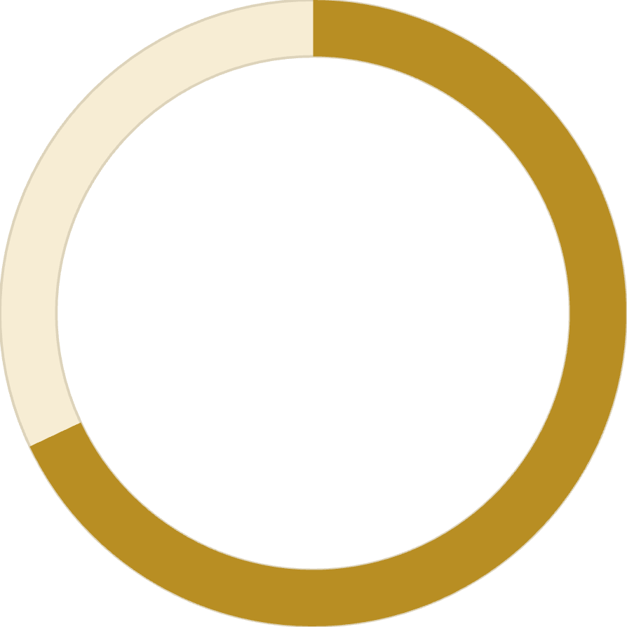
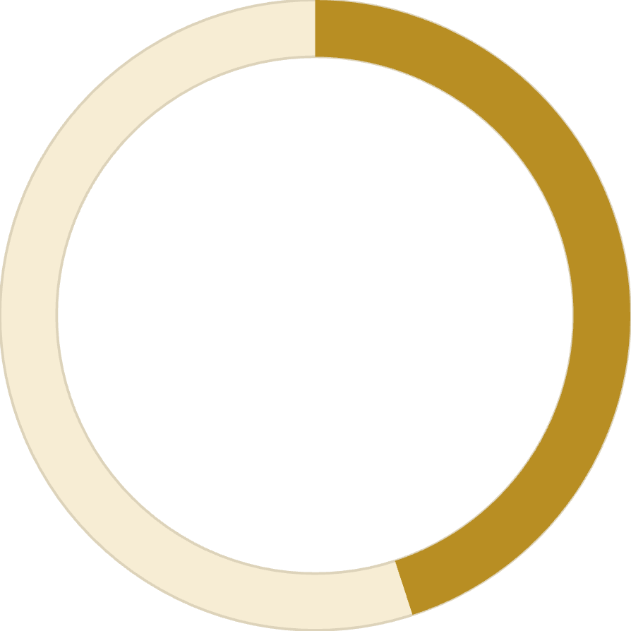
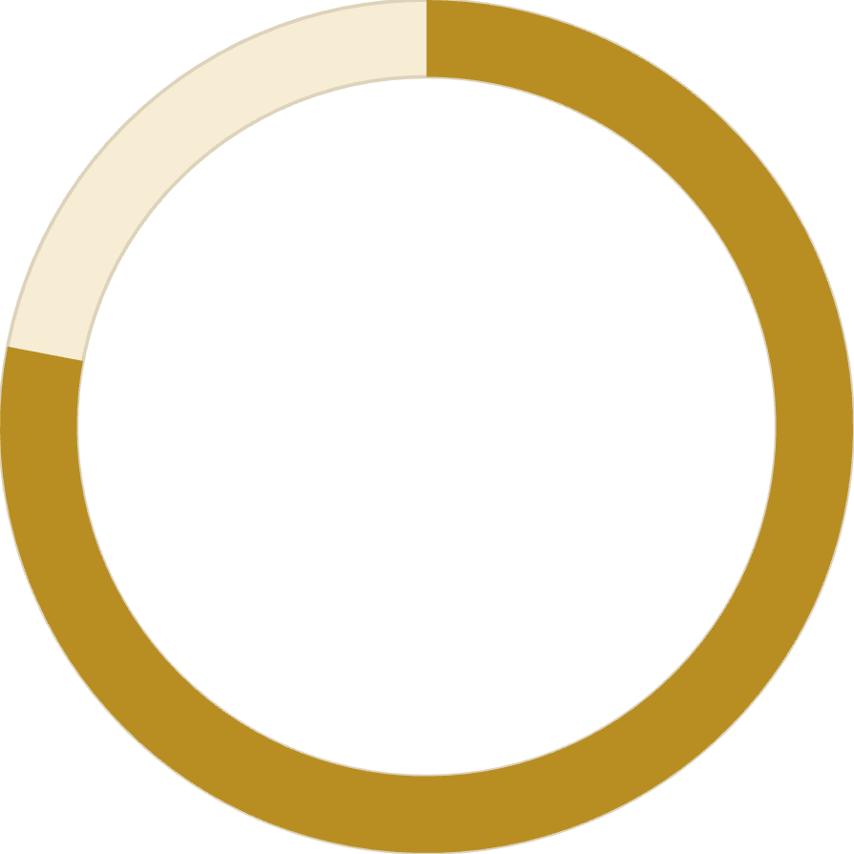
Subscription Impact
68%
45%
78%
Higher Spend
Revenue Share
Loyalty Rate
Subscribers vs non-subscribers
From subscription customers
Repeat purchase frequency

Slide 10



Customer Segmentation
Loyal
1
15% - High value customers
Returning
2
35% - Regular shoppers
New
3
50% - First-time buyers
Focus on converting New to Returning, Returning to Loyal

Slide 11





Strategic Recommendations
Boost Subscriptions
Promote exclusive benefits for subscribers
Loyalty Programs
Reward repeat buyers to increase retention
Targeted Marketing
Focus on high-revenue segments and express users
Product Positioning
Highlight top-rated products in campaigns

