Slide 1
Computer Organization
CSEN2203

Slide 2
Module I
Basics of Computer Organization:
Basic organization of the stored program computer and operation sequence for execution of a program
Von Neumann & Harvard Architecture.
RISC vs. CISC based architecture.
Fetch, decode and execute cycle,
Concept of registers and storage,
Instruction format,
Instruction sets
addressing modes.

Slide 3
Computer Organization and Architecture
Introduction
Computer technology has made incredible improvement in the past half century. In the early part of computer evolution, there were no stored-program computer, the computational power was less and on the top of it the size of the computer was a very huge one.
Today, a personal computer has more computational power, more main memory, more disk storage, smaller in size and it is available in affordable cost.
This rapid rate of improvement has come both from advances in the technology used to build computers and from innovation in computer design.
In this course we will mainly deal with the innovation in computer design.

Slide 4
Computer architecture
Computer architecture refers to those parameters of a computer system that are visible to a programmer or those parameters that have a direct impact on the logical execution of a program.
Examples of architectural attributes include the
instruction sets
the number of bits used to represent different data types
I/O mechanisms
techniques for addressing memory.

Slide 5
Computer organization
Computer organization refers to the operational units and their interconnections that realize the architectural specifications.
Examples of organizational attributes include those hardware details transparent to the programmer, such as
control signals,
interfaces between the computer and peripherals, and the memory technology used.

Slide 6
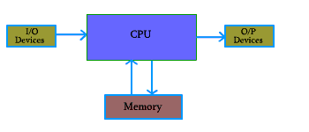
Figure 1.1: Basic Unit of a Computer
Central Processor Unit
Input Unit
Output Unit
Memory Unit

Slide 7
Central Processor Unit (CPU) :
Central processor unit consists of two basic blocks :
The program control unit has a set of registers and control circuit to generate control signals.
The execution unit or data processing unit contains a set of registers for storing data and an Arithmetic and Logic Unit (ALU) for execution of arithmetic and logical operations.
In addition, CPU may have some additional registers for temporary storage of data.

Slide 8
Input Unit
With the help of input unit data from outside can be supplied to the computer.
Program or data is read into main storage from input device or secondary storage under the control of CPU input instruction.
Example of input devices:
Keyboard, Mouse, Hard disk, Floppy disk, CD-ROM drive etc.

Slide 9
Output Unit
With the help of output unit computer results can be provided to the user or it can be stored in storage device permanently for future use. Output data from main storage go to output device under the control of CPU output instructions.
Example of output devices:
Printer, Monitor, Plotter, Hard Disk, Floppy Disk etc.

Slide 10
Memory Unit
Memory unit is used to store the data and program. CPU can work with the information stored in memory unit. This memory unit is termed as primary memory or main memory module. These are basically semi conductor memories.
There ate two types of semiconductor memories -
Volatile Memory : RAM (Random Access Memory).
Non-Volatile Memory :
ROM (Read only Memory), PROM (Programmable ROM) EPROM (Erasable PROM), EEPROM (Electrically Erasable PROM).

Slide 11
Secondary Memory
Secondary memories are non volatile memory and it is used for permanent storage of data and program.
Example of secondary memories
Hard Disk, Floppy Disk, Magnetic Tape :magnetic devices
CD-ROM: optical device
Thumb drive (or pen drive):semiconductor memory

Slide 12
Basic Working Principle of a Computer
Before going into the details of working principle of a computer, we will analyse how computers work with the help of a small hypothetical computer.
In this small computer, we do not consider about Input and Output unit. We will consider only CPU and memory module. Assume that somehow we have stored the program and data into main memory. We will see how CPU can perform the job depending on the program stored in main memory

Slide 13
Arithmetic and Logic Unit (ALU) of Central Processing Unit
Consider an ALU which can perform four arithmetic operations and four logical operations To distingish between arithmetic and logical operation, we may use a signal line,
0 - signal, represents an arithmetic operation a
1 - signal, represents a logical operation.
In the similar manner, we need another two signal lines to distinguish between four arithmetic operations and four logic operations.

Slide 14
Operational Table
The different operations and their binary code is as follows:
Consider the part of control unit, its task is to generate the appropriate signal at right moment.
Arithmatic | operations | Logical | operations
000 | ADD | 100 | OR
001 | SUB | 101 | AND
010 | MULT | 110 | NAND
011 | DIV | 111 | NOR

Slide 15
Arithmetic and Logic Unit (ALU)
There is an instruction decoder in CPU which decodes this information in such a way that computer can perform the desired task
The simple model for the decoder may be considered that there is three input lines to the decoder and correspondingly it generates eight output lines. Depending on input combination only one of the output signals will be generated and it is used to indicate the corresponding operation of ALU.

Slide 16
Storage units
In our simple model, we use three storage units in CPU, Two -- for storing the operands and one -- for storing the results. These storage units are known as register.
But in computer, we need more storage space for proper functioning of the Computer.
Some of them are inside CPU, which are known as register. Other bigger chunk of storage space is known as primary memory or main memory. The CPU can work with the information available in main memory only.

Slide 17
Interfacing with the Primary Memory
To access the data from memory, we need two special registers one is known as
Memory Data Register (MDR)
Memory Address Register (MAR).
Data and program is stored in main memory. While executing a program, CPU brings instruction and data from main memory, performs the tasks as per the instruction fetch from the memory. After completion of operation, CPU stores the result back into the memory.

Slide 18
Main Memory Organization
Main memory unit is the storage unit, There are several location for storing information in the main memory module.
The capacity of a memory module is specified by the number of memory location and the information stored in each location.
A memory module of capacity 16 X 4 indicates that, there are 16 location in the memory module and in each location, we can store 4 bits of information.
We have to know how to indicate or point to a specific memory location. This is done by address of the memory location.

Slide 19
Memory operations
We need two operation to work with memory
READ : This operation is to retrieve the data from memory and bring it to CPU register
WRITE: This operation is to store the data to a memory location from CPU register
With the help of one signal line, we can differentiate these two operations. If the content of this signal line is 0, we say that we will do a READ operation; and if it is 1, then it is a WRITE operation.
To transfer the data from CPU to memory module and vice-versa, we need some connection. This is termed as DATA BUS

Slide 20
DATA BUS &ADDRESS BUS.
The size of the data bus indicate how many bit we can transfer at a time. Size of data bus is mainly specified by the data storage capacity of each location of memory module.
We have to resolve the issues how to specify a particular memory location where we want to store our data or from where we want to retrieve the data.
This can be done by the memory address. Each location can be specified with the help of a binary address.
These signal lines use to identify a memory location is termed as ADDRESS BUS.

Slide 21
ADDRESS BUS
Size of address bus depends on the memory size.
For a memory module of capacity of 2^{n} location, we need n address lines, that is, an address bus of size n.
We use a address decoder to decode the address that are present in address bus
As for example, consider a memory module of 16 location and each location can store 4 bit of information.
The size of address bus is 4 bits
size of the data bus is 4 bits
The size of address decoder is 4 X 16.

Slide 22
control signals for read or write
There is a control signal named R/W. If R/W = 0, indicates READ operation
if R/W = 1, indicates WRITE operation
If the contents of address bus is 0101 and contents of data bus is 1100 and R/W = 1, then 1100 will be written in location 5.
If the contents of address bus is 1011 and R/W=0, then the contents of location 1011 will be placed in data bus.

Slide 23
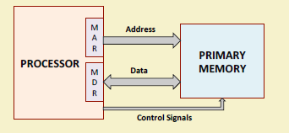
Interfacing with the Primary Memory
To read data from memory
Load the memory address into MAR.
Issue the control signal READ.
The data read from the memory is stored into MDR.
To write data into memory
Load the memory address into MAR.
Load the data to be written into MDR.
Issue the control signal WRITE.

Slide 24
Registers
The memory has 4096 words in it
4096 = 2¹², so it takes 12 bits to select a word in memory
Each word is 16 bits long
Size of MAR=12 bits
Size of MDR=16bits
Two special-purpose registers are used:
Program Counter (PC): Holds the memory address of the next instruction to be executed.
Automatically incremented to point to the next instruction when an instruction is being executed.
Instruction Register (IR): Temporarily holds an instruction that has been fetched from memory.
Need to be decoded to find out the instruction type.
Also contains information about the location of the data.

Slide 25
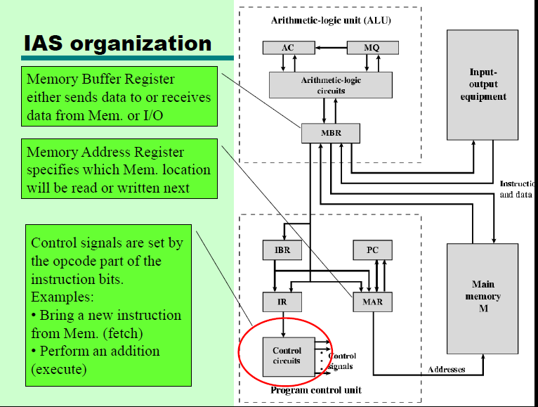

Slide 26
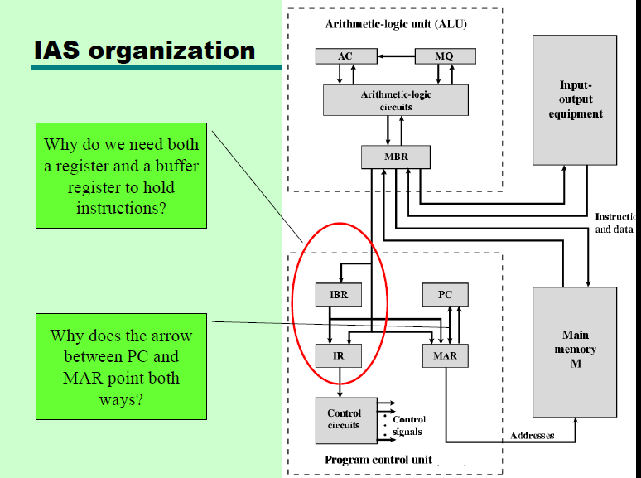

Slide 27
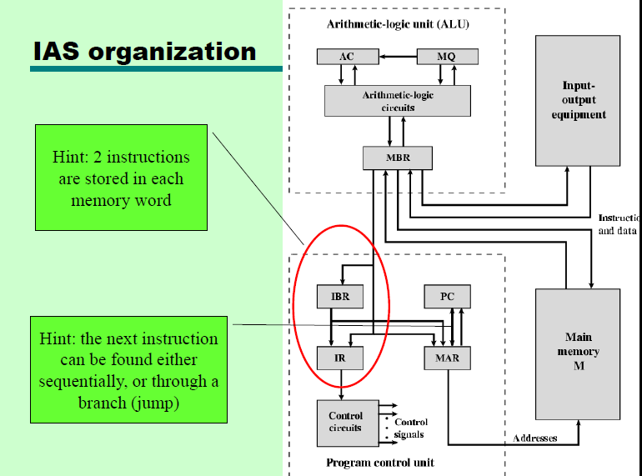

Slide 28
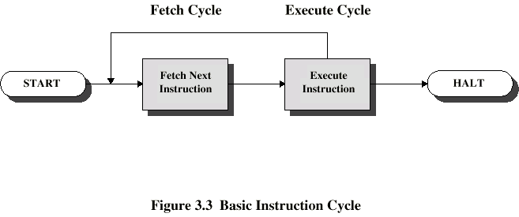
Instruction Cycle
Two steps:
Fetch
Execute
Fetch Cycle
Program Counter (PC) holds address of next instruction to fetch
Processor fetches instruction from memory location pointed to by PC
Increment PC
Unless told otherwise
Instruction loaded into Instruction Register (IR)
Processor interprets instruction and performs required actions

Slide 29
IAS –the FETCH-EXECUTE cycle
Each instruction is executed in the same two-step manner:
FETCH load the binary code of the instr. from Memory (or IBR)
Opcode goes into IR
Address goes into MAR
EXECUTE send appropriate control signals to do what the instr. needs to do

Slide 30
Execute Cycle
Processor-memory
data transfer between CPU and main memory
Processor I/O
Data transfer between CPU and I/O module
Data processing
Some arithmetic or logical operation on data
Control
Alteration of sequence of operations
e.g. jump
Combination of above

Slide 31
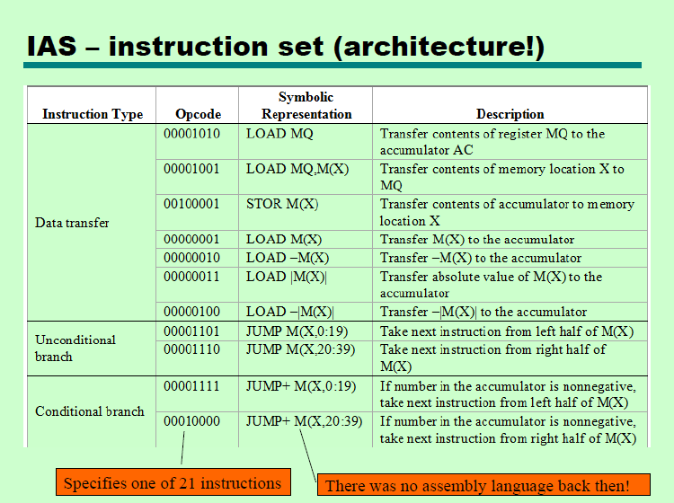

Slide 32
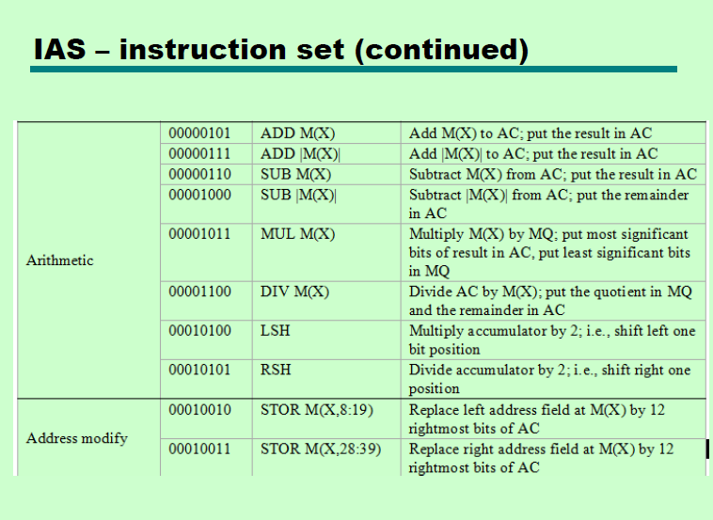

Slide 33
Input Output
Input devices are used to put the information into computer. With the help of input devices we can store information in memory so that CPU can use it. Program or data is read into main memory from input device or secondary storage under the control of CPU input instruction.
Output devices are used to output the information from computer. If some results are evaluated by computer and it is stored in computer, then with the help of output devices, we can present it to the user. Output data from the main memory go to output device under the control of CPU output instruction.

Slide 34
von-Neumann Architecture
Stored Program concept
Main memory storing programs and data
ALU operating on binary data
Control unit interpreting instructions from memory and executing
Input and output equipment operated by control unit
More flexible and easier to implement.
Suitable for most of the general purpose processors.
Disadvantage:
The processor-memory bus acts as the bottleneck.
All instructions and data are moved back and forth through the pipe

Slide 35
von-Neumann Architecture
How can this be reduced?
This performance problem is reduced by using cache memory.(details in memory part)
Using RISC architecture as it uses less number of memory reference instruction and uses large number of registers.

Slide 36
Harvard Architecture
Separate memory for program and data.
Instructions are stored in program memory
Data are stored in data memory.
Instruction and data accesses can be done in parallel.
Some microcontrollers and pipelines with separate instruction and data caches follow this concept.
The processor-memory bottleneck remains.

Slide 37
Instruction Set & Addressing
Various addressing modes
Machine Instruction
Instruction Format

Slide 38
Instructions
Program
A sequence of (machine) instructions
(Machine) Instruction
A group of bits that tell the computer to perform a specific operation (a sequence of micro-operation)
The instructions of a program, along with any needed data are stored in memory
The CPU reads the next instruction from memory
It is placed in an Instruction Register (IR)
Control circuitry in control unit then translates the instruction into the sequence of micro operations necessary to implement it

Slide 39
Instruction Set Architecture (ISA)
Serves as an interface between software and hardware.
Typically consists of information regarding the programmer’s view of the architecture (i.e. the registers, address and data buses, etc.).
Also consists of the instruction set.
Many ISA’s are not specific to a particular computer architecture.
They survive across generations.
Classic examples: IBM 360 series, Intel x86 series, etc.

Slide 40
Instruction Formats
Layout of bits in an instruction
Includes opcode
Includes (implicit or explicit) operand(s)
Usually more than one instruction format in an instruction set

Slide 41
Instruction Length
Affected by and affects:
Memory size
Memory organization
Bus structure
CPU complexity
CPU speed

Slide 42
Instruction Addressing
We have examined the types of operands and operations that may be specified by machine instructions. Now we have to see how is the address of an operand specified, and how are the bits of an instruction organized to define the operand addresses and operation of that instruction.

Slide 43
Addressing Modes:
The most common addressing techniques are:
Immediate
Direct
Indirect
Register
Register Indirect
Displacement
Stack

Slide 44
Addressing Modes:
All computer architectures provide more than one of these addressing modes. The question arises as to how the control unit can determine which addressing mode is being used in a particular instruction. Several approaches are used. Often, different opcodes will use different addressing modes. Also, one or more bits in the instruction format can be used as a mode field. The value of the mode field determines which addressing mode is to be used.
What is the interpretation of effective address. In a system without virtual memory, the effective address will be either a main memory address or a register. In a virtual memory system, the effective address is a virtual address or a register. The actual mapping to a physical address is a function of the paging mechanism and is invisible to the programmer.

Slide 45
Addressing Modes:
To explain the addressing modes, we use the following notation:
A=contents of an address field in the instruction that refers to a memory
R=contents of an address field in the instruction that refers to a register
EA=actual (effective) address of the location containing the referenced operand
(X)=contents of location X

Slide 46

Immediate Addressing:
The simplest form of addressing is immediate addressing, in which the operand is actually present in the instruction:
OPERAND = A
This mode can be used to define and use constants or set initial values of variables.

Slide 47
Immediate Addressing:
The advantage of immediate addressing is that no memory reference other than the instruction fetch is required to obtain the operand.
The disadvantage is that the size of the number is restricted to the size of the address field, which, in most instruction sets, is small compared with the world length.

Slide 48
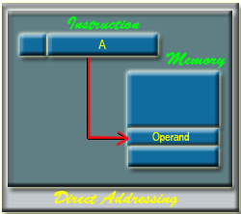
Direct Addressing:
A very simple form of addressing is direct addressing, in which the address field contains the effective address of the operand:
EA = A
It requires only
one memory reference
and no special calculation.
Here, 'A' indicates the memory
address field for the operand.

Slide 49
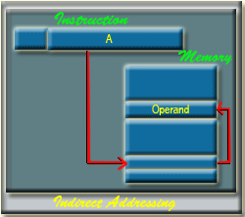
Indirect Addressing:
With direct addressing, the length of the address field is usually less than the word length, thus limiting the address range. One solution is to have the address field refer to the address of a word in memory, which in turn contains a full-length address of the operand. This is know as indirect addressing:
EA = (A)
Here 'A' indicates the memory address field of the required operands.

Slide 50
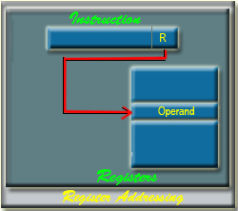
Register Addressing:
Register addressing is similar to direct addressing. The only difference is that the address field referes to a register rather than a main memory address:
EA = R
The advantages of register addressing are that only a small address field is needed in the instruction and no memory reference is required.
The disadvantage of register addressing is that the address space is very limited.
'R' indicates a register where the operand is present.

Slide 51
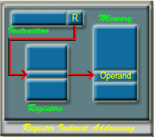
Register Indirect Addressing:
From that memory location, we use to get the data or information. In general, register access is much more faster than the memory access.
Register indirect addressing is similar to indirect addressing, except that the address field refers to a register instead of a memory location. It requires only one memory reference and no special calculation.
EA = (R)
Register indirect addressing uses one less memory reference than indirect addressing. Because, the first information is available in a register which is nothing but a memory address.

Slide 52
Displacement Addressing:
A very powerful mode of addressing combines the capabilities of direct addressing and register indirect addressing, which is broadly categorized as displacement addressing:
EA = A + (R)
Displacement addressing requires that the instruction have two address fields, at least one of which is explicit. The value contained in one address field (value = A) is used directly.
The other address field, or an implicit reference based on opcode, refers to a register whose contents are added to A to produce the effective address.

Slide 53
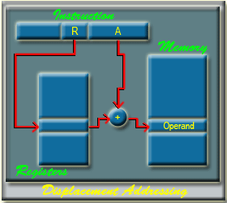
Displacement Addressing:
Three of the most common use of displacement addressing are:
Relative addressing
Base-register addressing
Indexing

Slide 54
Displacement Addressing:
Relative Addressing:
It implicitly referenced register is the program counter (PC).
That is, the current instruction address is added to the address field to produce the EA.
Thus, the effective address is a displacement relative to the address of the instruction.
Base-Register Addressing:
The reference register contains a memory address, and the address field contains a displacement from that address. The register reference may be explicit or implicit.
In some implementation, a single segment/base register is employed and is used implicitly. In others, the programmer may choose a register to hold the base address of a segment, and the instruction must reference it explicitly.

Slide 55
Indexing:
The address field references a main memory address, and the reference register contains a positive displacement from that address. In this case also the register reference is sometimes explicit and sometimes implicit.
Generally index register are used for iterative tasks, it is typical that there is a need to increment or decrement the index register after each reference to it. Because this is such a common operation, some system will automatically do this as part of the same instruction cycle.

Slide 56
This is known as auto-indexing. We may get two types of auto-indexing: -- auto-incrementing -- auto-decrementing.
If certain registers are devoted exclusively to indexing, then auto-indexing can be invoked implicitly and automatically.
If general purpose register are used, the auto index operation may need to be signaled by a bit in the instruction.

Slide 57
Auto-indexing using increment can be depicted as follows: EA = (R) R = (R) + 1
Auto-indexing using decrement can be depicted as follows:
R = (R) - 1
EA = (R)

Slide 58
In some machines, both indirect addressing and indexing are provided, and it is possible to employ both in the same instruction. There are two possibilities: The indexing is performed either before or after the indirection.
If indexing is performed after the indirection, it is termed postindexing
EA = (A) + (R)
First, the contents of the address field are used to access a memory location containing an address. This address is then indexed by the register value.
With preindexing, the indexing is performed before the indirection:
EA = ( A + (R) )
An address is calculated, the calculated address contains not the operand, but the address of the operand.

Slide 59
Stack Addressing:
A stack is a linear array or list of locations. It is sometimes referred to as a pushdown list or last-in-first-out queue. A stack is a reserved block of locations. Items are appended to the top of the stack so that, at any given time, the block is partially filled. Associated with the stack is a pointer whose value is the address of the top of the stack. The stack pointer is maintained in a register. Thus, references to stack locations in memory are in fact register indirect addresses.
The stack mode of addressing is a form of implied addressing. The machine instructions need not include a memory reference but implicitly operate on the top of the stack.

Slide 60
Questions
A two address instruction available at memory location 200. 1st word ” LOAD AC” and mode stored at location 200 with its address field at location 201. The address field has the value 500. Pc has the value 200 for fetching the instruction .The processor register R1 contains the number 400, index register has value 100. AC receives the operand after the instruction executed.
Evaluate the effective address of operand and content of accumulator after this statement if the addressing mode of the instruction is as follows i) direct ii) immediate iii) relative iv) register indirect v)index vi)Register vii)Auto increment viii) Auto decrement

Slide 61
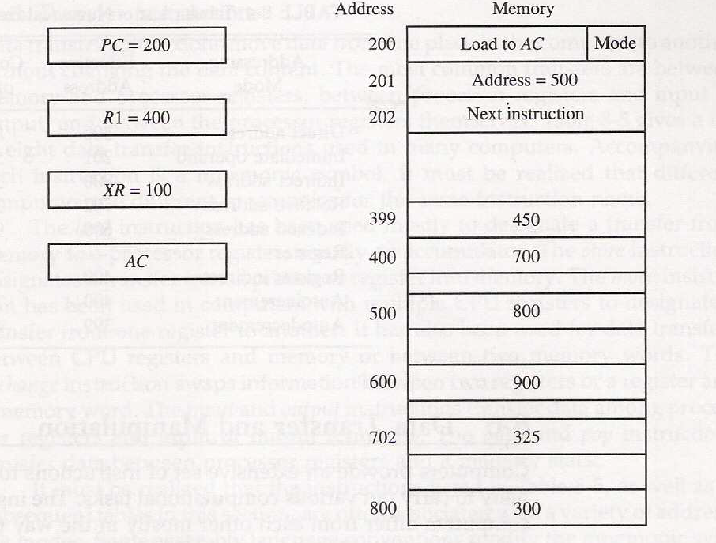

Slide 62
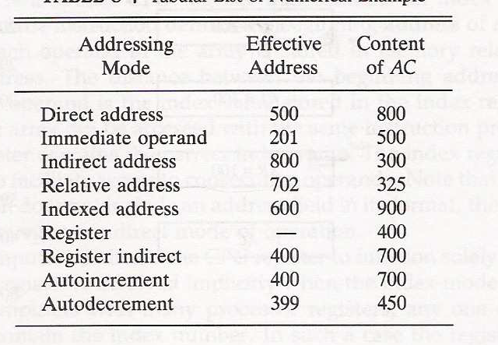

Slide 63
Addressing Modes
Name
Assem
bler
syn
tax
Addressing
function
The different ways in which the location of an operand is specified in an instruction are referred to as addressing modes.
Immediate
#V
alue
Op
erand
=
V
alue
Register
R
i
EA
=
R
i
Absolute
(Direct)
LOC
EA
=
LOC
Indirect
(R
i
)
EA
=
[R
i
]
(LOC)
EA
=
[LOC]
Index
X(R
i
)
EA
=
[R
i
]
+
X
Base
with
index
(R
i
,R
j
)
EA
=
[R
i
]
+
[R
j
]
Base
with
index
X(R
i
,R
j
)
EA
=
[R
i
]
+
[R
j
]
+
X
and
offset
Relative
X(PC)
EA
=
[PC]
+
X
Autoincremen
t
(R
i
)+
EA
=
[R
i
]
;
Incremen
t
R
i
Autodecrement
−
(R
i
)
Decremen
t
R
i
;
EA
=
[R
i
]

Slide 64
questions
Registers R1 and R2 contain decimal values 1200 and 4600. What is the effective address of the memory operand and the type of addressing modes used in each of the following instructions?
a) load 20( R1 ), R5
b) move #3000, R5
c) store R5, 30(R1,R2)
d) add –(R2) , R5
e) sub (R1)+, R5

Slide 65
Questions and answer
Registers R1 and R2 contain decimal values 1200 and 4600. What is the effective address of the memory operand and the type of addressing modes used in each of the following instructions?
a) load 20( R1 ), R5// index EA=1220
b) move #3000, R5// immediate R5<-3000
c) store R5, 30(R1,R2) // base with index and offset
//EA=5830
d) add –(R2) , R5 //Auto decrement EA=4599
e) sub (R1)+, R5 //auto increment EA=4600

Slide 66
Machine Instruction The operation of a CPU is determine by the instruction it executes, referred to as machine instructions or computer instructions. The collection of different instructions is referred as the instruction set of the CPU.
Each instruction must contain the information required by the CPU for execution. The elements of an instruction are as follows:
Operation Code: Specifies the operation to be performed (e.g., add, move etc.). The operation is specified by a binary code, know as the operation code or opcode.
Source operand reference: The operation may involve one or more source operands; that is, operands that are inputs for the operation.
Result operand reference: The operation may produce a result.

Slide 67
Next instruction reference: This tells the CPU where to fetch the next instruction after the execution of this instruction is complete.
The next instruction to be fetched is located in main memory. But in case of virtual memory system, it may be either in main memory or secondary memory (disk). In most cases, the next instruction to be fetched immediately follow the current instruction. In those cases, there is no explicit reference to the next instruction.When an explicit reference is needed, then the main memory or virtual memory address must be given.

Slide 68
Source and result operands can be in one of the three areas:
main or virtual memory,
CPU register or
I/O device.

Slide 69
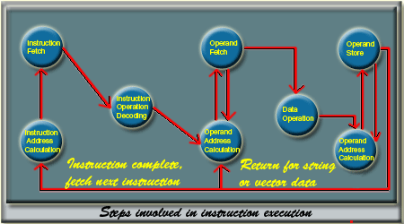

Slide 70
Instruction Representation
Within the computer, each instruction is represented by a sequence of bits.
The instruction is divided into fields, corresponding to the constituent elements of the instruction.
The instruction format is highly machine specific and it mainly depends on the machine architecture

Slide 71

A simple example of an instruction format is shown in the Figure .
It is assume that it is a 16-bit CPU.
4 bits are used to provide the operation code. So, we may have to 16 (2⁴ = 16) different set of instructions.
With each instruction, there are two operands.
To specify each operands, 6 bits are used.
It is possible to provide 64 ( 2⁶ = 64 ) different operands for each operand reference.

Slide 72
Instruction Types
The instruction set of a CPU can be categorized as follows:
Data Processing:
Arithmatic and Logic instructions Arithmatic instructions provide computational capabilities for processing numeric data. Logic (Boolean) instructions operate on the bits of a word as bits rather than as numbers.
Logic instructions thus provide capabilities for processing any other type of data. There operations are performed primarily on data in CPU registers.
Data Storage:
Memory instructions are used for moving data between memory and CPU registers.

Slide 73
Instruction Types
Data Movement:
I/O instructions are needed to transfer program and data into memory from storage device or input device and the results of computation back to the user.
Control:
Test and branch instructions Test instructions are used to test the value of a data word or the status of a computation. Branch instructions are then used to branch to a different set of instructions depending on the decision made.

Slide 74
Number of Addresses
What is the maximum number of addresses one might need in an instruction?
Most of the arithmantic and logic operations are either unary (one operand) or binary (two operands).
Thus we need a maximum of two addresses to reference operands.
The result of an operation must be stored, suggesting a third address.
Finally after completion of an instruction, the next instruction must be fetched, and its address is needed.
This reasoning suggests that an instruction may require to contain four address references: two operands, one result, and the address of the next instruction. In practice, four address instructions are rare. Most instructions have one, two or three operands addresses, with the address of the next instruction being implicit (obtained from the program counter).

Slide 75
Instruction Set Design
One of the most interesting, and most analyzed, aspects of computer design is instruction set design. The instruction set defines the functions performed by the CPU.
The instruction set is the programmer's means of controlling the CPU.
Thus programmer requirements must be considered in designing the instruction set.

Slide 76
Instruction Set Design
Operations performed :How many and which operations to provide, and how complex operations should be.
Data Types :The various type of data upon which operations are performed.
Instruction format: Instruction length (in bits), number of addresses, size of various fields and so on.
Registers: Number of CPU registers that can be referenced by instructions and their use.
Addressing: The mode or modes by which the address of an operand is specified.

Slide 77
Types of Operands
Machine instructions operate on data. Data can be categorized as follows :
Addresses: It basically indicates the address of a memory location. Addresses are nothing but the unsigned integer, but treated in a special way to indicate the address of a memory location. Address arithmetic is somewhat different from normal arithmetic and it is related to machine architecture.
Numbers: All machine languages include numeric data types. Numeric data are classified into two broad categories: integer or fixed point and floating point.

Slide 78
Characters: A common form of data is text or character strings. Since computer works with bits, so characters are represented by a sequence of bits. The most commonly used coding scheme is ASCII (American Standard Code for Information Interchange) code.
Logical Data: Normally each word or other addressable unit (byte, halfword, and so on) is treated as a single unit of data. It is sometime useful to consider an n-bit unit as consisting of n 1-bit items of data, each item having the value 0 or 1. When data are viewed this way, they are considered to be logical data. Generally 1 is treated as true and 0 is treated as false.

Slide 79
Types of Opearations
The number of different opcodes and their types varies widely from machine to machine. However, some general type of operations are found in most of the machine architecture. Those operations can be categorized as follows:
Data Transfer
Arithmetic
Logical
Conversion
Input Output [ I/O ]
System Control
Transfer Control

Slide 80
Commonly used data transfer operation:
Operation Name | Description
Move (Transfer) | Transfer word or block from source to destination
Store | Transfer word from processor to memory
Load (fetch) | Transfer word from memory to processor
Exchange | Swap contents of source and destination
Clear (reset) | Transfer word of 0s to destination
Set | Transfer word of 1s to destination
Push | Transfer word from source to top of stack
Pop | Transfer word from top of stack to destination

Slide 81
arithmetic operations
Operation Name | Description
Add | Compute sum of two operands
Subtract | Compute difference of two operands
Multiply | Compute product of two operands
Divide | Compute quotient of two operands
Absolute | Replace operand by its absolute value
Negate | Change sign of operand
Increment | Add 1 to operand
Decrement | Subtract 1 from operand

Slide 82
logical operations
Operation Name | Description
AND | Performs the logical operation AND bitwise
OR | Performs the logical operation OR bitwise
NOT | Performs the logical operation NOT bitwise
Exclusive OR | Performs the specified logical operation Exculsive-OR bitwise
Test | Test specified condition; set flag(s) based on outcome
Compare | Make logical or arithmatic comparison Set flag(s) based on outcome
Set Control Variables | Class of instructions to set controls for protection purposes, interrupt handling, timer control etc.
Shift | Left (right) shift operand, introducing constant at end
Rotate | Left (right) shift operation, with wraparound end

Slide 83
I/O operations are:
Operation Name | Description
Input (Read) | Transfer data from specified I/O port or device to destination (e.g., main memory or processor register)
Output (Write) | Transfer data from specified source to I/O port or device.
Start I/O | Transfer instructions to I/O processor to initiate I/O operation.
Test I/O | Transfer status information from I/O system to specified destination

Slide 84
Conversion:
Conversion instructions are those that change the format or operate on the format of data. An example is converting from decimal to binary.
System Control:
System control instructions are those which are used for system setting and it can be used only in privileged state. Typically, these instructions are reserved for the use of operating systems. For example, a system control instruction may read or alter the content of a control register. Another instruction may be to read or modify a storage protection key.

Slide 85
Branch Instruction
A branch instruction, also called a jump instruction, has one of its operands as the address of the next instruction to be executed.
Basically there are two types of branch instructions:
Conditional Branch instruction
the branch is made only if a certain condition is met. Otherwise, the next instruction in sequence is executed.
unconditional branch instruction.
the branch is made by updating the program counter to address specified in operand.

Slide 86
Branch Instruction
BRP X ; Branch to location X if result is positive BRN X ; Branch to location X if result is negative BRZ X ; Branch to location X is result is zero BRO X ; Branch to location X if overflow occurs
For example,
BRE R1, R2, X ; Branch to X if contents of R1 = Contents of R2.

Slide 87
Instruction Format:
An instruction format defines the layout of the bits of an instruction, in terms of its constituents parts.
An instruction format must include an opcode and, implicitly or explicitly, zero or more operands.
Each explicit operand is referenced using one of the addressing mode that is available for that machine.
The format must, implicitly or explicitly, indicate the addressing mode of each operand.

Slide 88
Instruction Format: CPU Design
Single Accumulator
Result usually goes to the Accumulator
Accumulator has to be saved to memory quite often
General Register
Registers hold operands thus reduce memory traffic
Register bookkeeping
Stack
Operands and result are always in the stack

Slide 89
Instruction Format:
Three-Address Instructions
ADD R1, R2, R3 R1 ← R2 + R3
Three address instruction formats are not common because they require a relatively long instruction format to hold the three address reference.
Two-Address Instructions
ADD R1, R2 R1 ← R1 + R2
With two address instructions, and for binary operations, one address must do double duty as both an operand and a result.

Slide 90
Instruction Format
One-Address Instructions
ADD M AC ← AC + M[AR]
In one address instruction format, a second address must be implicit for a binary operation. For implicit reference, a processor register is used and it is termed as accumulator(AC). the accumulator contains one of the operands and is used to store the result.
Zero-Address Instructions
ADD TOS ← TOS + (TOS – 1)
RISC Instructions
Lots of registers. Memory is restricted to Load & Store

Slide 91
Three-Address
Consider a simple arithmetic expression to evaluate: X= (A + B) * (C + D)
Example: Evaluate (A+B) ∗ (C+D)
Three-Address
ADD R1, A, B ; R1 ← M[A] + M[B]
ADD R2, C, D ; R2 ← M[C] + M[D]
MUL X, R1, R2 ; M[X] ← R1 ∗ R2

Slide 92
Two-Address
Example: Evaluate (A+B) ∗ (C+D)
Two-Address
MOV R1, A ; R1 ← M[A]
ADD R1, B ; R1 ← R1 + M[B]
MOV R2, C ; R2 ← M[C]
ADD R2, D ; R2 ← R2 + M[D]
MUL R1, R2 ; R1 ← R1 ∗ R2
MOV X, R1 ; M[X] ← R1

Slide 93
One-Address
Example: Evaluate (A+B) ∗ (C+D)
One-Address
LOAD A ; AC ← M[A]
ADD B ; AC ← AC + M[B]
STORE T ; M[T] ← AC
LOAD C ; AC ← M[C]
ADD D ; AC ← AC + M[D]
MUL T ; AC ← AC ∗ M[T]
STORE X ; M[X] ← AC

Slide 94
Zero-Address
Example: Evaluate (A+B) ∗ (C+D)
Zero-Address
PUSH A ; TOS ← A
PUSH B ; TOS ← B
ADD ; TOS ← (A + B)
PUSH C ; TOS ← C
PUSH D ; TOS ← D
ADD ; TOS ← (C + D)
MUL ; TOS ← (C+D)∗(A+B)
POP X ; M[X] ← TOS

Slide 95
RISC
Example: Evaluate (A+B) ∗ (C+D)
RISC
LOAD R1, A ; R1 ← M[A]
LOAD R2, B ; R2 ← M[B]
LOAD R3, C ; R3 ← M[C]
LOAD R4, D ; R4 ← M[D]
ADD R1, R1, R2 ; R1 ← R1 + R2
ADD R3, R3, R4 ; R3 ← R3 + R4
MUL R1, R1, R3 ; R1 ← R1 ∗ R3
STORE X, R1 ; M[X] ← R1

Slide 96
Questions
Evaluate the arithmetic statement Y=(A+B)/(C*D) in zero, one, two, three addresses machine instructions. A,B,C,D are variables.

Slide 97
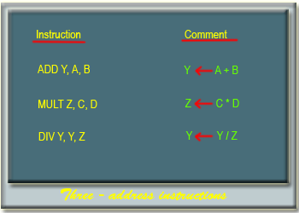

Slide 98
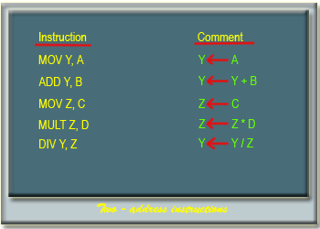

Slide 99
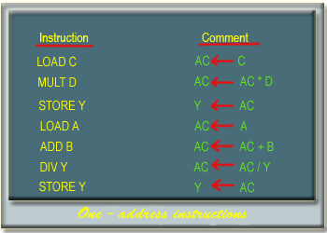

Slide 100
Questions
A processor has 16 integer registers (R0, R1, .. , R15) and 64 floating point registers (F0, F1,… , F63). It uses a 2-byte instruction format. There are four categories of instructions:Type-1, Type-2, Type-3, and Type-4. Type-1 category consists of four instructions, each with 3 integer register operands (3Rs). Type-2 category consists of four instructions, each with 2 floating point register operands (2Fs). Type-3 category consists of fourteen instructions, each with one integer register operand and one floating point register operand (1R+1F). Type-4 category consists of N instructions, each with a floating point register operand (1F).
Specify instruction format for each type.
The maximum value of N is __________.

Slide 101
End of Module I
Thank you

