Slide 1
Module No-2
Basics of ALU Design

Slide 2
Module No-2: Basics of ALU Design:
Binary number representation;
Fixed and Floating point representation of numbers.
Adders: Serial and Parallel adders, Ripple Carry / Carry Look ahead / Carry Save;
Multipliers & Divider Circuits: Multiplication of signed binary numbers Booth Multipliers;

Slide 3
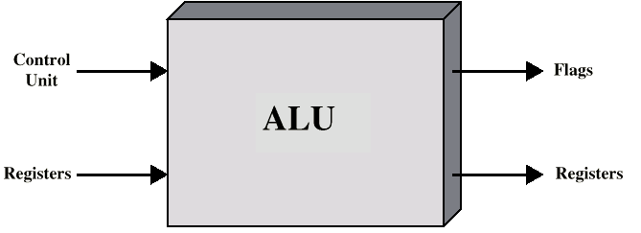
ALU Inputs and Outputs

Slide 4
Integer Representation
Only have 0 & 1 to represent everything
Positive numbers stored in binary
e.g. 41=00101001
No minus sign
No period
Sign-Magnitude
Two’s compliment

Slide 5
Sign-Magnitude
Left most bit is sign bit
0 means positive
1 means negative
+18 = 00010010
-18 = 10010010
Problems
Need to consider both sign and magnitude in arithmetic
Two representations of zero (+0 and -0)

Slide 6
Two’s Compliment
+3 = 00000011
+2 = 00000010
+1 = 00000001
+0 = 00000000
-1 = 11111111
-2 = 11111110
-3 = 11111101

Slide 7
Benefits
One representation of zero
Arithmetic works easily (see later)
Negating is fairly easy
3 = 00000011
Boolean complement gives 11111100
Add 1 to LSB 11111101

Slide 8
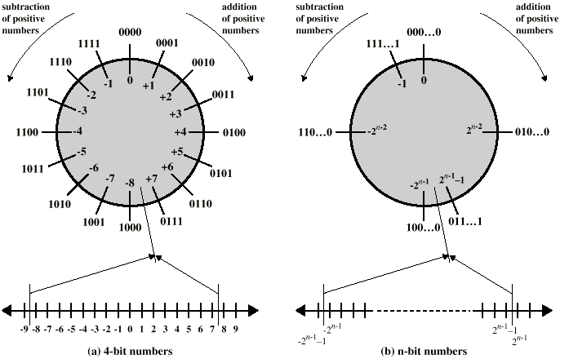
Geometric Depiction of Twos Complement Integers

Slide 9
Negation Special Case 1
0 = 00000000
Bitwise not 11111111
Add 1 to LSB +1
Result 1 00000000
Overflow is ignored, so:
- 0 = 0 √

Slide 10
Negation Special Case 2
-128 = 10000000
bitwise not 01111111
Add 1 to LSB +1
Result 10000000
So:
-(-128) = -128 X
Monitor MSB (sign bit)
It should change during negation

Slide 11
Range of Numbers
8 bit 2s compliment
+127 = 01111111 = 2⁷ -1
-128 = 10000000 = -2⁷
16 bit 2s compliment
+32767 = 011111111 11111111 = 2¹⁵ - 1
-32768 = 100000000 00000000 = -2¹⁵

Slide 12
Conversion Between Lengths
Positive number pack with leading zeros
+18 = 00010010
+18 = 00000000 00010010
Negative numbers pack with leading ones
-18 = 10010010
-18 = 11111111 10010010
i.e. pack with MSB (sign bit)

Slide 13
Real Numbers
Numbers with fractions
Could be done in pure binary
1001.1010 = 2³ + 2⁰ +2⁻¹ + 2⁻³ =9.625
Where is the binary point?
Fixed?
Very limited
Moving?
How do you show where it is?

Slide 14
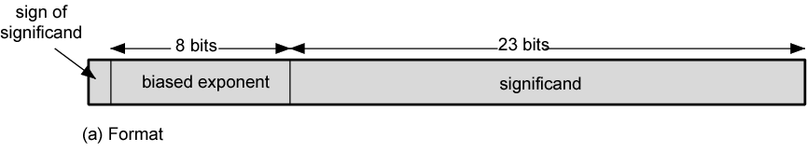
Floating Point
+/- .significand x 2^{exponent}
Point is actually fixed between sign bit and body of mantissa
Exponent indicates place value (point position)
Misnomer:เรียกชื่อผิด, ใช้ชื่อผิด

Slide 15
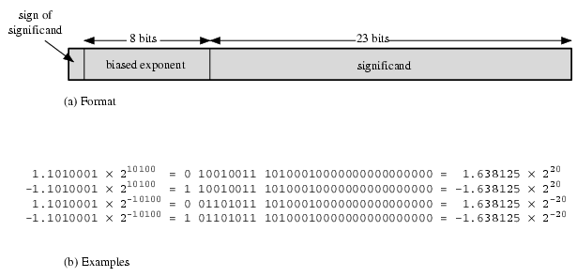
Floating Point Examples

Slide 16
Signs for Floating Point
Mantissa is stored in 2s compliment
Exponent is in excess or biased notation
e.g. Excess (bias) 128 means
8 bit exponent field
Pure value range 0-255
Subtract 128 to get correct value
Range -128 to +127

Slide 17
Normalization
FP numbers are usually normalized
i.e. exponent is adjusted so that leading bit (MSB) of mantissa is 1
Since it is always 1 there is no need to store it
(c.f. Scientific notation where numbers are normalized to give a single digit before the decimal point e.g. 3.123 x 10³)

Slide 18
FP Ranges
For a 32 bit number
8 bit exponent
+/- 2²⁵⁶ ≈ 1.5 x 10⁷⁷
Accuracy
The effect of changing lsb of mantissa
23 bit mantissa 2⁻²³ ≈ 1.2 x 10⁻⁷
About 6 decimal places

Slide 19
IEEE 754
Standard for floating point storage
32 and 64 bit standards
8 and 11 bit exponent respectively
Extended formats (both mantissa and exponent) for intermediate results

Slide 20
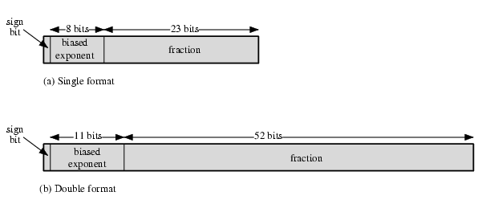
IEEE 754 Formats

Slide 21
IEEE 754 Formats
Most of the binary floating-point representations follow the IEEE-754 standard.
The data type float uses IEEE 32-bit single precision format and the data type double uses IEEE 64-bit double precision format.
A floating-point constant is treated as a double precision number by GCC.

Slide 22
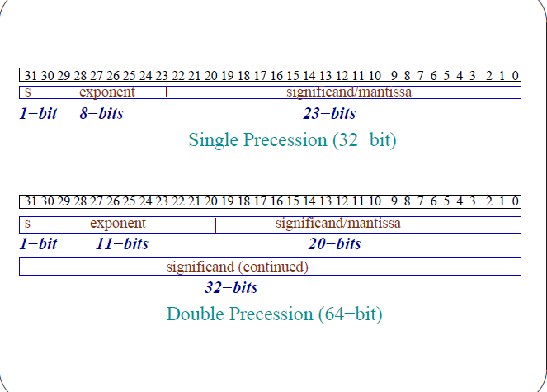

Slide 23
Interpretation of Bits
The most significant bit indicates the sign of
the number - one is negative and zero is positive.
The next eight bits (11 in case of double precession) store the value of the signed exponent of two (2^{biasedExp}).
Remaining 23 bits (52 in case of double
precession) are for the significand (mantissa).

Slide 24
Types of Data
Data represented in this format are classified in five groups.
Normalized numbers,
Zeros,
Subnormal(denormal) numbers,
Infinity and not-a-number (nan).

Slide 25
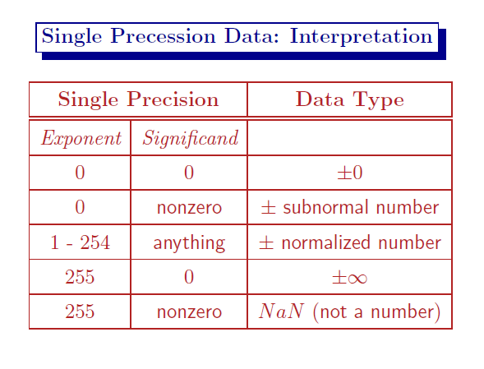

Slide 26
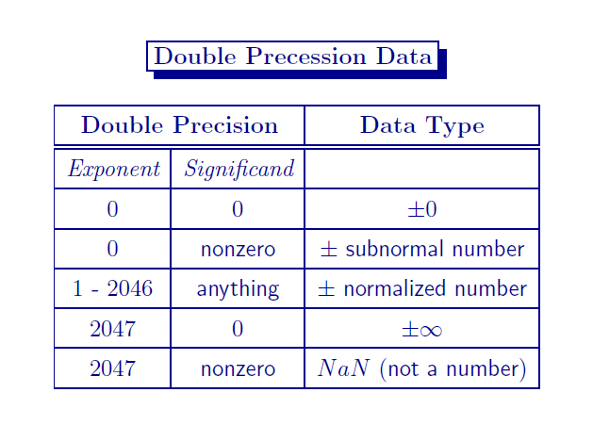

Slide 27
Single Precession Normalized Number
Let the sign bit (31) be s, the exponent (30-23)
be e and the mantissa (significand or fraction)
(22-0) be m.
The valid range of the exponents is 1 to 254 (if e is treated as an unsigned number).
The actual exponent is biased by 127
To get e i.e. the actual value of the exponent is e − 127.
This gives the range: 2¹⁻¹²⁷ = 2⁻¹²⁶ to 2²⁵⁴⁻¹²⁷ = 2¹²⁷.

Slide 28

Single Precession Normalized Number
The normalized significand is 1.m (binary
dot).
The binary point is before bit-22 andthe 1 (one) is not present explicitly.
The sign bit s = 1 for a −ve number is zero (0) for a +ve number.
The value of a normalized number is

Slide 29
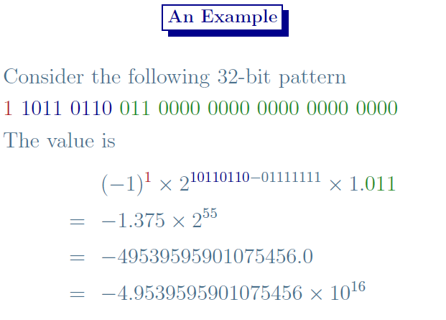

Slide 30
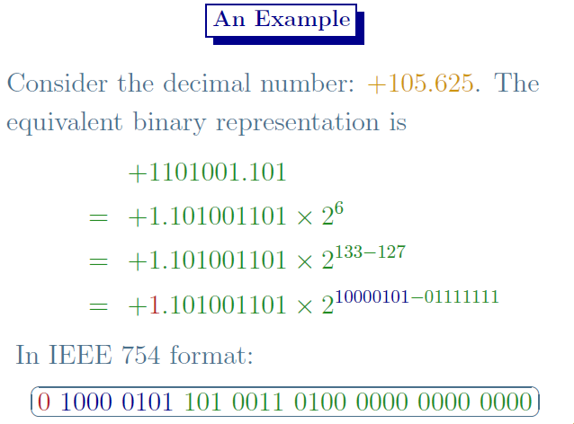

Slide 31
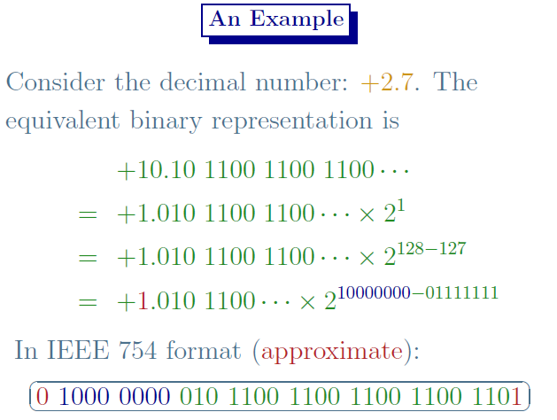

Slide 32
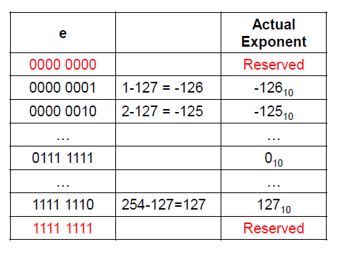

Slide 33
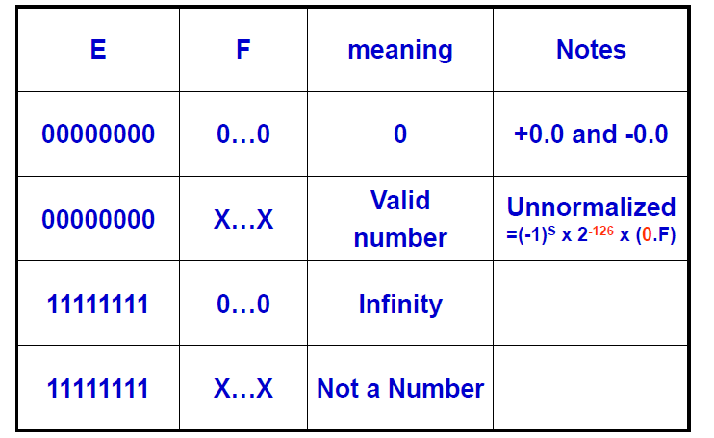

Slide 34
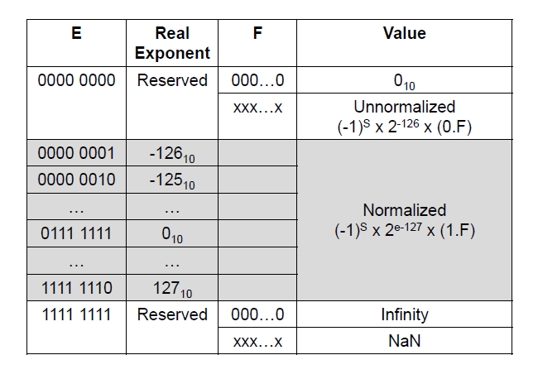

Slide 35
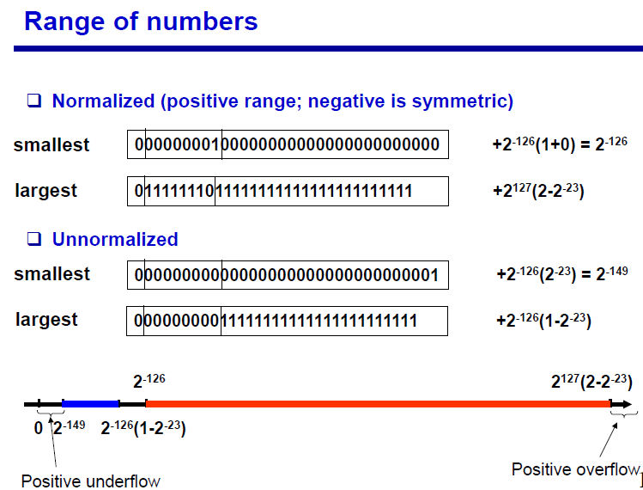

Slide 36
The smallest magnitude of a normalized number in single precession is
± 0000 0001 000 0000 0000 0000 0000 0000, whose value is 1.0 × 2 ⁻¹²⁶ .
The largest magnitude of a normalized number in single precession is
± 1111 1110 111 1111 1111 1111 1111 1111, whose value is
1.99999988 × 2¹²⁷ ≈ 3.403 × 10³⁸

Slide 37
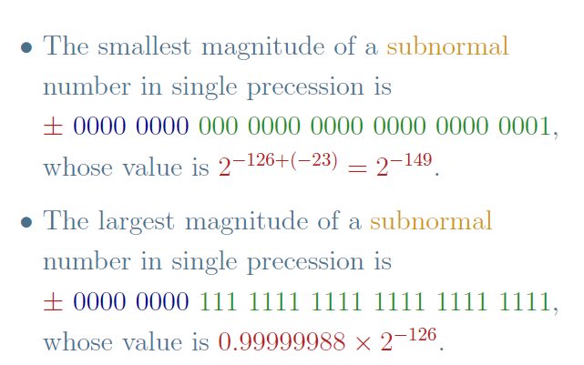

Slide 38
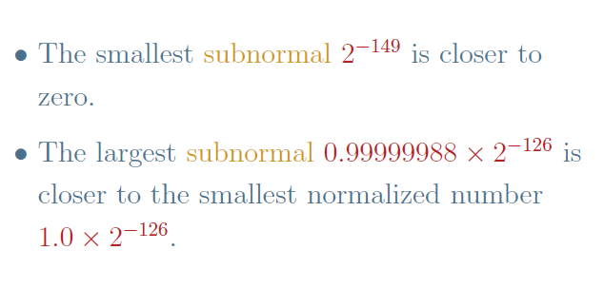

Slide 39
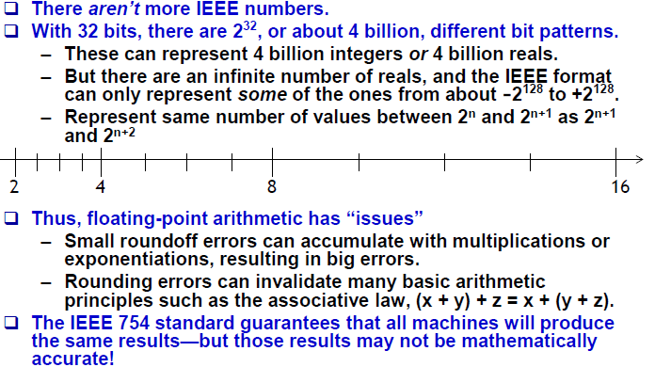

Slide 40
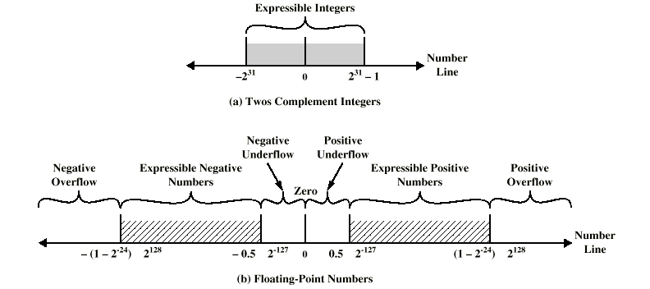
Expressible Numbers

Slide 41
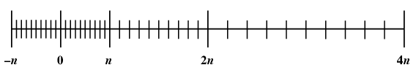
Density of Floating Point Numbers

Slide 42
Arithmetic

Slide 43
Addition/subtraction of signed numbers
x
i
y
i
Carry-in
c
i
Sum
s
i
Carry-out
c
i
+1
At the i^{th} stage:
Input:
c_{i} is the carry-in
Output:
s_{i} is the sum
c_{i+1} carry-out to (i+1)^{st}
state
0
0
0
0
0
0
0
1
1
0
0
1
0
1
0
0
1
1
0
1
1
0
0
1
0
1
0
1
0
1
1
1
0
0
1
1
1
1
1
1
s
i
=
x
i
y
i
c
i
+
x
i
y
i
c
i
+
x
i
y
i
c
i
+
x
i
y
i
c
i
=
x
i
⊕
y
i
⊕
c
i
c
=
y
i
c
i
+
x
i
c
i
+
x
i
y
i
i
+1
E
xample:
X
7
0
1
1
1
Carry-out
x
i
Carry-in
+
Y
=
+ 6
=
+
0
0
1
1
1
1
0
0
0
c
y
i
c
Z
13
1
1
0
1
i
+1
s
i
i
Legend for stage
i

Slide 44
Addition logic for a single stage
Sum
Carry
y
i
c
i
x
i
y
s
x
i
c
i
i
c
i
i
+
1
c
i
x
x
i
y
i
y
i
i
c
i
+
1
Full adder
c
i
(F
A)
s
i
Full Adder (FA): Symbol for the complete circuit
for a single stage of addition.

Slide 45
n-bit adder
Cascade n full adder (FA) blocks to form a n-bit adder.
Carries propagate or ripple through this cascade, n-bit ripple carry adder.
x
n
-
1
y
n
-
1
x
1
y
1
x
0
y
0
c
n
-
1
c
1
c
n
F
A
F
A
F
A
c
0
s
n
-
1
s
1
s
0
Most significant bit
Least significant bit
(MSB) position
(LSB) position
Carry-in c₀ into the LSB position provides a convenient way to
perform subtraction.

Slide 46
K n-bit adder
K n-bit numbers can be added by cascading k n-bit adders.
x
k
n
-
1
y
k
n
-
1
x
2
n
-
1
y
2
n
-
1
x
n
y
n
x
n
-
1
y
n
-
1
x
0
y
0
n
-
bit
n
-
bit
c
n
n
-
bit
c
k
n
adder
adder
adder
c
0
s
k
n
-
1
s
(
k
-
1
)
n
s
2
n
-
1
s
n
s
n
-
1
s
0
Each n-bit adder forms a block, so this is cascading of blocks.
Carries ripple or propagate through blocks, Blocked Ripple Carry Adder

Slide 47
n-bit subtractor
Recall X – Y is equivalent to adding 2’s complement of Y to X.
2’s complement is equivalent to 1’s complement + 1.
X – Y = X + Y + 1
2’s complement of positive and negative numbers is computed similarly.
x
n
-
1
y
n
-
1
x
1
y
1
x
0
y
0
c
n
-
1
c
1
c
n
F
A
F
A
F
A
1
s
n
-
1
s
1
s
0
Most significant bit
Least significant bit
(MSB) position
(LSB) position

Slide 48
n-bit adder/subtractor (contd..)
y
n
-
1
y
1
y
0
Add/Sub
control
x
n
-
1
x
1
x
0
c
n
-bit adder
n
c
0
s
n
-
1
s
1
s
0
Add/sub control = 0, addition.
Add/sub control = 1, subtraction.

Slide 49
Detecting overflows
Overflows can only occur when the sign of the two operands is the same.
Overflow occurs if the sign of the result is different from the sign of the operands.
Recall that the MSB represents the sign.
x_{n-1}, y_{n-1}, s_{n-1} represent the sign of operand x, operand y and result s respectively.
Circuit to detect overflow can be implemented by the following logic expressions:

Slide 50
Computing the add time
x₀
y₀
Consider 0th stage:
c₁ is available after 2 gate delays.
s₁ is available after 1 gate delay.
c₁
FA
c₀
s₀
Sum
Carry
y
i
c
i
x
i
y
s
x
i
c
i
i
c
i
i
+
1
c
i
x
y
i
i

Slide 51
Computing the add time (contd..)
Cascade of 4 Full Adders, or a 4-bit adder
x₀
y₀
x₀
y₀
x₀
y₀
x₀
y₀
FA
FA
FA
c₁
FA
c₀
c₄
c₃
c₂
s₃
s₂
s₁
s₀
s₀ available after 1 gate delays, c₁ available after 2 gate delays.
s₁ available after 3 gate delays, c₂ available after 4 gate delays.
s₂ available after 5 gate delays, c₃ available after 6 gate delays.
s₃ available after 7 gate delays, c₄ available after 8 gate delays.
For an n-bit adder, s_{n-1} is available after 2n-1 gate delays
c_{n} is available after 2n gate delays.

Slide 52
Fast addition
Recall the equations:
Second equation can be written as:
We can write:
G_{i} is called generate function and P_{i} is called propagate function
G_{i} and P_{i} are computed only from x_{i} and y_{i} and not c_{i}, thus they can
be computed in one gate delay after X and Y are applied to the
inputs of an n-bit adder.

Slide 53
Carry lookahead
All carries can be obtained 3 gate delays after X, Y and c₀ are applied.
-One gate delay for P_{i} and G_{i}
-Two gate delays in the AND-OR circuit for c_{i+1}
All sums can be obtained 1 gate delay after the carries are computed.
Independent of n, n-bit addition requires only 4 gate delays.
This is called Carry Lookahead adder.

Slide 54
Carry-lookahead adder
x
3
y
3
x
2
y
2
x
1
y
1
x
0
y
0
.
4-bit
carry-lookahead
adder
c
c
3
c
2
c
1
c
4
B cell
B cell
B cell
B cell
0
s
3
s
2
s
1
s
0
G
3
P
3
G
2
P
2
G
1
P
1
G
0
P
0
Carry-lookahead logic
x
i
y
i
.
.
.
c
i
B-cell for a single stage
B cell
G
i
P
i
s
i

Slide 55
Carry lookahead adder (contd..)
Performing n-bit addition in 4 gate delays independent of n is good only theoretically because of fan-in constraints.
Last AND gate and OR gate require a fan-in of (n+1) for a n-bit adder.
For a 4-bit adder (n=4) fan-in of 5 is required.
Practical limit for most gates.
In order to add operands longer than 4 bits, we can cascade 4-bit Carry-Lookahead adders. Cascade of Carry-Lookahead adders is called Blocked Carry-Lookahead adder.
c
=
G
+
P
G
+
P
P
G
+
..
+
P
P
..
P
G
+
P
P
...
P
c₀
i
+
1
i
i
i
−
1
i
i
−
1
i
−
2
i
i
−
1
1
0
i
i
−
1
0

Slide 56
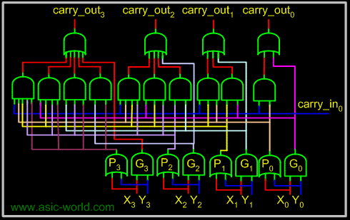
4-bit carry-lookahead Adder

Slide 57
Blocked Carry-Lookahead adder
Carry-out from a 4-bit block can be given as:
Rewrite this as:
Subscript I denotes the blocked carry lookahead and identifies the block.
Cascade 4 4-bit adders, c₁₆ can be expressed as:

Slide 58
Blocked Carry-Lookahead adder
x
15-12
y
15-12
x
11-8
y
11-8
x
7-4
y
7-4
x
3-0
y
3-0
.
c
12
c
8
c
4
c
16
4-bit adder
4-bit adder
4-bit adder
4-bit adder
c
0
s
15-12
s
11-8
s
7-4
s
3-0
G
3
I
P
3
I
G
2
I
P
2
I
G
1
I
P
1
I
G
0
I
P
0
I
Carry-lookahead logic
After x_{i}, y_{i} and c₀ are applied as inputs:
- G_{i} and P_{i} for each stage are available after 1 gate delay.
- P^{I} is available after 2 and G^{I} after 3 gate delays.
- All carries are available after 5 gate delays.
- c₁₆ is available after 5 gate delays.
- s₁₅ which depends on c₁₂ is available after 8 (5+3)gate delays
(Recall that for a 4-bit carry lookahead adder, the last sum bit is
available 3 gate delays after all inputs are available)

Slide 59
Multiplication

Slide 60
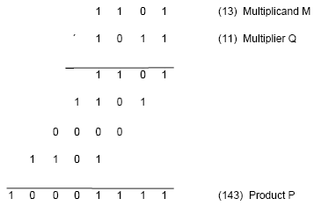
Multiplication of unsigned numbers
Product of 2 n-bit numbers is at most a 2n-bit number.
Unsigned multiplication can be viewed as addition of shifted
versions of the multiplicand.

Slide 61
Multiplication of unsigned numbers (contd..)
We added the partial products at end.
Alternative would be to add the partial products at each stage.
Rules to implement multiplication are:
If the i^{th} bit of the multiplier is 1, shift the multiplicand and add the shifted multiplicand to the current value of the partial product.
Hand over the partial product to the next stage
Value of the partial product at the start stage is 0.

Slide 62
Multiplication of unsigned numbers
Typical multiplication cell
Bit of incoming partial product (PPi)
j^{th} multiplicand bit
i^{th} multiplier bit
i^{th} multiplier bit
carry out
FA
carry in
Bit of outgoing partial product (PP(i+1))

Slide 63
Combinatorial array multiplier
Combinatorial array multiplier
Multiplicand
(PP0)
0
m
3
0
m
2
0
m
1
0
m
0
q
0
PP1
0
q
p
0
0
1
PP2
p
Multiplier
q
2
1
0
PP3
p
2
q
3
0
p
p
p
p
p
,
7
6
5
4
3
Product is: p₇,p₆,..p₀
Multiplicand is shifted by displacing it through an array of adders.

Slide 64
Combinatorial array multiplier (contd..)
Combinatorial array multipliers are:
Extremely inefficient.
Have a high gate count for multiplying numbers of practical size such as 32-bit or 64-bit numbers.
Perform only one function, namely, unsigned integer product.
Improve gate efficiency by using a mixture of combinatorial array techniques and sequential techniques requiring less combinational logic.

Slide 65
Sequential multiplication
Recall the rule for generating partial products:
If the ith bit of the multiplier is 1, add the appropriately shifted multiplicand to the current partial product.
Multiplicand has been shifted left when added to the partial product.
However, adding a left-shifted multiplicand to an unshifted partial product is equivalent to adding an unshifted multiplicand to a right-shifted partial product.

Slide 66
Sequential Circuit Multiplier
Register A (initially 0)
Shift right
C
a
a
q
q
n
-
1
0
n
-
1
0
Multiplier Q
Add/Noadd
control
n-bit
Adder
MUX
Control
sequencer
0
0
m
m
n
-
1
0
Multiplicand M

Slide 67
Sequential multiplication (contd..)
M
1 1 0 1
Initial configuration
0
0 0 0 0
1 0 1 1
C
A
Q
0
1 1 0 1
1 0 1 1
Add
First cycle
0
0 1 1 0
1 1 0 1
Shift
1
0 0 1 1
1 1 0 1
Add
Second cycle
0
1 0 0 1
1 1 1 0
Shift
0
1 0 0 1
1 1 1 0
No add
Third cycle
0
0 1 0 0
1 1 1 1
Shift
1
0 0 0 1
1 1 1 1
Add
0
1 0 0 0
1 1 1 1
Shift
Fourth cycle
Product

Slide 68
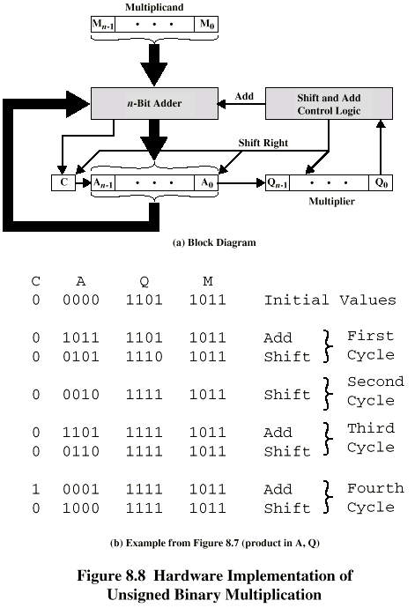
Unsigned Binary Multiplication

Slide 69
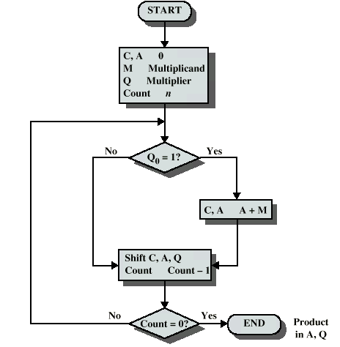
Flowchart for Unsigned Binary Multiplication

Slide 70
Execution of Example

Slide 71
Signed Multiplication

Slide 72
Signed Multiplication
Considering 2’s-complement signed operands, what will happen to (-13)×(+11) if following the same method of unsigned multiplication?
1
0
0
1
1
(
-
13
)
0
1
0
1
1
(
+
11
)
1
1
1
1
1
1
0
0
1
1
1
1
1
1
1
0
0
1
1
Sign extension is
0
0
0
0
0
0
0
0
shown in blue
1
1
1
0
0
1
1
0
0
0
0
0
0
1
1
0
1
1
1
0
0
0
1
(
-
143
)
Sign extension of negative multiplicand.

Slide 73
Signed Multiplication
For a negative multiplier, a straightforward solution is to form the 2’s-complement of both the multiplier and the multiplicand and proceed as in the case of a positive multiplier.
This is possible because complementation of both operands does not change the value or the sign of the product.
A technique that works equally well for both negative and positive multipliers – Booth algorithm.

Slide 74
Booth Algorithm
Consider in a multiplication, the multiplier is positive 0011110, how many appropriately shifted versions of the multiplicand are added in a standard procedure?
0
1
0
1
1
0
1
0
0
+
1
+
1
+
1
+
1
0
0
0
0
0
0
0
0
0
1
0
1
1
0
1
0
1
0
1
1
0
1
0
1
0
1
1
0
1
0
1
0
1
1
0
1
0
0
0
0
0
0
0
0
0
0
0
0
0
0
0
0
0
1
0
1
0
1
0
0
0
1
1
0

Slide 75
Booth Algorithm
Since 0011110 = 0100000 – 0000010, if we use the expression to the right, what will happen?
0
1
0
1
1
0
1
0
+
1
0
0
0
-
1
0
0
0
0
0
0
0
0
0
0
0
0
0
0
0
2's complement of
1
1
1
1
1
1
1
0
1
0
0
1
1
the multiplicand
0
0
0
0
0
0
0
0
0
0
0
0
0
0
0
0
0
0
0
0
0
0
0
0
0
0
0
0
0
0
0
0
0
0
0
0
1
0
1
1
0
1
0
0
0
0
0
0
0
0
0
0
0
1
0
1
0
1
0
0
0
1
1
0

Slide 76
Booth Algorithm
In general, in the Booth scheme, -1 times the shifted multiplicand is selected when moving from 0 to 1, and +1 times the shifted multiplicand is selected when moving from 1 to 0, as the multiplier is scanned from right to left.
0
0
1
0
1
1
0
0
1
1
1
0
1
0
1
1
0
0
0
+
1
-
1
+
1
0
-
1
0
+
1
0
0
-
1
+
1
-
1
+
1
0
-
1
0
0
Booth recoding of a multiplier.

Slide 77
Booth Algorithm
0
1
1
0
1
(
+
13
)
0
1
1
0
1
X
1
1
0
1
0
(
-
6
)
0
-
1
+1
-
1
0
0
0
0
0
0
0
0
0
0
0
1
1
1
1
1
0
0
1
1
0
0
0
0
1
1
0
1
1
1
1
0
0
1
1
0
0
0
0
0
0
1
1
1
0
1
1
0
0
1
0
(
-
78
)
Booth multiplication with a negative multiplier.

Slide 78
Booth Algorithm
Multiplier
V
ersion of multiplicand
selected by bit
i
Bit
i
Bit
i
-
1
0
0
0
X
M
0
1
+
1
X
M
1
0
−
1
X
M
1
1
0
X
M
Booth multiplier recoding table.

Slide 79
Booth Algorithm
Best case – a long string of 1’s (skipping over 1s)
Worst case – 0’s and 1’s are alternating
0
1
0
1
0
1
0
1
0
1
0
1
0
1
0
1
Worst-case
multiplier
+
1
-
1
+
1
-
1
+
1
-
1
+
1
-
1
+
1
-
1
+
1
-
1
+
1
-
1
+
1
-
1
1
1
0
0
0
1
0
1
1
0
1
1
1
1
0
0
Ordinary
multiplier
0
-
1
0
0
+
1
-
1
+
1
0
-
1
+
1
0
0
0
-
1
0
0
0
0
0
0
1
1
1
1
1
0
0
0
0
1
1
1
Good
multiplier
0
0
0
+
1
0
0
0
0
-
1
0
0
0
+
1
0
0
-
1

Slide 80
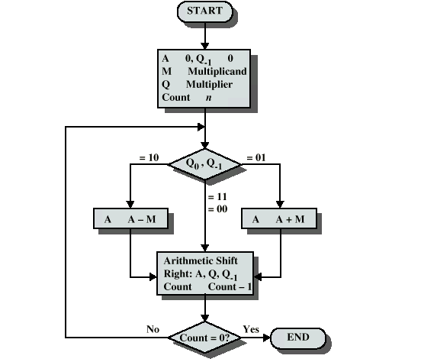
Booth’s Algorithm

Slide 81
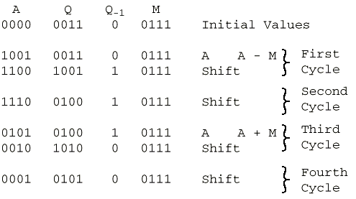
Example of Booth’s Algorithm

Slide 82
Fast Multiplication

Slide 83
Bit-Pair Recoding of Multipliers
Bit-pair recoding halves the maximum number of summands (versions of the multiplicand).
Sign extension
Implied 0 to right of LSB
1
1
1
0
1
0
0
0
0
−
1
+
1
−
1
0
0
−
1
−
2
(a) Example of bit-pair recoding derived from Booth recoding

Slide 84
Bit-Pair Recoding of Multipliers
Multiplier bit-pair
Multiplier bit on the right
Multiplicand
i
+
1
i
i
−
1
selected at position
i
0
0
0
0
X M
0
0
1
+
1
X M
0
1
0
+
1
X M
0
1
1
+
2
X M
1
0
0
−
2
X M
1
0
1
−
1
X M
1
1
0
−
1
X M
1
1
1
0
X M
(b) Table of multiplicand selection decisions

Slide 85
Bit-Pair Recoding of Multipliers
0
1
1
0
1
0
-
1
+
1
-
1
0
0
0
0
0
0
0
0
0
0
0
1
1
1
1
1
0
0
1
1
0
0
0
0
1
1
0
1
1
1
1
0
0
1
1
0
1
1
0
1
(
+
13
)
0
0
0
0
0
0
×
1
1
0
1
0
(
-
6
)
1
1
1
0
1
1
0
0
1
0
(
-
78
)
0
1
1
0
1
0
-
1
-
2
1
1
1
1
1
0
0
1
1
0
1
1
1
1
0
0
1
1
0
0
0
0
0
0
1
1
1
0
1
1
0
0
1
0
Figure 6.15. Multiplication requiring only n/2 summands.

Slide 86
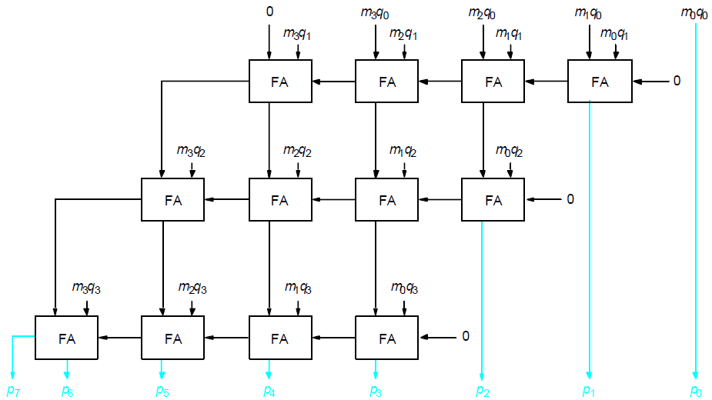
Carry-Save Addition of Summands
CSA speeds up the addition process.
P7
P6
P5
P4
P3
P2
P1
P0

Slide 87
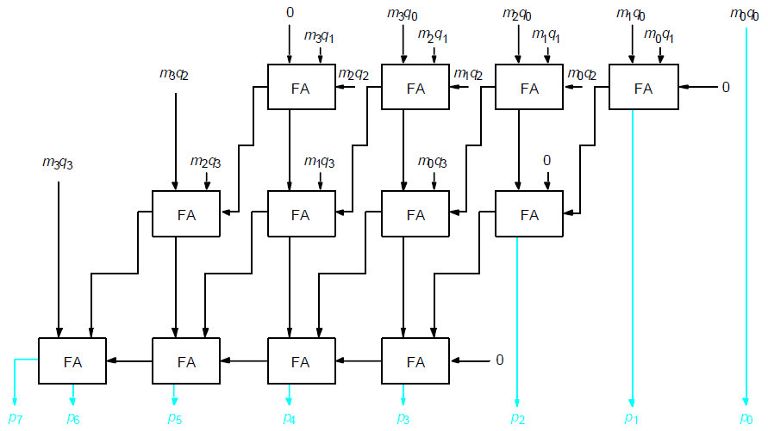
Carry-Save Addition of Summands(Cont.,)
P7
P6
P5
P4
P3
P2
P1
P0

Slide 88
Carry-Save Addition of Summands(Cont.,)
Consider the addition of many summands, we can:
Group the summands in threes and perform carry-save addition on each of these groups in parallel to generate a set of S and C vectors in one full-adder delay
Group all of the S and C vectors into threes, and perform carry-save addition on them, generating a further set of S and C vectors in one more full-adder delay
Continue with this process until there are only two vectors remaining
They can be added in a RCA or CLA to produce the desired product

Slide 89
Carry-Save Addition of Summands
1
0
1
1
0
1
(45)
M
X
1
1
1
1
1
1
(63)
Q
1
0
1
1
0
1
A
1
0
1
1
0
1
B
1
0
1
1
0
1
C
1
0
1
1
0
1
D
1
0
1
1
0
1
E
1
0
1
1
0
1
F
1
0
1
1
0
0
0
1
0
0
1
1
(2,835)
Product
Figure 6.17. A multiplication example used to illustrate carry-save addition as shown in Figure 6.18.

Slide 90
1
0
1
1
0
1
M
x
1
1
1
1
1
1
Q
1
0
1
1
0
1
A
1
0
1
1
0
1
B
1
0
1
1
0
1
C
1
1
0
0
0
0
1
1
S
1
0
0
1
1
1
1
0
0
C
1
1
0
1
1
0
1
D
1
0
1
1
0
1
E
1
0
1
1
0
1
F
1
1
0
0
0
0
1
1
S
2
0
0
1
1
1
1
0
0
C
2
1
1
0
0
0
0
1
1
S
1
0
0
1
1
1
1
0
0
C
1
1
1
0
0
0
0
1
1
S
2
1
1
0
1
0
1
0
0
0
1
1
S
3
0
0
0
0
1
0
1
1
0
0
0
C
3
0
0
1
1
1
1
0
0
C
2
0
1
0
1
1
1
0
1
0
0
1
1
S
4
+
0
1
0
1
0
1
0
0
0
0
0
C
4
1
0
1
1
0
0
0
1
0
0
1
1
Product
Figure 6.18. The multiplication example from Figure 6.17 performed using
carry-save addition.

Slide 91
Integer Division

Slide 92
Manual Division
13
21
1101
10101
274
100010010
26
1101
14
10000
13
1101
1
1110
1101
1
Longhand division examples.

Slide 93
Longhand Division Steps
Position the divisor appropriately with respect to the dividend and performs a subtraction.
If the remainder is zero or positive, a quotient bit of 1 is determined, the remainder is extended by another bit of the dividend, the divisor is repositioned, and another subtraction is performed.
If the remainder is negative, a quotient bit of 0 is determined, the dividend is restored by adding back the divisor, and the divisor is repositioned for another subtraction.

Slide 94
Circuit Arrangement
Shift left
a_{n}
a_{n-1}
a₀
q_{n-1}
q₀
Dividend Q
A
Quotient
Setting
N+1 bit
adder
Add/Subtract
Control
Sequencer
0
m_{n-1}
m₀
Divisor M
Figure 6.21. Circuit arrangement for binary division.

Slide 95
Restoring Division
Shift A and Q left one binary position
Subtract M from A, and place the answer back in A
If the sign of A is 1, set q₀ to 0 and add M back to A (restore A); otherwise, set q₀ to 1
Repeat these steps n times

Slide 96
Examples
Initially
0
0
0
0
0
1
0
0
0
0
0
0
1
1
Shift
0
0
0
0
1
0
0
0
Subtract
1
1
1
0
1
First cycle
Set
q
0
1
1
1
1
0
Restore
1
1
1
0
0
0
0
0
1
0
0
0
0
Shift
0
0
0
1
0
0
0
0
1
1
1
0
0
0
Subtract
1
1
1
0
1
1
1
Set
q
0
1
1
1
1
1
Second cycle
Restore
1
1
1
1
0
0
0
0
1
0
0
0
0
0
Shift
0
0
1
0
0
0
0
0
Subtract
1
1
1
0
1
Set
q
0
0
0
0
0
1
Third cycle
Shift
0
0
0
1
0
0
0
0
1
Subtract
1
1
1
0
1
0
0
1
Set
q
0
1
1
1
1
1
Fourth cycle
Restore
1
1
0
0
0
1
0
0
0
1
0
Remainder
Quotient
Figure 6.22. A restoring-division example.

Slide 97
Nonrestoring Division
Avoid the need for restoring A after an unsuccessful subtraction.
Any idea?
Step 1: (Repeat n times)
If the sign of A is 0, shift A and Q left one bit position and subtract M from A; otherwise, shift A and Q left and add M to A.
Now, if the sign of A is 0, set q₀ to 1; otherwise, set q₀ to 0.
Step2: If the sign of A is 1, add M to A

Slide 98
Examples
Initially
0
0
0
0
0
1
0
0
0
0
0
0
1
1
Shift
0
0
0
0
1
0
0
0
First cycle
Subtract
1
1
1
0
1
Set
q
0
1
1
1
1
0
0
0
0
0
Shift
1
1
1
0
0
0
0
0
Add
0
0
0
1
1
Second cycle
Set
q
0
1
1
1
1
1
0
0
0
0
Shift
1
1
1
1
0
0
0
0
1
1
1
1
1
Restore
remainder
Add
0
0
0
1
1
Third cycle
0
0
0
1
1
Set
q
0
0
0
0
0
1
0
0
0
1
Add
0
0
0
1
0
Remainder
Shift
0
0
0
1
0
0
0
1
Subtract
1
1
1
0
1
Fourth cycle
Set
q
0
1
1
1
1
1
0
0
1
0
A nonrestoring-division example.
Quotient

Slide 99
Division
More complex than multiplication
Negative numbers are really bad!
Based on long division

Slide 100
Division of Unsigned Binary Integers
00001101
Quotient
Divisor
1011
10010011
Dividend
1011
001110
Partial
Remainders
1011
001111
1011
Remainder
100

Slide 101
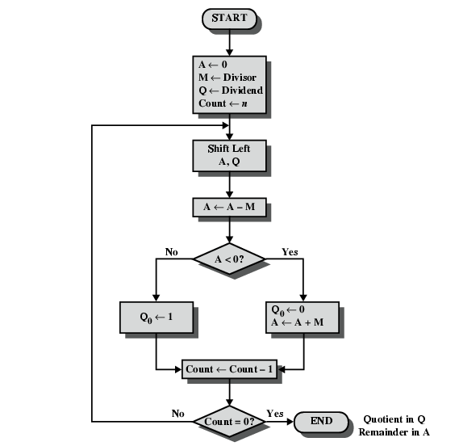
Flowchart for Unsigned Binary Division

