Slide 1
Amazon Product Review Data
Ankur Shanbhag
Hardik Shah
Rahul Thakkar
Vardhman Jain

Slide 2


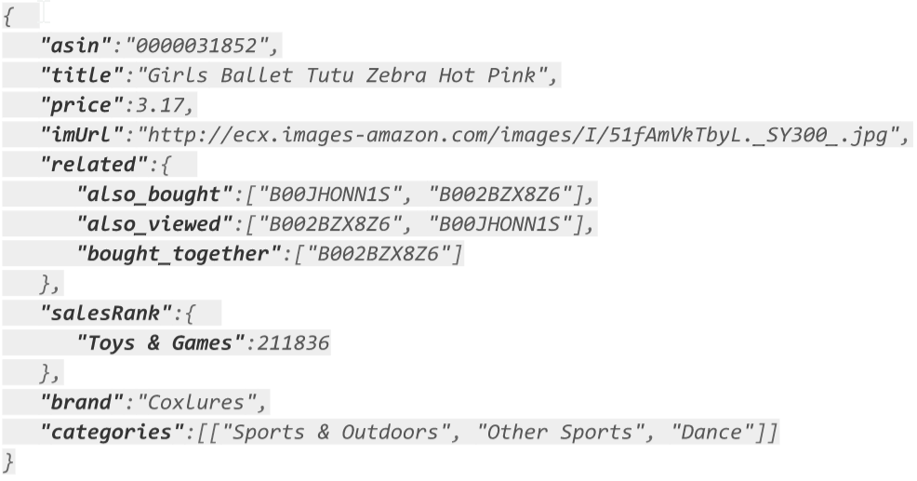
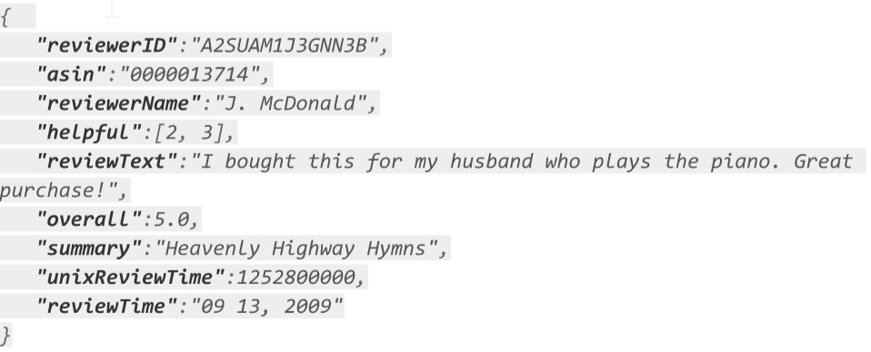
Sample Data Records:

Slide 3
Metadata and Review Join
Joined Amazon Product Metadata with User Reviews to get average review for a product
Total 24 Categories for the Join e.g. Books, Movies and TV
MapReduce Job for each category in parallel
Used multiple Mappers and GenericWritable for multiple values to Reducer
Outputted data in directories such as: “category=Books” for easy category based partitioning in Hive

Slide 4
Job Statistics
11 m3.xlarge (4 cores, 15GB RAM, 80 GB SSD) machines for Joining 24 categories
~ 63 GB of input data Metadata and Review (split across 4 S3 buckets)
Data contains 9 Millions Products with 143 Million Reviews
~ 2.5 GB of output data
~ 22 minutes for joining the Metadata and Reviews

Slide 5
Top - K Products

Slide 6
Top - K Products
Created external table in Hive which can point to pre-processed data on S3
Data partitioned by categories into files - gives good performance when running query for particular category
Hive queries for getting top - K products filtered by category and sorted by review count and average rating

Slide 7
Sample Query and Results
(SELECT asin, price, title, avg_rating, review_count FROM products where category='Books' DISTRIBUTE BY review_count SORT BY review_count DESC LIMIT 5) as s;
ASIN Price Title AvgRating ReviewCount
0439023483 , 4.99 , The Hunger Games (The Hunger Games Book 1) , 4.6 , 21400
0439023513 , 6.99 , Mockingjay (The Final Book of The Hunger Games) , 4.2 , 14114
0375831002 , 6.99 , The Book Thief , 4.6 , 12571
038536315X , 10.49 , Sycamore Row , 4.5 , 12564
0849922070 , 7.99 , Heaven is for Real Movie Edition , 4.5 , 10424

Slide 8
Job Statistics and Logs
2 m3.xlarge (4 cores, 15GB RAM, 80 GB SSD) machines used to run the hive queries
Time taken ~ 70 seconds
The input size of ~ 250 MB signifies that partitioning reduced the data read considerably visible in the following log snippet
2015-12-07 23:50:07,797 INFO [main()]: exec.Utilities (Utilities.java:estimateNumberOfReducers(3126)) - BytesPerReducer=256000000 maxReducers=1009 totalInputFileSize=252,586,462

Slide 9
Correlated Products

Slide 10
Determine Correlated Product
Every product metadata has information like also bought and also viewed before buying products.
This information can be leveraged to determine correlation between products (Generally substitute and complimentary products)
We are using Apache Spark GraphX library to find correlation among the categories.
We run simple MapReduce job to get the final count for categories in every disjoint set.

Slide 11
Disjoint Sets - Graph
The data can be represented in form of a graph and determine disjoint sets within them.
Plain Java MapReduce framework is not suitable for iterative graph algorithms.
Apache Spark has Directed Acyclic Graph (DAG) engine which is suitable for iterative algorithms. Approximately 100 times faster than traditional MapReduce.
We are using Spark GraphX library to compute disjoint sets.

Slide 12

Represent data in form of a Graph
Vertex
Adjacency List

Slide 13
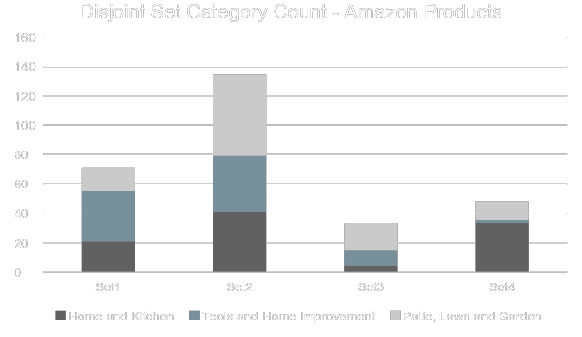
Sample Observation
~ 25 minutes to process data for 1 Million products on 4 m3.xlarge machines
Running such graph algorithms using plain MapReduce will take several hours.

Slide 14
Seasonal Peaks

Slide 15
Seasonal Peaks
- Here we find the sales of a product in every month of the year and plot on the graph and observe seasonal peaks of that product over the range of time.
- Seasonal peak of a product can be used to mark interesting events.
Assumption -: Number of reviews for a product is directly proportional to the sales of that product

Slide 16
Technical Details
JSON to CSV parser using Mapreduce
Mapreduce tasks to separate data for a specific product for the given year range which computes average monthly rating and count of reviews
JFreeChart library used to plot visualizations

Slide 17
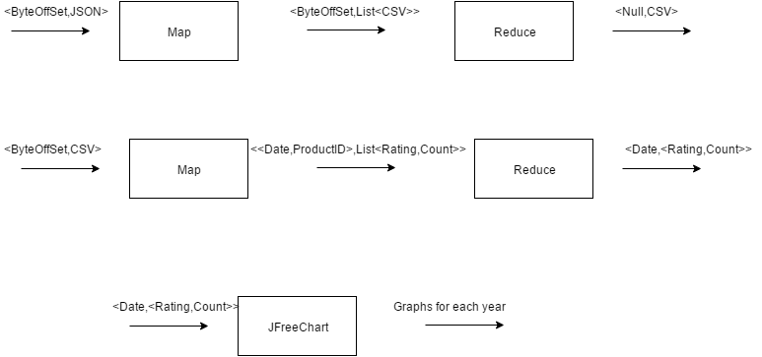
Seasonal Peak Job Flow

Slide 18
Case Studies
- Seasonal peak of flu and allergy medicines comparison with google flu trends
- BBQ grill sales higher during the summer which is synchronous with BBQ trends among people
- Harry Potter book sales peak comparison with movie release date
Notes:
--Plot the seasonal peak for various flu and allergy medicines and when this was cross checked with the google flu trend and observed that the year 2013 had seen more flu occurrence as compared to other years in recent past
--Sales of a BBQ grill clearly shows peak in Summer and a strange peaks in 2012 - 2013 winter which we guess the reason could be a good discount during thanksgiving or a warmer winter.

Slide 19
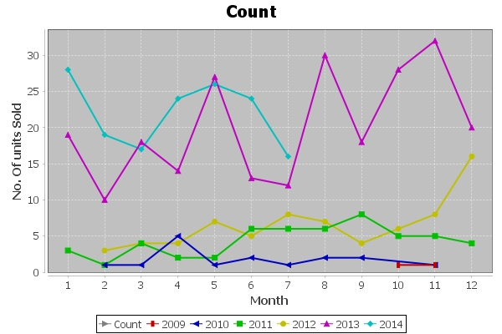
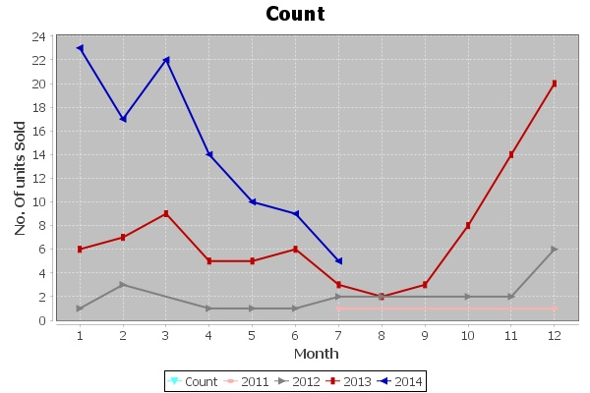
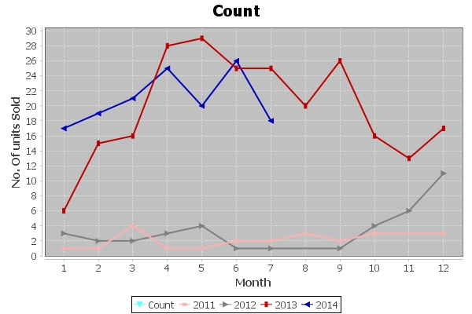
Flu and Cold Case Study
Cetrizine, Oscillococcinum, Loraditine (flu medicines) sale shows rise for year 2013.

Slide 20
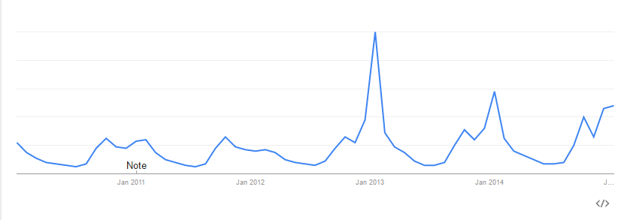
Google Trends for flu
https://www.google.com/trends/explore#q=flu&geo=US&date=1%2F2010%2061m&cmpt=geo&tz=Etc%2FGMT%2B5

Slide 21
Job Statistics
11 m3.xlarge machines (4 cores, 15GB RAM, 80 GB SSD) for data conversion from JSON to CSV
~ 45 GB of input data (split across multiple 4 user buckets)
~ 2 GB of output data
10 minutes to process the data
- 3 m3.xlarge machines used to compute monthly averages
~ 2 GB of input data (on one s3 bucket)
~ 5 minutes to process data

Slide 22
References
Image-based recommendations on styles and substitutes J. McAuley, C. Targett, J. Shi, A. van den Henge SIGIR, 2015
Inferring networks of substitutable and complementary products J. McAuley, R. Pandey, J. Leskovec Knowledge Discovery and Data Mining, 2015
Google Trends: https://www.google.com/trends/explore#q=flu&geo=US&date=1%2F2010%2061m&cmpt=geo&tz=Etc%2FGMT%2B5

Slide 23
Thank You

