Slide 1
Css Presentation
Presented By Ankur Singh

Slide 2
History
On December 17, 1996, W3C published the first standard for CSS.
Latest version
The latest version is W3.CSS 4.15 December 2020

Slide 3
CSS ( Cascading style sheet )
CSS describes how HTML elements are to be displayed on screen, paper, or in other media.
CSS saves a lot of work. It can control the layout of multiple web pages all at once.
External stylesheets are stored in CSS files.

Slide 4
CSS Selectors
A CSS selector selects the HTML element(s) you want to style.
We can divide CSS selectors into five categories:
Simple selectors (select elements based on name, id, class)
Combinator selectors (select elements based on a specific relationship between them)
Pseudo-class selectors (select elements based on a certain state)
Pseudo-elements selectors (select and style a part of an element)
Attribute selectors (select elements based on an attribute or attribute value)

Slide 5
The CSS element Selector
The element selector selects HTML elements based on the element name.
Example :
p {
text-align: center;
color: red;
}
Here, all <p> elements on the page will be center-aligned, with a red text color:

Slide 6
The CSS id Selector
The id selector uses the id attribute of an HTML element to select a specific element.
The id of an element is unique within a page, so the id selector is used to select one unique element!
To select an element with a specific id, write a hash (#) character, followed by the id of the element.
Example
#para1
{
text-align: center;
color: red;
}

Slide 7
The CSS class Selector
The class selector selects HTML elements with a specific class attribute.
To select elements with a specific class, write a period (.) character, followed by the class name.
Example :
.center {
text-align: center;
color: red;
}
Note: A class name cannot start with a number!

Slide 8
The CSS Universal Selector
The universal selector (*) selects all HTML elements on the page.
Example : The CSS rule below will affect every HTML element on the page:--
* {
text-align: center;
color: blue;
}

Slide 9
The CSS Grouping Selector
The grouping selector selects all the HTML elements with the same style definitions.
To group selectors, separate each selector with a comma.
Example :
h1, h2, p {
text-align: center;
color: red;
}

Slide 10
All CSS Simple Selectors
Selector Example Example description
#id #firstname Selects the element with id="firstname"
.class .intro Selects all elements with class="intro"
element.class p.intro Selects only <p> elements with class="intro"
* * Selects all elements
element p Selects all <p> elements
element,element,.. div, p Selects all <div> elements and all <p> elements

Slide 11
CSS Combinators
A combinator is something that explains the relationship between the selectors.
A CSS selector can contain more than one simple selector. Between the simple selectors, we can include a combinator.
There are four different combinators in CSS:
descendant selector (space)
child selector (>)
adjacent sibling selector (+)
general sibling selector (~)

Slide 12
Descendant Selector
The descendant selector matches all elements that are descendants of a specified element.
The following example selects all <p> elements inside <div> elements:
Example :
div p {
background-color: yellow;
}

Slide 13
Child Selector (>)
The child selector selects all elements that are the children of a specified element.
The following example selects all <p> elements that are children of a <div> element:
Example :
div > p {
background-color: yellow;
}
<div>
<p>Paragraph 1 in the div.</p>
<p>Paragraph 2 in the div.</p>
<section>
<!-- not Child but Descendant -->
<p>Paragraph 3 in the div (inside a section element).</p>
</section>
<p>Paragraph 4 in the div.</p>
</div>

Slide 14
Adjacent Sibling Selector (+)
The adjacent sibling selector is used to select an element that is directly after another specific element.
Sibling elements must have the same parent element, and "adjacent" means "immediately following".
The following example selects the first <p> element that are placed immediately after <div> elements:
Example :
div + p {
background-color: yellow;
}

Slide 15
General Sibling Selector (~)
The general sibling selector selects all elements that are next siblings of a specified element.
The following example selects all <p> elements that are next siblings of <div> elements:
Example :
div ~ p {
background-color: yellow;
}

Slide 16
CSS Pseudo-classes
A pseudo-class is used to define a special state of an element.
For example, it can be used to:
Style an element when a user mouses over it
Style visited and unvisited links differently
Style an element when it gets focus
Example
selector:pseudo-class {
property: value;
}

Slide 17
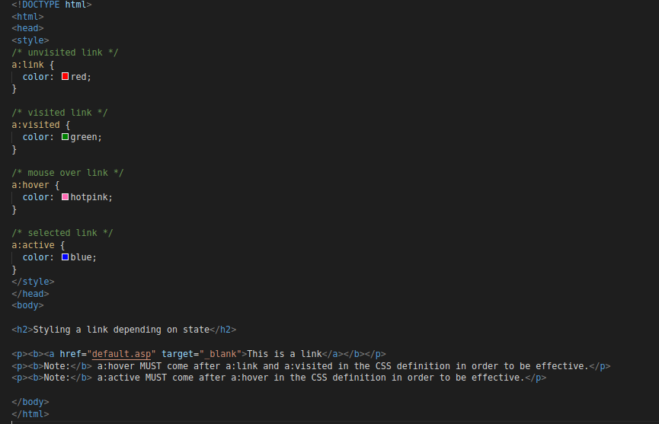
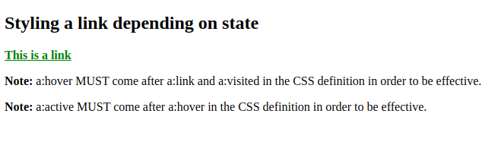
Anchor Pseudo-classes
Links can be displayed in different ways:

Slide 18
Example
/* unvisited link */
a:link {
color: #FF0000;
}
/* visited link */
a:visited {
color: #00FF00;
}
/* mouse over link */
a:hover {
color: #FF00FF;
}
/* selected link */
a:active {
color: #0000FF;
}

Slide 19
Pseudo-classes and HTML Classes
Pseudo-classes can be combined with HTML classes:
When you hover over the link in the example, it will change color:
Example :
a.highlight:hover {
color: #ff0000;
}

Slide 20
Hover on <div>
An example of using the :hover pseudo-class on a <div> element:
div:hover {
background-color: blue;
}

Slide 21
Simple Tooltip Hover
Hover over a <div> element to show a <p> element (like a tooltip):
Example :-
p {
display: none;
background-color: yellow;
padding: 20px;
}
div:hover p {
display: block;
}

Slide 22
The :first-child Pseudo-class
The :first-child pseudo-class matches a specified element that is the first child of another element.
Match the first <p> element
the selector matches any <p> element that is the first child of any element:
p:first-child {
color: blue;
}

Slide 23
The :lang Pseudo-class
The :lang pseudo-class allows you to define special rules for different languages.
In the example below, :lang defines the quotation marks for <q> elements with lang="no":
q:lang(no) {
quotes: "~" "~";
}
<body>
<p>Some text <q lang="no">A quote in a paragraph</q> Some text.</p>
</body>

Slide 24
checked Selector
Set the height and width for all checked <input> elements:
Example :
input:checked {
height: 50px;
width: 50px;
}

Slide 25
first-of-type Selector
Specify a background color for the first <p> element of its parent:
The :first-of-type selector matches every element that is the first child, of a particular type, of its parent.
Example :
p:first-of-type {
background: red;
}

Slide 26
CSS :focus Selector
Select and style an input field when it gets focus.
The :focus selector is used to select the element that has focus.
Tip: The :focus selector is allowed on elements that accept keyboard events or other user inputs.
Example :
input:focus {
background-color: yellow;
}

Slide 27
last-child Selector
Specify a background color for the <p> element that is the last child of its parent:
The :last-child selector matches every element that is the last child of its parent.
Tip: p:last-child is equal to p:nth-last-child(1).
Example
p:last-child {
background: #ff0000;
}

Slide 28
last-of-type Selector
Specify a background color for the last <p> element of its parent:
The :last-of-type selector matches every element that is the last child, of a particular type, of its parent.
Tip: This is the same as :nth-last-of-type(1).
Example:
p:last-of-type {
background: #ff0000;
}

Slide 29
link Selector
Select and style unvisited links:
The :link selector is used to select unvisited links.
Note: The :link selector does not style links you have already visited.
a:link {
background-color: yellow;
}

Slide 30
CSS :not Selector
Set a background color for all elements that are not a <p> element:
The :not(selector) selector matches every element that is NOT the specified element/selector.
Example :
:not(p) {
background: #ff0000;
}

Slide 31
CSS :nth-child() Selector
Specify a background color for every <p> element that is the second child of its parent:
The :nth-child(n) selector matches every element that is the nth child, regardless of type, of its parent.
n can be a number, a keyword, or a formula.
Example :
p:nth-child(2) {
background: red;
}

Slide 32
CSS :nth-last-child() Selector
Specify a background color for every <p> element that is the second child of its parent, counting from the last child:
The :nth-last-child(n) selector matches every element that is the nth child, regardless of type, of its parent, counting from the last child.
n can be a number, a keyword, or a formula.
Example :
p:nth-last-child(2) {
background: red;
}

Slide 33
CSS :nth-last-of-type() Selector
Specify a background color for every <p> element that is the second p element of its parent, counting from the last child:
The :nth-last-of-type(n) selector matches every element that is the nth child, of a particular type, of its parent, counting from the last child.
n can be a number, a keyword, or a formula.
Example :
p:nth-last-of-type(2)
{
background: red;
}

Slide 34
CSS :nth-of-type() Selector
Specify a background color for every <p> element that is the second p element of its parent:
The :nth-of-type(n) selector matches every element that is the nth child, of a particular type, of its parent.
n can be a number, a keyword, or a formula.
Example :
p:nth-of-type(2) {
background: red;
}

Slide 35
CSS :only-of-type Selector
Specify a background color for every <p> element that is the only child of its type, of its parent:
The :only-of-type selector matches every element that is the only child of its type, of its parent.
Example :
p:only-of-type {
background: #ff0000;
}

Slide 36
CSS :only-child Selector
Specify a background color for every <p> element that is the only child of its parent:
The :only-child selector matches every element that is the only child of its parent.
Example :
p:only-child {
background: #ff0000;
}

Slide 37
CSS ::after Selector
Insert some text after the content of each <p> element:
The ::after selector inserts something after the content of each selected element(s).
Example :
p::after {
content: " - Remember this";
}

Slide 38
CSS ::before Selector
Insert some text before the content of each <p> element:
The ::before selector inserts something before the content of each selected element(s).
p::before {
content: "Read this: ";
}

Slide 39
CSS :checked Selector
Set the height and width for all checked <input> elements:
The :checked selector matches every checked <input> element (only for radio buttons and checkboxes) and <option> element.
Example :
input:checked {
height: 50px;
width: 50px;
}

Slide 40
CSS :default Selector
Add a red shadow color to the default input element:
The :default selector selects the default form element in a group of related elements.
The :default selector can only be used on <button>, <input type="checkbox">, <input type="radio">, and <option> elements
Example :
input:default {
box-shadow: 0 0 1px 1px red;
}

Slide 41
CSS ::first-letter Selector
Select and style the first letter of every <p> element:
The ::first-letter selector is used to add a style to the first letter of the specified selector.
Note: The ::first-letter selector can only be used with block-level elements.
Example :
p::first-letter {
font-size: 200%;
color: #8A2BE2;
}

Slide 42
The following properties can be used with ::first-letter:
font properties
color properties
background properties
margin properties
padding properties
border properties
text-decoration
vertical-align (only if float is 'none')
text-transform
line-height
float
clear

Slide 43
CSS ::first-line Selector
Select and style the first line of every <p> element:
The ::first-line selector is used to add a style to the first line of the specified selector.
Example :
p::first-line {
background-color: yellow;
}

Slide 44
The following properties can be used with ::first-line:
font properties
color properties
background properties
word-spacing
letter-spacing
text-decoration
vertical-align
text-transform
line-height
clear

Slide 45
CSS ::selection Selector
Make the selected text red on a yellow background:
The ::selection selector matches the portion of an element that is selected by a user.
Only a few CSS properties can be applied to the ::selection selector: color, background, cursor, and outline.
Example :
::selection {
color: red;
background: yellow;
}

Slide 46
CSS Attribute Selectors
Style HTML Elements With Specific Attributes.
It is possible to style HTML elements that have specific attributes or attribute values
eg:-
a[target="_blank"] {
background-color: yellow;
}

Slide 47
CSS [attribute~="value"] Selector
The [attribute~="value"] selector is used to select elements with an attribute value containing a specified word.
Example:-
[title~="flower"] {
border: 5px solid yellow;
}

Slide 48
[attribute*=value]
Example:-
a[href*="ankur"]
Selects every <a> element whose href attribute value contains the substring "ankur".

