Slide 1
JS Events and Methods Document
HTML events are "things" that happen to HTML elements.
When JavaScript is used in HTML pages, JavaScript can "react" on these events ::--
An HTML web page has finished loading
An HTML input field was changed
An HTML button was clicked
Example
With single quotes:
<element event='some JavaScript'>
With double quotes:
<element event="some JavaScript">

Slide 2
Common HTML Events
Event Description
onchange An HTML element has been changed
onclick The user clicks an HTML element
onmouseover The user moves the mouse over an
onmouseout The user moves the mouse away from an HTML element
onkeydown The user pushes a keyboard key
onload The browser has finished loading the page

Slide 3
HTML DOM Events
Dblclick The event occurs when the user double-clicks on an element
Focus The event occurs when an element gets focus
Input The event occurs when an element gets user input
Keypress The event occurs when the user presses a key
Keyup The event occurs when the user releases a key
Onsubmit The event occurs when a form is submitted

Slide 4
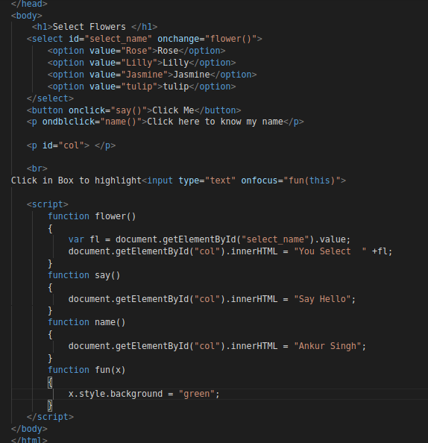
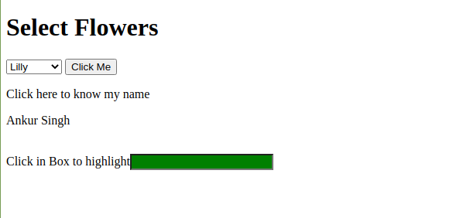
Onclick() Events

Slide 5
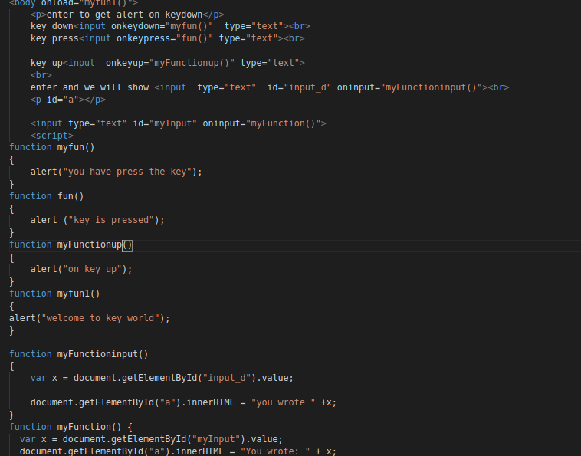
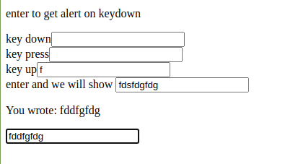
On Key Events

Slide 6
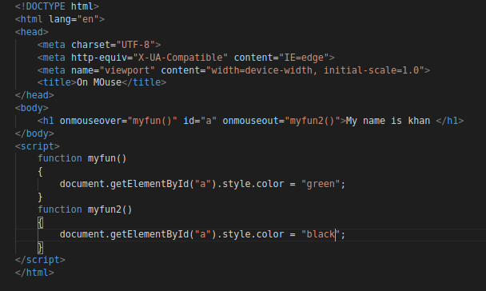
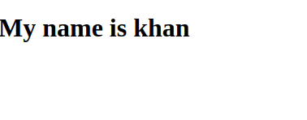
On Mouse events

Slide 7
Common String ‘& Array Methods
CharAt() filter()
Concat() find()
Indexof() map()
Replace() push()
Slice() pop()
Split() reduce()
Substring() reverse()
Tostring() sort()
Trim() shift()
Include() unshift()

Slide 8
filter()
The filter() method creates a new array filled with elements that pass a test provided by a function.
The filter() method does not execute the function for empty elements.
The filter() method does not change the original array.

Slide 9
concat()
The concat() method concatenates (joins) two or more arrays.
The concat() method returns a new array, containing the joined arrays.
The concat() method does not change the existing arrays.

Slide 10
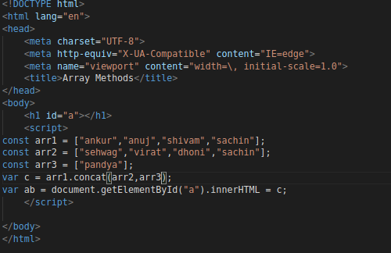
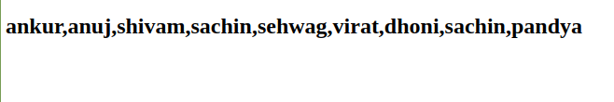
Concat()

Slide 11
Array indexOf()
The indexOf() method returns the first index (position) of a specified value.
The indexOf() method returns -1 if the value is not found.
The indexOf() method starts at a specified index and searches from left to right.
By default the search starts at the first element and ends at the last.
Negative start values counts from the last element (but still searches from right to left).

Slide 12
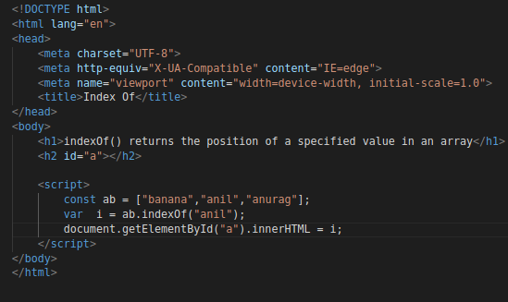
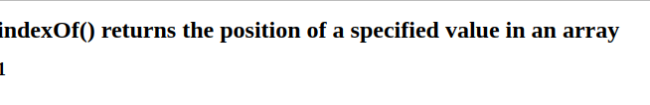
indexOf()

Slide 13
Array slice()
The slice() method returns selected elements in an array, as a new array.
The slice() method selects from a given start, up to a (not inclusive) given end.
The slice() method does not change the original array.

Slide 14
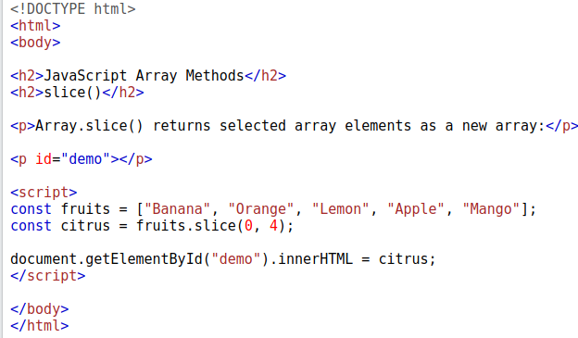
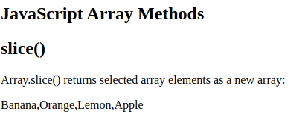
slice()

Slide 15
filter()
The filter() method creates a new array filled with elements that pass a test provided by a function.
The filter() method does not execute the function for empty elements.
The filter() method does not change the original array.

Slide 16
Array find()
The find() method returns the value of the first element that passes a test.
The find() method executes a function for each array element.
The find() method retuns undefined if no elements are found.
The find() method does not execute the function for empty elements.
The find() method does not change the original array.

Slide 17
Array map()
map() creates a new array from calling a function for every array element.
map() calls a function once for each element in an array.
map() does not execute the function for empty elements.
map() does not change the original array.

Slide 18
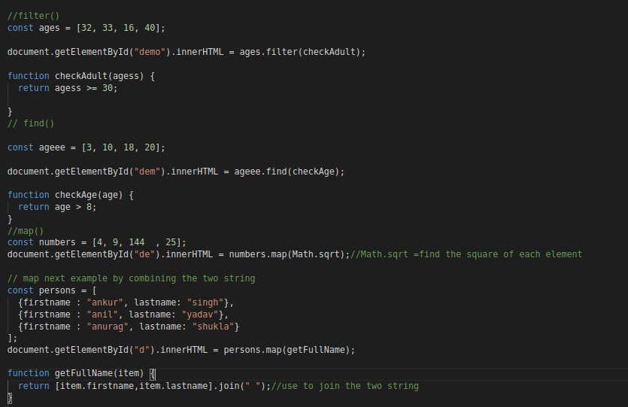
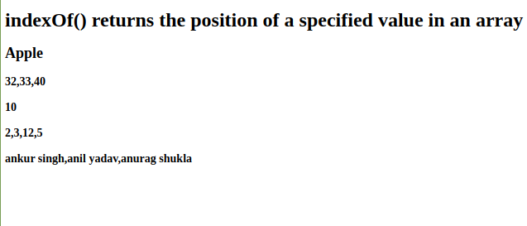
Array methods

Slide 19
Array push()
The push() method adds new items to the end of an array.
The push() method changes the length of the array.
The push() method returns the new length.

Slide 20
Array pop()
The pop() method removes (pops) the last element of an array
The pop() method changes the original array.
The pop() method returns the removed element

Slide 21
Array reduce()
The reduce() method executes a reducer function for array element.
The reduce() method returns a single value: the function's accumulated result.
The reduce() method does not execute the function for empty array elements.
The reduce() method does not change the original array.

Slide 22
Array reverse()
The reverse() method reverses the order of the elements in an array.
The reverse() method overwrites the original array.

Slide 23
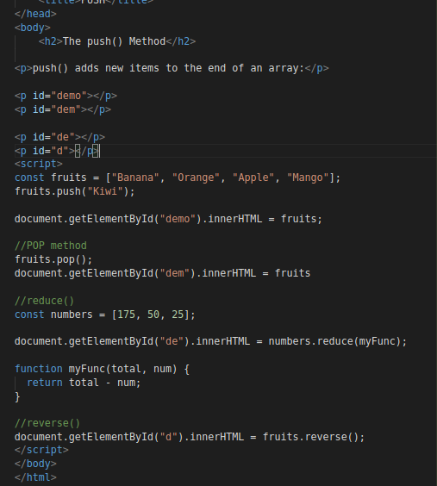
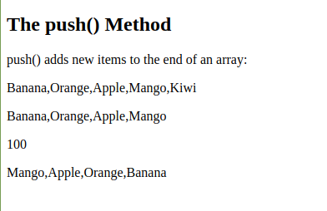
Reverse,push,pop,reduce

Slide 24
Array shift()
The shift() method removes the first item of an array.
The shift() method changes the original array.
The shift() method returns the shifted element.

Slide 25
Array unshift()
The unshift() method adds new elements to the beginning of an array.
The unshift() method overwrites the original array.

Slide 26
Array sort()
The sort() sorts the elements of an array.
The sort() overwrites the original array.
The sort() sorts the elements as strings in alphabetical and ascending order.

Slide 27
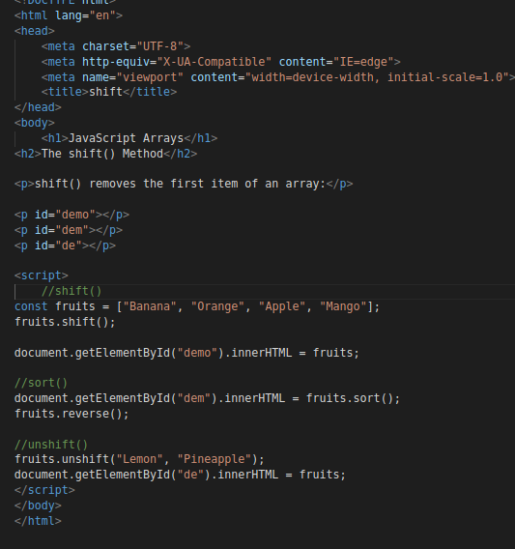
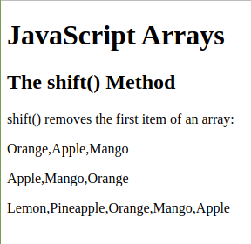
Shift,unshift,sort

Slide 28
Array includes()
The includes() method returns true if an array contains a specified value
The includes() method returns false if the value is not found.
The includes() method is case sensitive.

Slide 29
Array toString()
The toString() method returns a string with array values separated by commas.
The toString() method does not change the original array.

Slide 30
String charAt()
The charAt() method returns the character at a specified index (position) in a string.
The index of the first character is 0, the second 1, ...
The index of the last character is string length - 1 .

Slide 31
String substring()
The substring() method extracts characters, between to indices (positions), from a string, and returns the substring.
The substring() method extracts characters from start to end (excusive).
The substring() method does not change the original string.
If start is greater than end, arguments are swapped: (1, 4) = (4, 1).
Start or end less than 0 are treated as 0.

Slide 32
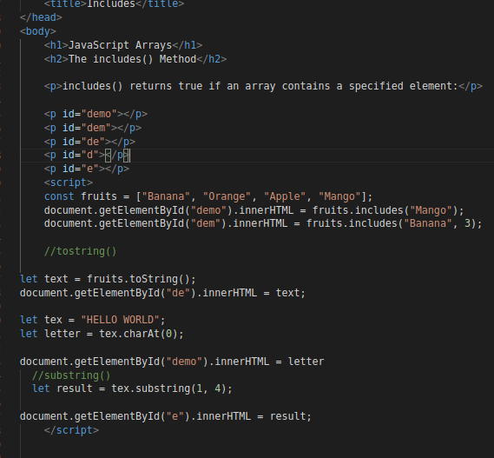
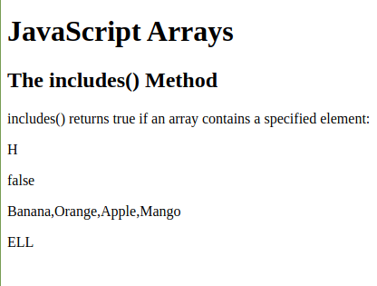
Include,tostring,substring

