Slide 1
Semi-Supervised Multi-View Correlation Feature
Learning with Application to Web Page Classification
Team - 45 (Random_Team_2)
Ankur Srivastava (2018900080)

Slide 2
Background
Webpage data is often multi-view and high-dimensional, and the webpage classification application is usually semisupervised.
Due to these characteristics, using semisupervised multi-view feature learning (SMFL) technique to deal with the webpage classification problem has recently received much attention.

Slide 3
Web Page Classification has three characteristics
Webpage is a kind of multi-view data since it usually contains two or more types of data, ex - text, hyperlinks and images, where each type of data can be regarded as a view. These multiple views describe the same webpage. Multi-view learning is concerned with the problem of machine learning from data represented by multiple distinct feature sets. Like in web-page classification, a web page can be described by the document text itself and at the same time by the anchor text attached to hyperlinks pointing to this page.
Webpage classification is a semisupervised application, since labeled pages are harder to collect compared to unlabeled pages in practice.
Webpage data is high-dimensional, since webpages usually contain much information.

Slide 4
Correlation Analysis
Considering the three characteristics, it is crucial to design effective semi-supervised multi-view feature learning (SMFL) methods.
The point is how to effectively utilize the correlation information among multi-view of webpage data is an important research area.
Correlation analysis on multi-view data can facilitate extraction of the complementary information.
Two webpage classification methods taking these three characteristics into account have been developed, namely semi-paired and semi-supervised generalized correlation analysis (SSGCA) and uncorrelated semi-supervised intra-view and inter-view manifold discriminant (USI2MD).

Slide 5
Motivation and Contribution
The correlation information from inter-view and intra-view depicts association relation among multiple views which has close connection with classification.
To recap - the term intra-view means relationship between samples within a certain view. And inter-view means samples across different views.
Most of the current webpage classification methods do not consider all three characteristics of webpage classification.
Also currently most of SMFL methods do not consider correlation information.
For few there exists room to for improvement.

Slide 6
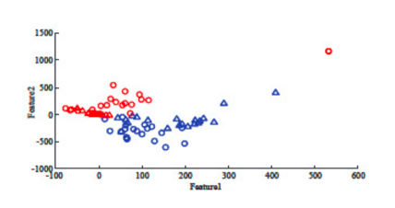
Cont ..
Sample Distribution of 40 webpage samples in the WebKB dataset, where RED and BLUE colors denote two views.
Here we are finding that samples of different views own small correlation and between-class samples within each view own relatively large correlation.

Slide 7
Cont ..
Therefore we would be maximizing the correlation of samples from different views while in the same class and minimize the correlation of samples in the same view wule from different classes to make the distribution more favourable for classification.

Slide 8
Drawbacks in the current SMFL methods
Some of the Existing SMFL methods do not consider the correlation information
For other there exists much room to improve their discriminant abilities, since
They do not explore intra-view correlation information.
They simply maximize the correlation from both intra-view and inter-view, which cannot make full use of the discriminant correlation from the aspect of classification.
They only maximizes the inter-view within-class correlation without considering the inter-view between-class correlation.

Slide 9
Summary of the new approach
Semi-supervised Multi-view Correlation Feature Learning (SMCFL)
The objective function is designed to maximize correlation b/w intra-class samples and minimize inter-class correlation.
The solution is global optimal and can be derived analytically without iterative calculation. We transform the matrix variable based non-convex objective function into a convex quadratic programming problem with 1 real var.
It's verified on a widely used webpage dataset and can outperform state of art webpage classification methods.

Slide 10
Dataset
http://www.cs.cmu.edu/afs/cs.cmu.edu/project/theo-51/www/co-training/data/
The WebKB dataset contains 1051 webpages from two classes (230 pages in the course class and 821 pages in the non-course class).
Each webpage is characterized by the page view and the link view.

Slide 11
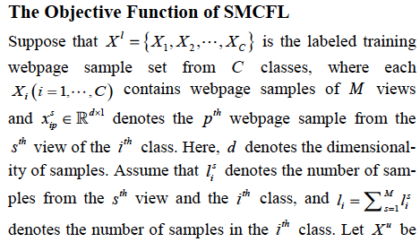
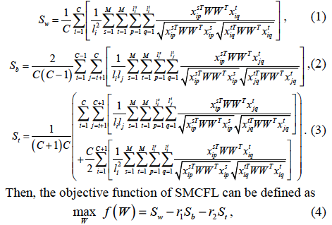

Objective Function

Slide 12

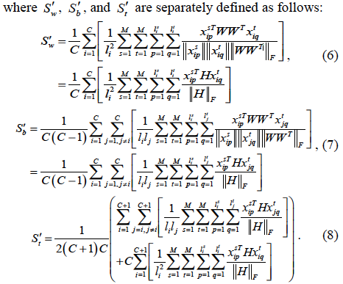
We relax (4) into the following formulation:

Slide 13
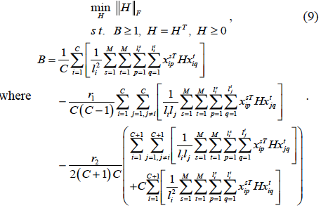
(5) can be further translated into

Slide 14

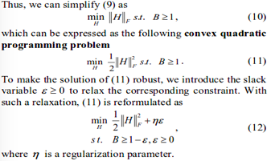
Solution of SMCFL

Slide 15
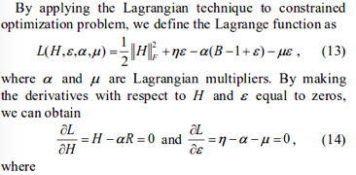
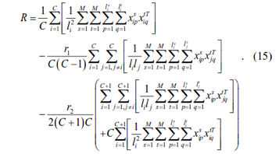

Slide 16
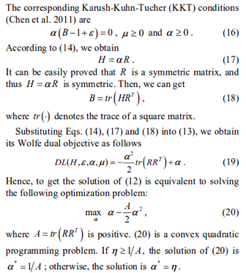
Cont ..

Slide 17
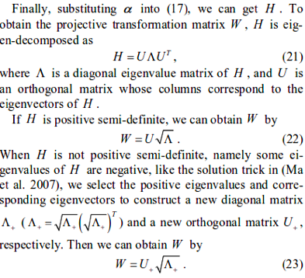
Cont ..

Slide 18
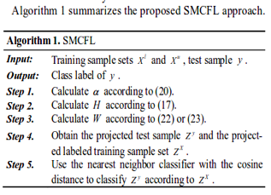
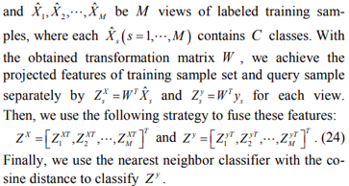
Solution of SMFCL - The Algorithm

Slide 19
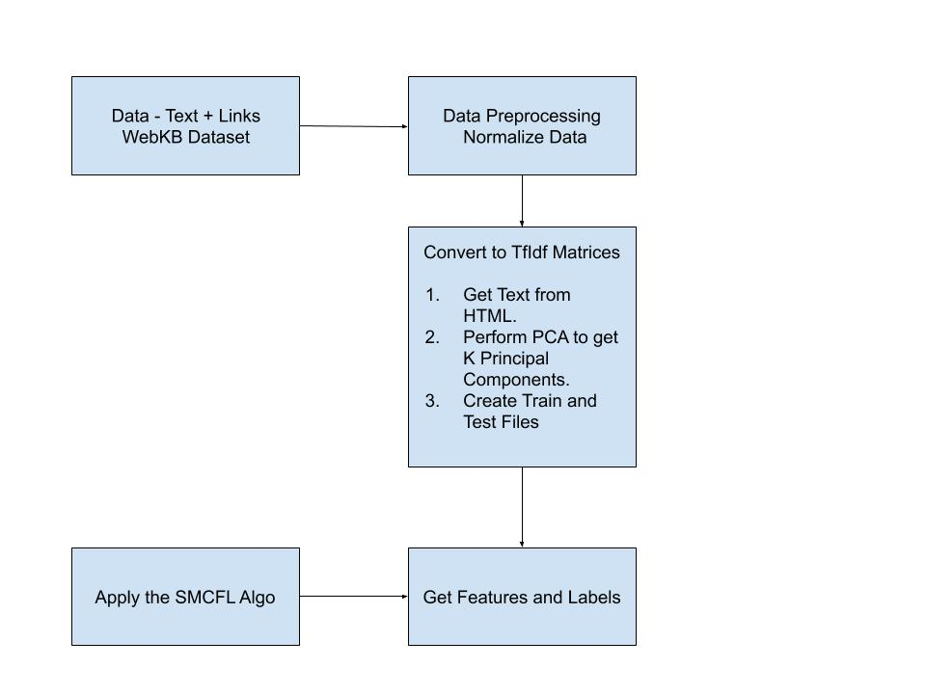
Design

Slide 20
THANK YOU !!

