Slide 1

Organization Name:
Department of Empowerment of Persons with Disabilities(Divyangjan) , Ministry of Social Justice and Empowerment
Problem Statement Title:
Development of a Web-based platform and mobile app for storing and sharing information about accessible Buildings/Offices/Public Places/Bus Stops/Railways/Marketplace/Schools etc.
Category : Software
PS Code: RK762 Theme Name: Smart Automation
Team Name: Pro-Code Team Leader: Sarwesh Khairnar

Slide 2
Idea/Approach Details
Disabled Specially Abled
We are going to develop maps based solution for web and mobile platforms. There will be three types of users Business owners, Surveyor/Visitor(Person who visited the place earlier) and Disabled user. Information like Ramps, handrails, accessible toilets, Braille signage, accessible counters, lifts, wheelchairs etc. will be displayed with supporting images to the disabled user. User description as follows:
Disabled User
Disabled user will be able to search a place just like google maps and will get all information in a click. Voice based instructions will be provided on long click on options. Voice based location search will also be available. For Navigation, Directions purpose we rely on Google Maps.
Business owners
They will play important role by adding location, details, images of place/business while registration. We can add private as well as public places through this solution. Doing this will increase footfall of customers for owners and make specially abled people comfortable to visit.
Visitor/Survey User
A pop-up notification to rate and give information will be displayed to the user whenever he/she visits particular location just like google maps does. User can voluntarily come and take survey too. This information will be treated as supporting information and shown to user.
Please refer this link for ARCHITECTURE: Process Flow.png
Please refer this link for basic prototype: Prototype.mp4
Technology stack:
Because of wide use and faster Android app development : Java/Kotlin/Flutter, Android SDK
For creating UI of application: XML/Jetpack Compose
For integrating maps and related technologies in app and website: Maps SDK, Geocoding, Places API.
For real time CRUD operations and scalability: Firebase
Front-end for web app: HTML + CSS + JS

Slide 3
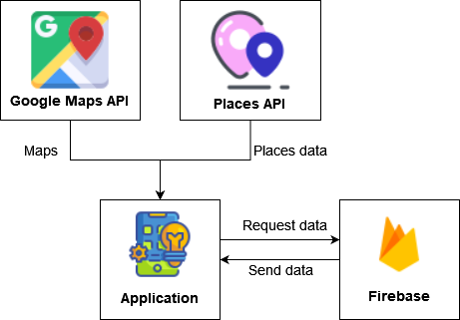
Technical Details
For map based feature we use google maps and places API because google has huge amount of location data and it is quite fast, reliable as well as cheap as it supports “Pay as You Go” model.
For backend we will be using Firebase. The only reason for this is firebase is a real-time database which is our main use case. Also, it’s quite fast compared to other databases.
For web fronted we are going to use HTML, CSS, JavaScript as normal web frontend stack.
For android we are going to use Kotlin. Because in India more then 90% people use android then iOS. Also, native development is preferred on cross platform development. Each of them have their pro and cons but still we prefer native development.
For implementing push notifications and taking surveys we use Geofencing to get entry and exit trigger of user location fence.
Fig: Technology Working

Slide 4
Approach Details
Use Cases:
Dependencies
This solution can be used by millions of specially abled people as well as their relatives.
Business owners, government organizations will also use this solution for adding their places and it’s information.
Through this they can make their business/place available for many other users.
Another use case is for anyone who want’s to join cause, do good stuff can give information about places to the app.
This will increase efficiency of data and provide more accurate information to users.
We use google maps in day to day life just like that user will use this solution in day to day life.
What if user using the app/website can’t see.
But to overcome this we will add voice based feature to the app/website.
Another show stopper is awareness.
We can run awareness sessions and campaigns to spread awareness regarding all these things.
Internet connection is also one of the dependency. Because, without internet connection location service can’t work.
The solution for this is also spreading awareness.

Slide 5
We are “Pro-Code”
Team Lead: Sarwesh Khairnar
B. Tech Stream: AI & DS Year: II
Member 1: Diksha Prasad
B. Tech Stream: AI & DS Year: II
Member 2: Rohan Golawar
B. Tech Stream: AI & DS Year: II
Member 3: Arnav Dhiwar
B. Tech Stream: AI & DS Year: II
Member 4: Sarthak Wakchoure
B. Tech Stream: AI & DS Year: II
Member 5: Sumit Bhoite
B. Tech Stream: AI & DS Year: II

