Slide 1

ONLINE ADVERTISEMENT MANAGEMENT
DONE BY-
ANKUR JAISWAL(11500112051)
DEBAJYOTI BISHNU(11500112065)
PAVNEET KAUR(11500112088)

Slide 2


INTRODUCTION
Online Advertising Management System provides and interface where advertisers and content providers meet together. The project provides a tool for classified advertisements to be embedded in targeted webpages who provide space to advertisers.
PORTAL

Slide 3


objectives
Websites as Publishers
Generating Advertising Revenue
Generating Consumer Interest
Target specific customer

Slide 4
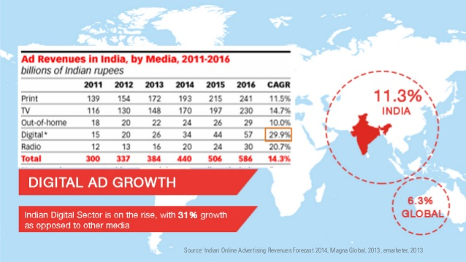
statistics

Slide 5



Software specifications
NETBEANS IDE 8.1
WAMPP SERVER
MySQL 5.5

Slide 9
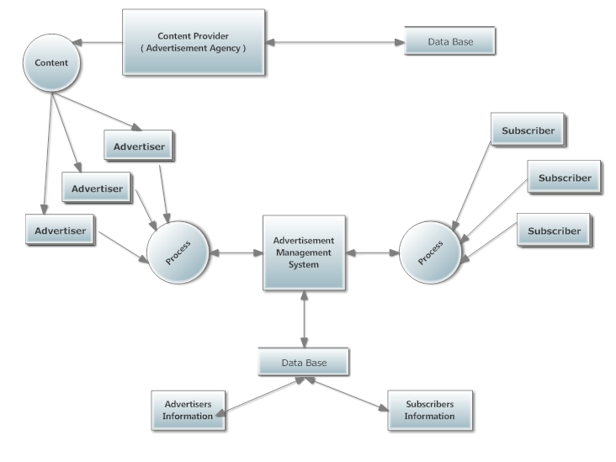
Data flow diagram

Slide 10
Project flow

Slide 11

Home

Slide 12

SIGN UP

Slide 13

CHOOSE ADVERTISEMENT TYPE

Slide 14
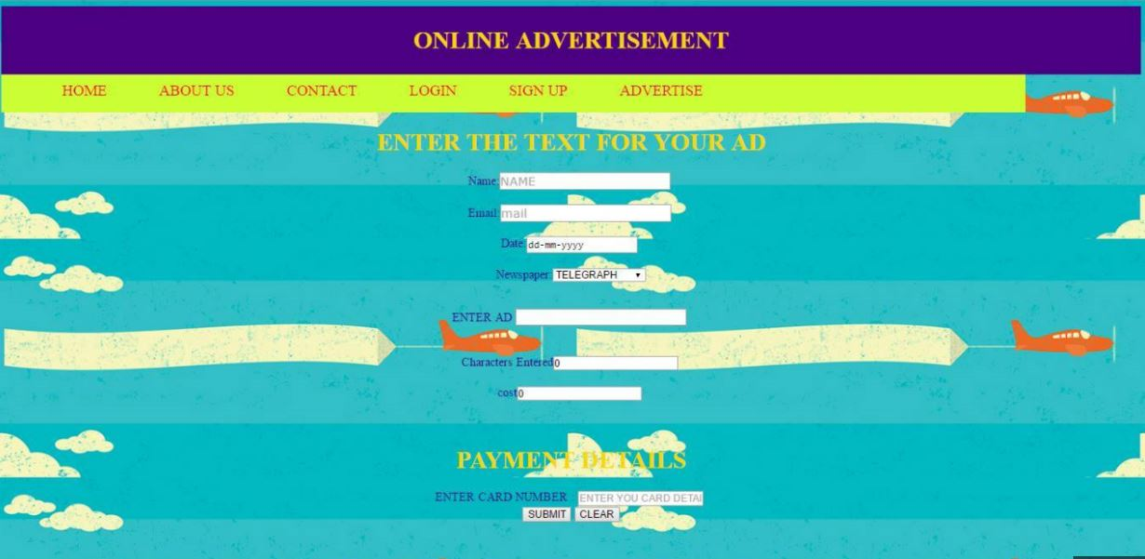
CHOOSING TEXT AD

Slide 15

Confirmation message

Slide 16
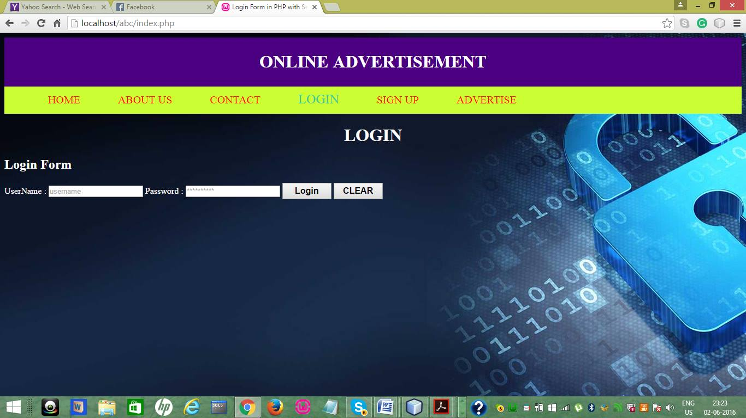
Login for content providers

Slide 17

Content provider moderation

Slide 18
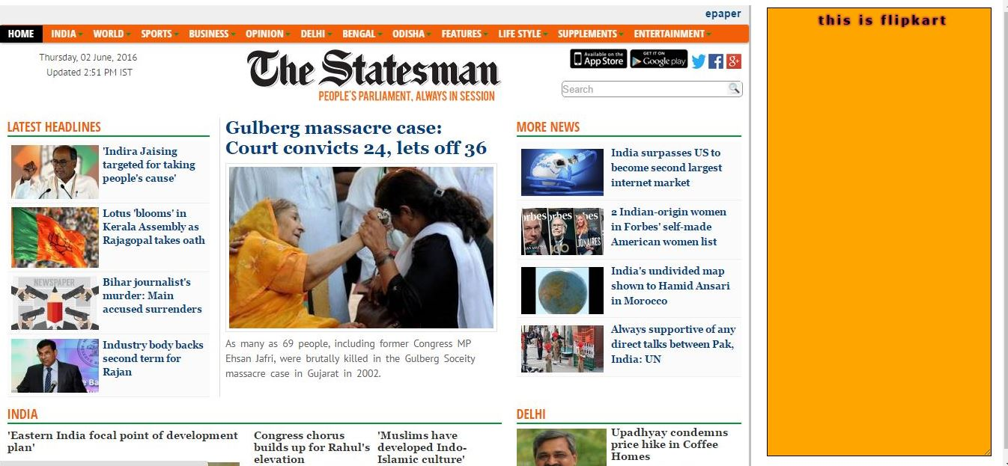
Website displaying ad

Slide 20
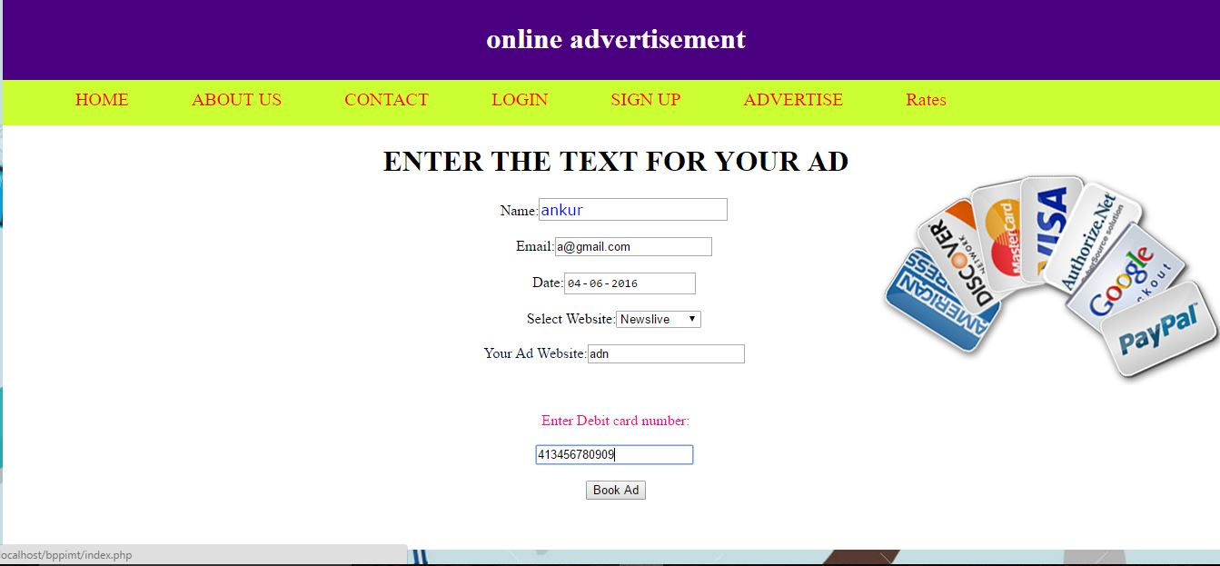
FILLING BANNER AD

Slide 22
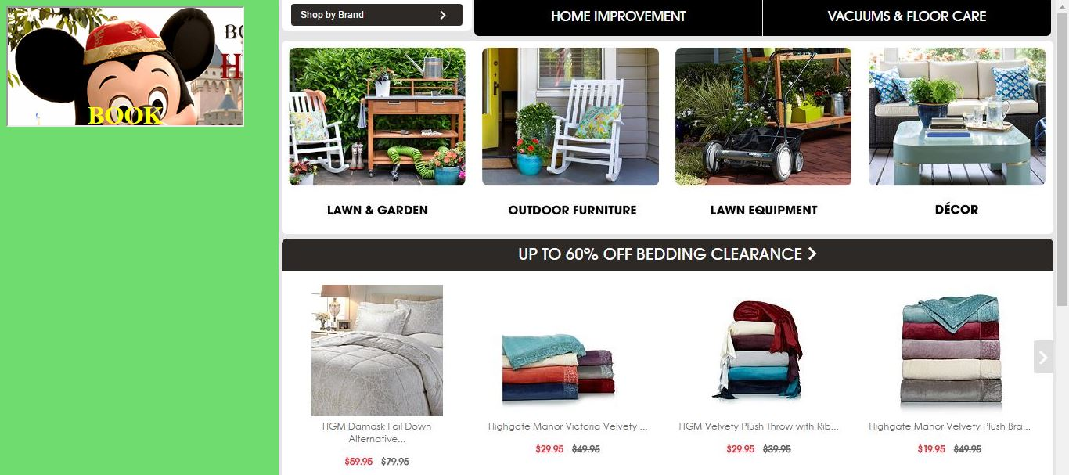
WEBSITE WITH BANNER AD

Slide 23

ONE CLICK TO AD SITE

Slide 24
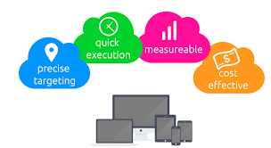
advantages
Extensive Coverage.
Large Capacity Information.
Strong Interaction.
Accurate Delivery goals.
Easy interaction between advertisers and content providers.

Slide 25

Future scope
Some of the features that we would like to add are:
Adding a feature of giving rating to content provider and advertiser
Online chat feature for support and customer care
Pay per click system of advertisement
Auto-play video ads
Email notification to our subscribers on expiry of there service

Slide 26

Maintenance and conclusion
The system code is flexible and hence can be reused.
As all the modules are being tested so the codes are almost bug free.
Easy to maintain code.
When the database will be exhausted, next major maintenance is likely to happen

Slide 27


