Slide 1
Sorting Visualizer
Overview of Various Sorting Algorithms
Made By:
Ankur Kumar 2022EEB1154
Rahul Yadav 2022MEB1334
Soumy Bisht 2022EEB1347
Sumer Bassi 2022MEB1351
Date: November 9, 2024

Slide 2
Sorting Algorithms Included
List of Algorithms:
- Insertion Sort
- Selection Sort
- Quick Sort
- Heap Sort
- Radix Sort
- Counting Sort
- Bubble Sort
- Merge Sort

Slide 3
STRUCTURE OF THE PROJECT
Basic Structure & JavaScript Logic
Basic Structure (HTML):Array Display: A <div> container holds the visual array representation as vertical bars.
Control Buttons: Enable users to select and trigger sorting algorithms.
Sliders: Adjust array size and speed for custom visualization.
JavaScript Logic:Random Array Generation: Uses Math.random() to create an array with random heights.
Sorting Functions: Algorithms (Bubble, Quick, Merge, etc.) are implemented with real-time updates.
Visualization Control: Bars change colors on comparisons/swaps using async-await for timing.

Slide 4
Bubble Sort
Description: Bubble Sort is a simple sorting algorithm that repeatedly steps through the list, swapping adjacent elements if they are in the wrong order.
How It Works: Each pass moves the largest unsorted element to its correct position at the end, "bubbling" it up to the sorted section.
Best Use Case: Small datasets or educational demonstrations.
Time Complexity: Best: O(n), Average/Worst: O(n²)

Slide 5
Insertion Sort
Description: Insertion Sort builds the sorted list one item at a time by comparing each new element with the ones before it and inserting it in the correct position.
How It Works: It starts with the first element (considered sorted) and takes the next unsorted element, compares it backward with sorted elements, and shifts items to make space until it finds the right position.
Best Use Case: Small or nearly sorted datasets.
Time Complexity: Best: O(n), Average/Worst: O(n²)

Slide 6
Selection Sort
Description: Selection Sort repeatedly finds the smallest element from the unsorted section and moves it to the sorted section.
How It Works: In each iteration, it selects the minimum element and swaps it with the first unsorted element, slowly building a sorted section at the array’s beginning.
Best Use Case: Simple, small datasets where memory usage is a concern.
Time Complexity: O(n²) for all cases

Slide 7
Quick Sort
Description: Quick Sort is a fast, divide-and-conquer sorting algorithm that works by selecting a “pivot” and partitioning elements around it.
How It Works: The array is divided based on the pivot: elements less than the pivot go to the left, and elements greater go to the right. This partitioning is applied recursively to subarrays.
Best Use Case: Large datasets and when average performance is prioritized.
Time Complexity: Best/Average: O(n log n), Worst: O(n²)

Slide 8
Merge Sort
Description: Merge Sort is a stable, divide-and-conquer sorting algorithm that divides the list into halves, sorts each half, and then merges them back together.
How It Works: The array is split until each part contains a single element. Then, adjacent parts are merged in a sorted order, building up a sorted array.
Best Use Case: Large datasets where stable sorting is required.
Time Complexity: O(n log n) for all cases

Slide 9
Heap Sort
Description: Heap Sort uses a binary heap structure to efficiently sort elements by repeatedly removing the root of the heap.
How It Works: It first builds a max-heap (where the highest value is at the root). Then, the root (largest element) is swapped with the last element, removed, and the heap is restructured. This continues until all elements are sorted.
Best Use Case: When memory use is critical and stability isn't required.
Time Complexity: O(n log n) for all cases

Slide 10
Counting Sort
Description: Counting Sort is a linear-time sorting algorithm that counts occurrences of each value and uses this count to determine each element’s correct position.
How It Works: It first creates a frequency array to count occurrences, then transforms this into cumulative counts to place each element at the correct position.
Best Use Case: Sorting integers within a limited range.
Time Complexity: O(n+k), where k is the range of input values

Slide 11
Radix Sort
Description: Radix Sort is a non-comparative algorithm that sorts numbers by processing individual digits or characters.
How It Works: It sorts numbers by each digit from the least significant to the most significant, using another stable sorting algorithm like Counting Sort at each digit level.
Best Use Case: Sorting integers or strings with a fixed width, especially when keys have multiple digits or characters.
Time Complexity: O(nk), where k is the number of digits

Slide 12
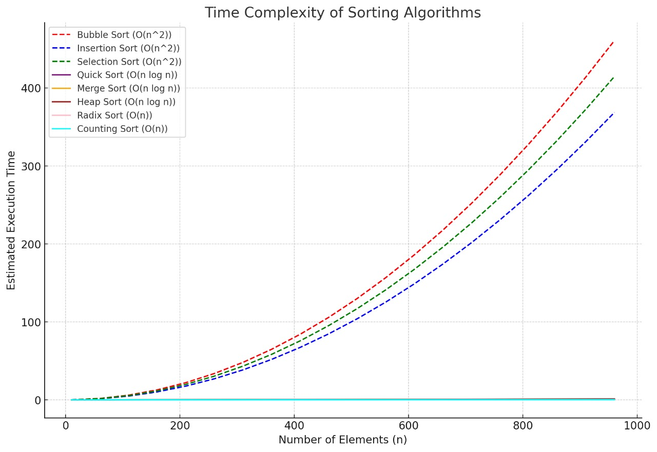
Time Complexities of Each Algorithm

Slide 13
TIME COMPLEXITIES
.
CASE | BUBBLE | SELECTION | INSERTION | MERGE | QUICK | HEAP | COUNTING | RADIX
BEST CASE | O(n) | O(n²) | O(n) | O(n logn) | O(n logn) | O(nlogn) | O(n+k) | O(nk)
AVG CASE | O(n²) | O(n²) | O(n²) | O(n logn) | O(n logn) | O(nlogn) | O(n+k) | O(nk)
WORST CASE | O(n²) | O(n²) | O(n²) | O(n logn) | O(n²) | O(nlogn) | O(n+k) | O(nk)

Slide 14
Conclusion
- The Sorting Visualizer project effectively demonstrates the inner workings of multiple sorting algorithms, making complex processes accessible and interactive. By providing real-time feedback through animations, color-coded comparisons, and customizable controls, the visualizer not only enhances user understanding but also allows hands-on exploration of each algorithm's efficiency and behavior with various data sizes.
This project highlights key programming and visualization techniques, such as asynchronous JavaScript for timing control and CSS for smooth animations, which together create an engaging educational tool. In sum, the Sorting Visualizer offers a powerful approach to learning algorithms, bridging the gap between theoretical concepts and practical application.

