Slide 1
DBT (Data Build Tool) on Snowflake Training
Ankur Sahu https://www.linkedin.com/in/ankur-sahu-ab30255a/

Slide 2
Content
Introduction
Set-up : DBT Core/Cloud
Config YAML's
dbt CLI commands
Models & Sources
Increment models
Snapshots
Seeds
Macros
Jinjas
Hooks
Variables
Tests
DBT Documentation

Slide 3
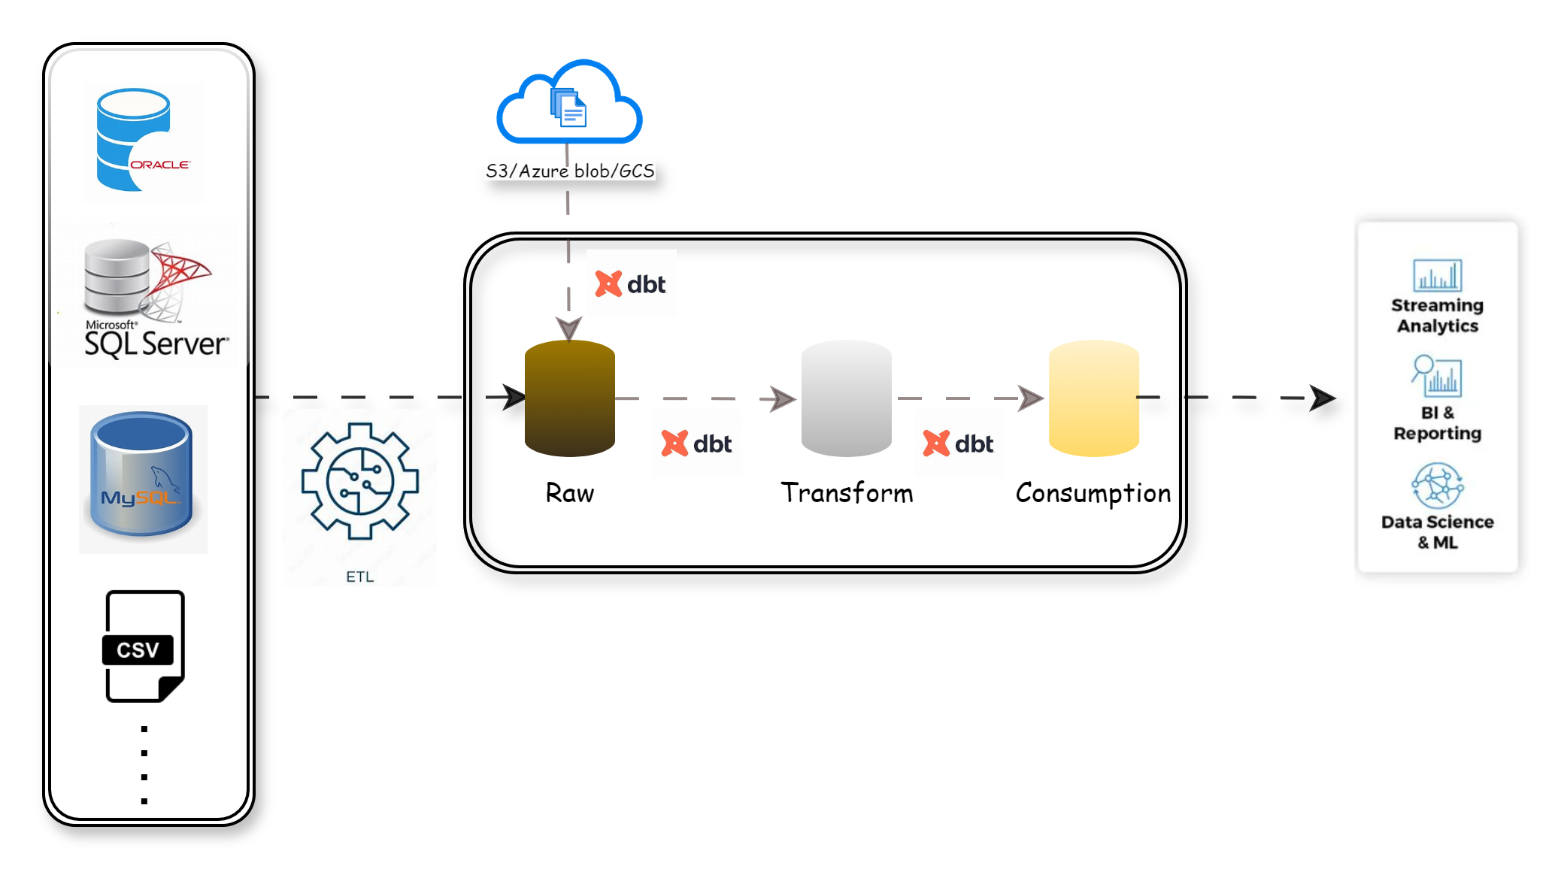
Introduction
Why Use dbt?
Version Control: Keeps track of changes using Git, like how Word tracks edits in a document.
Modularity: Breaks big tasks into smaller, manageable pieces called as Models consists SELECT SQL.
Documentation: Automatically writes down what was done, like a recipe book.
Testing: Has built-in tools to check if everything is working correctly.
Orchestration: DBT Cloud/Any workflow manager (e.g. Airflow)

Slide 4
dbt vs. ETL
 | dbt | ETL
Approach | Focus on SQL based transformation Example: Transforming raw sales data into a table showing total sales per region. | Focus on extraction ,transformation Example: Extracting sales data from multiple systems (ERP, CRM), transforming it to standardize formats, and loading it into a data warehouse.
Simplicity | Uses simple SQL for transformations. Example: Model consists SELECT SQL for transforming raw sales data into a table showing total sales per region. | Often requires complex coding or specialized tools use UI or proprietary scripting languages.. Example: Each ETL tool like IICS, Talend, Matillion require significant understanding for tool usage.
Modularity | Breaks transformations into small, reusable pieces. Example: Creating a base model for sales data that other models can reference to calculate metrics like total sales, average sales, etc. | Typically, large monolithic processes. Example: There will be workflow each data pipeline which will be isolated to that workflow and complex to build dependences between data pipelines .
Version Control | Integrates Well with Version Control Systems Example: Using Git branches for development, ensuring changes to transformation logic are reviewed and tracked which are in SQL or YML without any conversion to different format. | Limited built-in version control or uses proprietary systems. Example: In general, the ETL tool code is maintained as binary or JSON any other format which are versioned and are not easier to interpret by glancing through.
Documentation | Automatically Generates Documentation and Data Lineage Example: Generating a visual map showing how raw data flows through different transformation steps to the final output | Often Requires Manual Documentation. Example: Manually creating diagrams or documentation to illustrate the flow of data from source systems to the data warehouse.
Complexity and Maintenance | Simplifies Transformation Processes, Easier to Maintain Example: Updating a transformation logic in one place and having it propagate to all dependent models. | Can Become Complex and Harder to Maintain Example: Maintaining separate scripts and configurations for extraction, transformation, and loading stages, each requiring specialized knowledge.
Testing | In-built testing capabilities for data quality. | Testing is often manual or requires additional tools.
Setup | Easier setup with SQL knowledge. | Setup can be complex and may require extensive training.

Slide 5
DBT Core Set-up
Pre-requisites
Python
Python Python Releases for Windows | Python.org
DBT Library – pip install dbt-snowflake
Visual Source Code
Install https://code.visualstudio.com/docs/?dv=win64user
Python Install extension for Python & set python interpreter (Ctrl+Shift+P)
Snowflake
Snowflake Trial
Github : GitHub
Snowflake
Snowflake Trial
Cloud registration link: dbt Labs | Transform Data in Your Warehouse (getdbt.com)
For DBT cloud setup info, please refer. https://docs.getdbt.com/docs/cloud/about-cloud-setup

Slide 6
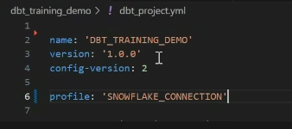
Config Yaml’s
About dbt_project.yml
It’s the main configuration file for dbt project which helps dbt understand the structure the project and defines how dbt should behave and where to find your models , tests and data etc.
By default, dbt looks for the dbt_project.yml in your current working directory and high level holds below .
Project Configuration: It sets the name of the project, the dbt version, and the configuration profile to use.
Profile: Database profile name from profile.yml.
Path Configuration: It defines paths for models, tests, seeds, macros, snapshots, and analyses…
Macro Management: One can define custom macros and specify their scope.
Materialization Configuration: It provides option to set directory/Sub-directory level materialization for models.
Hooks: Configure pre/post hooks.
Version Control: Specifies which version of dbt is required for the project, ensuring compatibility.
Variable: Define project level global variables.
For more details refer dbt_project.yml | dbt Developer Hub (getdbt.com).

Slide 7
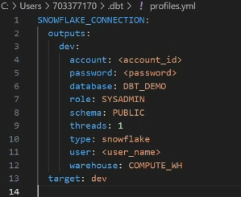
Config Yaml’s
About profiles.yml
For DBT Core, profiles.yml file is required to store connection details.
It can have multiple profiles defined and which one to be used is mentioned in dbt_project.yml configuration file.
Environmental variables can be used to avoid passing sensitive information like password in profile.
Need to define below parameters for Snowflake connection in profiles.yml.
dev Indicates that this configuration is for the development environment.
account Snowflake account name which includes region in it (e.g., string.region.snowflakecomputing.com)
database Target Snowflake database (e.g., DBT_DEMO).
password Password for the specified user.
role Snowflake role (e.g., SYSADMIN).
schema Schema within the database (e.g., RAW).
threads Number of threads for parallel processing (e.g., 3).
type Database type (e.g., snowflake).
user Snowflake username.
warehouse Snowflake virtual warehouse (e.g., COMPUTE_WH).
target Specifies the target environment for the dbt project
Note: DBT Cloud does not need profiles.yml file.
For more details refer About profiles.yml | dbt Developer Hub (getdbt.com).

Slide 8
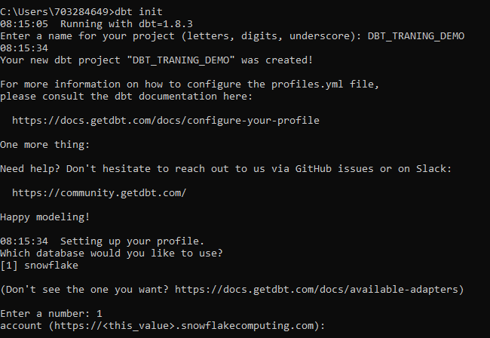
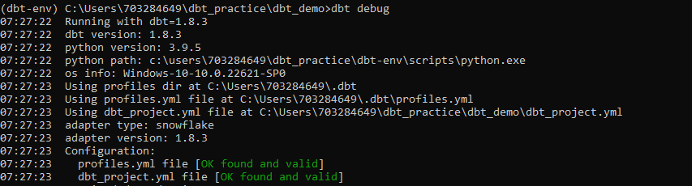
dbt CLI commands
Below is list of DBT commands
dbt init
dbt debug
dbt show
dbt compile
dbt seed
dbt source freshness
dbt run
dbt test
dbt snapshot
dbt build
dbt docs serve
dbt docs generate
Dbt empty
There are various option can be provided along with above commands.
Select
Exclude
Graph Selector
Method Selector
For more details refer: https://docs.getdbt.com/reference/dbt-commands

Slide 9
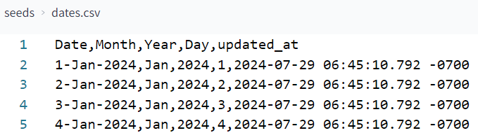
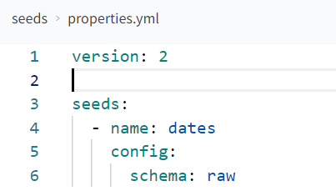
Seeds
Seeds are CSV files saved under seeds directory that can be used to load data which changes infrequently into your data warehouse using dbt seed command.
Seeds can be referenced in the downstream models using ref() function.
You can configure the properties for seed in either dbt_project.yml file or properties.yml file in seeds directory.
For more details refer: Seed | dbt Developer Hub (getdbt.com)
seeds/dates.csv file
Seeds/properties.yml file

Slide 10
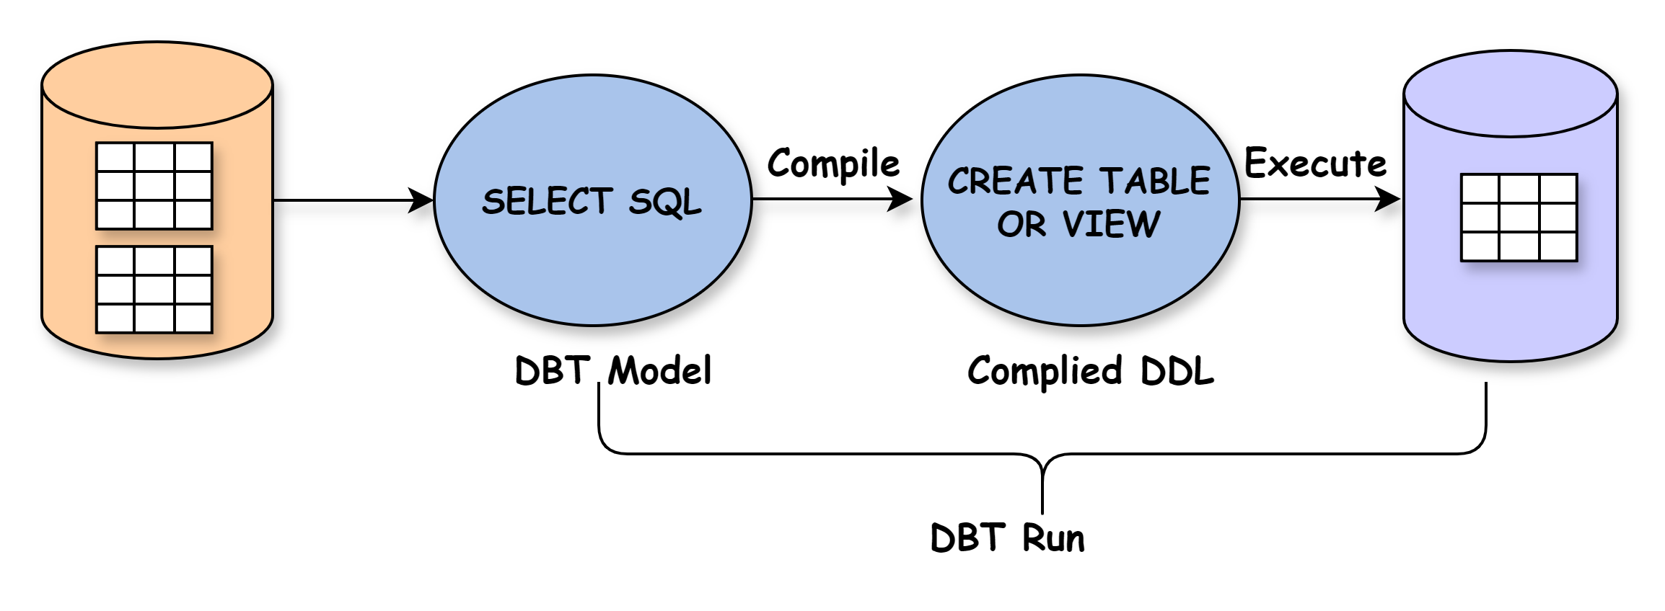
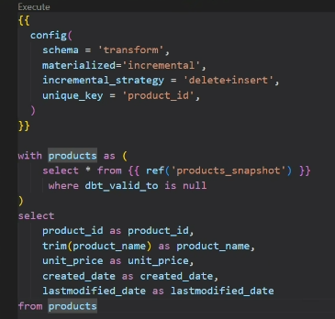
Models
Dbt – SQL Models
Models are primarily written as a SELECT statement and saved as a .sql file.
In a project it can have multiple models, and models can even reference each other.
Each dbt model name should be unique across project and the model name is inherited from the filename.
When you execute the dbt run command, dbt will build this model in data warehouse by wrapping it in a create view as or create table as statement as per materization in config.
For more details refer: About dbt models | dbt Developer Hub (getdbt.com),
SQL models | dbt Developer Hub (getdbt.com)

Slide 11
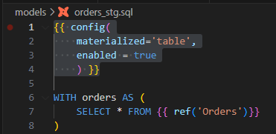
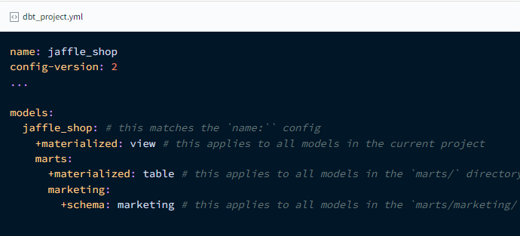
Configuring Model materializations
Method 1 inside Model .sql file
Configurations are "model settings" that can be set in your dbt_project.yml file, and in your model, file using a config block.
With configuration we can change the materialization that determines the SQL which dbt uses to create the model as a table/view in warehouse.
There are five types of materializations built into DBT
View
Table
Incremental
Ephemeral
Materialized view
For more details refer: About dbt models | dbt Developer Hub (getdbt.com)
Method 2 inside dbt_project.yml file

Slide 12
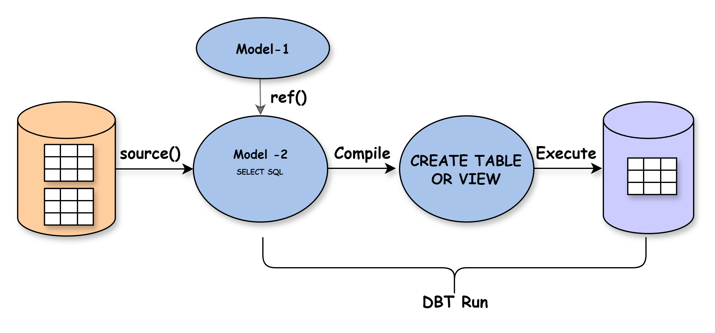
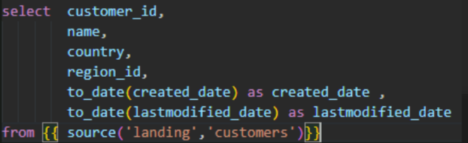
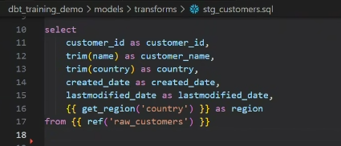
Jinja for lineage
ABOUT source() FUNCTION
Source() function is similar to the ref() function. It establishes a relation between the model and the source table specified.
We pass 2 arguments in the source function source name and table name. Which refer to the configuration/details in the source YAML file
For more details refer About source function | dbt Developer Hub (getdbt.com)
ABOUT ref() FUNCTION
ref() is how you reference one model within another
The ref function allows us to build dependencies between models in a flexible way. This will enable dbt to deploy models in the correct order when using dbt run also, helps in generating documentation lineage graph.
For more details refer About ref function | dbt Developer Hub (getdbt.com)

Slide 13
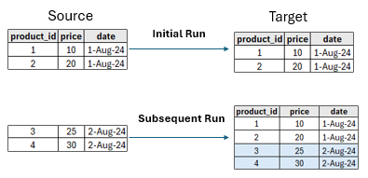
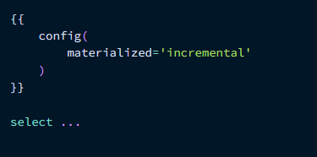
Incremental Models
Incremental models in dbt are designed to efficiently update your data warehouse tables by only transforming and loading new or changed data since the last run.
How Incremental Models Work:
Initial Run: When the incremental model runs for the first time, it processes the entire dataset and creates a new table or updates an existing one.
Subsequent Runs: In subsequent runs, dbt processes only the new or changed records and appends them to the existing table.
We have 3 incremental strategies
Append
Merge
Delete+Insert
For more details refer: About incremental models | dbt Developer Hub (getdbt.com)

Slide 14
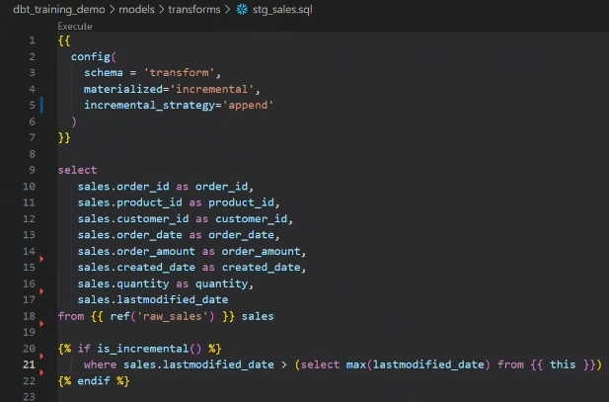
Incremental Strategies
Append:
This strategy appends new rows to the existing table without modifying or deleting any existing rows.
Use Case: Ideal for continuously accumulating data where historical updates aren't relevant. Examples include website activity logs, sensor readings, or social media feeds.
Steps to Implement
1. Define the Model: Configure the model to be incremental.
2. Filtering New Rows: Use the is_incremental() macro to filter only the new rows.
For more details refer About incremental strategy | dbt Developer Hub (getdbt.com)

Slide 15
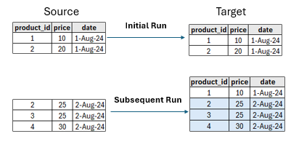
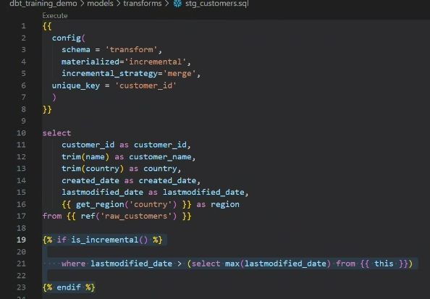
Incremental Strategies
2. Merge:
This strategy updates existing rows if they have changed and inserts new rows. It's useful for capturing changes in the source data.
Use Case: Suitable for scenarios where data can be inserted or updated. This strategy works best when you have a reliable unique key to identify changes.
Steps to Implement
1. Define the Model: Configure the model to be incremental.
2. Unique Key: Define a unique_key to identify rows uniquely.
3. Filtering New and Updated Rows: Use the is_incremental() macro to filter rows.
For more details refer About incremental strategy | dbt Developer Hub (getdbt.com)

Slide 16
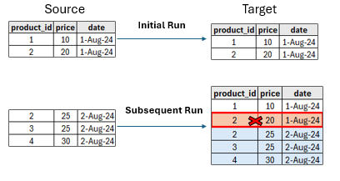
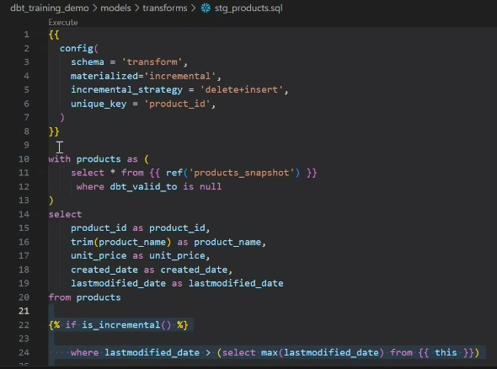
Incremental Strategies
3. Delete+insert:
This strategy deletes existing rows if they have changed and inserts new rows.
Use Case: This strategy involves explicitly deleting existing records from the target table before inserting new records based on matching unique_key. It's useful when historical updates are not needed.
Steps to Implement:
1. Define the Model: Configure the model to be incremental.
2. Filtering New Rows: Use the is_incremental() macro to filter only the new rows
3. Unique Key: Define a unique_key to identify rows uniquely which will be used to delete existing row and insert new one.
For more details refer About incremental strategy | dbt Developer Hub (getdbt.com)

Slide 17
Snapshots
Snapshots allows you to track changes in your source data over time . Essentially, they create a historical record of your data, enabling you to analyze data trends, identify changes and implement SCD2 effectively.
One can configure the snapshot by specifying properties like unique_key, strategy, and updated_at column.
dbt materializes the snapshot as a table, adding metadata columns like dbt_valid_from and dbt_valid_to to track data validity periods.
When you run the dbt snapshot command:
On the first run:
dbt will create the initial snapshot table.
this will be the result set of select statement, with additional columns including dbt_valid_from and dbt_valid_to. All records will have a dbt_valid_to = null.
On subsequent runs: dbt will check which records have changed or if any new records have been created.
The dbt_valid_to column will be updated for any existing records that have changed.
The updated record and any new records will be inserted into the snapshot table. These records will now have dbt_valid_to = null
For more details refer: Add snapshots to your DAG | dbt Developer Hub (getdbt.com)
id | status
1 | pending
id | status | dbt_valid_from | dbt_valid_to
1 | Pending | 2019-01-01 | 2019-01-02
1 | Shipped | 2019-01-02 | null
id | status
1 | shipped

Slide 18
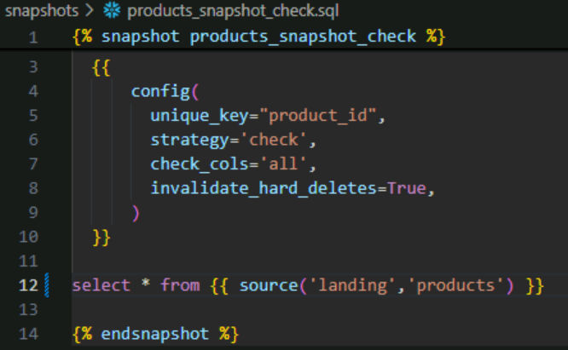
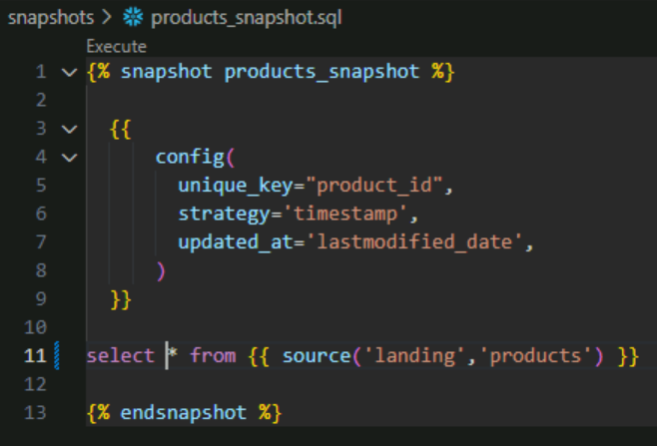
Snapshot Strategies
Check Strategy
Snapshot "strategies" define how dbt knows if a row has changed. There are two strategies built-in to dbt : timestamp and check.
Check Strategy:
The check strategy is useful for tables which do not have a reliable updated_at column. This strategy works by comparing a list of columns between their current and historical values. If any of these columns have changed, then dbt will invalidate the old record and record the new one.
Timestamp strategy :
The timestamp strategy uses an updated_at field to determine if a row has changed.
For more details refer: strategy | dbt Developer Hub (getdbt.com)
Timestamp Strategy

Slide 19

Macros
Macros are jinja templates created as .sql files in the macros folder. They are equivalent to functions in programming languages.
Macros are useful if you have a code that is used in multiple models. It improves code reusability.
There are many built-in macros in DBT like ref(), source(), var() … that is used while building dbt models.
Macros can be used in model definitions, hooks.
Syntax
For more details refer Jinja and macros | dbt Developer Hub (getdbt.com)

Slide 20
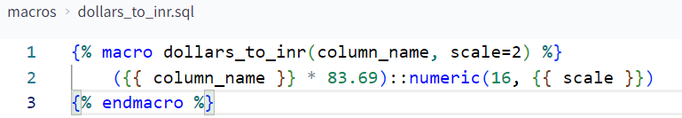
Macros Implementation
Example I have an amount field in USD which comes from multiple source tables. I want another amount field in INR when the data is loaded into further layers.
You can define .sql file in macros directory.
You can call the macros in model using {{ macro_name(arg1, arg2, …) }}
For more details refer Jinja and macros | dbt Developer Hub (getdbt.com)

Slide 21
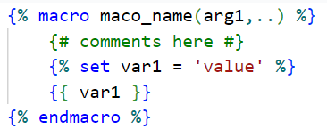
Jinja
Jinja is a templating language which acts as a tool to enhance and extend the capabilities of SQL within your dbt projects. Jinja allows for the embedding of Python-like expressions and control structures directly into SQL files (.sql), enabling dynamic SQL code generation.
You can recognize Jinja based on the delimiters the language uses, which is referred to as "curlies":
Expressions {{ ... }}: Expressions are used when you want to output a string. You can use expressions to reference variables and call macros.
Statements {% ... %}: Statements don't output a string. They are used for control flow, for example, to set up for loops and if statements, to set or modify variables, or to define macros.
Comments {# ... #}: Jinja comments are used to prevent the text within the comment from executing or outputting a string.
For more details refer Jinja and macros | dbt Developer Hub (getdbt.com)

Slide 22
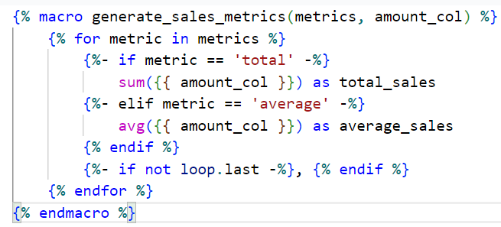
Jinja Implementation
The below example is a macro which generates total sales and average sales by using for loop and if statements.
For more details refer Jinja and macros | dbt Developer Hub (getdbt.com)

Slide 23
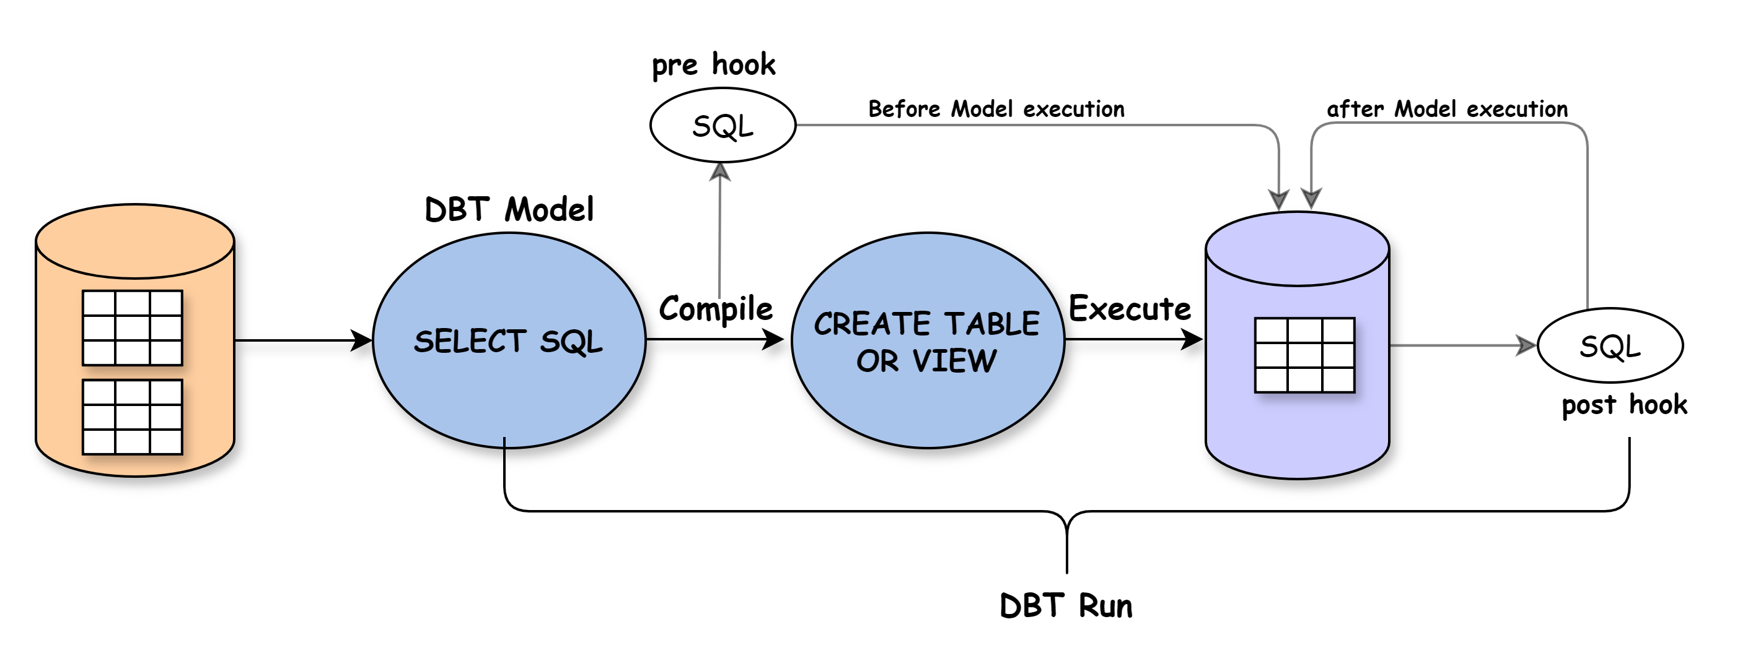
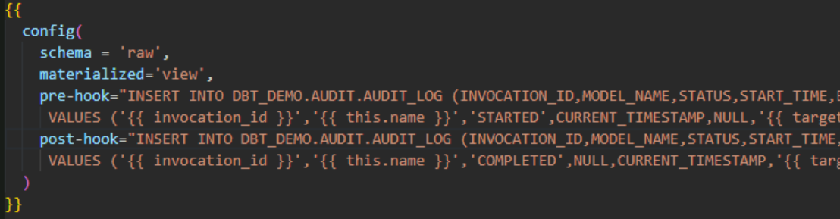
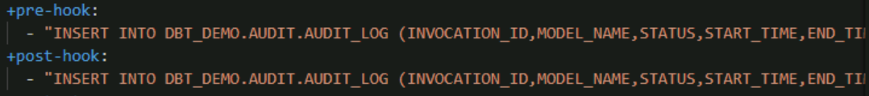
Hooks
To execute custom SQL before/after any model pre/post-hook can be utilized.
Same way any one want to execute custom SQL before/after a run on-run-start/end can be utilized
Types of Hooks:
pre-hook: executed before a model
post-hook: executed after a model
For more details refer Hooks and operations | dbt Developer Hub (getdbt.com)
In model.sql
In dbt_project.yml

Slide 24
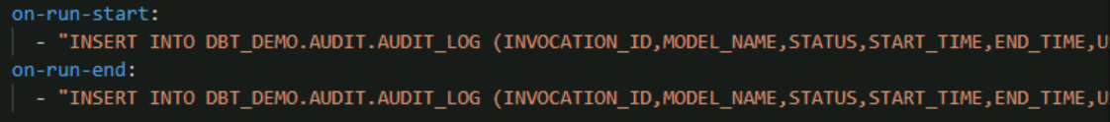
Hooks
on-run-start:
A SQL Statement or list of SQL Statement executed at the start of dbt build, dbt compile, dbt docs generate, dbt run, dbt seed, dbt snapshot, or dbt test.
on-run-end:
A SQL Statement or list of SQL Statement executed at the end of dbt build, dbt compile, dbt docs generate, dbt run, dbt seed, dbt snapshot, or dbt test.
For more details refer on-run-start & on-run-end | dbt Developer Hub (getdbt.com)
In dbt_project.yml

Slide 25
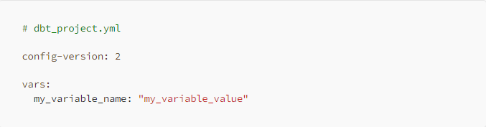
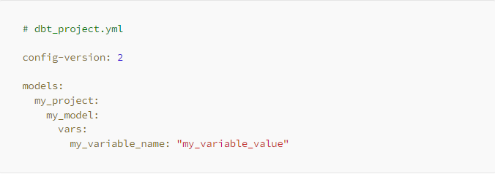
Variables
Variables are placeholders that store values used throughout your dbt code. To use a variable in a model, hook, or macro, use the {{ var('...') }} function.
There are two main ways to define variables:
dbt variables: can be used in the dbt project wide (models, macros, tests, etc). Are defined in the dbt_proyect.yml, under vars: line, and call them as {{ var(‘my_var’) }}
The position of the variable in the dbt_project.yml file determines whether the variable is global or local.
Global variable : dbt project-level variable, These variables exist and can be used globally throughout your project
Local variable : dbt model-level variable These variables are resource-specific, meaning they exist only within the resource-path they have been assigned to.
For more details refer Project variables | dbt Developer Hub (getdbt.com)

Slide 26
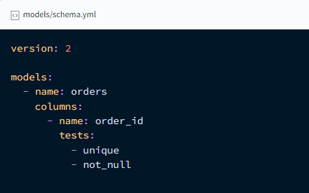
DBT Data Test
In dbt, tests are written as select statements. These select statements are run against your materialized models to ensure they meet your assertions.
There are two types of tests :-
Generic tests:
These are written in YAML and return the number of records that do not meet your assertions. These are run on specific columns in model.
Unique tests Check if every value in a column is unique.
Not_null tests Check if every value in a column is not null.
Accepted_values tests Ensure every value in a column is equal to a value in a provided list.
Relationships testsEnsure that every value in a column exists in a column in another model.
2. Singular tests:
These are specific queries that you run against your models. These are run on the entire model.
For more details refer Add data tests to your DAG | dbt Developer Hub (getdbt.com)

Slide 27
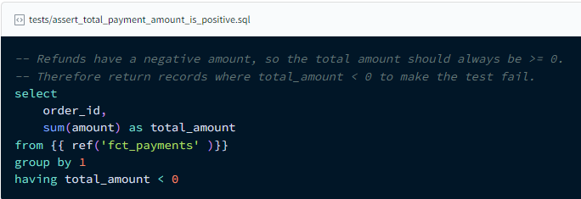
Singular Data Test example
The simplest way to define a data test is by writing the exact SQL that will return failing records. We call these "singular" data tests, because they're one-off assertions usable for a single purpose.
These tests are defined in .sql files, typically in your tests directory. Each .sql file contains one select statement, and it defines one data test.
You can use Jinja (including ref and source) in the test definition, just like you can when creating models.
Below example shows singular test to assert that order should not have –ve amount.
For more details refer Add data tests to your DAG | dbt Developer Hub (getdbt.com)

Slide 28
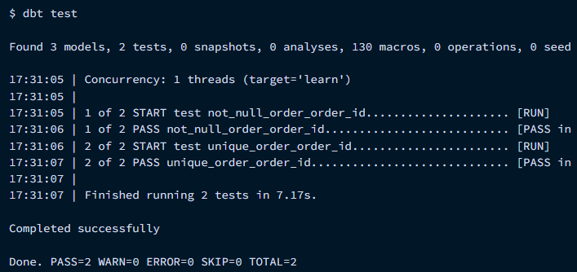
DBT Test Run Command
# Run tests on a model dbt test --select "customers"
# Run tests on all models in the models/staging/jaffle_shop directory dbt test --select "staging.jaffle_shop"
# tests on one source
dbt test --select "source:jaffle_shop"
Check out the SQL dbt is running for the tests :
dbt Core: checking the target/compiled directory
For more details refer About dbt test command | dbt Developer Hub (getdbt.com)

Slide 29
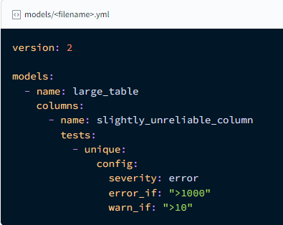
Configuring test `severity`
It's possible to configure tests to return warnings instead of errors, or to make the test status conditional on the number of failures returned.
The relevant configs are:
severity: error or warn (default: error)
error_if: conditional expression (default: !=0)
warn_if: conditional expression (default: !=0)
For more details refer Configuring test `severity` | dbt Developer Hub (getdbt.com)

