Slide 1
Nexthikes
User Analytics in the Telecommunication Industry
Overview
Made by :- Ankur Kumar

Slide 2
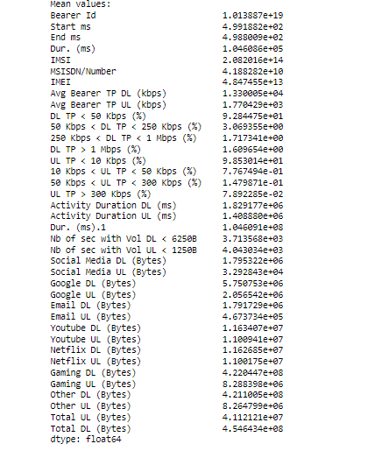
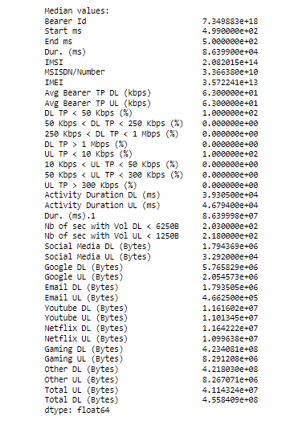
Non-graphical Univariate analysis Mean Values Median Values

Slide 3
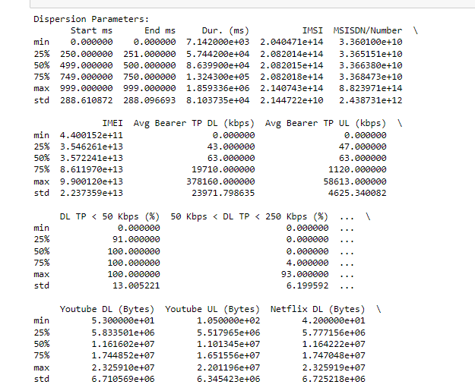
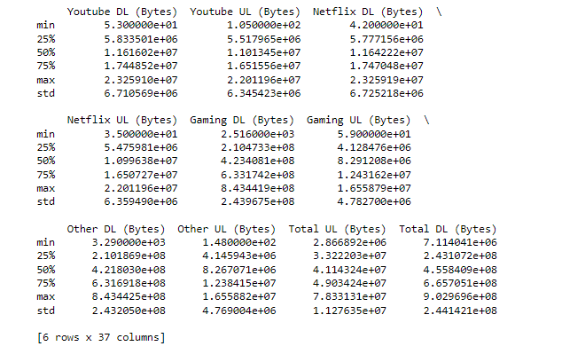
Non-graphical Univariate analysis

Slide 4
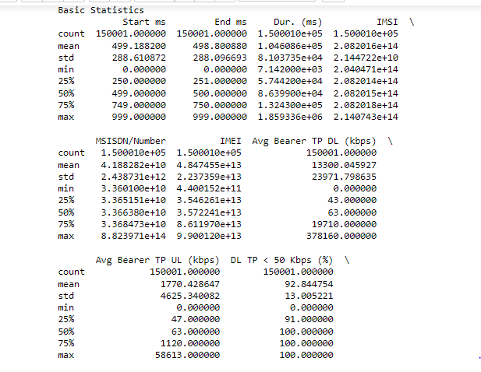
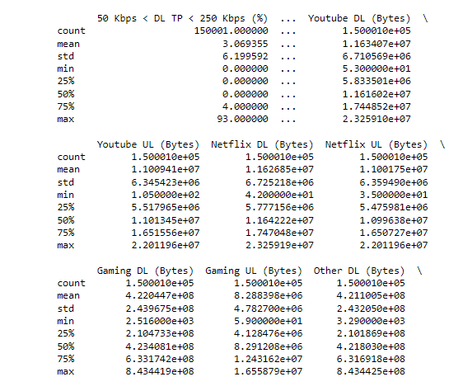
Non-graphical Univariate analysis

Slide 5
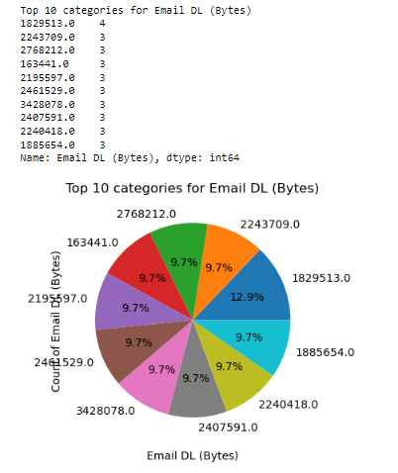
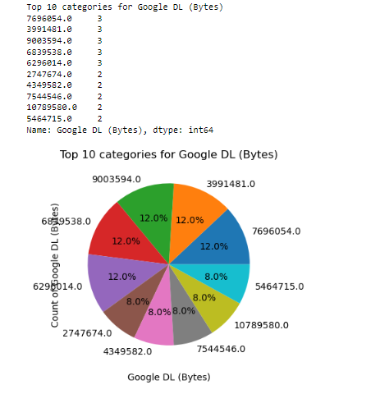
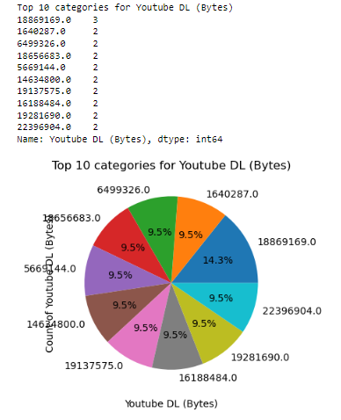
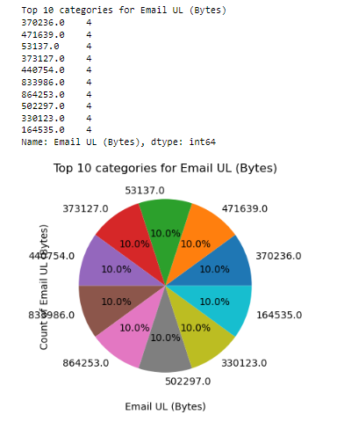
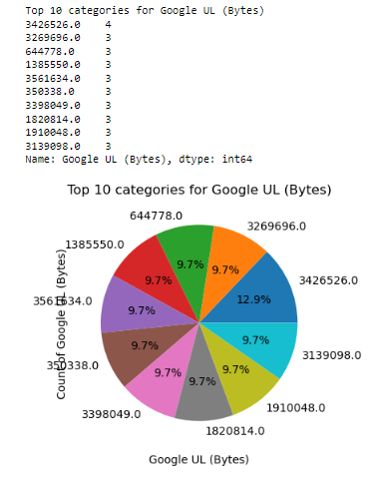
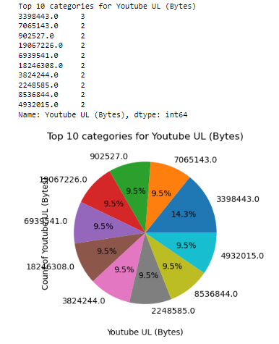
Graphical Univariate Analysis

Slide 6
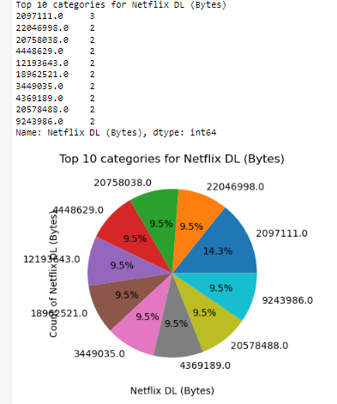
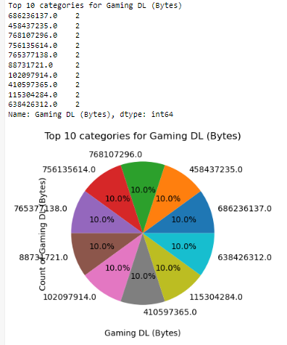
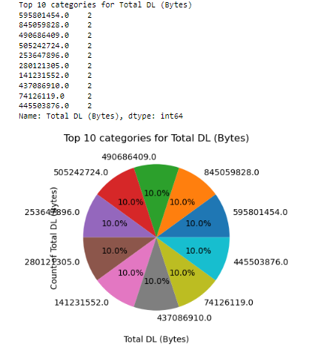
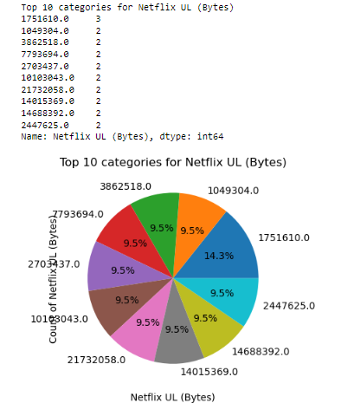
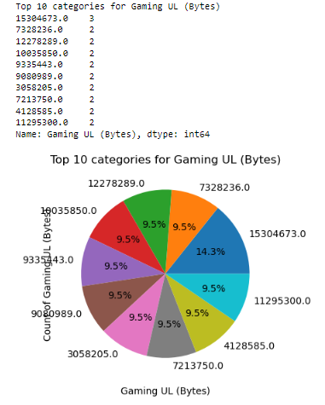
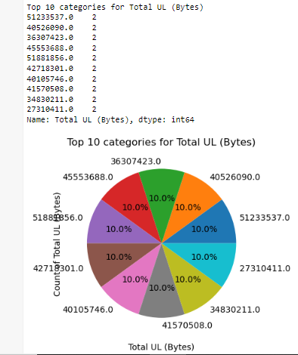
Graphical Univariate Analysis

Slide 7
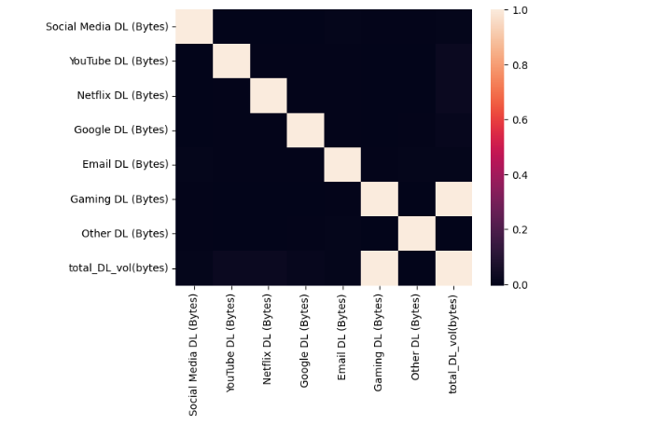
Graphical Univariate Analysis

Slide 8
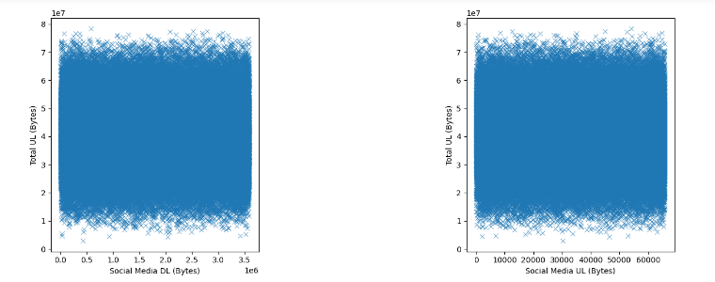
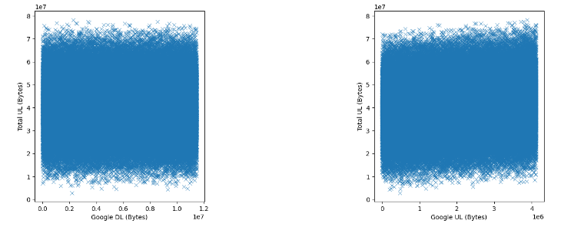
The data consumption applications (Social Media & Google)(DL&UL)

Slide 9
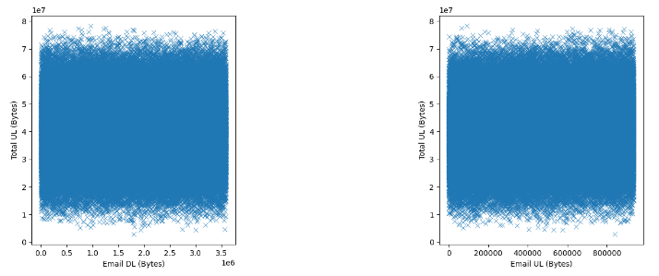
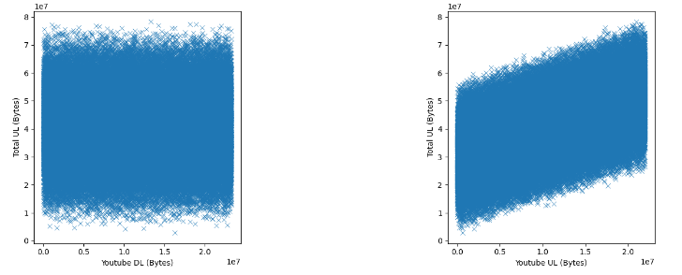
The data consumption applications (Email & YouTube)(DL & UL)

Slide 10
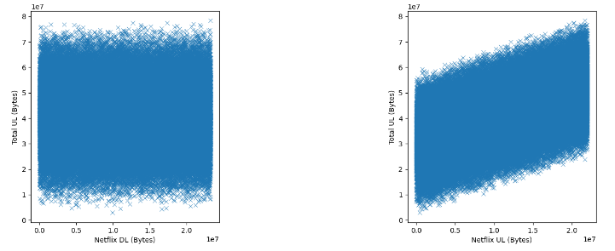
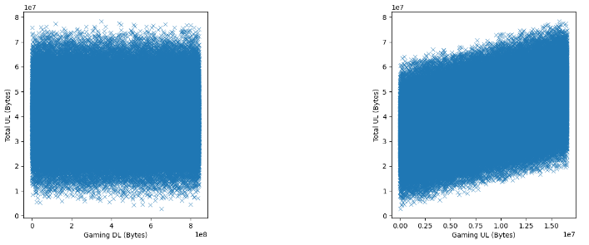
The data consumption applications (Netflix & Gaming)(DL&UL)

Slide 11
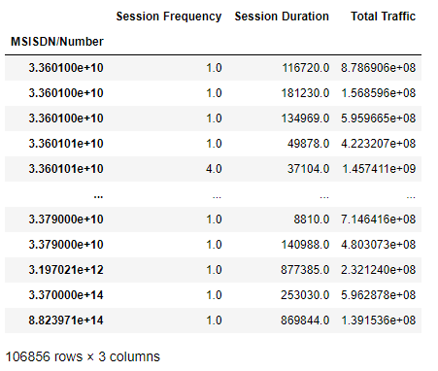
Session Frequency, Duration & Traffic

Slide 12
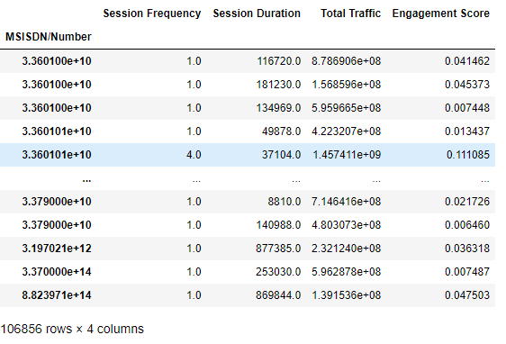
Engagement score to each user

Slide 13
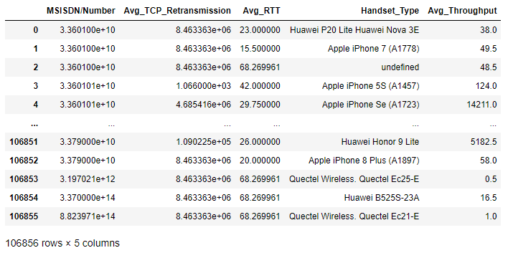
Average TCP retransmission , Average RTT , Handset type & Average throughput

Slide 14
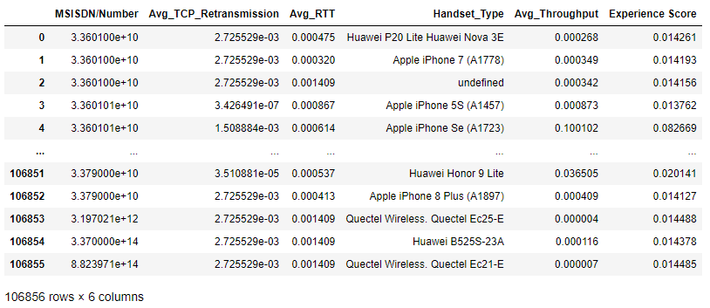
Experience Score (Average TCP retransmission , Average RTT , Handset type & Average throughput)

Slide 15
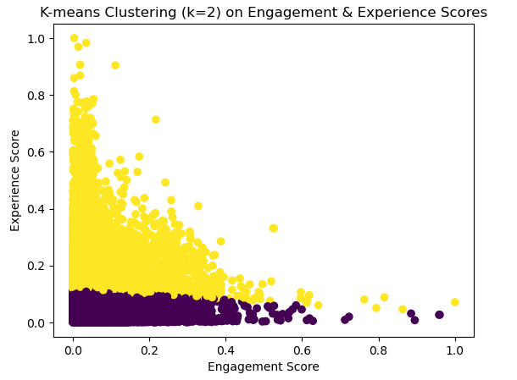
k-means (k=2) on the engagement & the experience score
K-means clustering is a machine learning algorithm used for partitioning a dataset into K distinct, non-overlapping subsets (or clusters). The goal is to group similar data points together while keeping different groups as separate as possible. The parameter K represents the number of clusters you want to form.

Slide 16
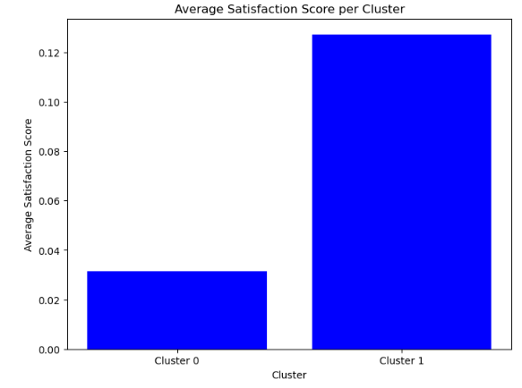
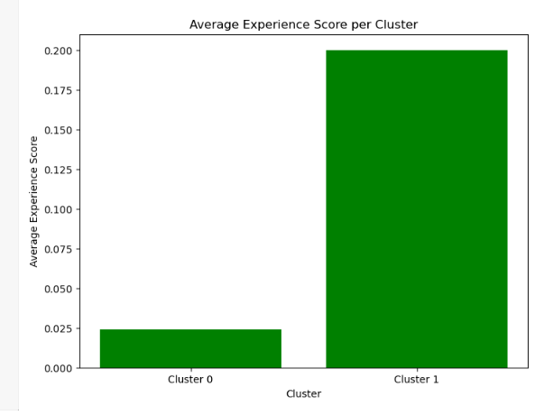
The average satisfaction & experience score

Slide 17
Thank You 🙏 Made by :- Ankur Kumar

