Slide 1
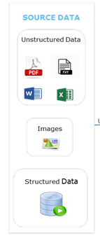
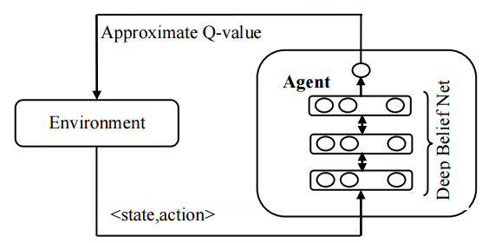
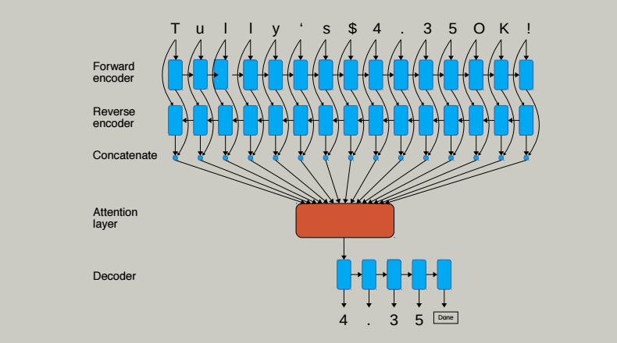
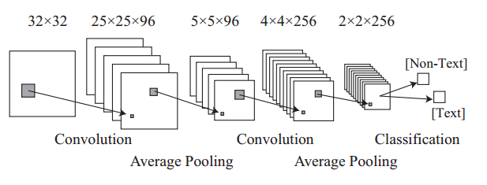
OCR Core Engine
Pre-processing
DPI Enhancement
Segmentation/Feature Extraction
Segmentation using Deep Reinforcement Learning
Extract Feature of Character Image using Convolutional Neural Network
Classification
Map the extracted character with best possible symbol using Recurrent Neural Network
Background Removal
Noise Clearing
Customized Output/ Visualization/ Target System
Post-Processing
Post Processing Rules
Output Format customization
OCR API/CNN/RNN
Conversion : JAVA, Python
OCR : Tensor Flow, Tesseract, Google Cloud Vision API, OCRopus
Deep Reinforcement Learning
Convolutional Neural Network
Recurrent Neural Network

Slide 2
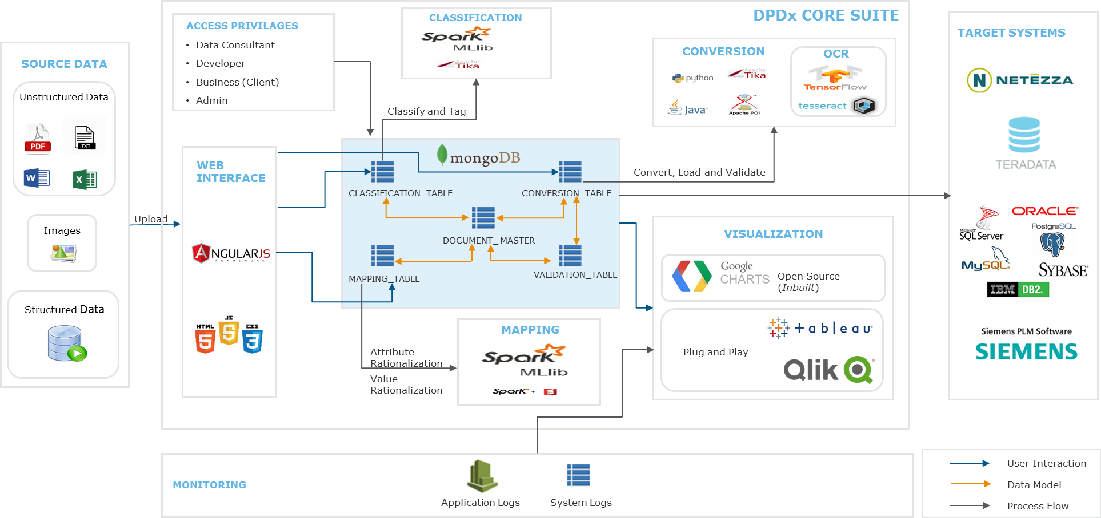
Detailed Architecture

