Slide 1

Building Scalable Micro-services
using Kotlin
Building Scalable Microservices using Kotlin

Slide 2

Principal engineer at lowe’s.
Twitter: https://twitter.com/ankur4u007
GitHub: https://github.com/ankur4u007
Medium: https://medium.com/@thewritingmonk
Father: 1.5 year old daughter
Loves to hike, code, ride!
About me

Slide 3

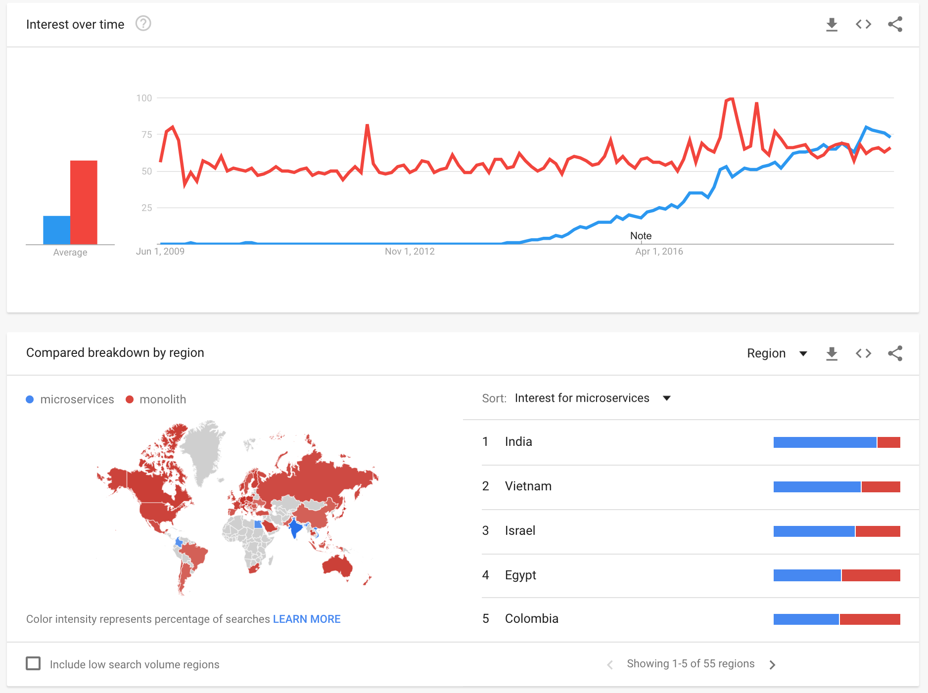
Why ?
https://trends.google.com/trends/explore?date=2009-05-26%202019-06-26&q=microservices,monolith

Slide 4
What ?
Microservice architecture – a variant of the service-oriented architecture (SOA) structural style – arranges an application as a collection of loosely coupled services.[1] In a microservices architecture, services are fine-grained and the protocols are lightweight.
Highly maintainable and testable
Loosely coupled
Independently deployable
Organized around business capabilities
Owned by a small team
https://en.wikipedia.org/wiki/Microservices

Slide 5
How?
Micronaut by object computing: https://github.com/micronaut-projects
Spring boot by pivotal: https://github.com/spring-projects/spring-boot
Quarkus by Red Hat : https://github.com/quarkusio
Vert.x by Eclipse foundation: https://github.com/eclipse-vertx/vert.x

Slide 6
Problems with scale
Beginning of the end of Moore's law
Growing Cloud Cost
Failures/Downtime
Alternatives - serverless

Slide 7
Solution
Architecture
Higher throughput
Faster startup times
Resiliency

Slide 8
Architecture
SOLID
Clean code
12factor

Slide 9
SOLID
Single Responsibility Principle
Open/Closed Principle
Liskov Substitution Principle
Interface Segregation Principle
Dependency Inversion

Slide 10
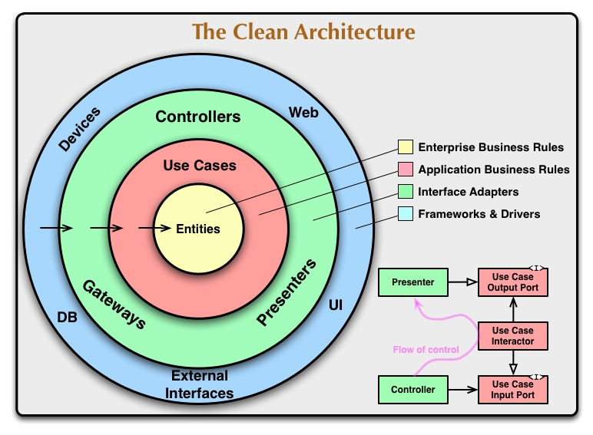
Clean code
https://blog.cleancoder.com/uncle-bob/2012/08/13/the-clean-architecture.html

Slide 11
12 factor
https://12factor.net/

Slide 12
Higher throughput
Reactive manifesto: https://reactivemanifesto.org/
Reactor api: https://projectreactor.io/docs/core/release/reference/
kotlinx coroutines: https://kotlinlang.org/docs/reference/coroutines/flow.html

Slide 13
Faster startup times
AOT: https://openjdk.java.net/jeps/295

Slide 14
Resiliency
Circuit breakers
RateLimiter
Retry
Cache

Slide 15
Demo!

