Slide 1

Building Scalable Micro-services
using Kotlin
Building Scalable Microservices using Kotlin
Notes:
greetings
disclaimer going to be focussed on backend tech
basic and foundational principles that governs a scalable architecture
how can you leverage open source frameworks to build a resilient system
in the end empower you so that you can make a right decision for yourself

Slide 2

Principal engineer at lowe’s.
Twitter: https://twitter.com/ankur4u007
GitHub: https://github.com/ankur4u007
Medium: https://medium.com/@thewritingmonk
Father: 1.5 year old daughter
Loves to hike, code, ride!
About me
Deepankar

Slide 3

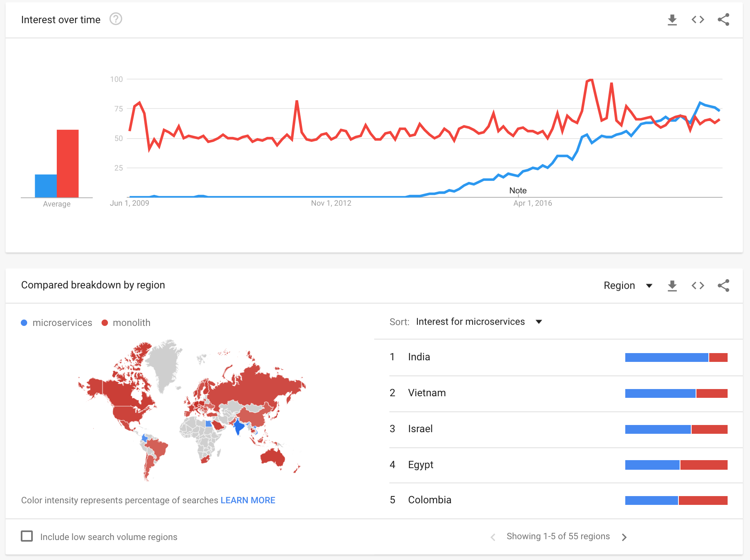
Why ?
https://trends.google.com/trends/explore?date=2009-05-26%202019-06-26&q=microservices,monolith
Notes:
team size!
too small to break down. Only if complex to manage
performance critical.

Slide 4
What ?
Microservice architecture – a variant of the service-oriented architecture (SOA) structural style – arranges an application as a collection of loosely coupled services.[1] In a microservices architecture, services are fine-grained and the protocols are lightweight.
Highly maintainable and testable
Loosely coupled
Independently deployable
Organized around business capabilities
Owned by a small team
https://en.wikipedia.org/wiki/Microservices

Slide 5
How?
Micronaut by object computing: https://github.com/micronaut-projects
Spring boot by pivotal: https://github.com/spring-projects/spring-boot
Quarkus by Red Hat : https://github.com/quarkusio
Vert.x by Eclipse foundation: https://github.com/eclipse-vertx/vert.x

Slide 6
Problems with scale
Beginning of the end of Moore's law
Growing Cloud Cost
Failures/Downtime
Alternatives - serverless
Notes:
Moore's law is the observation that the number of transistors in a dense integrated circuit (IC) doubles about every two years.
Moore's law is an observation and projection of a historical trend. Rather than a law of physics,
it is an empirical relationship linked to gains from experience in production.

Slide 7
Solution
Architecture
Higher throughput
Faster startup times
Resiliency and observability

Slide 8
Architecture
SOLID
Clean code
12factor
Notes:
SOLID: five design principles for object-oriented software development described by Robert C. Martin.
Single responsibility: A class should have one, and only one, reason to change.
Opne closed: “Software entities (classes, modules, functions, etc.) should be open for extension, but closed for modification.”
Liskov substitution: The principle defines that objects of a superclass shall be replaceable with objects of its subclasses without breaking the application.
Interface segregation: “Clients should not be forced to depend upon interfaces that they do not use.”
Dependency Inversion Principle: High-level modules should not depend on low-level modules. Both should depend on abstractions.
Abstractions should not depend on details. Details should depend on abstractions.

Slide 9
SOLID
Single Responsibility Principle
Open/Closed Principle
Liskov Substitution Principle
Interface Segregation Principle
Dependency Inversion
Notes:
Single responsibility: A class should have one, and only one, reason to change.
Opne closed: “Software entities (classes, modules, functions, etc.) should be open for extension, but closed for modification.”
Liskov substitution: The principle defines that objects of a superclass shall be replaceable with objects of its subclasses without breaking the application.
Interface segregation: “Clients should not be forced to depend upon interfaces that they do not use.”
Dependency Inversion Principle: High-level modules should not depend on low-level modules. Both should depend on abstractions.
Abstractions should not depend on details. Details should depend on abstractions.

Slide 10
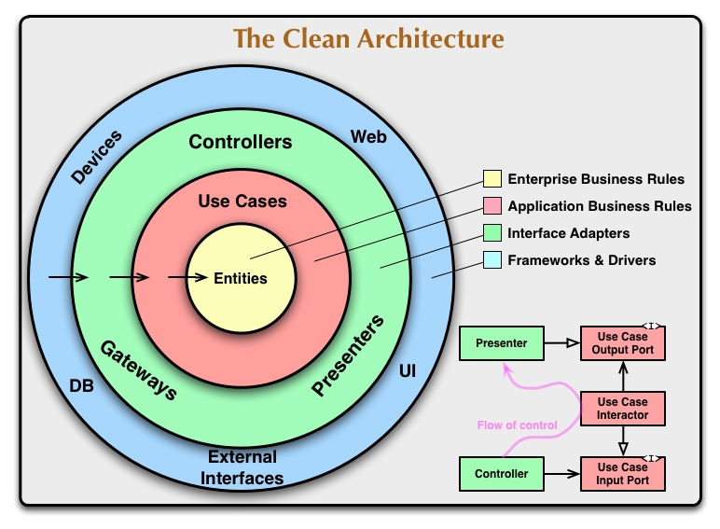
Clean code
https://blog.cleancoder.com/uncle-bob/2012/08/13/the-clean-architecture.html
Notes:
Independent of Frameworks. The architecture does not depend on the existence of some library of feature laden software. This allows you to use such frameworks as tools, rather than having to cram your system into their limited constraints.
Testable. The business rules can be tested without the UI, Database, Web Server, or any other external element.
Independent of UI. The UI can change easily, without changing the rest of the system. A Web UI could be replaced with a console UI, for example, without changing the business rules.
Independent of Database. You can swap out Oracle or SQL Server, for Mongo, BigTable, CouchDB, or something else. Your business rules are not bound to the database.
Independent of any external agency. In fact your business rules simply don’t know anything at all about the outside world.
Dependncy rule:
This rule says that source code dependencies can only point inwards. Nothing in an inner circle can know anything at all about something in an outer circle. In particular, the name of something declared in an outer circle must not be mentioned by the code in the an inner circle. That includes, functions, classes. variables, or any other named software entity.
Entities
Entities encapsulate Enterprise wide business rules. An entity can be an object with methods, or it can be a set of data structures and functions
use cases
The software in this layer contains application specific business rules. It encapsulates and implements all of the use cases of the system.

Slide 11
12 factor
https://12factor.net/

Slide 12
Higher throughput
Reactive manifesto: https://reactivemanifesto.org/
Reactor api: https://projectreactor.io/docs/core/release/reference/
kotlinx coroutines: https://kotlinlang.org/docs/reference/coroutines/coroutines-guide.html

Slide 13
Faster startup times
AOT: https://openjdk.java.net/jeps/295

Slide 14
Resiliency and Observability
Circuit breakers
RateLimiter
Retry
Cache
actuators
metrics (web, infrastructure, functional)
tracing
async logs
Lightweight frameworks (examples):
resilience4j: https://github.com/resilience4j/resilience4j
micrometer: https://github.com/micrometer-metrics/micrometer
zipkin: https://github.com/openzipkin/zipkin
lmax-log4j2: https://logging.apache.org/log4j/2.x/manual/async.html

Slide 15
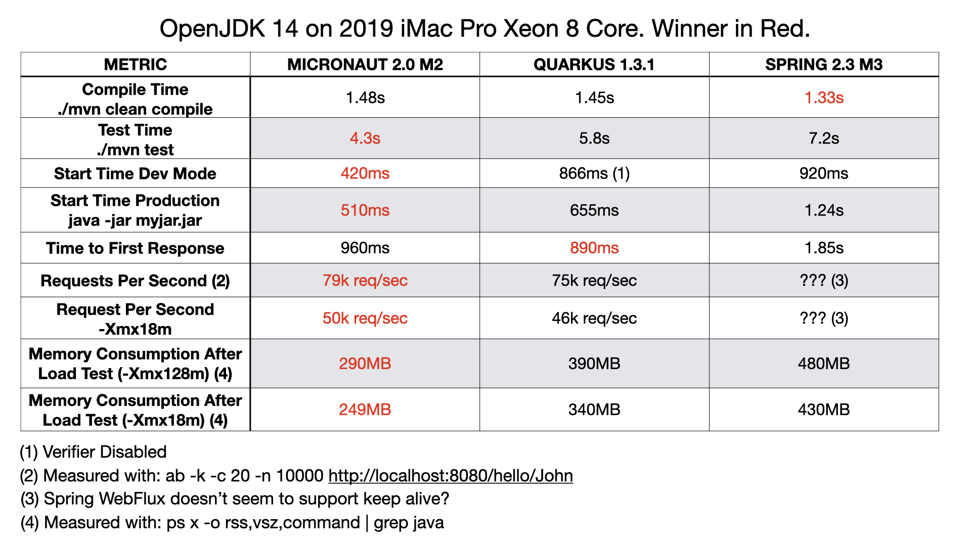
Comparison
https://micronaut.io/blog/2020-04-07-micronaut-vs-quarkus-vs-spring-boot-performance-jdk-14.html

Slide 16
Demo!

Slide 17
Future
GraalVM: https://www.graalvm.org/docs/why-graal/
Notes:
Kotlin Native has nothing in common with SubstrateVM (Graal is a runtime, Substrate is its part which allows AOT builds). These tools cover different use cases. K-N is used to create a multi-platform or stand-alone native applications, Substrate is used to pre-compile JVM applications for faster startup.

