Slide 1


Slide 2
CONTENTS
Functional Dependency
  Definition.
  Inference Rules.
Normalization
  The need
  Anomalies and Redundant Information in Tuples.
  Normalization Steps (1NF,2NF,3NF),BCNF

Slide 3
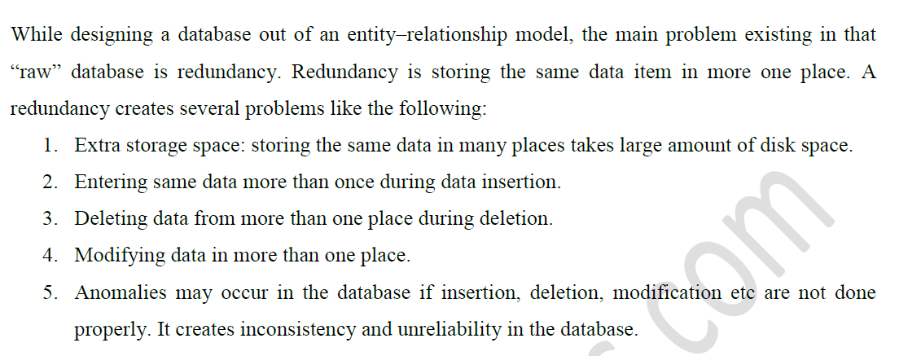

Slide 4
Anomalies-Update Anomaly
Consider the relation:
EMP_PROJ(Emp#, Proj#, Ename, Pname, No_hours)
Update Anomaly:
Changing the name of project number P1 from “Billing” to “Customer-Accounting” may cause this update to be made for all 100 employees working on project P1.

Slide 5
EXAMPLE OF AN INSERT ANOMALY
Consider the relation:
EMP_PROJ(Emp#, Proj#, Ename, Pname, No_hours)
Insert Anomaly: Cannot insert a project unless an employee is assigned to it.Conversely Cannot insert an employee unless a he/she is assigned to a project.

Slide 6
EXAMPLE OF AN DELETE ANOMALY
Consider the relation:
EMP_PROJ(Emp#, Proj#, Ename, Pname, No_hours)
Delete Anomaly: When a project is deleted, it will result in deleting all the employees who work on that project. Alternately, if an employee is the sole employee on a project, deleting that employee would result in deleting the corresponding project.

Slide 7
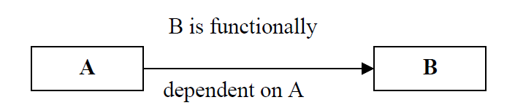
Functional Dependency
Describes the relationship between attributes in a relation. If A and B are attributes of a relation R, B is functionally dependent on A (den. A → B), if each value of A in R is associated with exactly one value of B in R.

Slide 8
Continued….
Determinant: attribute or set of attributes on the left hand side of the arrow.
Dependent: attribute or set of attributes on the right hand side of the arrow.
Identify the candidate key for a relation: recognize the attribute (group of attributes) that uniquely identifies each row in a relation. All of the attributes that are not part of the primary key (non-primary key attributes) should be functionally dependent on the key.
Primary key functionally determines all the non key fields in the table- given primary key we can retrieve the values of remaining non-key fields in that record.

Slide 9
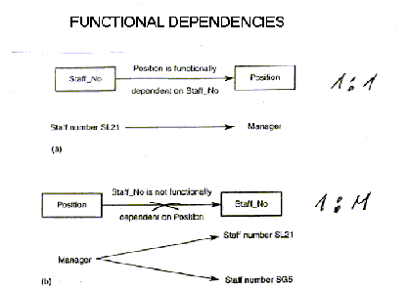

Slide 10
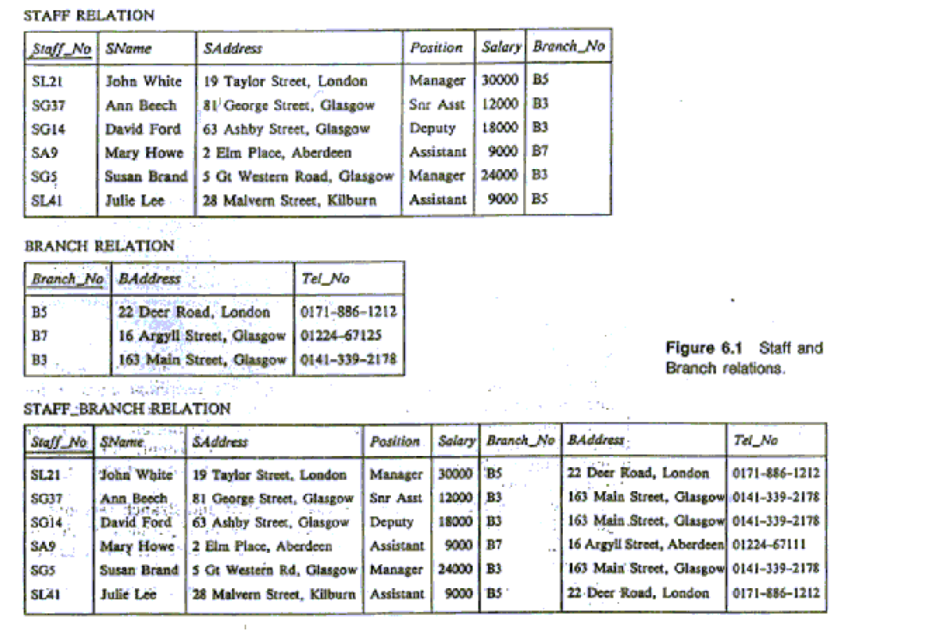

Slide 11
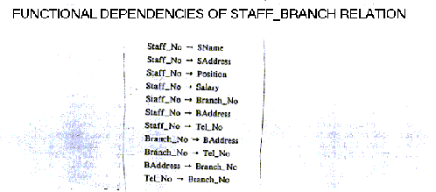
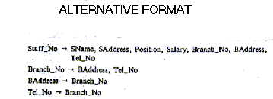

Slide 12
Functional Dependencies
Functional dependencies (FDs)
  Are used to specify formal measures of the "goodness" of relational designs
  And keys are used to define normal forms for relations
  Are constraints that are derived from the meaning and interrelationships of the data attributes
A set of attributes X functionally determines a set of attributes Y if the value of X determines a unique value for Y
Slide 10- <number>

Slide 13
Functional Dependencies
X -> Y holds if whenever two tuples have the same value for X, they must have the same value for Y
  For any two tuples t1 and t2 in any relation instance r(R): If t1[X]=t2[X], then t1[Y]=t2[Y]
X -> Y in R specifies a constraint on all relation instances r(R) written as X -> Y; can be displayed graphically on a relation schema as in Figures. ( denoted by the arrow: ).
FDs are derived from the real-world constraints on the attributes
Email | ENAME
sr@gmail.com | John
df@gmail.com | Smith
sr@gmail.com | John
Slide 10- <number>

Slide 14
Examples of FD constraints
Social security number determines employee name
  SSN -> ENAME
Project number determines project name and location
  PNUMBER -> {PNAME, PLOCATION}
Employee ssn and project number determines the hours per week that the employee works on the project
  {SSN, PNUMBER} -> HOURS
Slide 10- <number>

Slide 15
Examples of FD constraints
An FD is a property of the attributes in the schema R
The constraint must hold on every relation instance r(R)
If K is a key of R, then K functionally determines all attributes in R
  (since we never have two distinct tuples with t1[K]=t2[K])
SSN | ENAME
1 | John
2 | Smith
1 | John
Slide 10- <number>

Slide 16
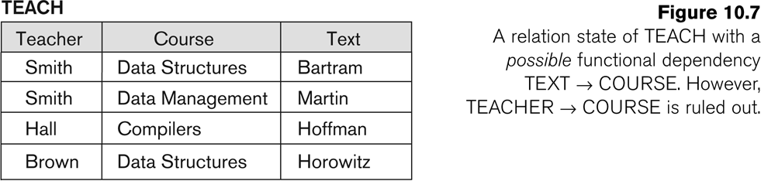
FD’s are a property of the meaning of data and hold at all times: certain FD’s can be ruled out based on a given state of the database
Slide 10- <number>

Slide 17
Functional Dependencies
If one set of attributes in a table determines another set of attributes in the table, then the second set of attributes is said to be functionally dependent on the first set of attributes.
Example 1
ISBN
Title
Price
Table Scheme: {ISBN, Title, Price}
Functional Dependencies: {ISBN} → {Title}
{ISBN} → {Price}
0-321-32132-1
Balloon
$34.00
0-55-123456-9
Main Street
$22.95
0-123-45678-0
Ulysses
$34.00
1-22-233700-0
Visual Basic
$25.00
Notes:
Notes to Instructor: Need more rigor in the functional dependencies. With a few examples. May be create a class assignment for functional dependencies.

Slide 18
Functional Dependencies
Example 2
Table Scheme: {PubID, PubName, PubPhone}
Functional Dependencies: {PubId} → {PubPhone}
{PubId} → {PubName}
{PubName, PubPhone} → {PubID}
PubID
PubName
PubPhone
1
Big House
999-999-9999
2
Small House
123-456-7890
3
Alpha Press
111-111-1111
Example 3
AuID
AuName
AuPhone
Table Scheme: {AuID, AuName, AuPhone}
Functional Dependencies: {AuId} → {AuPhone}
{AuId} → {AuName}
{AuName, AuPhone} → {AuID}
1
Sleepy
321-321-1111
2
Snoopy
232-234-1234
3
Grumpy
665-235-6532
4
Jones
123-333-3333
5
Smith
654-223-3455
6
Joyce
666-666-6666
7
Roman
444-444-4444

Slide 19
FD – Example
Database to track reviews of papers submitted to an academic conference. Prospective authors submit papers for review and possible acceptance in the published conference proceedings. Details of the entities
  Author information includes a unique author number, a name, a mailing address, and a unique (optional) email address.
  Paper information includes the primary author, the paper number, the title, the abstract, and review status (pending, accepted,rejected)
  Reviewer information includes the reviewer number, the name, the mailing address, and a unique (optional) email address
  A completed review includes the reviewer number, the date, the paper number, comments to the authors, comments to the program chairperson, and ratings (overall, originality, correctness, style, clarity)

Slide 20
FD – Example
Functional Dependencies
  AuthNo → AuthName, AuthEmail, AuthAddress
  AuthEmail → AuthNo
  PaperNo → Primary-AuthNo, Title, Abstract, Status
  RevNo → RevName, RevEmail, RevAddress
  RevEmail → RevNo
  RevNo, PaperNo → AuthComm, Prog-Comm, Date, Rating1, Rating2, Rating3, Rating4, Rating5

Slide 21
Inference Rules for FDs
Given a set of FDs F, we can infer additional FDs that hold whenever the FDs in F hold
Armstrong's inference rules:
  IR1. (Reflexive) If Y subset-of X, then X -> Y
  IR2. (Augmentation) If X -> Y, then XZ -> YZ
    (Notation: XZ stands for X U Z)
  IR3. (Transitive) If X -> Y and Y -> Z, then X -> Z
IR1, IR2, IR3 form a sound and complete set of inference rules
  These are rules hold and all other rules that hold can be deduced from these
Slide 10- <number>

Slide 22
Inference Rules for FDs
Some additional inference rules that are useful:
  Decomposition: If X -> YZ, then X -> Y and X -> Z
  Union: If X -> Y and X -> Z, then X -> YZ
  Psuedotransitivity: If X -> Y and WY -> Z, then WX -> Z
The last three inference rules, as well as any other inference rules, can be deduced from IR1, IR2, and IR3 (completeness property)
Slide 10- <number>

Slide 23
Inference Rules for FDs
Closure of a set F of FDs is the set F⁺ of all FDs that can be inferred from F
  FDs={{SSN -> ENAME},{SSN->ADDRESS},{SSN->SALARY}}
Closure of a set of attributes X with respect to F is the set X⁺ of all attributes that are functionally determined by X
  FDs={{SSN -> ENAME},{SSN->ADDRESS},{SSN->SALARY}}
X⁺ can be calculated by repeatedly applying IR1, IR2, IR3 using the FDs in F
Slide 10- <number>

Slide 24
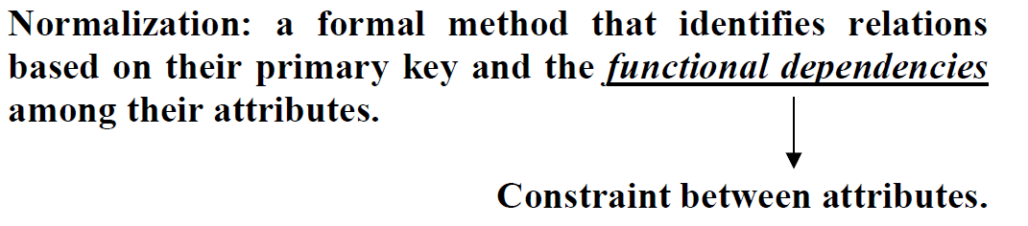
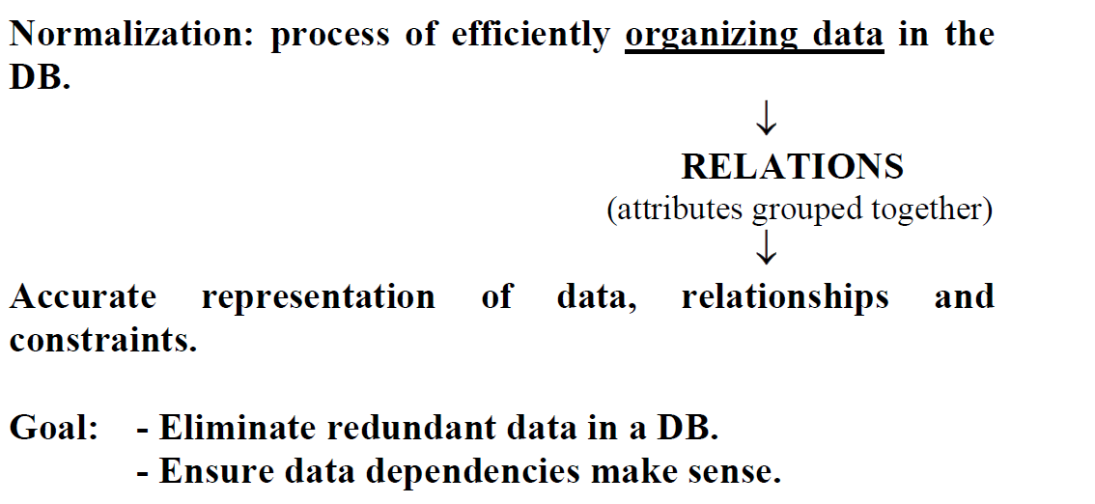
Normalization

Slide 25
Unnormalized Form
Unnormalized form (UNF): A table that contains one or more repeating groups.
Or
If a table contains non-atomic values at each row, it is said to be in UNF. An atomic value is something that can not be further decomposed.
A non-atomic value, as the name suggests, can be further decomposed and simplified.
Repeating group: an attribute or group of attributes within a table that occurs with multiple values for a single occurrence of the nominated key attributes of that table.

Slide 26
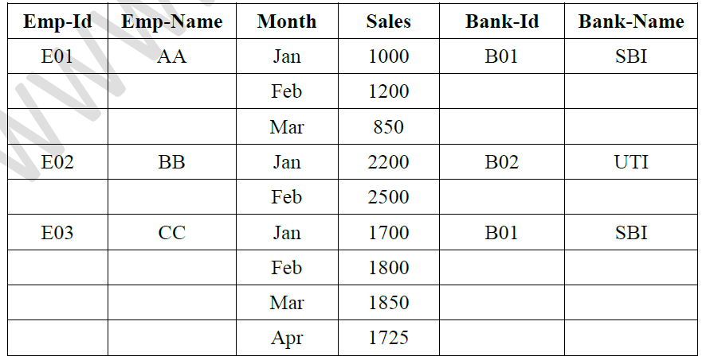
Example:

Slide 27
Levels of Normalization
Levels of normalization based on the amount of redundancy in the database.
Various levels of normalization are:
  First Normal Form (1NF)
  Second Normal Form (2NF)
  Third Normal Form (3NF)
  Boyce-Codd Normal Form (BCNF)
  Fourth Normal Form (4NF)
  Fifth Normal Form (5NF)
  Domain Key Normal Form (DKNF)
Redundancy
Number of Tables
Complexity
Most databases should be 3NF or BCNF in order to avoid the database anomalies.

Slide 28
Levels of Normalization
1NF
2NF
3NF
4NF
5NF
DKNF
Each higher level is a subset of the lower level

Slide 29
First Normal Form
Disallows
  composite attributes
  Multi valued attributes
  nested relations; attributes whose values for an individual tuple are non-atomic
A relation is said to be in 1NF if it contains no non-atomic values and each row can provide a unique combination of values.
Slide 10- <number>

Slide 30

Normalization into 1NF
Slide 10- <number>

Slide 31
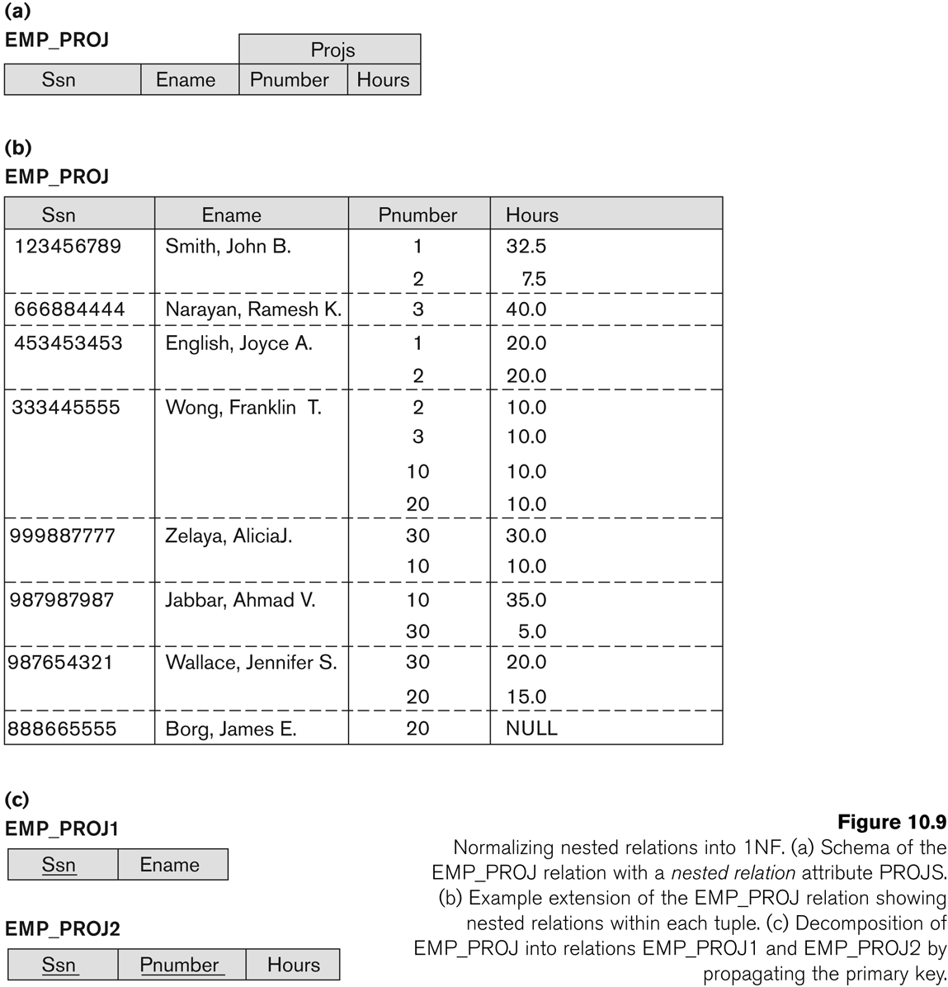
Normalization of nested relations into 1NF
Slide 10- <number>

Slide 32
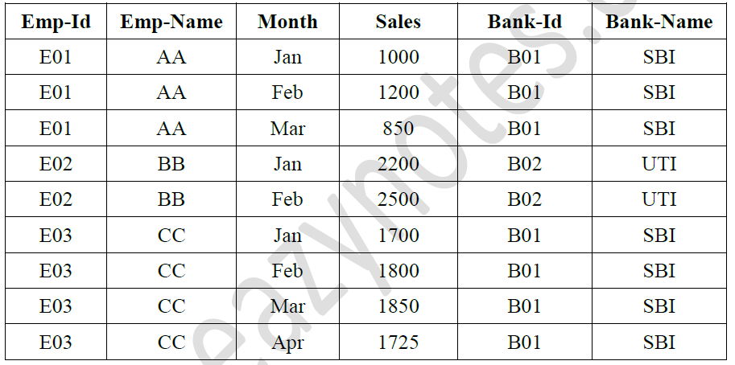

Slide 33
First Normal Form (1NF)
A table is considered to be in 1NF if all the fields contain
only scalar values (as opposed to list of values).
Example (Not 1NF)
ISBN
Title
AuName
AuPhone
PubName
PubPhone
Price
0-321-32132-1
Balloon
Sleepy, Snoopy, Grumpy
321-321-1111, 232-234-1234, 665-235-6532
Small House
714-000-0000
$34.00
0-55-123456-9
Main Street
Jones, Smith
123-333-3333, 654-223-3455
Small House
714-000-0000
$22.95
0-123-45678-0
Ulysses
Joyce
666-666-6666
Alpha Press
999-999-9999
$34.00
1-22-233700-0
Visual Basic
Roman
444-444-4444
Big House
123-456-7890
$25.00
Author and AuPhone columns are not scalar
Notes:
Having scalar values also means that all instances of a record type must contain the same number of fields.
A table not in first normal form is called un normalized

Slide 34
1NF - Decomposition
Place all items that appear in the repeating group in a new table
Designate a primary key for each new table produced.
Duplicate in the new table the primary key of the table from which the repeating group was extracted or vice versa.
Example (1NF)
ISBN
AuName
AuPhone
0-321-32132-1
Sleepy
321-321-1111
ISBN
Title
PubName
PubPhone
Price
0-321-32132-1
Snoopy
232-234-1234
0-321-32132-1
Balloon
Small House
714-000-0000
$34.00
0-321-32132-1
Grumpy
665-235-6532
0-55-123456-9
Main Street
Small House
714-000-0000
$22.95
0-55-123456-9
Jones
123-333-3333
0-123-45678-0
Ulysses
Alpha Press
999-999-9999
$34.00
0-55-123456-9
Smith
654-223-3455
1-22-233700-0
Visual Basic
Big House
123-456-7890
$25.00
0-123-45678-0
Joyce
666-666-6666
1-22-233700-0
Roman
444-444-4444
Notes:
1. The designated key will be the primary key of the original table concatenated with one or more data items from the new table.
For the first table the primary key is ISBN
For the second table the primary key is ISBN + Author Name

Slide 35
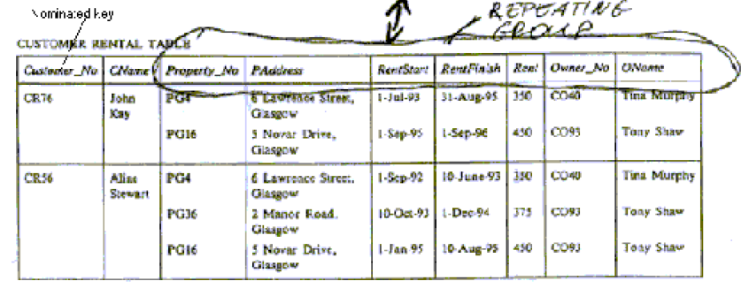

Slide 36
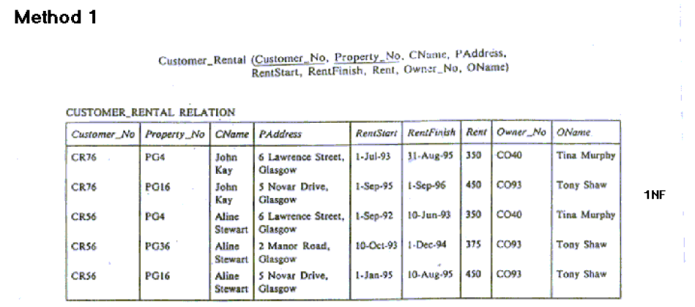

Slide 37
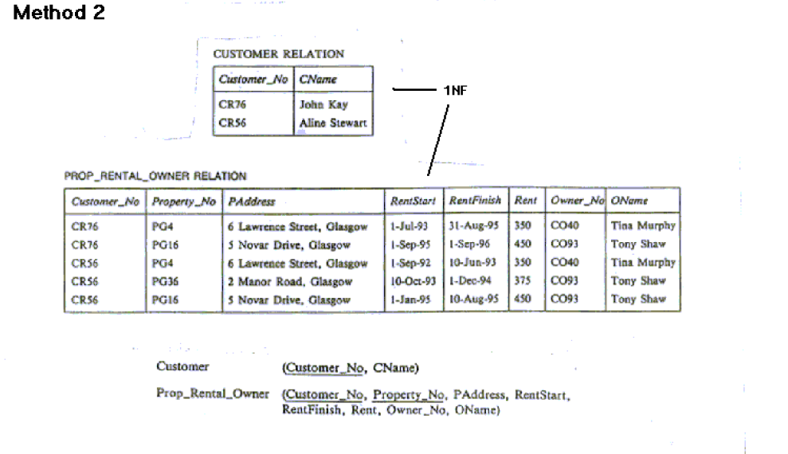
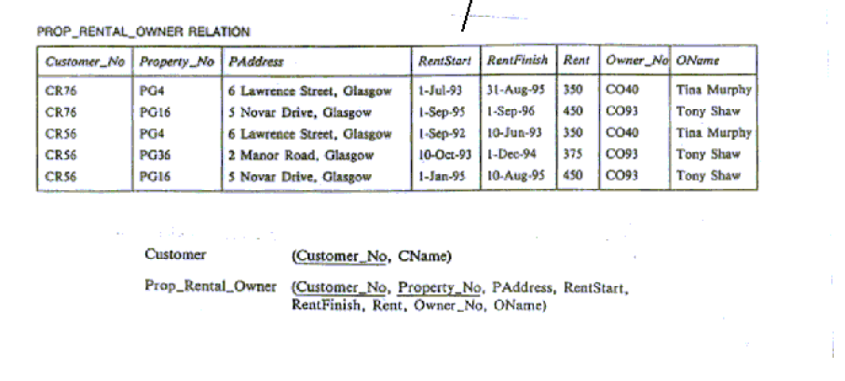

Slide 38
Second Normal Form
A relation schema R is in second normal form (2NF) if every non-prime attribute A in R is fully functionally dependent on every key of R
Uses the concepts of FDs and candidate key
Definitions
  Prime attribute: An attribute that is member of the primary key K
  Full functional dependency: a FD Y -> Z where removal of any attribute from Y means the FD does not hold any more
Slide 10- <number>

Slide 39
Examples:
  {SSN, PNUMBER} -> HOURS is a full FD since neither SSN -> HOURS nor PNUMBER -> HOURS hold
  {SSN, PNUMBER} -> ENAME is not a full FD (it is called a partial dependency ) since SSN -> ENAME also holds

Slide 40
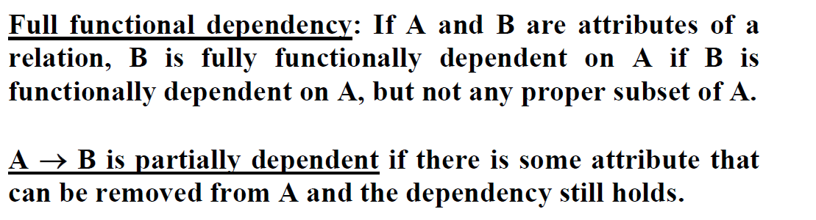
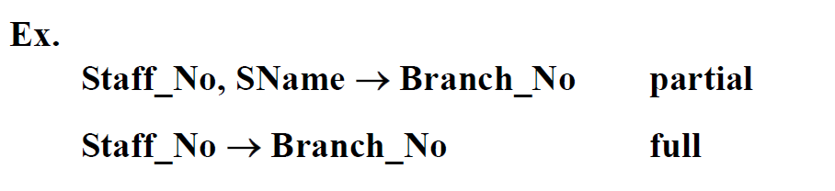

Slide 41
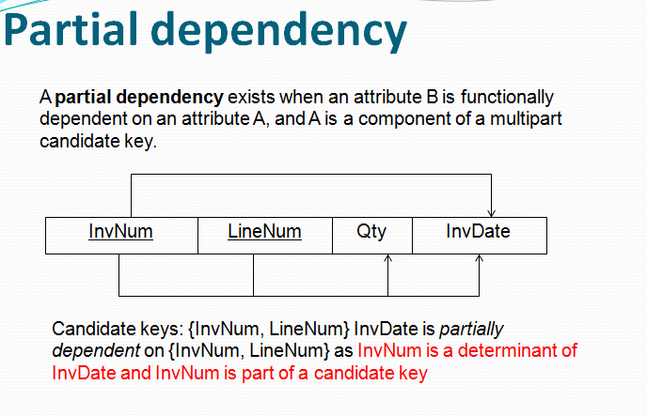

Slide 42
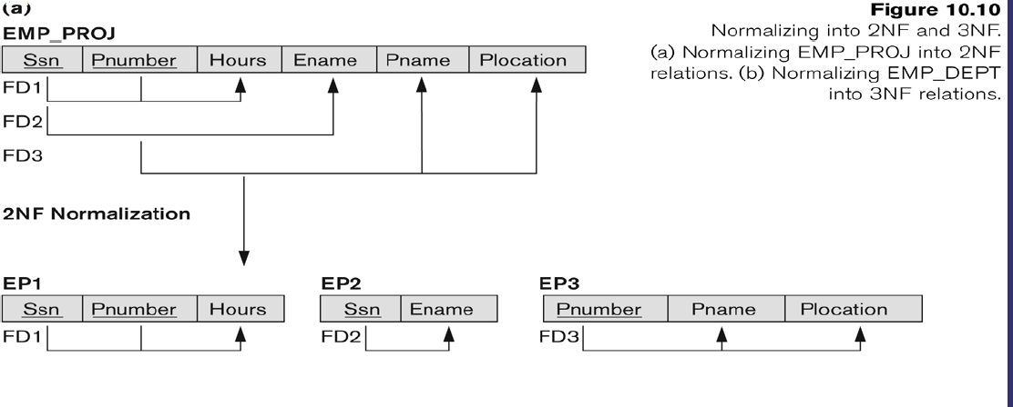

Slide 43
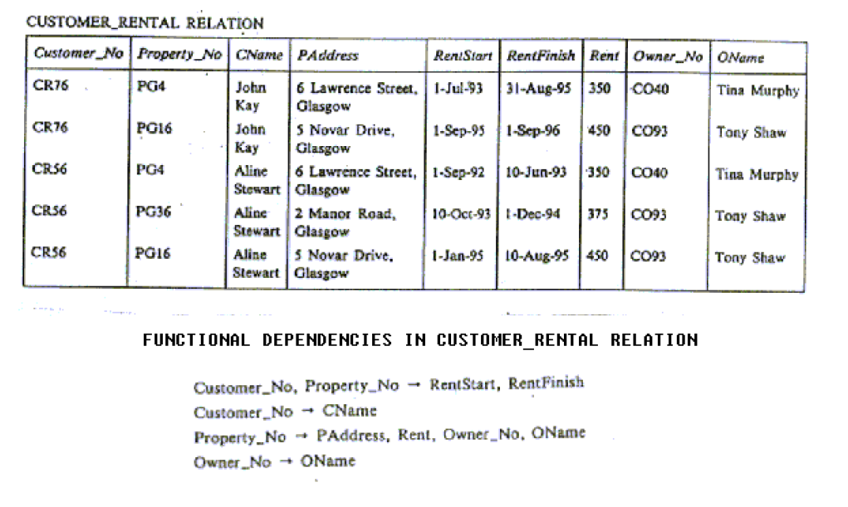

Slide 44
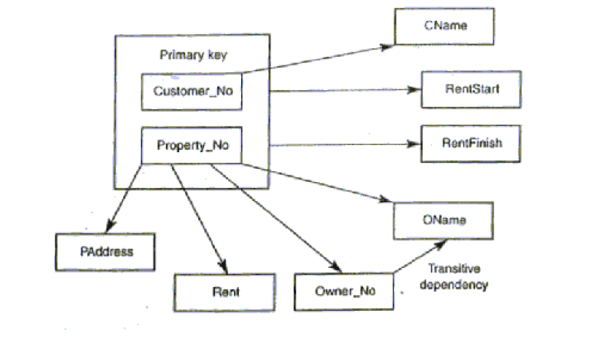

Slide 45
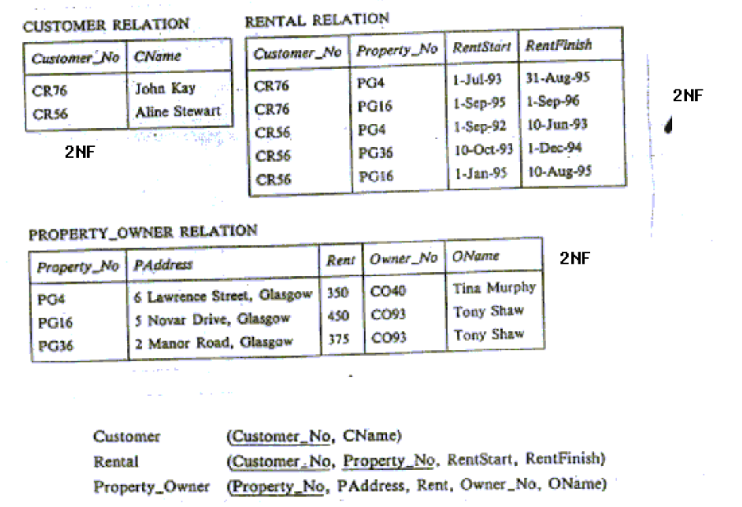

Slide 46

Transitive dependency
Consider attributes A, B, and C, and where
A → B and B → C.
Functional dependencies are transitive, which means that we also have the functional dependency A → C
We say that C is transitively dependent on A through B.
91.2914

Slide 47
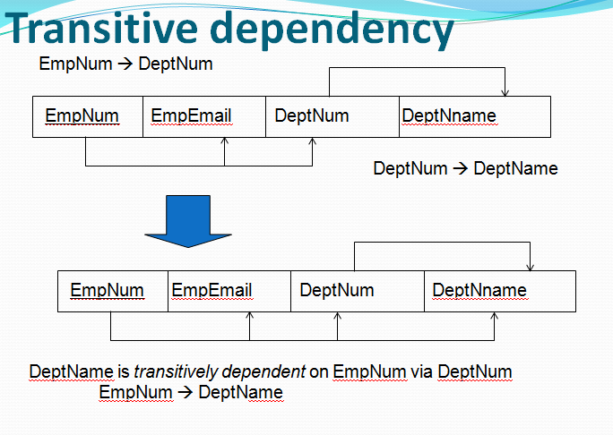

Slide 48
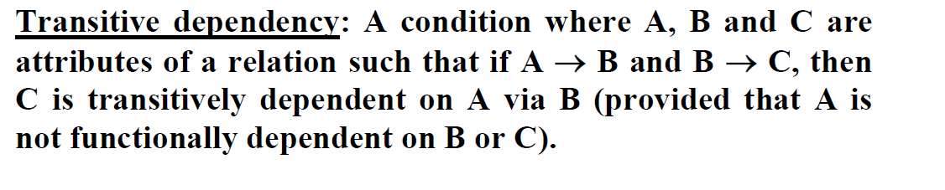
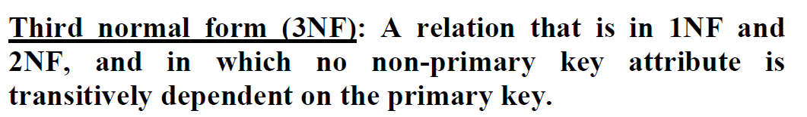
Third Normal Form
Definition:
  A relation schema R is in third normal form (3NF) if whenever a FD X -> A holds in R, then either:
    (a) X is a super key of R, or
    (b) A is a prime attribute of R
Slide 10- <number>

Slide 49
Third Normal Form
Definition:
Transitive functional dependency: a FD X -> Z that can be derived from two FDs X -> Y and Y -> Z
Examples:
SSN -> DMGRSSN is a transitive FD
  Since SSN -> DNUMBER and DNUMBER -> DMGRSSN hold
SSN -> ENAME is non-transitive
Since there is no set of attributes X where SSN -> X and X -> ENAME

Slide 50
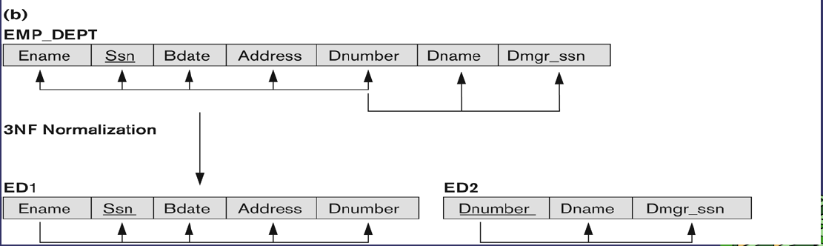

Slide 51
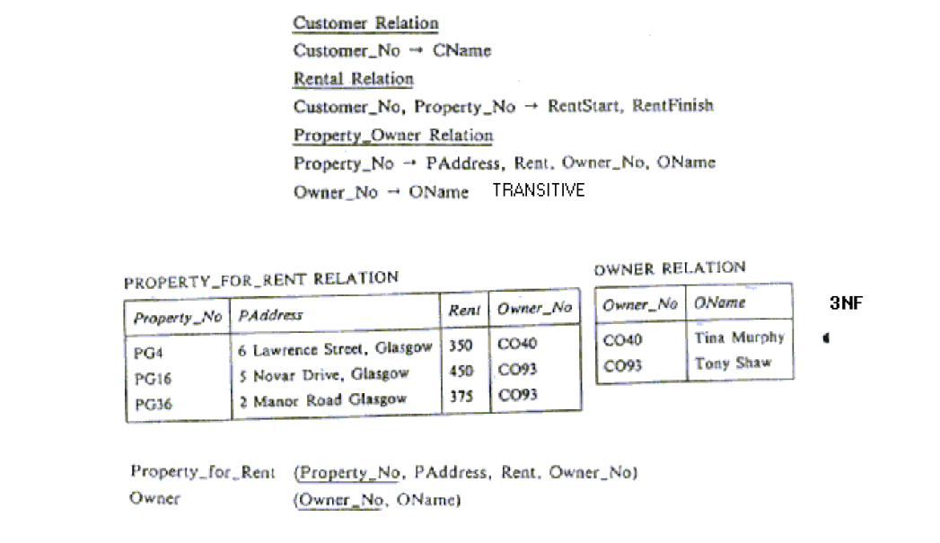

Slide 52
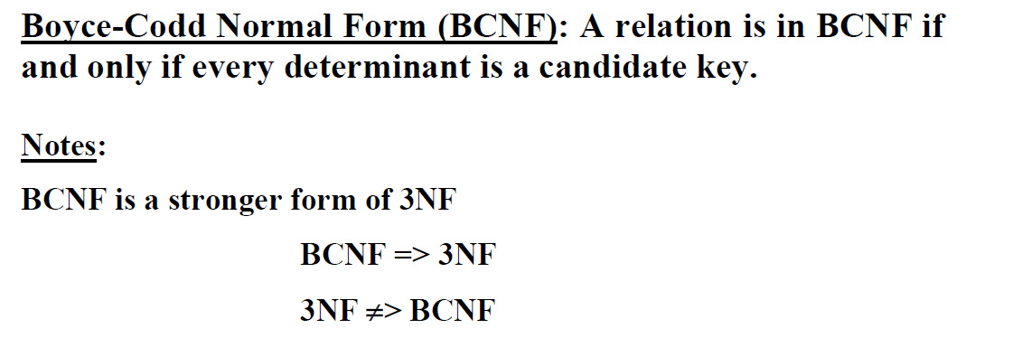
BCNF (Boyce-Codd Normal Form)
A relation schema R is in Boyce-Codd Normal Form (BCNF) if whenever an FD X -> A holds in R, then X is a superkey of R
NOTE: Boyce-Codd normal form disallows condition (b) above
Slide 10- <number>

Slide 53
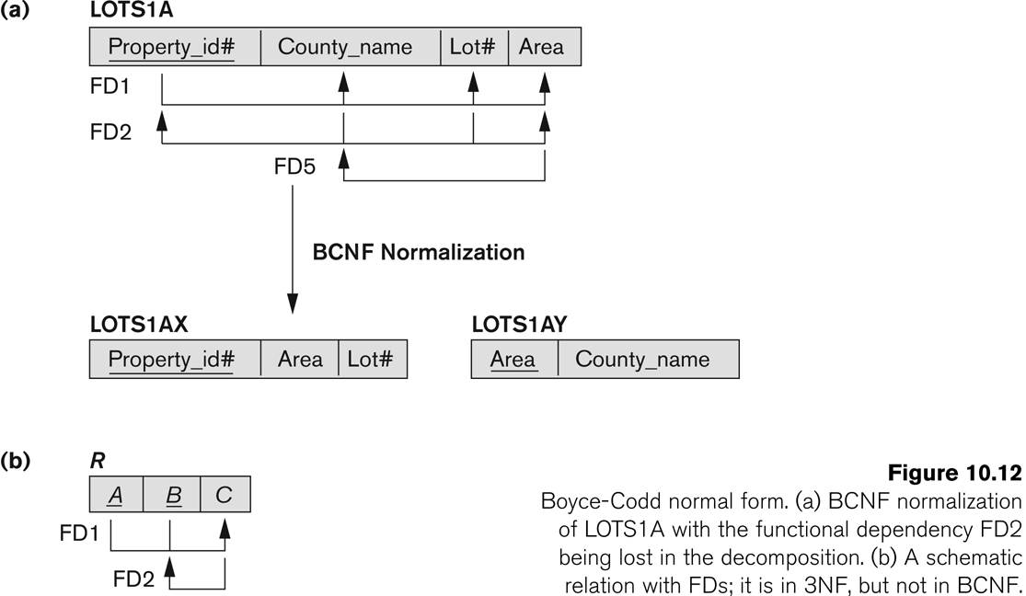
Boyce-Codd Normal Form
Slide 10- <number>

Slide 54
Contd….
Each normal form is strictly stronger than the previous one
  Every 2NF relation is in 1NF
  Every 3NF relation is in 2NF
  Every BCNF relation is in 3NF
There exist relations that are in 3NF but not in BCNF
The goal is to have each relation in BCNF (or 3NF)

Slide 55
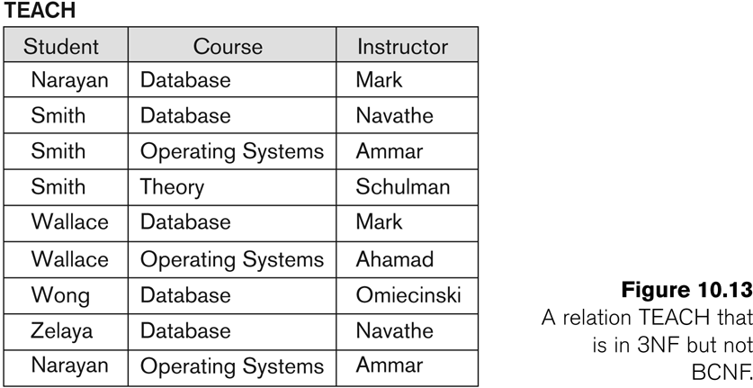
A relation TEACH that is in 3NF but not in BCNF
Slide 10- <number>

Slide 56
Achieving the BCNF by Decomposition
Two FDs exist in the relation TEACH:
  fd1: { student, course} -> instructor
  fd2: instructor -> course
{student, course} is a candidate key for this relation and that the dependencies shown follow the pattern in Figure 10.12 (b).
  So this relation is in 3NF but not in BCNF
A relation NOT in BCNF should be decomposed so as to meet this property, while possibly forgoing the preservation of all functional dependencies in the decomposed relations.
Slide 10- <number>

Slide 57
