Slide 1
Introduction to Deep Learning
Class 2

Slide 2
Agenda
Backpropagation: Single Input
Backpropagation: Batched case
Updating weights
Example: Predicting the value of Sin(x)
Minibatch Stochastic Gradient Descent
Implementing MSGD
Pytorch Dataloader/Dataset classes
Learning rate schedule
Regularization
Hyperparameter tuning
Homework

Slide 3
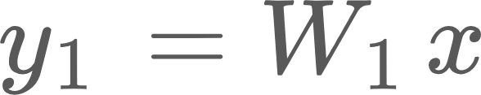


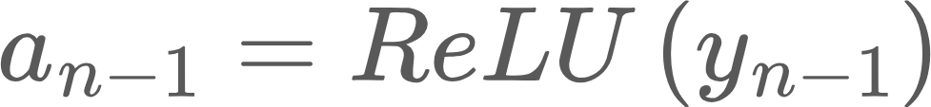
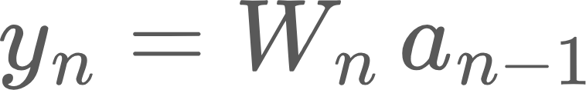




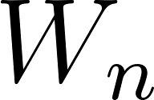



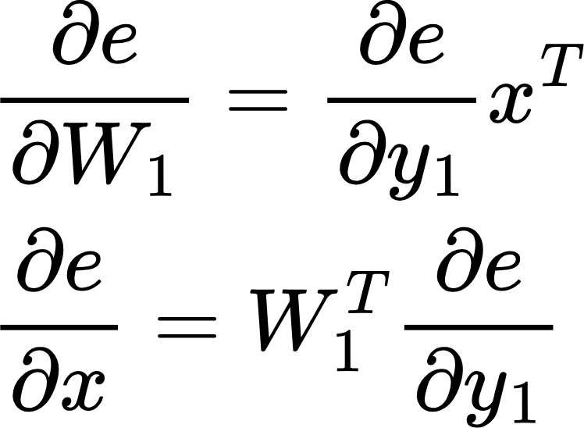
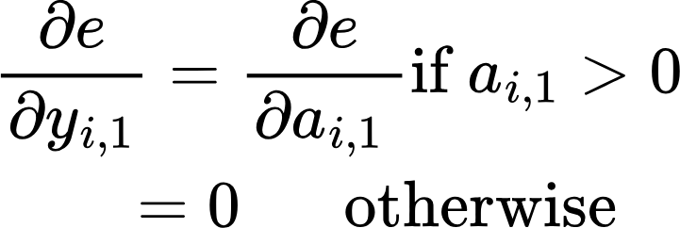
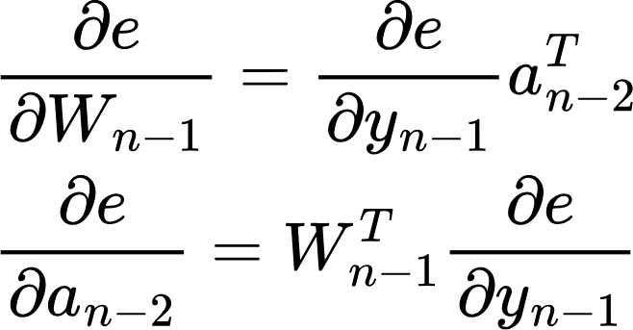
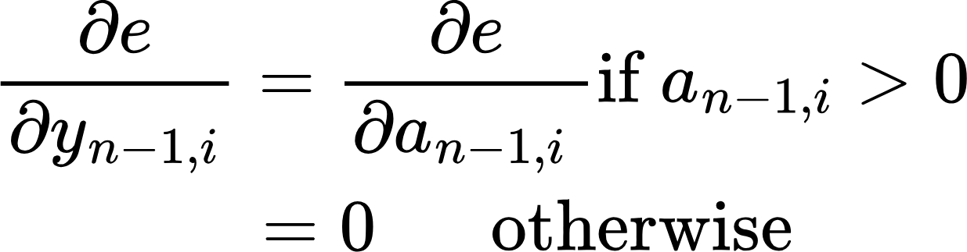
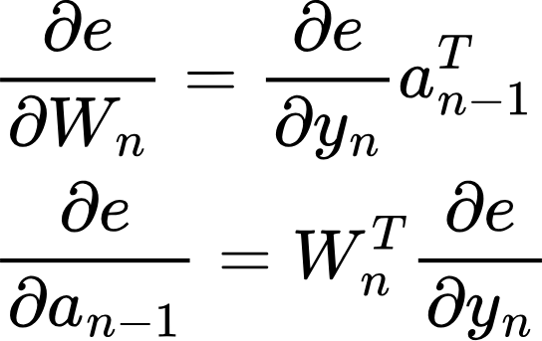
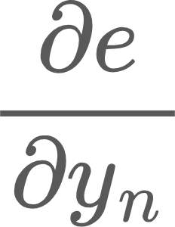
Backpropagation
Forward Pass or Inference
labels
ReLU
ReLU
Loss function (L)
…
Error
e = L(y)
Layer 1
Layer n-1
Layer n
Backward pass
(Training)
No parameters!
Notice we need the output of the previous layer in the backward pass!
Sent back to previous layers
Used to update the weights of this layer

Slide 4
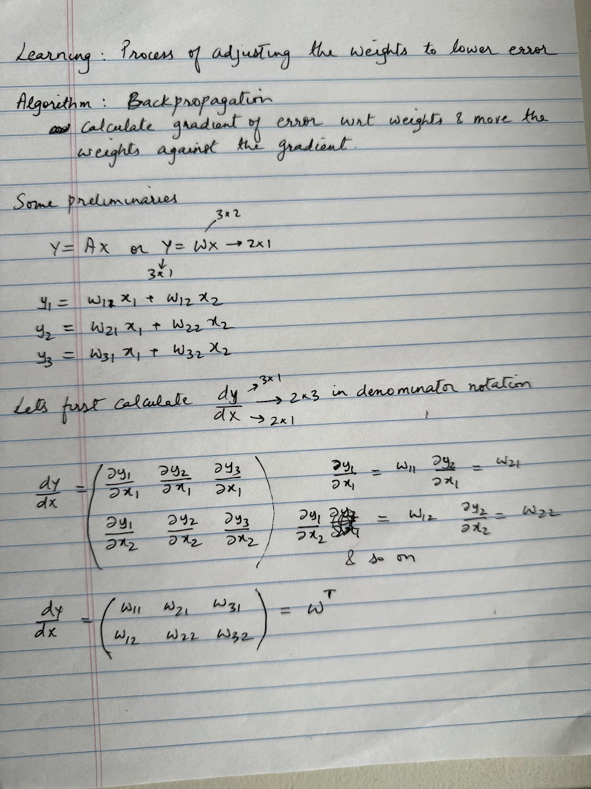
Backpropagation
Learning is the process of adjusting the weights of the layers in a network against the gradient.
This is done using an algorithm called Backpropagation.
Key idea is to calculate the derivative of the error against the parameters of the network, and move the parameters against the gradient to gradually lower the error, which directs the network’s output towards the desired output

Slide 5
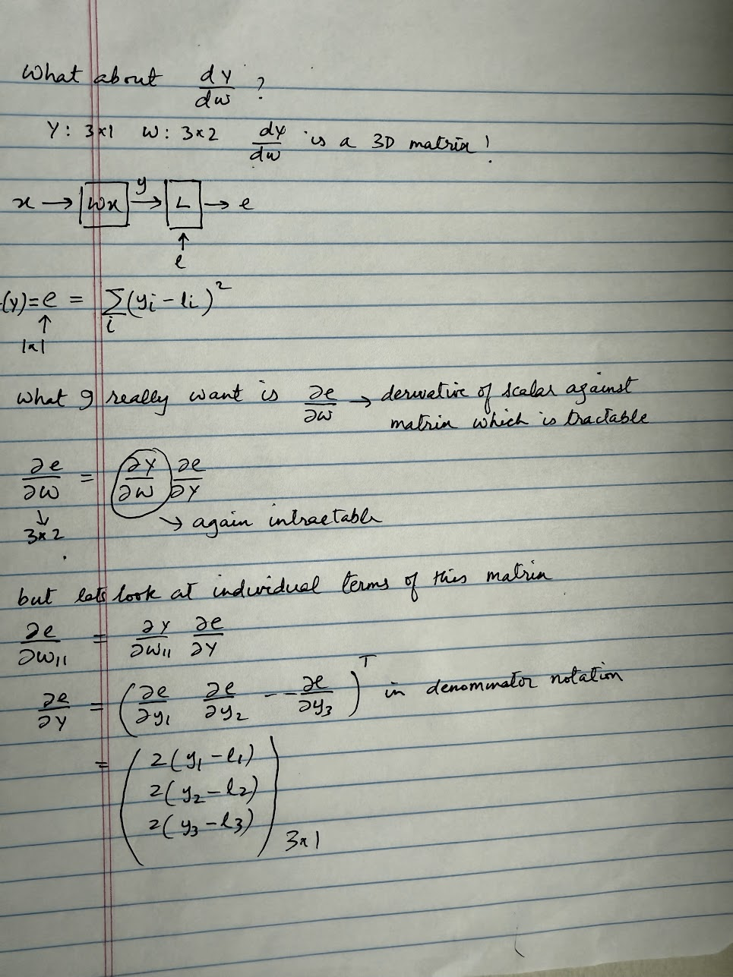
Backpropagation
Calculating the derivative of the error against the parameter matrix
Here our loss function is “squared error”
There are several loss functions:
Root Mean Square
Cross Entropy Loss
Contrastive Loss
We’ll look at these later in the course

Slide 6
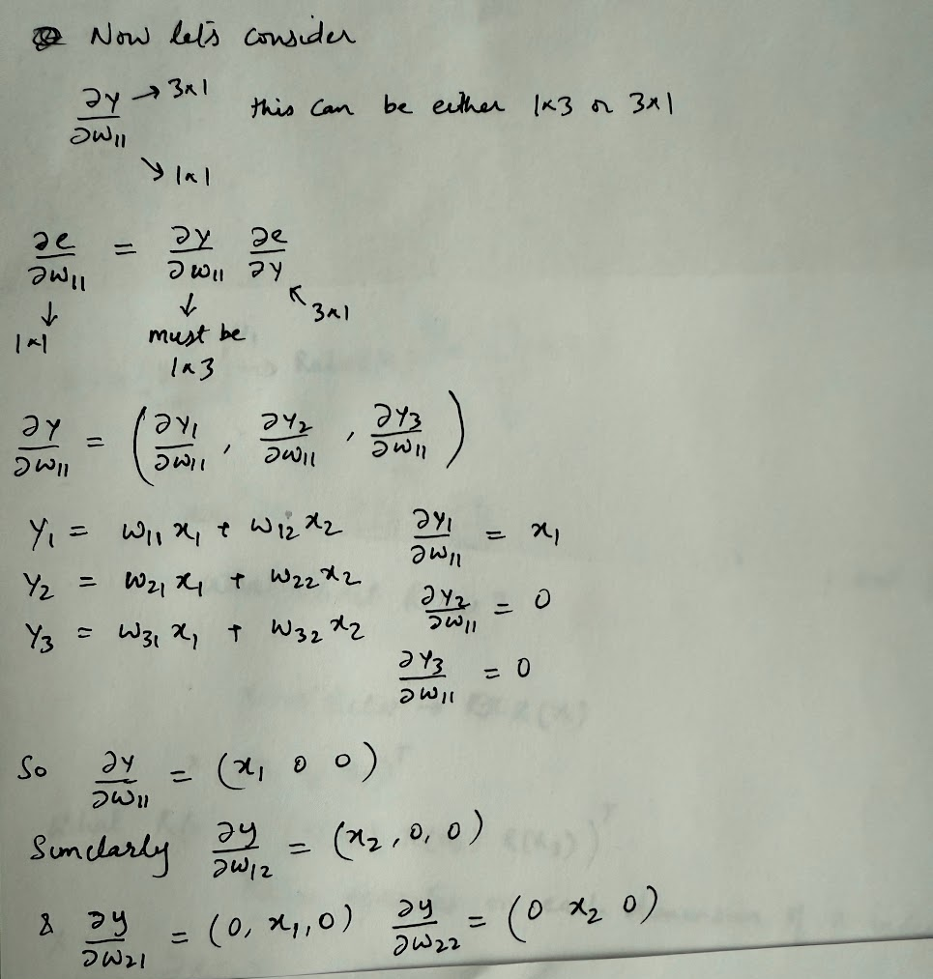
Backpropagation
Calculating the derivative of the error against the parameter matrix

Slide 7
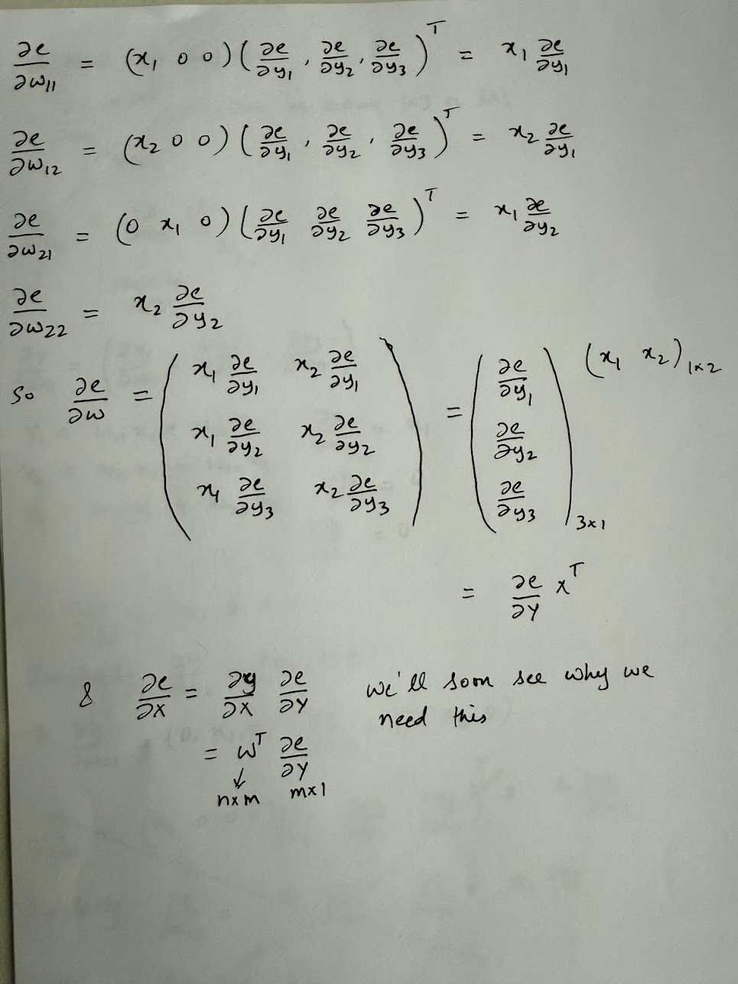
Backpropagation
Calculating the derivative of the error against the parameter matrix
This is a key result, because in a typical Transformer model, matrix multiplications account for a significant portion of the operations, often exceeding 80% of the total runtime.

Slide 8
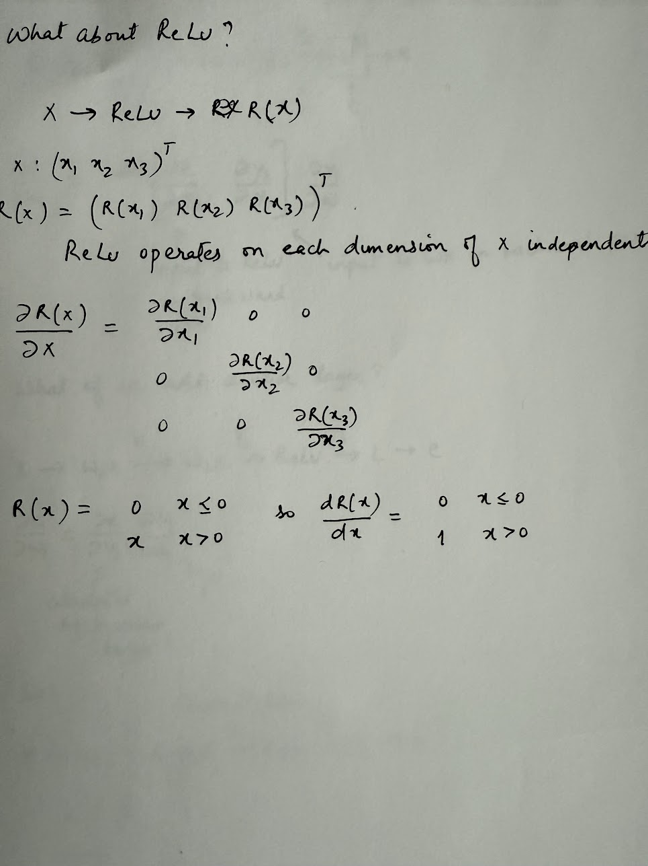
Backpropagation
Let’s look at ReLU now..
Note: In the derivation on the right, we are consider x as a 3*1 vector just as an example. In general, x would be a m*n matrix
Note: ReLU doesn’t have any parameters.. But we still need to calculate the derivative of its output against input

Slide 9
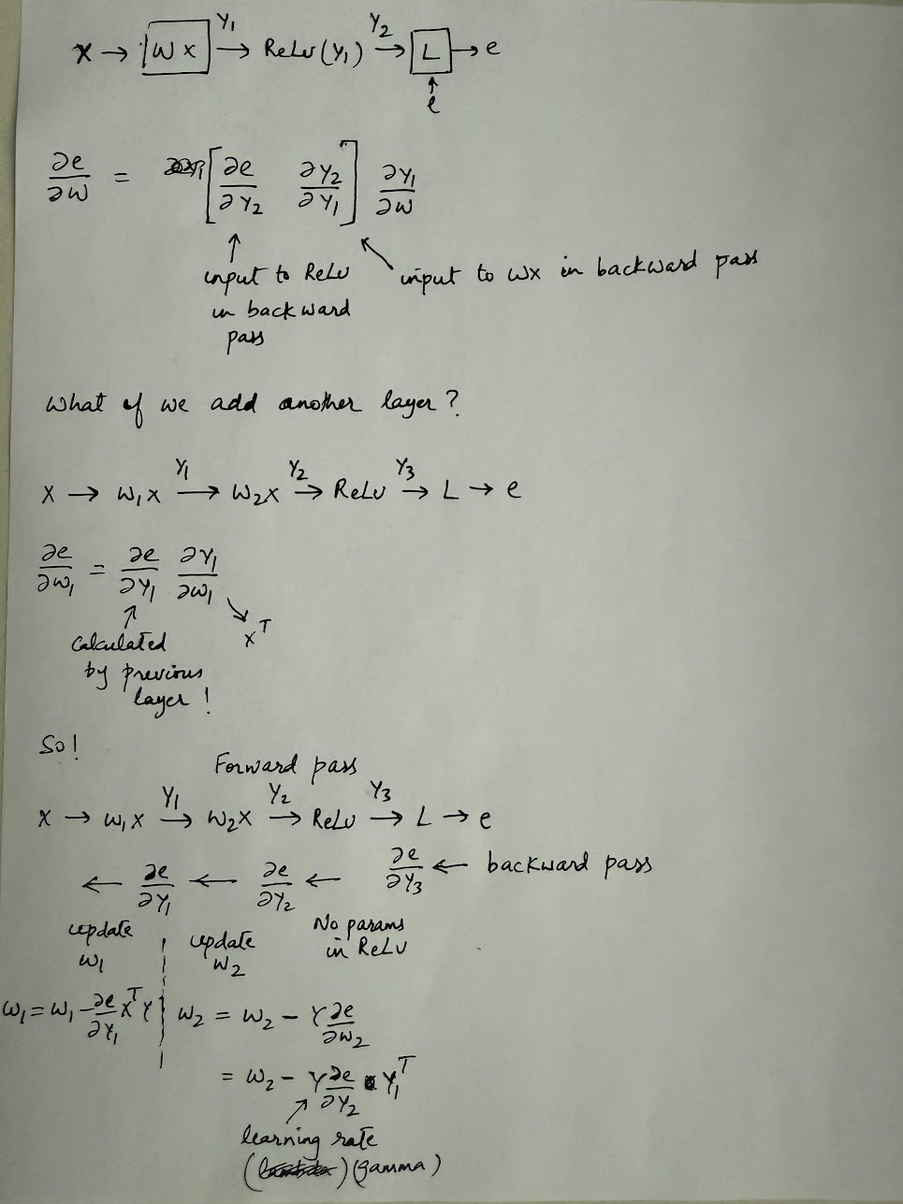
Backpropagation
Calculating the derivative of the error against the parameter matrix
Each layer uses the derivative of error against its output to calculate derivative of error against its parameters, and the derivative of error against its inputs, which is propagated back to the previous layer..

Slide 10
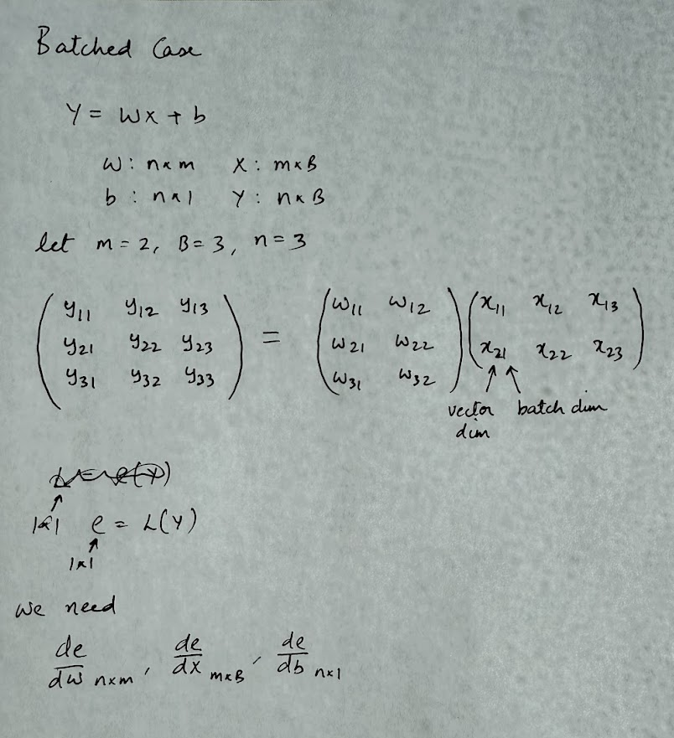
Backpropagation: Batched
So far, we calculated gradients for a single input. It is common to group the inputs into a batch. Let’s calculate the gradients for the batched case. We’ll also include the bias term now

Slide 11
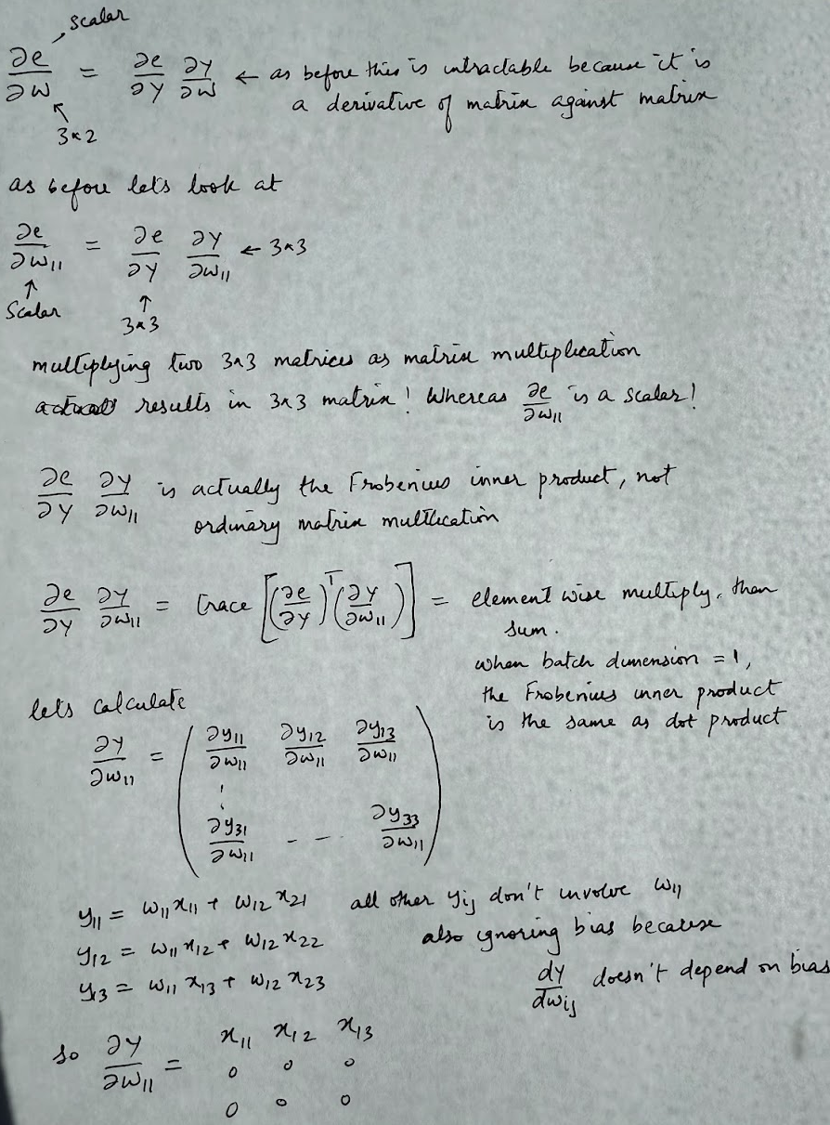
Backpropagation: Batched
Derivative of error against the weights

Slide 12
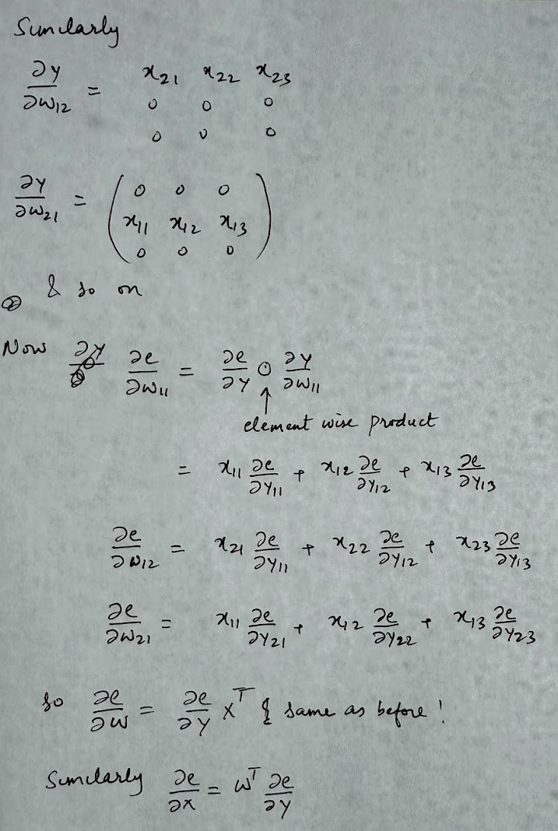
Backpropagation: Batched

Slide 13
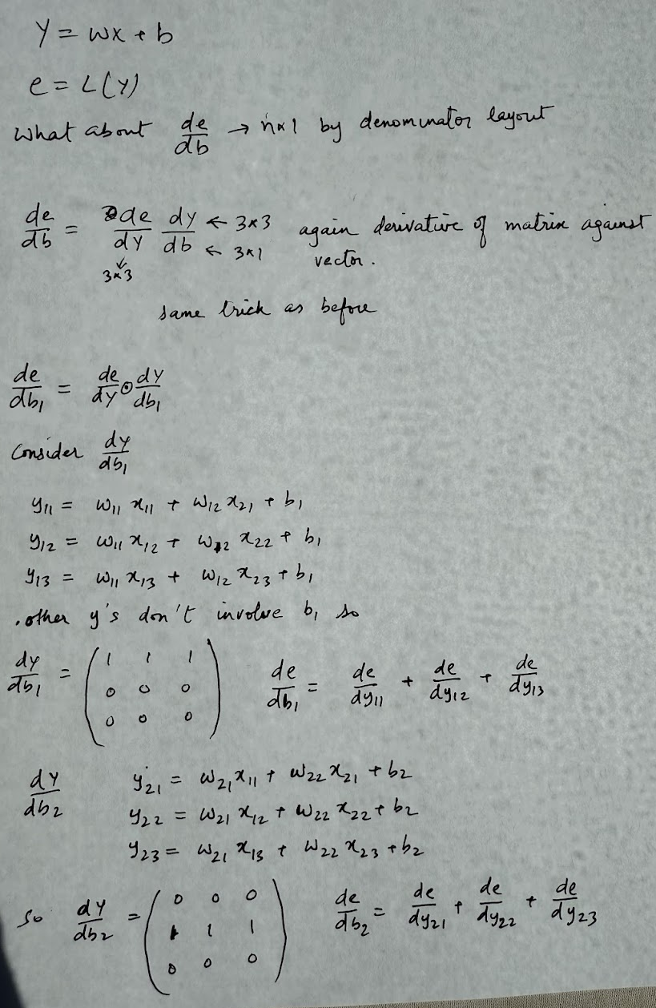
Backpropagation: Batched
Derivative of error against bias

Slide 14
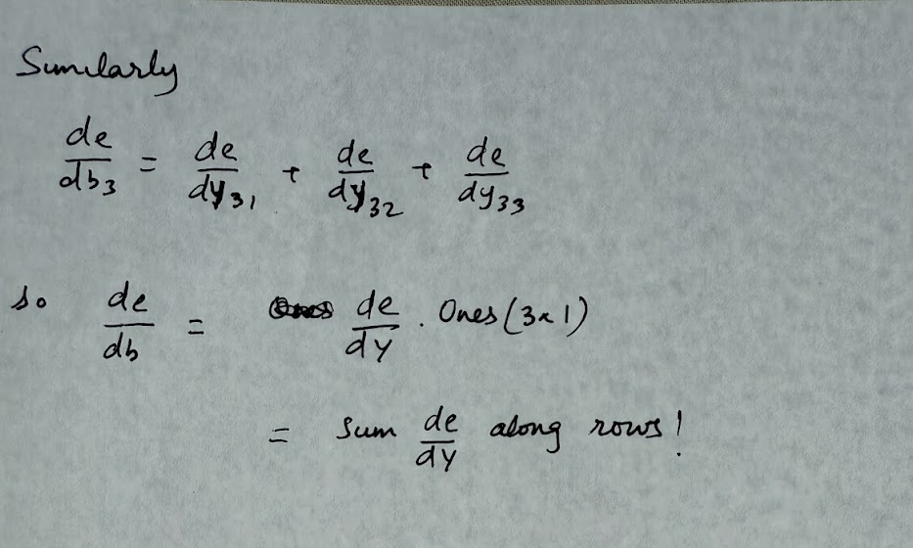
Backpropagation: Batched

Slide 15
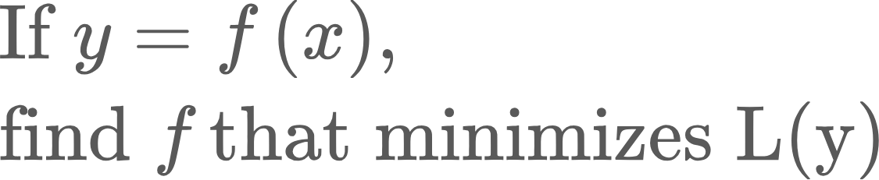
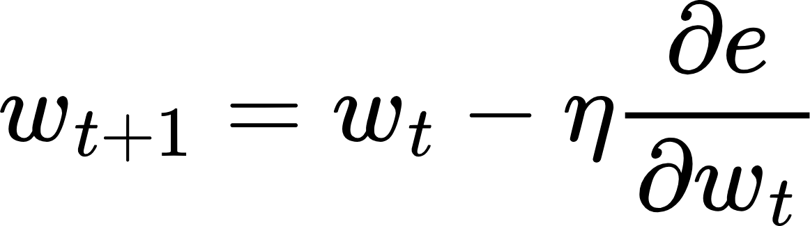
Updating Weights..
We calculated all these gradients.. Now what?
Recall the original optimization problem..
We modeled the unknown function f as a neural network, because neural networks can model any arbitrary function. Finding f means finding the weights of the network that minimize the loss function. We calculated the gradients so we know which direction to move the weights.
Learning rate.. This should get smaller as we get closer to the minimum

Slide 16
Stochastic Minibatch Gradient Descent
How do we select the batch size?
Say we have n data points
1<B<n
Select a subset of the dataset at every iteration (without replacement). Calculate gradient and update weights. Do until we sweep through the entire dataset
Best of both worlds. Stable gradients, lower compute
B=1
Select a random point from the dataset (without replacement)
Calculate gradient and update weights
Problem: Gradient is very noisy
B=n
Select the entire dataset at every iteration
Calculate gradient and update weights
Problem: Large matrices, compute heavy
n
Sample B=m at each iteration. A sweep through the entire training dataset is called an epoch. Number of iterations in an epoch: n/B, assuming B divides n

Slide 17
Learning rate schedule
Recall that in optimization, the learning rate controls the size of the step at each iteration. Generally, the loss function becomes shallower near the minimum.. Thus, we should lower the learning rate as optimization proceeds, otherwise the iterates might bounce along the optimization function rather than settling in.

Slide 18
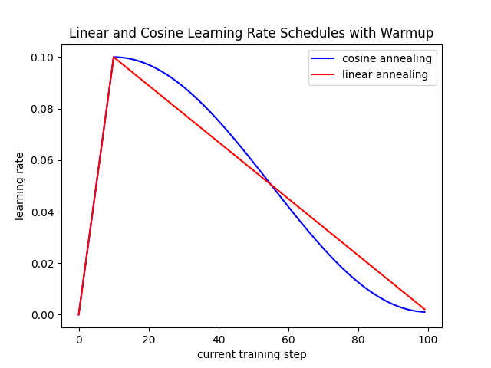
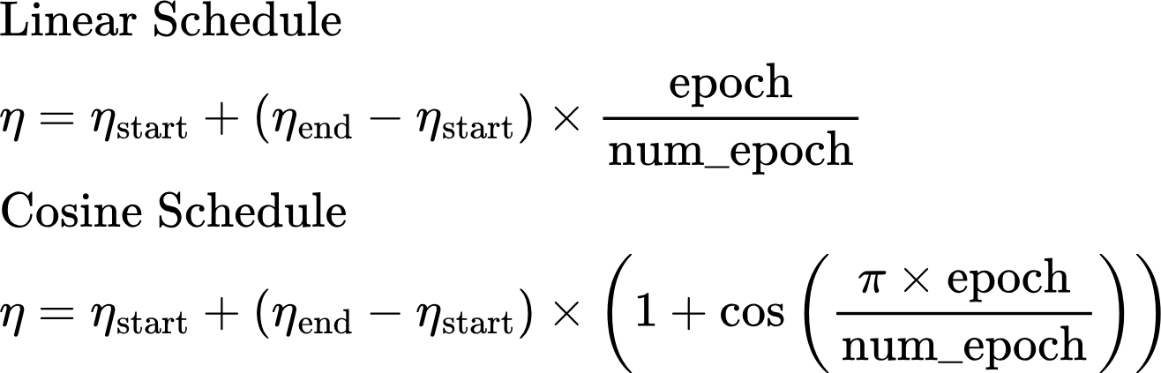
Learning rate schedule
In deep learning libraries, learning rate is generally adjusted after each epoch. The trajectory of the learning rate from its starting value to final value is called learning rate schedule. Some examples are:
There are several more eg., exponential decay
Learning Rate Warmup: For large NNs, learning rate is warmed up from a small starting value to base value, and then decayed following a schedule
In large networks, groups of layers can have their own learning rates
Cosine schedule paper

Slide 19
Regularization
Regularization means imposing constraints on the optimization process to meet certain desirable properties. Eg.,
It is a good idea to keep the weights of a Neural Network small (accomplished by weight decay)
Large weights make the model more sensitive to input noise → risk of overfitting.
Small weights encourage simpler functions, which often generalize better.
The network shouldn’t overly rely on a small number of neurons (accomplished by dropout)

Slide 20
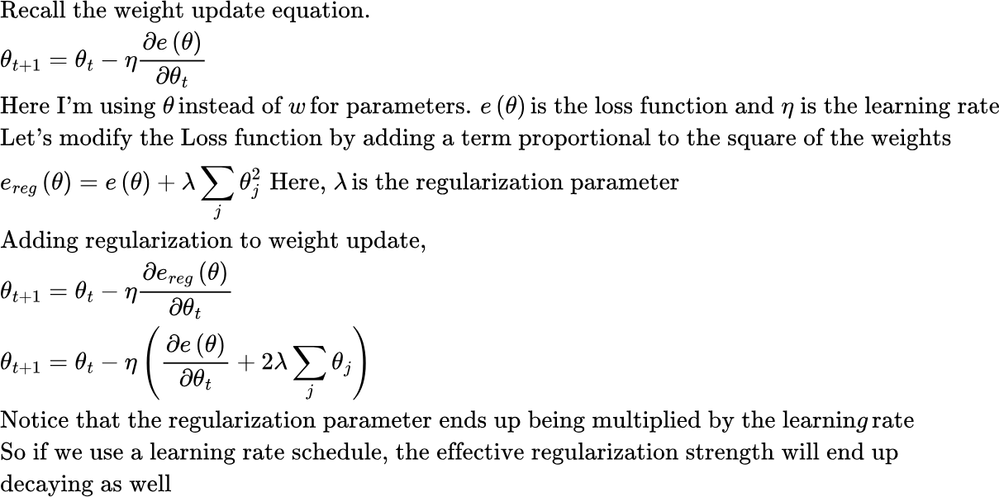
Regularization: Weight Decay
Generally, regularization is not applied to bias parameters. This is because bias often represents a "baseline prediction" (e.g., class prior probability). Regularizing it could distort this baseline estimate.
Note: lambda is called “weight decay” in Pytorch..
Notes:
Thinking of weights as the “slopes” of lines and biases as the “intercepts.”
Penalizing slopes keeps the line from becoming too steep (simpler model).
Penalizing intercepts just pushes the line toward the origin, which doesn’t really fight overfitting — it just shifts everything awkwardly.
If you are curious: Fixing Weight Decay Regularization in Adam” (Loshchilov & Hutter, 2017)

Slide 21
Regularization: Dropout
Another regularization method is Dropout, where during training, we randomly “drop” (set to zero) a fraction of neurons in a layer. Setting to zero means setting the corresponding activations to 0. The subset of neurons set to 0 is called “dropout mask”. This mask changes every training iteration.
The intuition is that Neurons can’t rely on specific other neurons being present and thus learn more independent, robust features.
Dropout used to be quite popular in older networks to prevent overfitting, but less common in latest Transformer-based networks. This is because the size of training datasets is huge, and each training sample is only seen a small number of times, making overfitting is less of a problem. See this article (search for dropout)

Slide 22
Hyperparameters
The initial value of these parameters is chosen by guesswork and set at the beginning of a training run.
A systematic exploration of the best value of these parameters for a given model is called Hyperparameter Tuning. More on that in a subsequent lecture

Slide 23
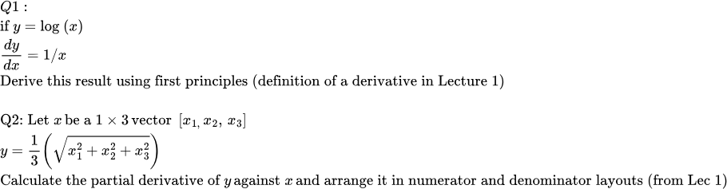
Homework
Q3: This code implements the math in slides 3-8. Run it in your favorite Python IDE (Pycharm recommended) and make sure you understand what’s going on. Do the exercise at the bottom of the code

Slide 24
Homework
Q4: Run simple_nn1.py with default parameters. Record the final value of the loss function. Also plot the loss function history to see how it changes
Change the optimizer from ‘adam’ to ‘simple’. Run the code. Surprised?
Now change the scale for the weight matrix initialization (in SimpleNN initialization) like below, and run the code again..
Change the learning rate scheduler from linear to constant and plot the loss function. What do you observe?
Vary the size of hidden layer: [20, 50, 100, 150], switch the optimizer to Adam, and learning scheduler to linear
You are effectively doing manual hyperparameter tuning!
Record the loss progression for each of the above cases and compare the loss progression curves. You’ll need to write the loss_func_history array to disk and write a separate program to compare the loss function across runs..
Isn’t a pain to compare the output of these experiments? Wouldn’t it be nice if we could somehow record the output of each experiment and compare across runs?

Slide 25
What’s next..
Can I use other non-linearities?
How do I initialize weights?

