Slide 1
Lecture 4
Introduction to Deep Learning

Slide 2
Agenda
Other non-linearities
Measuring performance
Optimizers
Memory consumed in forward pass and backward pass
Activation checkpointing
Gradient accumulation
Weight initialization
Batch/Layer normalization
Skip connections

Slide 3
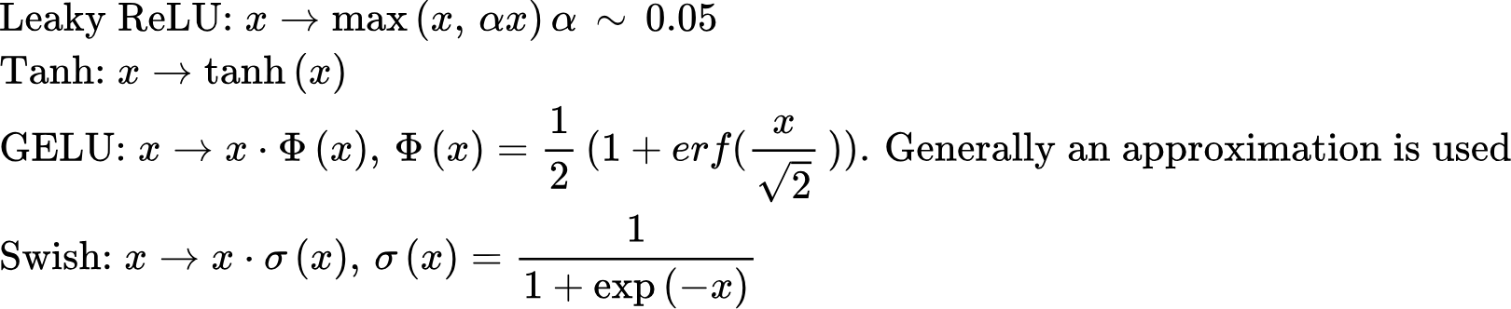
Other Non-Linearities
Lots of other non-linearities have been explored in literature, we’ll focus on some recent ones:
Leaky ReLU
Tanh
GELU (Gaussian Error Linear Unit)
Swish
SwiGLU (GELU + Swish: Latest in Transformers. Will discuss later)

Slide 4
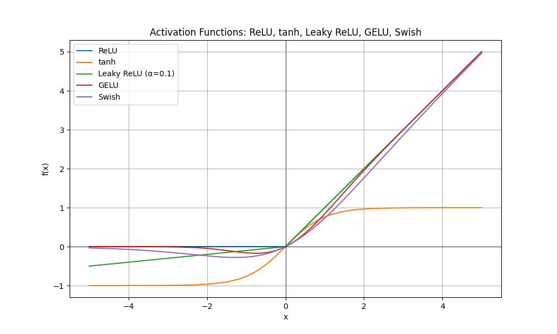
Other Non-Linearities
LeakyReLU: Allows a small, non-zero gradient when inputs are negative, keeping neurons alive and trainable
Tanh: zero-centered, smooth, but suffers from vanishing gradients
GELU: smoothest, probabilistic, dominates in modern Transformers.

Slide 5
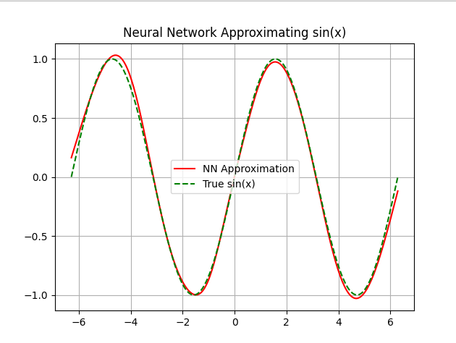
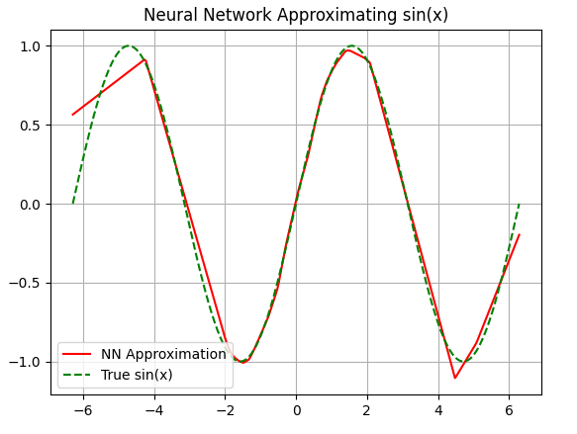

Slide 6
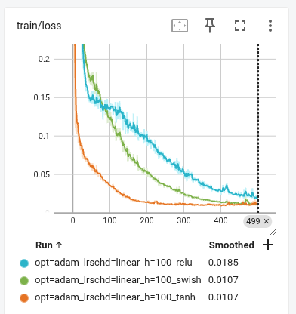
Loss progression using different non-linearities

Slide 7
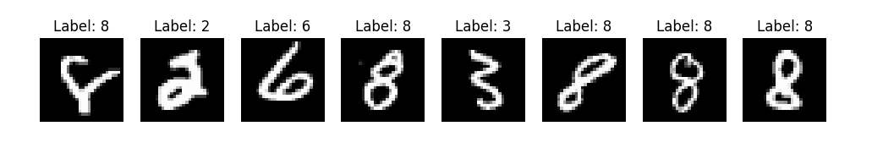
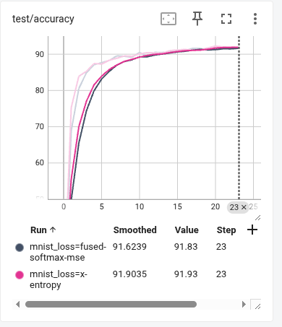
Classifying MNIST Digits

Slide 8
Measuring performance
What we optimize for can we different from our performance metrics!
We optimize for:
Mean Square Error for regression problems
Cross-Entropy Loss for classification problems
We measure performance using:
Precision/Recall@k, F1 score, AOC curve for classification problems
Mean Reciprocal Rank (MRR) for Information Retrieval and Ranking
BLEU, BERT Score in Machine Translation
TF-IDF/BM25

Slide 9
Precision/Recall
Accuracy can be misleading, specially when dataset is unbalanced
Declare H0
Declare H1
Is H0
Recall is the fraction of events where we correctly declared h0, out of all instances that are h0
Is H1
precision is the fraction of events where we correctly declared h0, out of all instances where we declared h0

Slide 10
MRR
Accuracy can be misleading, specially when dataset is unbalanced
Declare H0
Declare H1
Is H0
Recall is the fraction of events where we correctly declared h0, out of all instances that are h0
Is H1
precision is the fraction of events where we correctly declared h0, out of all instances where we declared h0

Slide 11
TF/IDF
Sentence: "the cat is on the mat"
Unigrams: [the, cat, is, on, the, mat]
Bigrams: [the cat, cat is, is on, on the, the mat]
Trigrams: [the cat is, cat is on, is on the, on the mat]
4-grams: [the cat is on, cat is on the, is on the mat]
In information retrieval:
Character n-grams are used in fuzzy search and spell checking.

Slide 12
BLEU
Sentence: "the cat is on the mat"
Unigrams: [the, cat, is, on, the, mat]
Bigrams: [the cat, cat is, is on, on the, the mat]
Trigrams: [the cat is, cat is on, is on the, on the mat]
4-grams: [the cat is on, cat is on the, is on the mat]
In information retrieval:
Character n-grams are used in fuzzy search and spell checking.

Slide 13
BERT-Score
Sentence: "the cat is on the mat"
Unigrams: [the, cat, is, on, the, mat]
Bigrams: [the cat, cat is, is on, on the, the mat]
Trigrams: [the cat is, cat is on, is on the, on the mat]
4-grams: [the cat is on, cat is on the, is on the mat]
In information retrieval:
Character n-grams are used in fuzzy search and spell checking.

Slide 14
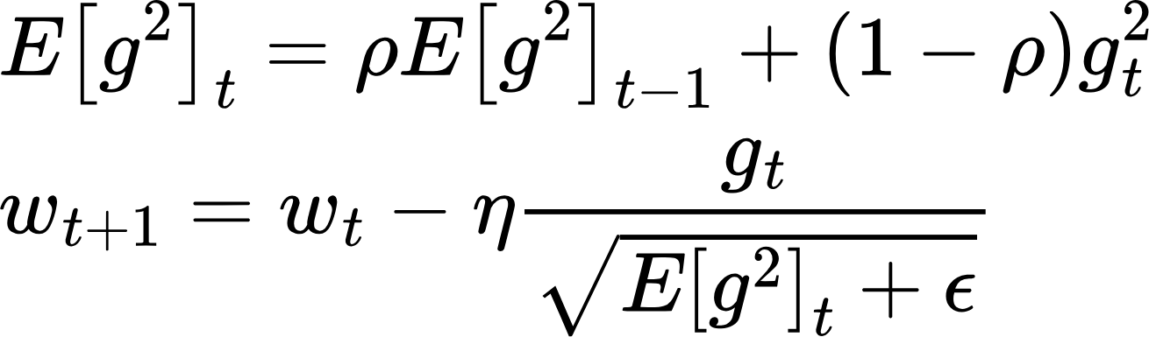
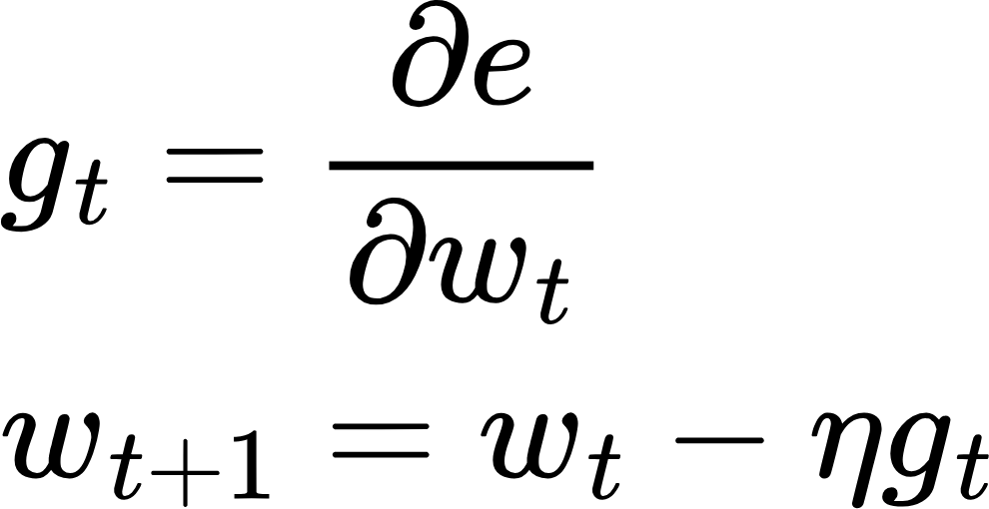
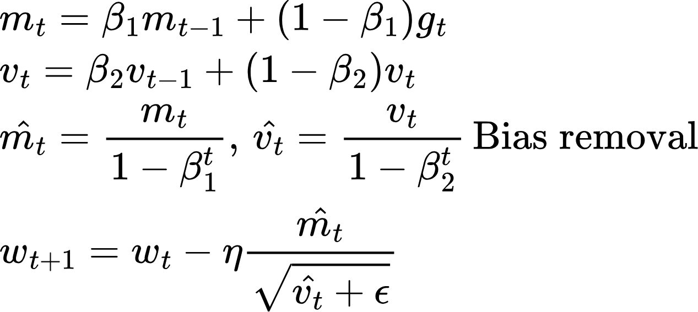
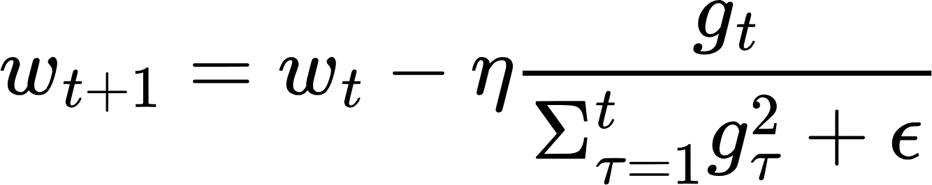
Optimizer
RMSProp: Using exponential moving average keeps denominator bounded
Adam: Scales gradients by unbiased estimator of second moment, uses moving average of the gradient
SGD
AdaGrad
Adam
AdamW
RMSProp
SGD: Parameter updates are scale dependent
AdaGrad: Dividing by sum of square of past gradients removes scaling issue

Slide 15
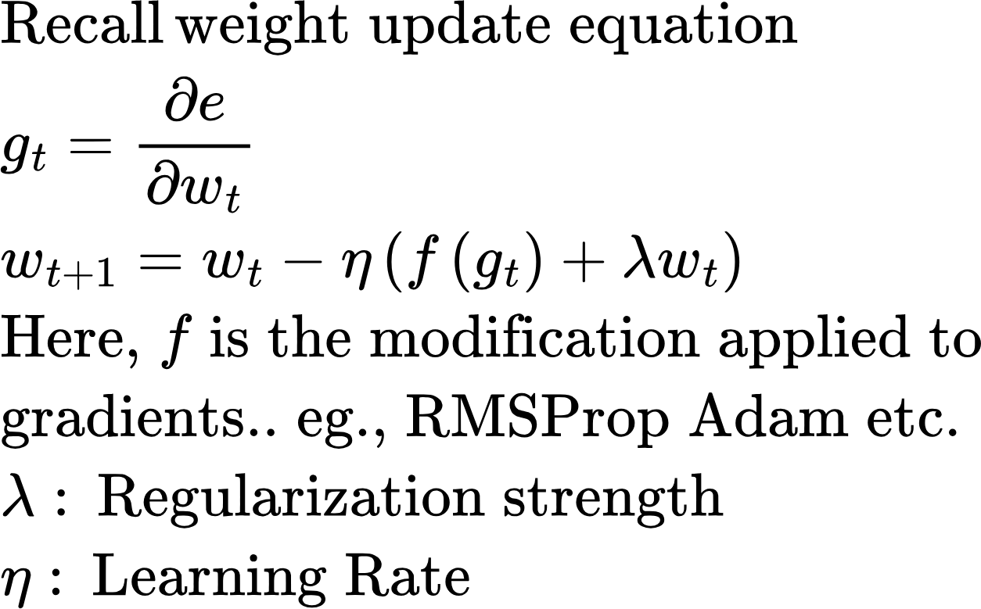
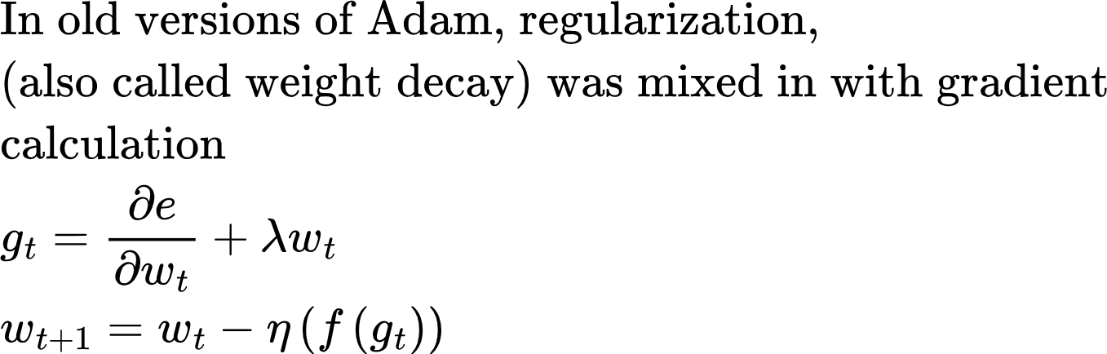
Optimizer
Adam vs AdamW

Slide 16
Weight Initialization
When stacking many layers, we want to avoid exploding or vanishing activations in the forward pass and gradients in the backward pass. This is accomplished by:
Initializing the weights the beginning of training in such a way that the variance of the input equals that of the output for each layer, both during forward and backward pass. Because variance is a measure of the spread of a distribution, bounding the variance bounds the probability of some activations or gradients becoming very large
Normalizing the mean and variance after each layer

Slide 17
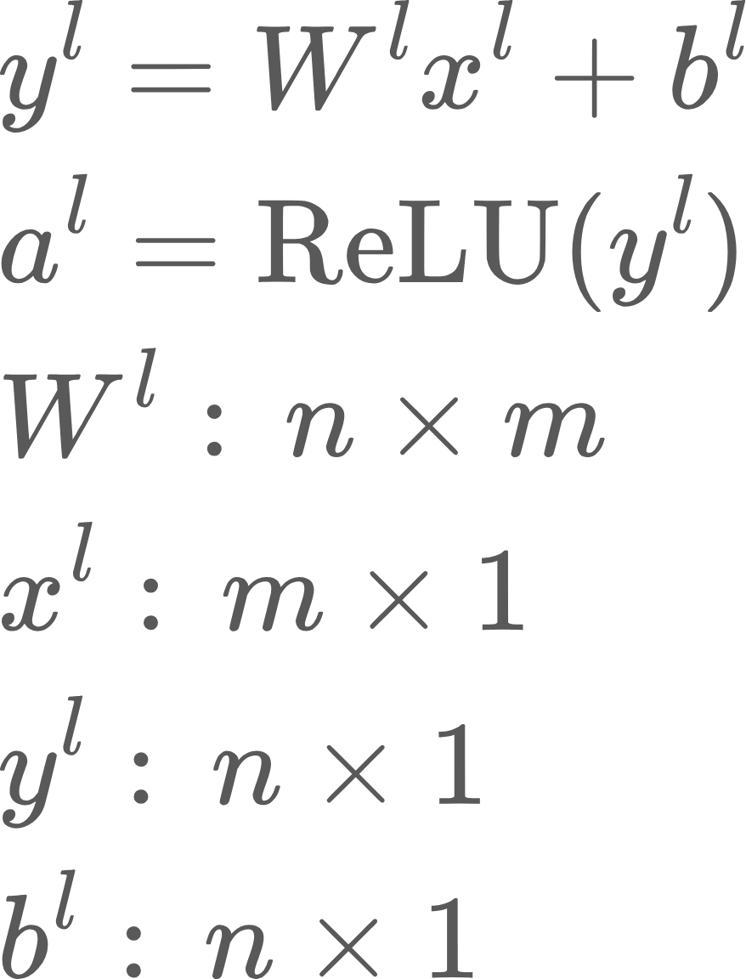
Weight initialization
Consider layer l in a n layer network
ReLU

Slide 18



Weight initialization
Consider layer l in a n layer network
ReLU

Slide 19
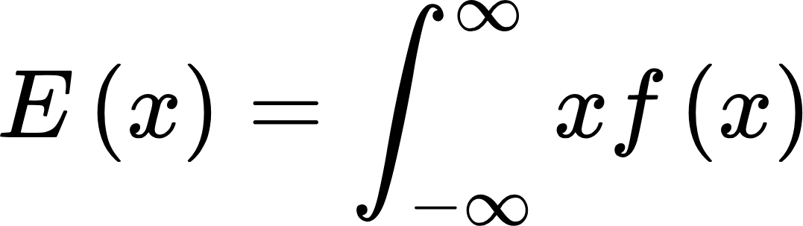
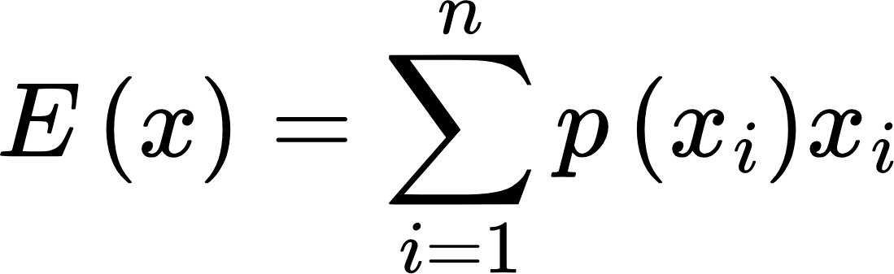
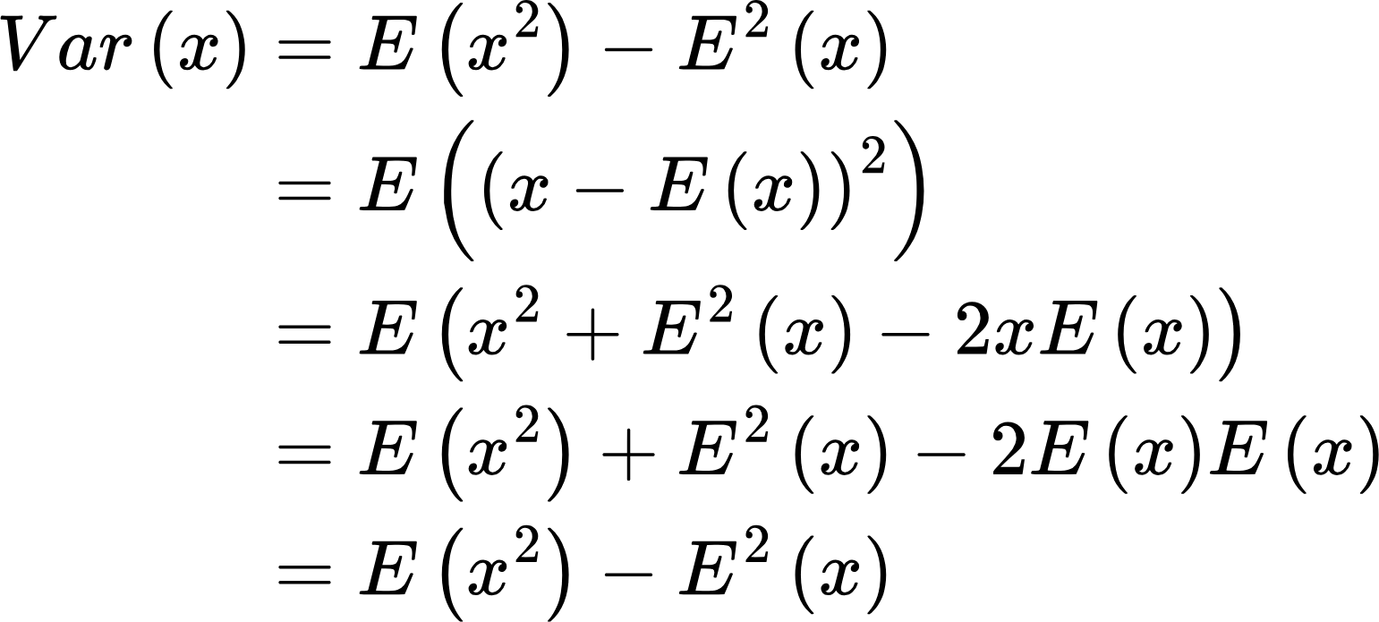
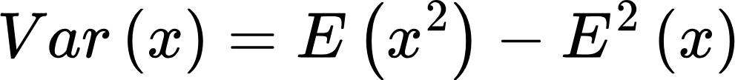
Some identities..
Note: Conventionally, random variables are written in capital letters.. I’m flouting the convention here

Slide 20
Some definitions
Random variables X and Y are Independent and Identically Distributed (IID) if they are independent of each other, and have the same distribution. Eg., repeatedly rolling the same dice, or tossing the same coin
Independent but not identically distributed: X: outcome of tossing a biased coin, Y: outcome of tossing an unbiased coin
Identically distributed but not independent: Two coins identical in every respect, but entangled so that when the first rolls a 1, the second also rolls a 1.

Slide 21
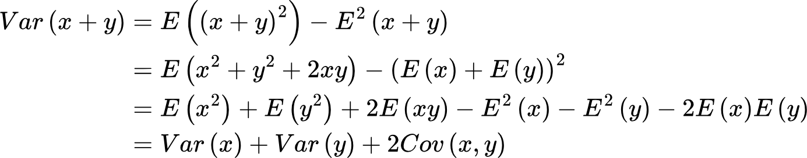
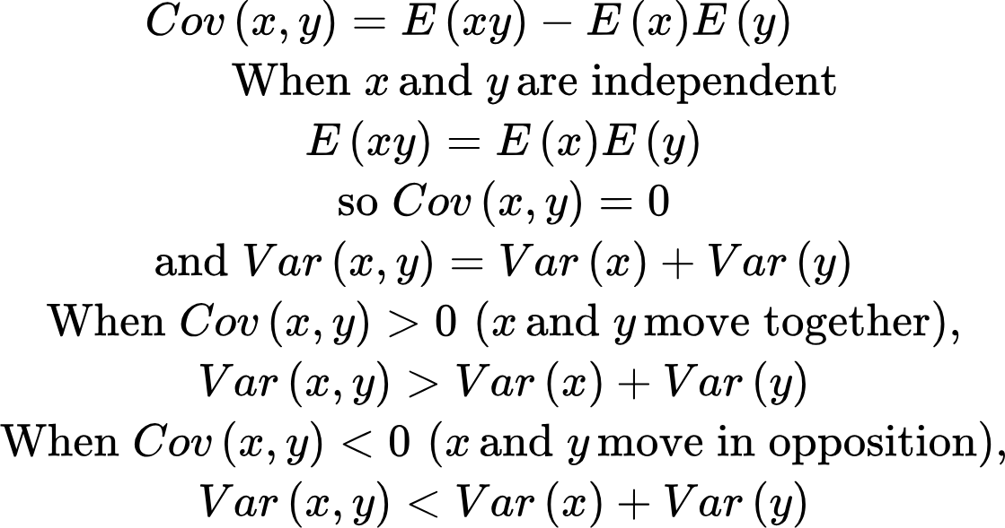
Some identities..
Always true.. IID or not

Slide 22
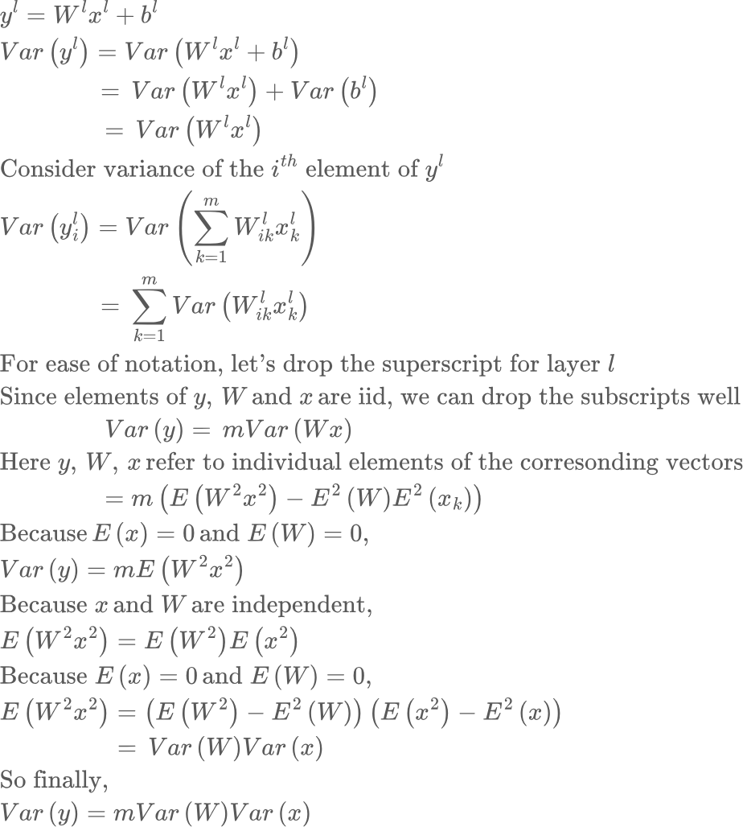

Slide 23
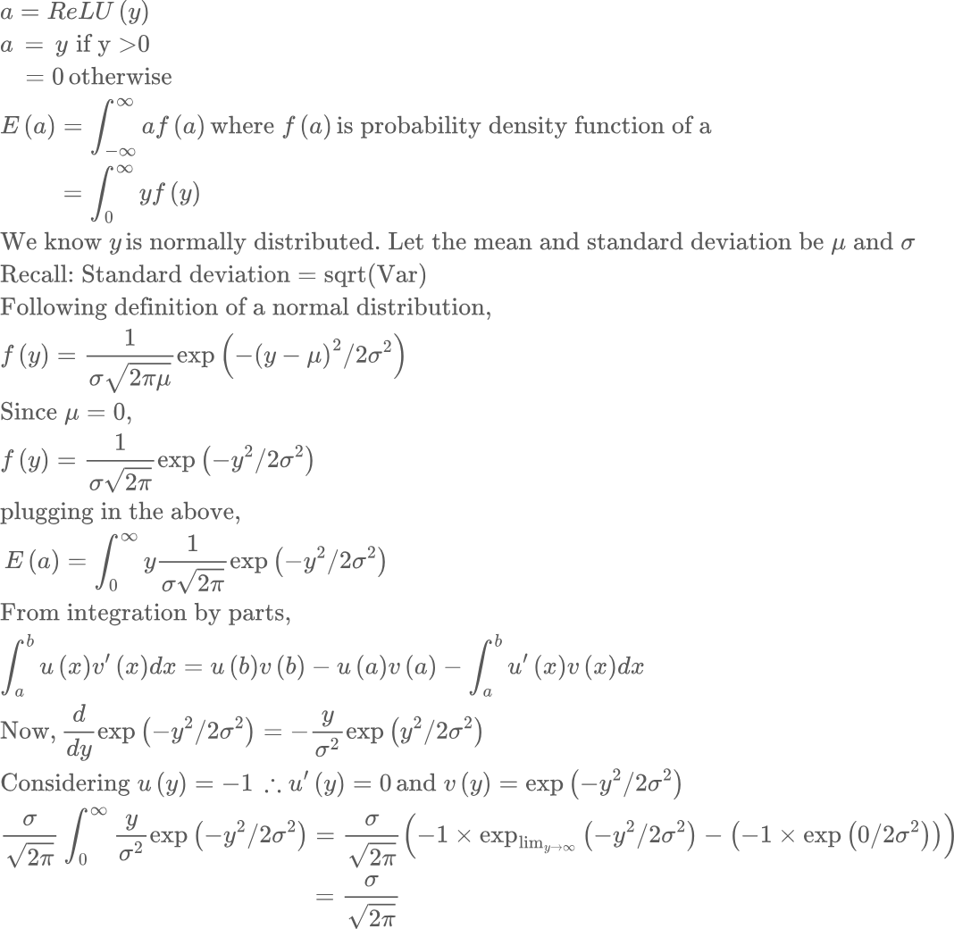

Slide 24
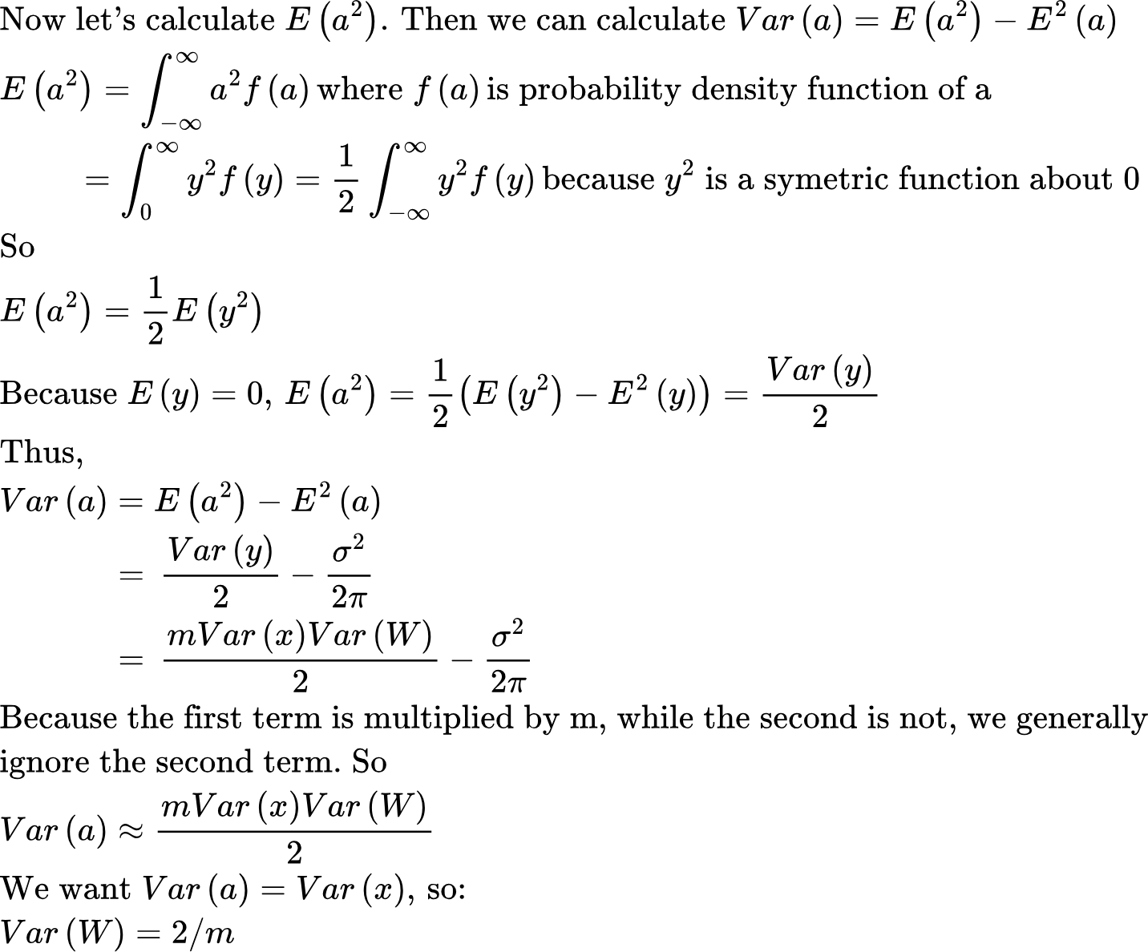

Slide 25
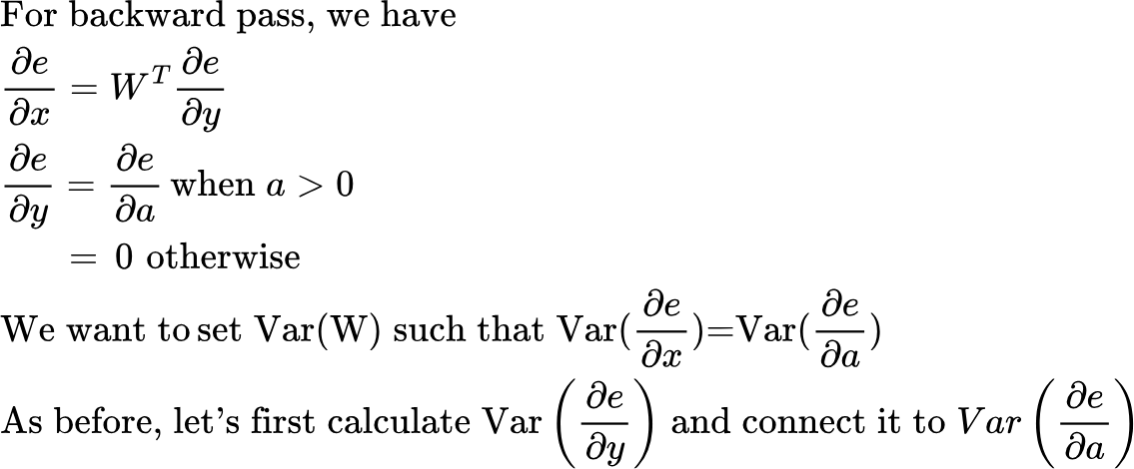
Backward Pass

Slide 26
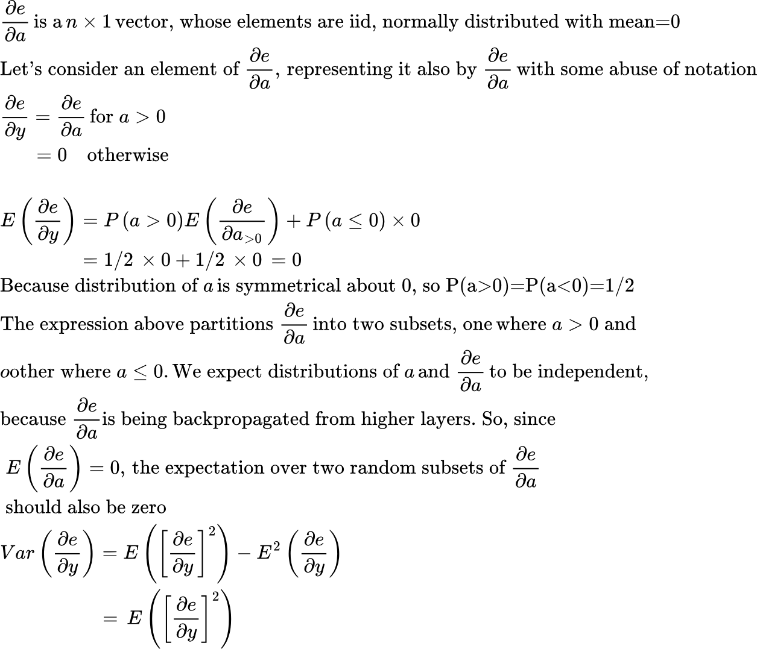

Slide 27
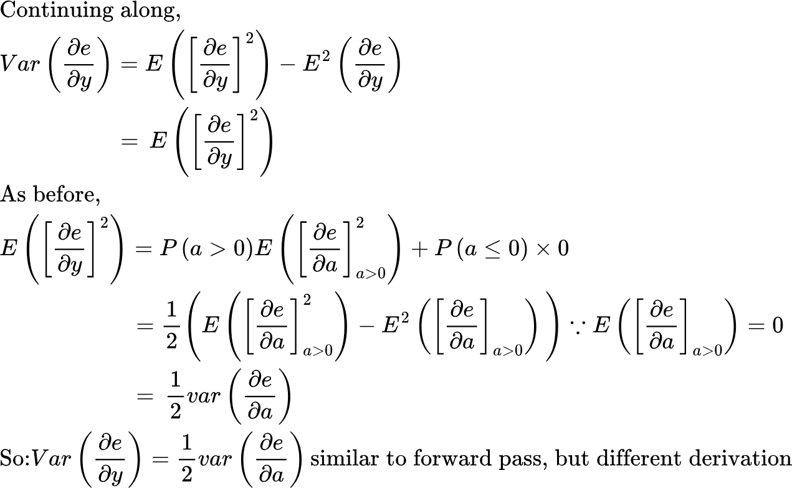

Slide 28
