Slide 1


PyCharm
PostgreSQL
S3
ankur715
Redshift
Data Management & Big Data
Ankur Patel

Slide 2

PostgreSQL - pgAdmin 4
Create ZAGI database
CREATE TABLE
INSERT VALUES
Note down credentials

Slide 3

PyCharm
Back-End coding!
Extract data & save .csv
AWS:
Load into S3
Load into Redshift for query
Libraries:
psycopg2- connect to PostgreSQL
boto3- upload to s3 client bucket
psycopg2- connect to Redshift

Slide 4
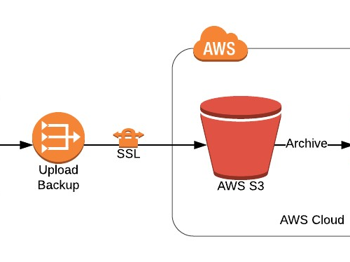
AWS S3
Boto3: integrate Python with Amazon S3 AWS
Create S3 bucket
Load .csv files

Slide 5
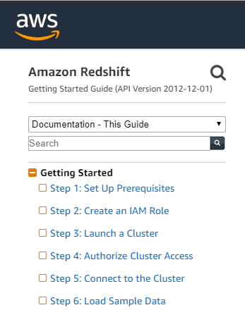
AWS Redshift
Follow Steps 1-5
Create and Launch Cluster
Note down user & password

Slide 6

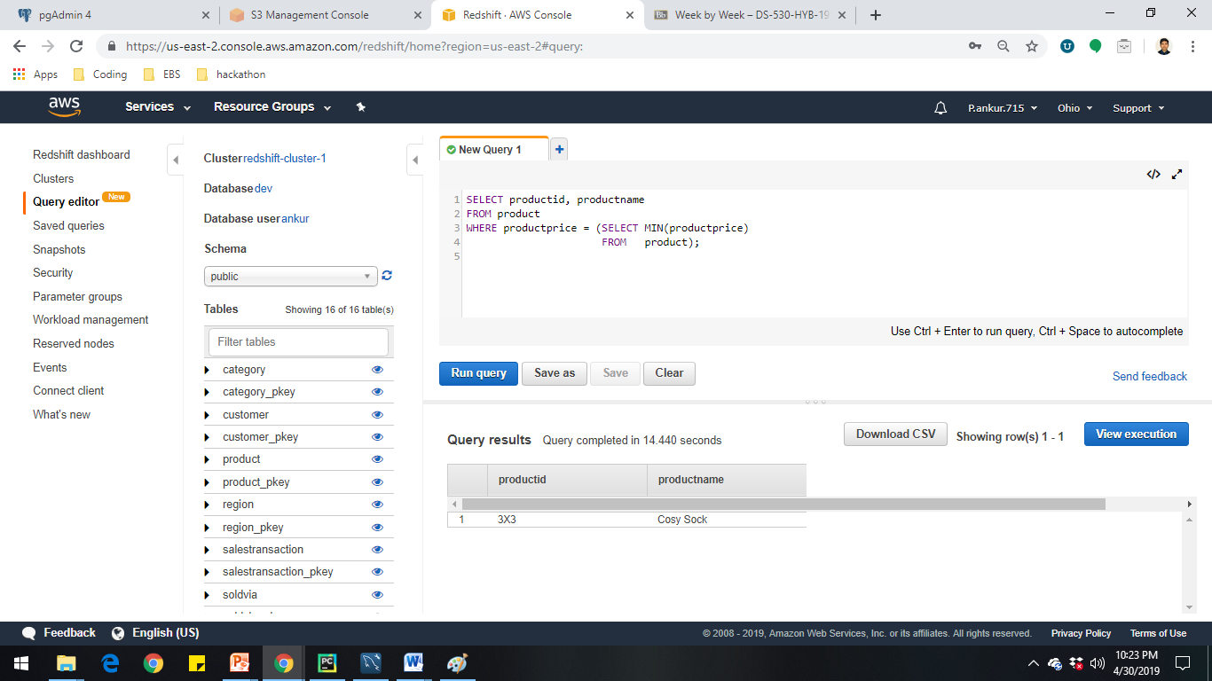
AWS Redshift
Ways to load S3 files to redshift:
PyCharm connect -> load
Redshift Query Editor -> load
Load: COPY command
S3 bucket -> Redshift cluster
ANALYZE:
Query editor
Pycharm execute+fetch

Slide 7


