Slide 1


Optimal Starbucks Locations

Slide 2
Introduction
Find optimal new Starbucks locations in three cities:
Chicago
Philadelphia
Manhattan
Create a model to identify the optimal new locations
Separate model for each city

Slide 3
Data Sources
Census Bureau API
Statistics from American Community Survey (ACS)
Demographic data
Census tract data
Most recent year was 2016
Ridership data
Subway or train system data
Number of people entering/leaving station turnstiles
Chicago – transit website
Philadelphia - Southeastern Pennsylvania Transportation Authority website
Manhattan – MTA website
Starbucks location
Kaggle - February 2017
Store address in Census Tract API for tract information

Slide 4
Exploratory Data Analysis
Current Starbucks Locations in US
https://public.tableau.com/profile/ankur715#!/vizhome/Starbucks-States/USStates?publish=yes
Demographics of the Census Tracts
Also of Starbucks locations using Census Burueau API
https://public.tableau.com/profile/ankur715#!/vizhome/Starbucks-Demographics/Demographics?publish=yes

Slide 5
Model
Logistic regression
Train: 2 cities, Test: 1 city
Predict binary variable (i.e. “No-Starbucks” or “Starbucks”) for each census tract
Probability of a Starbucks being in a census tract
Once the probabilities were conducted for each census tract for the test city, the top five census tracts that didn’t have a Starbucks were seen as optimal locations for a new Starbucks

Slide 6
Predictions
Census Tract | Tract Name | Probability of No Starbucks | Probability of Starbucks
17031080202 | Census Tract 802.02 | 42% | 58%
17031240500 | Census Tract 2405 | 46% | 54%
17031070300 | Census Tract 703 | 48% | 52%
17031071000 | Census Tract 710 | 49% | 51%
17031842300 | Census Tract 8423 | 49% | 51%
Chicago
Philadelphia
Manhattan
Census Tract | Tract Name | Probability of No Starbucks | Probability of Starbucks
42101000801 | Census Tract 8.01 | 37% | 63%
42101000300 | Census Tract 3 | 40% | 60%
42101001202 | Census Tract 12.02 | 41% | 59%
42101000401 | Census Tract 4.01 | 44% | 56%
42101000901 | Census Tract 9.01 | 45% | 55%
Census Tract | Tract Name | Probability of No Starbucks | Probability of Starbucks
36061007800 | Census Tract 78 | 13% | 87%
36061012600 | Census Tract 126 | 18% | 82%
36061008603 | Census Tract 86.03 | 21% | 79%
36061005502 | Census Tract 55.02 | 23% | 77%
36061010800 | Census Tract 108 | 23% | 77%

Slide 7
Observations of Optimal Tracts
Rent and Home Values much higher than the city average
Higher percentage of people with college degree than other census tracts
In census tracts right outside of the city’s downtown area
Lots of Starbucks locations in downtown area’s
Areas that Starbucks hasn’t take advantage of

Slide 8
Future Scope
Street level traffic
Include factor of competitors
COFFEE AND TEA SHOPS DATABASE
“free database of Dunkin Donut's locations to see what our savvy users can come”
Extend to more cities
Starbucks in California.csv

Slide 9
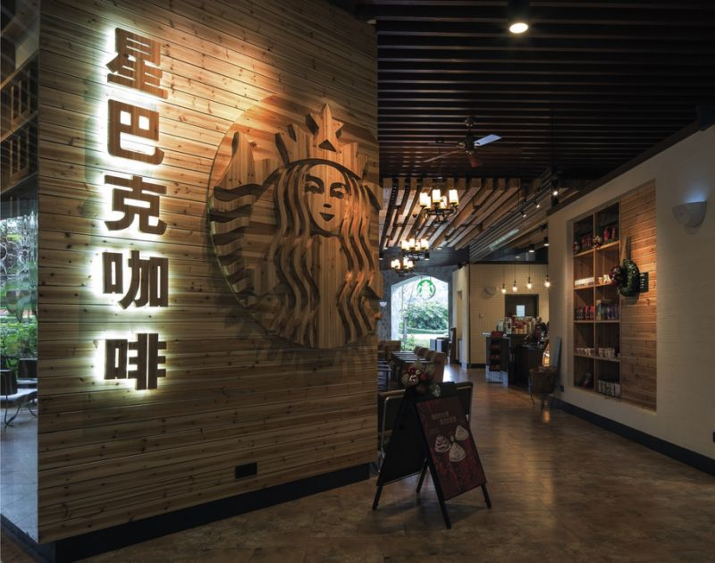
THANK YOU

