Slide 1
Report analysis for Approaches on
Live Streaming Platform By – Ankur Kumar

Slide 2
Problems in data
Data consists of outlier in several columns
Data consists of left skewness in several columns
Data consists of zero or missing values in several columns
Data is unbalanced in terms of Target Variable
Target variable is not define in the data

Slide 3
Target Variable
As per requirement of the organization target variable consider as those who are stream more than 10 min considered as good streamer and remaining consider as bad streamer.
Total Count of Data:
Good Streamers- 628 (20 % of whole data sets)
Bad Streamers - 2520

Slide 4
Data Analysis and Data Processing

Slide 5
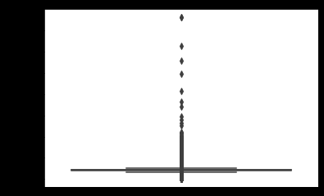
Data consists of outlier in several variables
From above plot you can see that data consists of outliers
For tackle this outliers problem I have written a user defined function which replaces outlier with median values

Slide 6
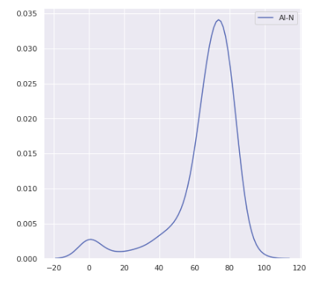
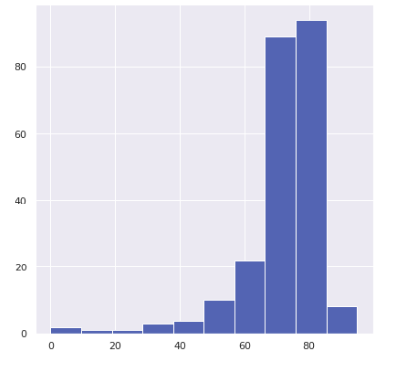
Data consists of Left sweeknews in several Columns
Density plot
Histogram
From above Density plot and Histogram Plot you can see that data is left sweekness
For tackle this sweekness problem I used scikit-learn library Log transformation

Slide 7
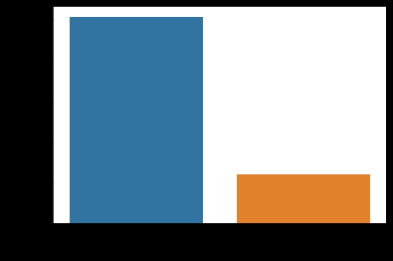
Data is unbalanced in terms of Bad Streamer (“0”) counts 2520 and Good Streamer (“1”) counts 628
From Count plot you can see that target variable consists of unbalanced in data
For tackle this unbalanced data u Using scikit-learn library I have applied two techniques Upsampling for handling Unbalanced data
Upsampling Techniques - RandomOverSampler

Slide 8
Data consists of zero and missing values in several Columns
Variables Missing Values
cultureGroup 1.000000
isContracted 1.000000
userID 0.682338
avgStreamJoinDuration 0.463469
avgViewerDuration 0.463469
totalViewerDuration 0.463469
maxLiveViewerTime 0.416137
From above figure you can see that data consists of zero values in several columns
Culture group and is Contracted variables are completely blank, so this variable is removed from data.
For tackle this problem I have written a user defined function which replaces zero value with mean values

Slide 9
Feature Engineering Techniques
Normalized the data
Problem :-Because our data Attributes consists of different ranges of values
Benefit :- The value of numeric columns in the dataset comes to a common scale without distorting differences in the range of value.
Goal : - In our problem I want to apply Classification Algorithm and if my data is not normalized it will lead to problem of Biased Model

Slide 10
Machine Learning Models
I have applied 6 different Machine learning model with Balanced data
Machine learning models
Random Forest
GaussionNB
SVM
KNN
Logistic Regression
.
Data Balance Techniques
Random Over Sampling

Slide 11
Machine Learning Prediction Results
Model | Accuracy | Precision |  | Recall |  | F1 Score
 |  | 0 | 1 | 0 | 1 | 0 | 1
Random Forest | 0.99 | 0.99 | 0.98 | 0.98 | 0.99 | 0.99 | 0.99
GaussionNB | 0.93 | 0.96 | 0.89 | 0.89 | 0.97 | 0.92 | 0.93
Support Vector Machine | 0.91 | 0.93 | 0.89 | 0.88 | 0.93 | 0.9 | 0.91
K Neighbors Classifier | 0.95 | 0.99 | 0.92 | 0.92 | 0.99 | 0.95 | 0.96
Logistic Regression | 0.87 | 0.85 | 0.89 | 0.9 | 0.84 | 0.87 | 0.86

Slide 12
Result
Highest Accuracy Achieved Using Machine learning is 99%
Model :- Random Forest
Data balancing technique :- RandomOverSampler

Slide 13
Thank you for
your time and attention

