Slide 1

Docker
DevilSec
Joseph Aorahim, Senior

Slide 2
What will I learn?
Notes:
Docker
Containerization
A new tool to use for school and industry

Slide 3
What is Docker?
Notes:
Docker is a platform for developers and sysadmins to develop, deploy, and run applications with containers. The use of Linux containers to deploy applications is called containerization. Containers are not new, but their use for easily deploying applications is.
Containerization is increasingly popular because containers are:
Flexible: Even the most complex applications can be containerized.
Lightweight: Containers leverage and share the host kernel.
Interchangeable: You can deploy updates and upgrades on-the-fly.
Portable: You can build locally, deploy to the cloud, and run anywhere.
Scalable: You can increase and automatically distribute container replicas.
Stackable: You can stack services vertically and on-the-fly.

Slide 4
How is different from a virtual machine?
Notes:
A container runs natively on Linux and shares the kernel of the host machine with other containers. It runs a discrete process, taking no more memory than any other executable, making it lightweight.
By contrast, a virtual machine (VM) runs a full-blown “guest” operating system with virtual access to host resources through a hypervisor. In general, VMs provide an environment with more resources than most applications need.

Slide 5
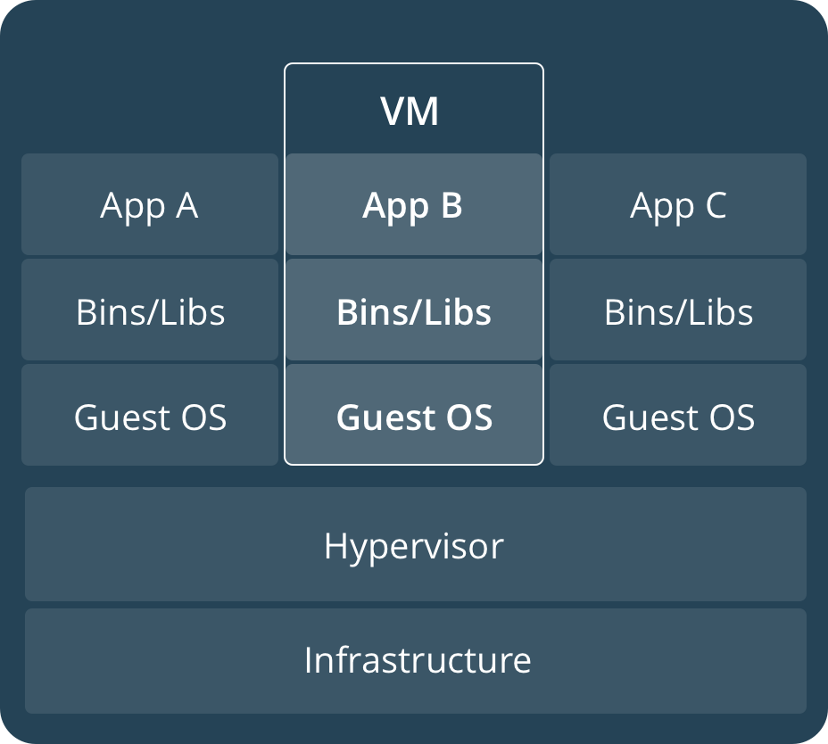
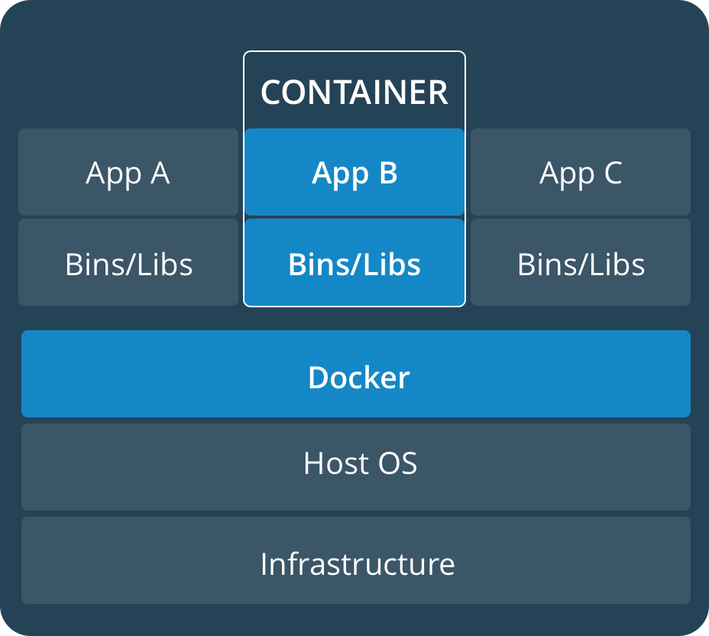
Notes:
A container runs natively on Linux and shares the kernel of the host machine with other containers. It runs a discrete process, taking no more memory than any other executable, making it lightweight.
By contrast, a virtual machine (VM) runs a full-blown “guest” operating system with virtual access to host resources through a hypervisor. In general, VMs provide an environment with more resources than most applications need.

Slide 6
Docker Hub, Client, and Daemon

Slide 7
Demo
Notes:
Docker run hello-world
A container is launched by running an image. An image is an executable package that includes everything needed to run an application--the code, a runtime, libraries, environment variables, and configuration files.
A container is a runtime instance of an image--what the image becomes in memory when executed (that is, an image with state, or a user process). You can see a list of your running containers with the command, docker ps, just as you would in Linux.
Basic commands:
Docker ps
Docker images
Docker run
Docker pull
Docker system prune
Run a couple of containers:
hello-world
Busybox
Alpine
Ubuntu

Slide 8
Dockerfiles
Notes:
Dockerfile defines what goes on in the environment inside your container. Access to resources like networking interfaces and disk drives is virtualized inside this environment, which is isolated from the rest of your system, so you need to map ports to the outside world, and be specific about what files you want to “copy in” to that environment. However, after doing that, you can expect that the build of your app defined in this Dockerfile behaves exactly the same wherever it runs.

Slide 9
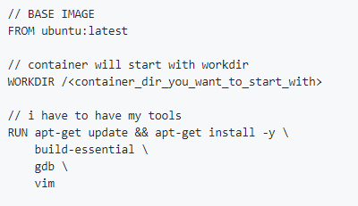

Slide 10
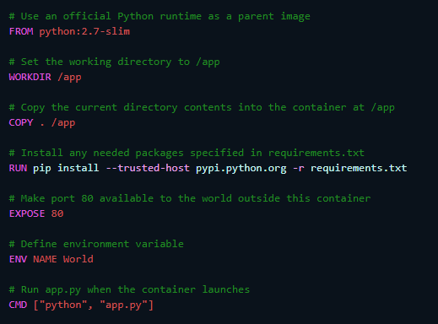

Slide 11
How can I use this tool?
Notes:
Use it to build custom environments for your applications
I used this to dockerize Devilsec.club, once it works on docker, itll work on all machines
Projects you need to collaborate with
Throwaway os’s

Slide 12
Academic
Notes:
I created a container specifically to test my in CSE340
For devilsec

Slide 13
Cyber Security
Notes:
How can I use docker with cyber security
1.

Slide 14
Industry
Notes:
Docker is getting more and more popular

Slide 15
Demo
Notes:
Devilsec.club
340_assignment
FIND A CYBER RELATED TASK

Slide 16
What did we learn?
Notes:
Containerization
Docker
A new tool
How to use this new tool for school and industry

