Slide 1
Retention

Slide 2
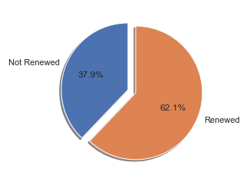
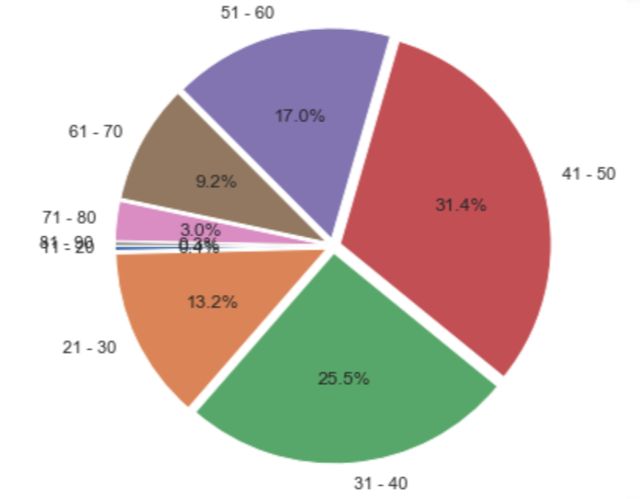
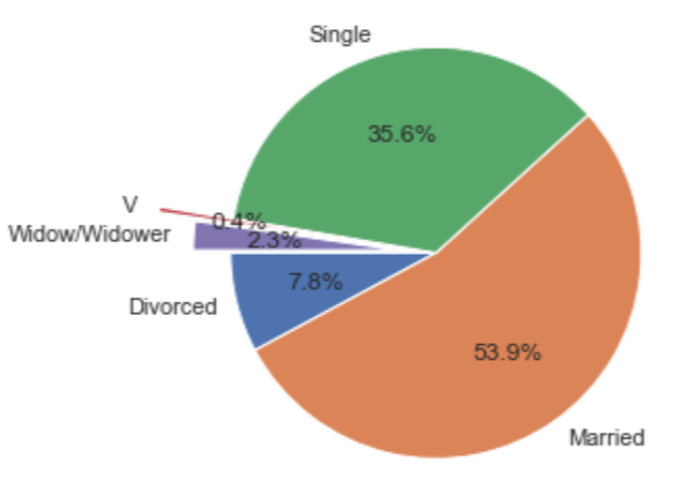
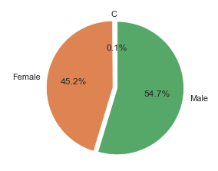
Policy renewal distribution
Age group distribution
Renewals ~ 62%
Non-renewals - 38%
11-20 ~ 0.4%
21-30 ~ 13.2%
31-40 ~ 25.5%
41-50 ~ 31.4%
51-60 ~ 17.0%
61-70 ~ 9.2%
71-80 ~ 3.0%
81-90 ~ 0.3%
Married ~ 54%
Single ~ 35%
Divorced ~8%
Widow/Widower ~ 2%
Others < 1%
Male ~ 54.7%
Female ~ 45.2%
Others ~ 0.1%
Marital status distribution
Gender distribution

Slide 3
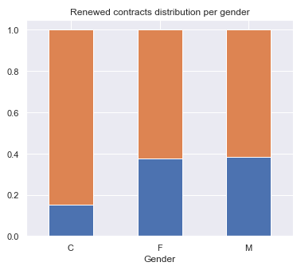
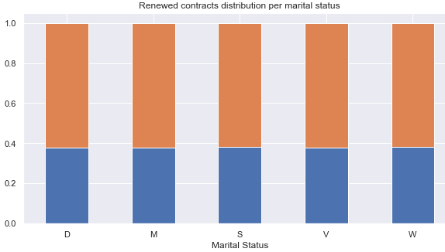
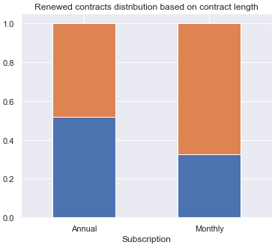

Equal renewal rate
for Male and Female (~60%)
Equal renewal rates for all
Marital status (~60% )
Monthly subscriptions have
more renewal rates.

Slide 4
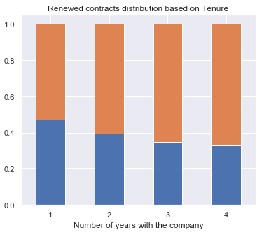
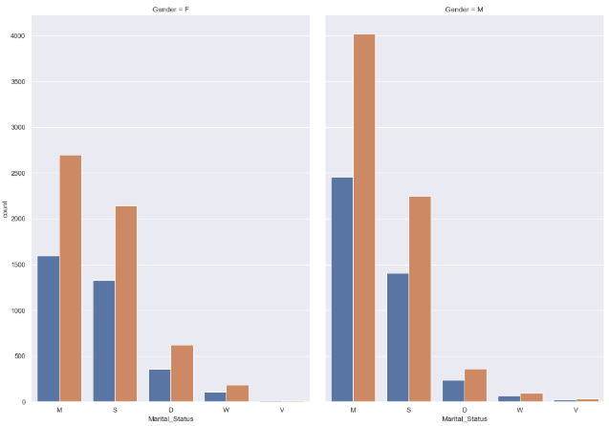
Renewal rate increases with increase in Tenure

Slide 5
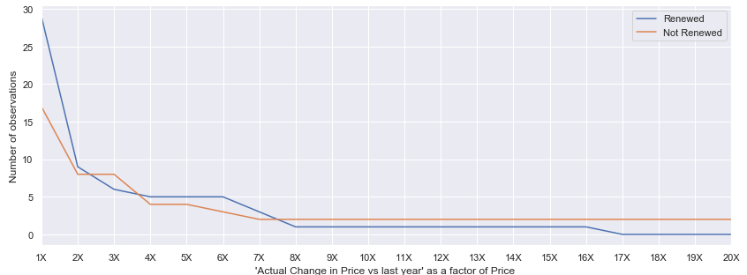
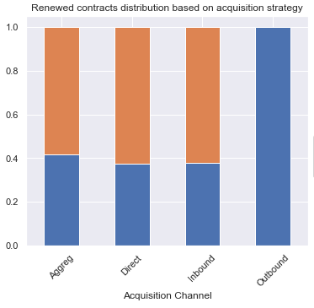
Renewal rate drops to ~0% when Actual change in price vs last year
is over 7.5 times that of Price.
0% renewal rate for Outbound acquisition channel
Requires strategy improvements

Slide 6
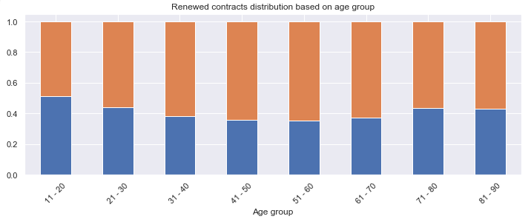
Lower renewal rate in age groups 11-30 and 71-90
31-60 – most effective

