Slide 1
Quick Commerce Ops Deck
AI INFRASTRUCTURE FOR RIDER AND PARCEL OPS
What this changes for {{lead_company_name}}
Automate {{primary_workflow}} for {{lead_company_name}}.
Rider ready
Parcel proof
Prepared for {{prospect_name}} and the {{lead_company_name}} team. Fracto can verify rider onboarding documents, classify delivery images, and return parcel-proof decisions directly into ops workflows.
KYC fields and onboarding documents become structured
Images return parcel, not parcel, or review decisions
Docs ready
Faster ops
- Rider onboarding for Aadhaar, PAN, DL, and ID files
- Parcel delivery image verification
- POD, AWB, invoice, and manifest extraction
- APIs for rider apps, seller portals, and ops queues
POD, AWB, invoice, and manifest extraction
Exceptions route before customer or billing delays
Extract/Verify
Rider KYC
Parcel proof
POD / AWB
Aadhar Masking
Positioning
One verification layer for {{lead_company_name}} across rider documents and parcel proof.
Prepared for {{lead_company_name}}
01

Slide 2






Reference Set
DELIVERY OPERATIONS
Fracto supports parcel, delivery, and e-commerce operations workflows.
Why this matters for {{lead_company_name}}
For {{lead_company_name}}, the same layer can support rider onboarding, delivery image verification, shipment documents, and exception routing.
- High daily proof-image volume
- Rider and seller uploads vary in quality
- Parcel proof decisions need to be fast
- Exceptions need quick routing to ops teams
Relevant delivery and e-commerce workflows
What your team can expect
- Automated parcel / not-parcel flags
- Cleaner rider onboarding records
- Structured shipment document outputs
- Lower manual review across ops queues
Prepared for {{lead_company_name}}
02

Slide 3
Why Delivery Ops Break Down
THE OPERATIONAL PROBLEM
Delivery teams move fast, but image proof and onboarding checks still get stuck in queues.
Typical failure pattern
For {{lead_company_name}}, {{pain_point_1}} can slow down {{primary_workflow}}.
- Random, duplicate, blurry, or cropped delivery photos
- Manual checks for package visibility and label presence
- Rider KYC and shipment files reviewed in separate tools
- Customer, billing, and claims teams wait on proof status
Images
KYC
Rider uploads are inconsistent
Rider onboarding needs cleanup
Ops teams still check whether a photo actually shows a parcel.
Aadhaar, PAN, DL, and ID uploads arrive blurred or incomplete.
What teams need instead
- Automated valid or invalid parcel image decisions
- Extraction for onboarding and shipment documents
- Review only uncertain cases
- API outputs for rider apps and ops tools
Docs
Scale
Shipment files are copied manually
Exceptions pile up quickly
POD, AWB, invoice, and manifest fields still move across tools by hand.
Daily delivery spikes create review backlogs across hubs and ops teams.
Prepared for {{lead_company_name}}
03

Slide 4
Rider Onboarding
RIDER KYC + VEHICLE CHECKS
Rider onboarding: verify identity, documents, and vehicle before first delivery.
The same Fracto layer can parse rider files, mask Aadhaar, validate DL/RC data, and return a clean onboarding decision.
Sample onboarding uploads
Extracted data
Fracto signals
rider_name: Ravi Kumar
aadhaar: XXXX-XXXX-4321
pan: ABCDE1234F
dl_no: KA05 20XX 1234567
rc_no: KA-05-AB-1234
aadhaar_masked: true
pan_name_match: true
dl_status: active
rc_status: verified
route_to: {{downstream_system}}
KYC
Aadhaar
PAN
PAN Card
Masked identity image
Tax ID image
NAME
RAVI KUMAR
NAME
RAVI KUMAR
AADHAAR
XXXX XXXX 4321
PAN
ABCDE1234F
DOB
19XX
STATUS
Name match
ADDRESS
Bengaluru
DOB
19XX
Parivahan DL API
Parivahan RC API
status: active
holder_match: true
vehicle_class: 2W/LMV
valid_till: 2028-12
status: verified
owner_match: true
fitness: active
insurance: valid
Verification inputs
DL: KA05 20XX 1234567 | RC: KA-05-AB-1234
Prepared for {{lead_company_name}}
04

Slide 5
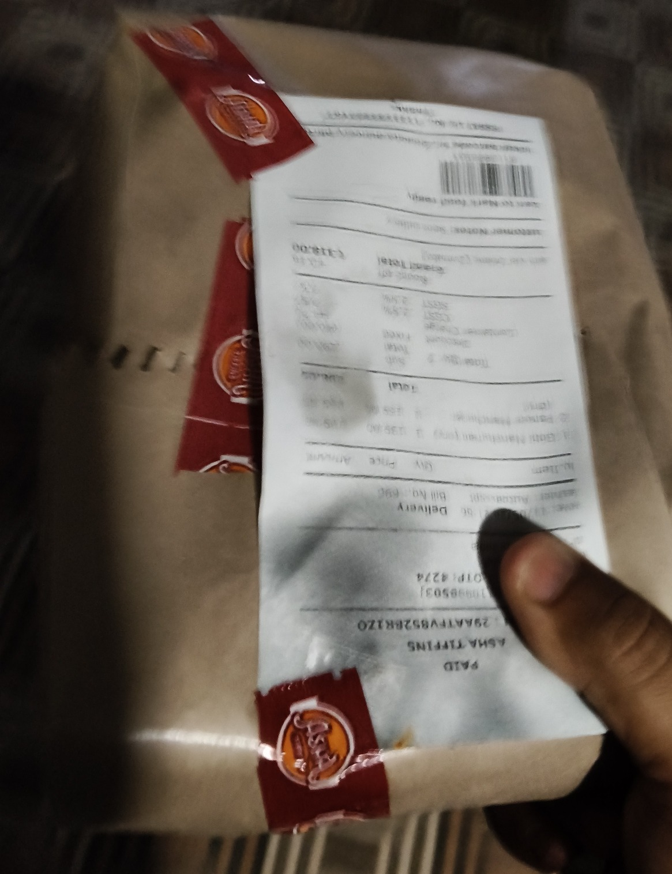
Visual Proof
PARCEL IMAGE + DECISION
ParcelX use case: confirm whether a parcel is visible in the delivery image.
Fracto reads the rider-uploaded image and returns a simple decision that can move directly into the delivery workflow.
Rider delivery image
Extracted fields
Is Parcel
Description
true
Brown package with shipping label and branded tape.
Delivery decision
Ops Callback
parcel_visible: true
proof_status: accept
review_required: false
order_id: {{order_id}}
image_type: parcel
route_to: {{downstream_system}}
send_review: false
Parcel and shipping label are visible in the uploaded proof image.
Prepared for {{lead_company_name}}
05

Slide 6
Workflow Fit
END-TO-END FLOW
Fracto can sit inside the {{lead_company_name}} rider and parcel workflow.
01
02
03
04
Capture
>
Classify
>
Verify
>
Route
Riders, sellers, or hubs upload KYC files, parcel photos, and shipment documents.
Fracto identifies whether each upload is KYC, parcel image, POD, AWB, invoice, or manifest.
Images are checked for parcel/not-parcel status while documents are parsed into fields.
Clean decisions move to {{downstream_system}} while exceptions route to {{review_team}}.
High-value insertion points
Decision signals
- Rider onboarding
- Delivery completion photos
- Return and claim evidence
- Seller or hub document uploads
- Billing proof workflows
- Parcel, not parcel, or review
- Package and label visibility
- KYC and shipment field confidence
- Duplicate, blurred, or irrelevant uploads
Prepared for {{lead_company_name}}
06

Slide 7
Operator Impact
BUSINESS OUTCOMES
The value case for {{prospect_role}} at {{lead_company_name}}.
Help improve {{outcome_1}}, {{outcome_2}}, and {{outcome_3}} across {{primary_workflow}}.
Faster rider activation
Cleaner delivery proof
One proof layer
KYC and onboarding documents move to decision faster.
Parcel photos can be accepted, rejected, or routed to review.
Images, rider files, PODs, AWBs, invoices, and manifests in one API.
Common workflow bottlenecks
What Fracto enables
- Rider photos are checked manually
- Random or unusable images enter ops queues
- KYC and shipment fields are retyped
- Claims and billing wait for proof status
- Automated image decisioning
- Structured rider and shipment outputs
- Reviewer queues only for exceptions
- Better delivery proof and audit trail
Prepared for {{lead_company_name}}
07

Slide 8
Book Demo
NEXT STEP
{{prospect_name}}, want to review this on a few {{lead_company_name}} delivery files?
TALK TO FRACTO
Book a demo and review capabilities.
Book a demo to review rider onboarding documents, parcel image verification, shipment document parsing, and exception routing on sample files.
EMAIL
sales@fracto.tech
Suggested demo scope
PHONE
+91 84483 33277
- Input bundle: {{sample_document_types}}
- Flow: {{demo_flow}}
- Success metric: {{success_metric}}
WEBSITE
fracto.tech
Demo Focus
Next step: review a small {{primary_workflow}} sample set.
Review real delivery images. Then scope the right integration path.
Prepared for {{lead_company_name}}
08

