Slide 1
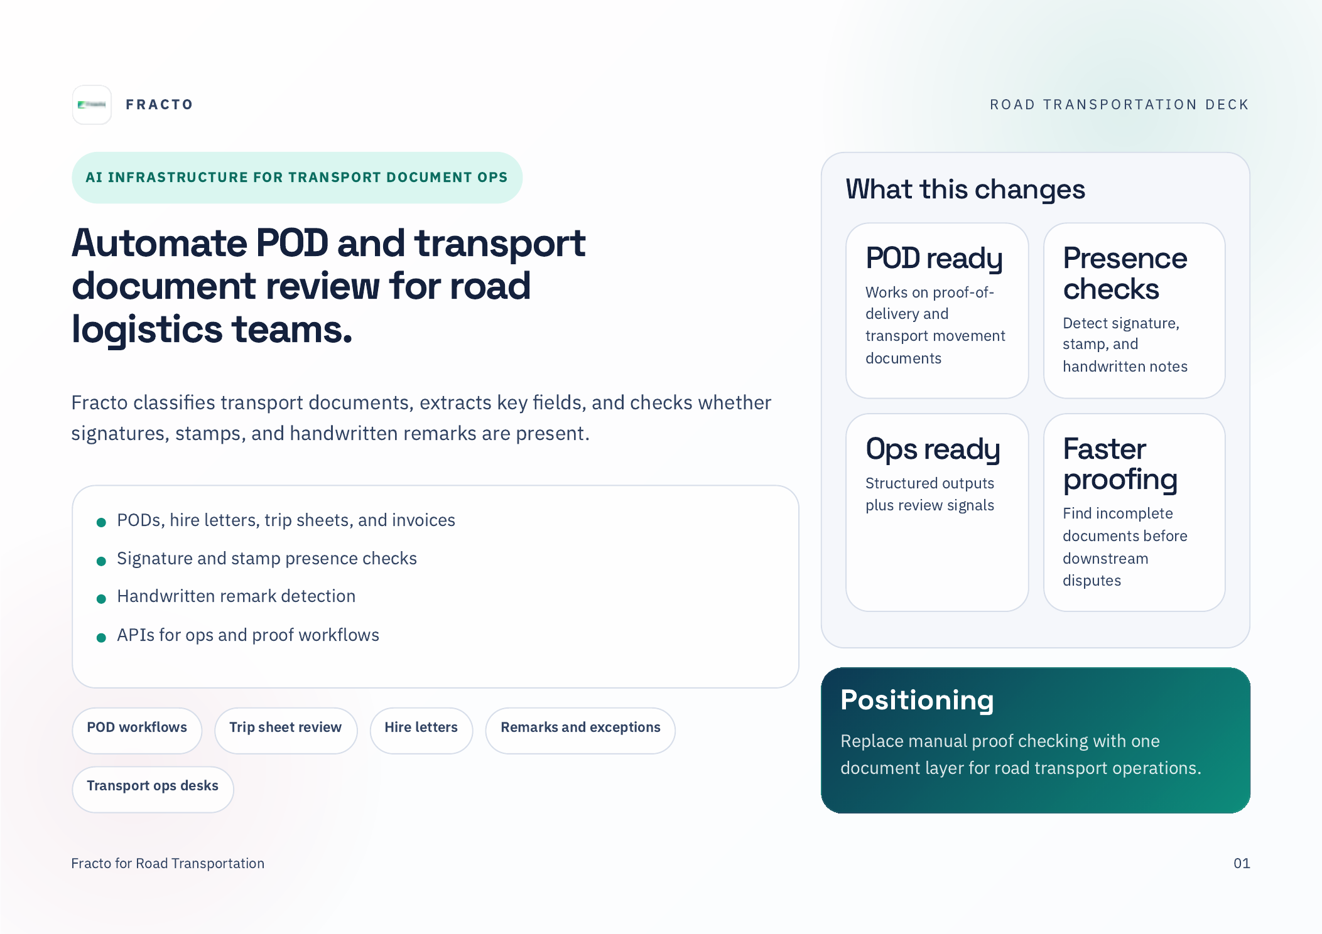
PERSONALIZED BRIEF
Prepared for {{lead_company_name}}
Hi {{prospect_name}}, here is how Fracto can help automate {{primary_workflow}} for your transport operations.
Persona: {{prospect_role}}
{{lead_company_name}}

Slide 2
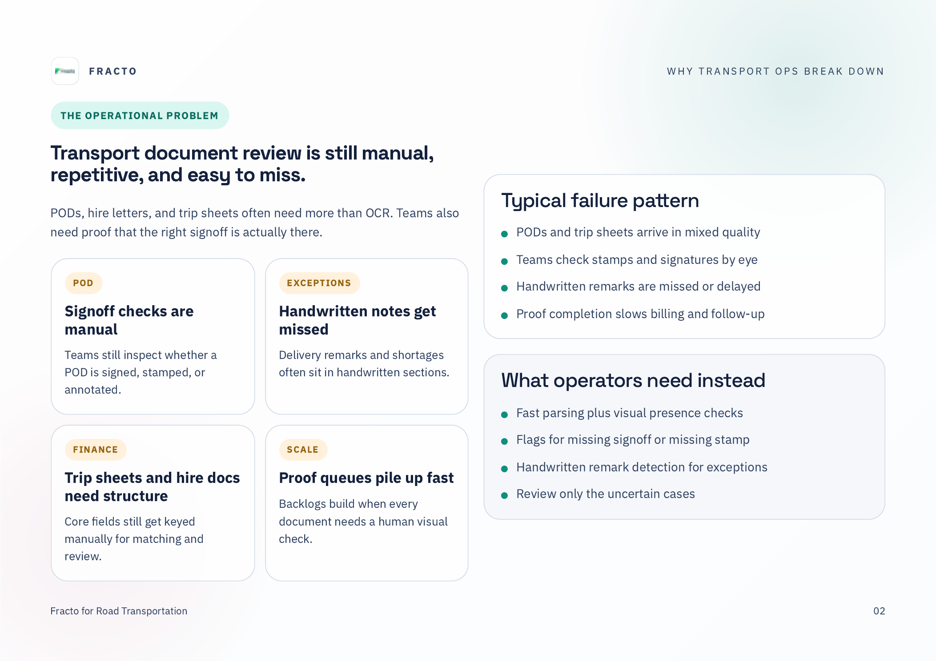
CLIENT-SPECIFIC PROBLEM
For {{lead_company_name}}, {{pain_point_1}}, {{pain_point_2}}, and {{pain_point_3}} can slow down {{primary_workflow}}.
{{lead_company_name}}

Slide 3
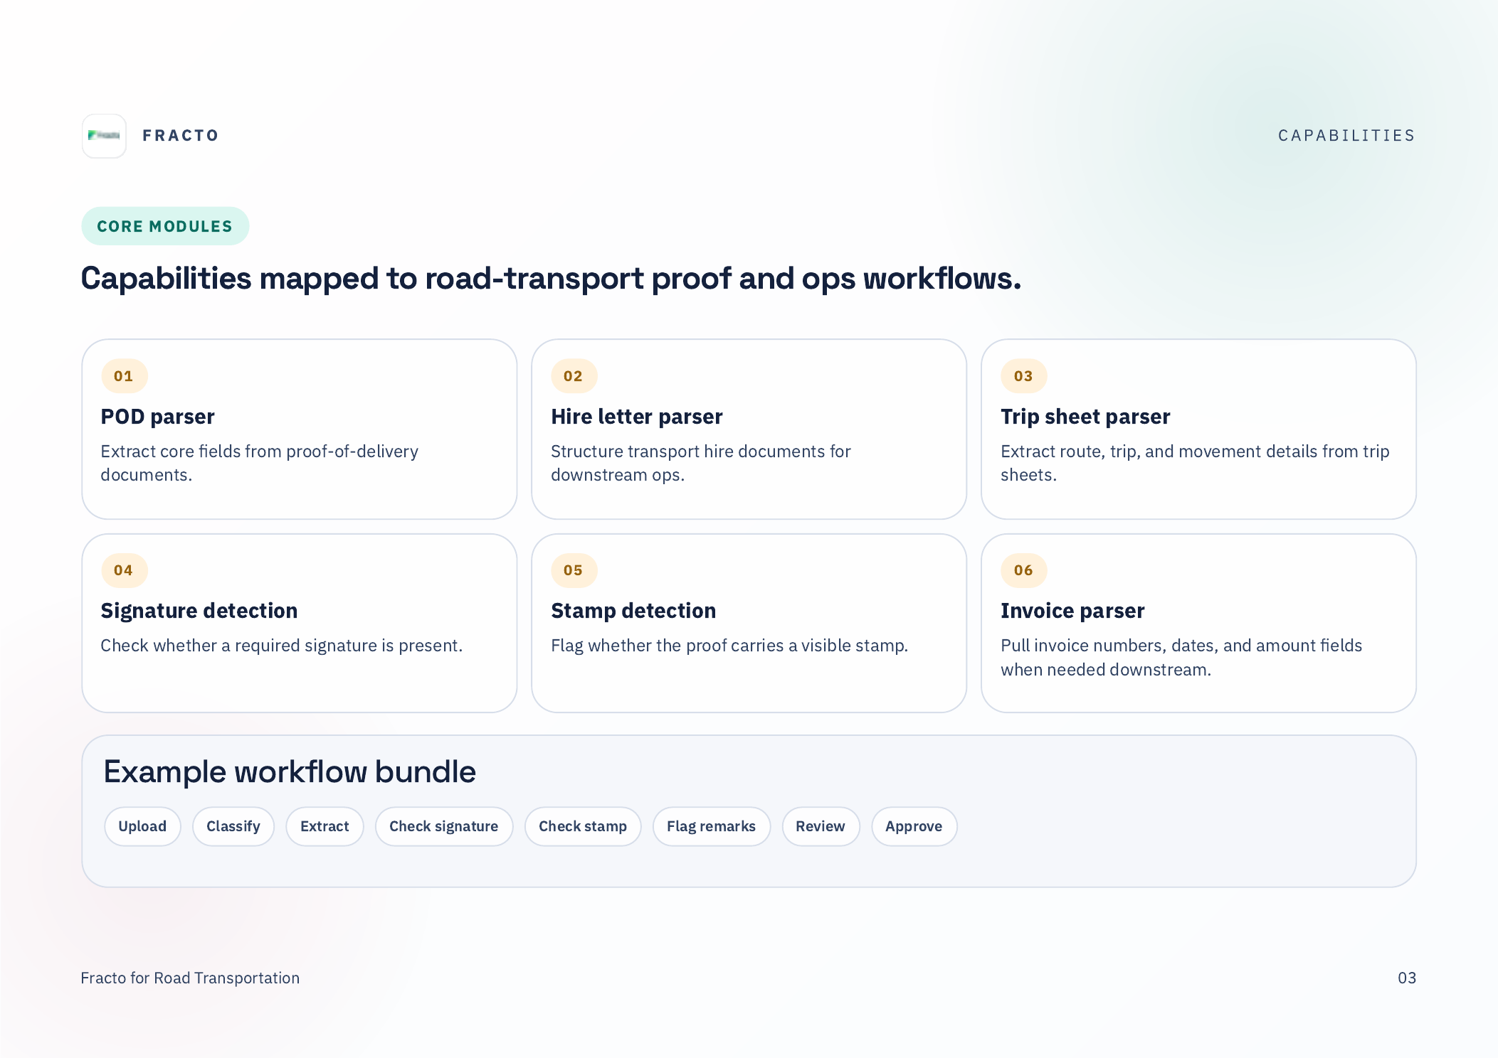
Priority for {{lead_company_name}}
{{use_case_1_title}}
{{use_case_2_title}}
{{use_case_3_title}}
{{lead_company_name}}

Slide 4
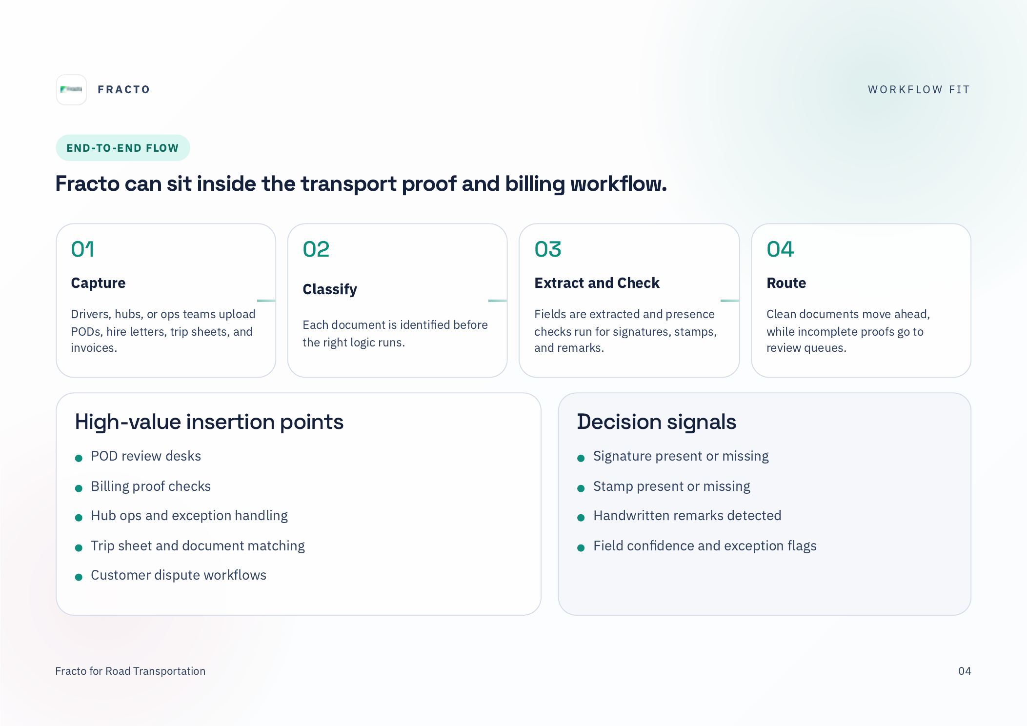
Suggested workflow for {{lead_company_name}}
{{lead_company_name}} uploads {{primary_workflow}} files -> Fracto classifies and extracts fields -> exceptions route to {{review_team}} -> clean files move to {{downstream_system}}.
{{lead_company_name}}

Slide 5
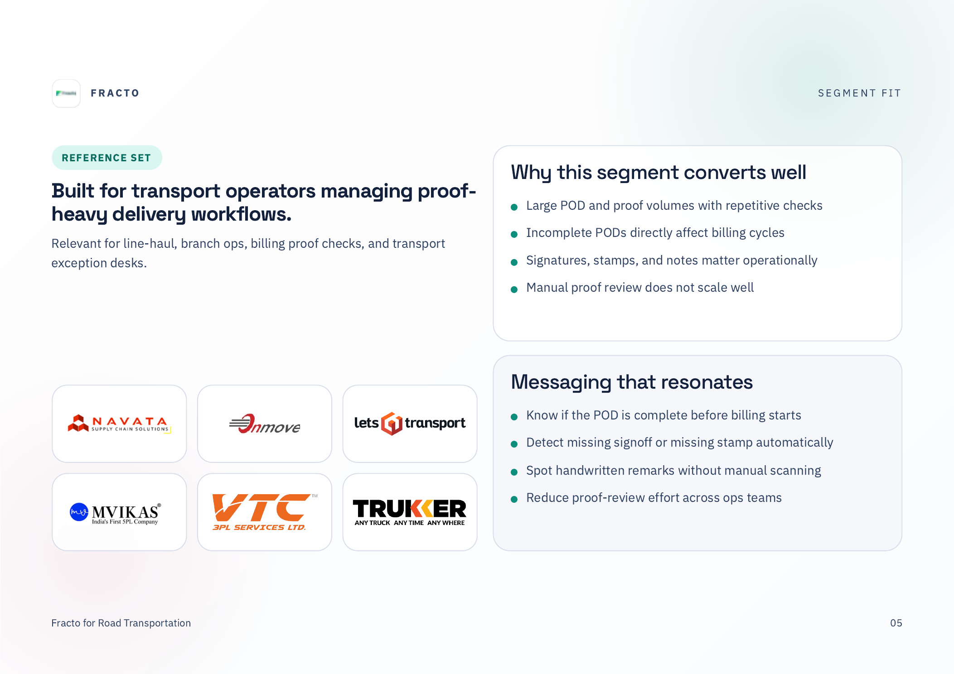
SEGMENT MATCH
{{lead_company_name}} appears to fit the {{segment}} motion, with emphasis on {{primary_workflow}} and {{secondary_workflow}}.
{{lead_company_name}}

Slide 6
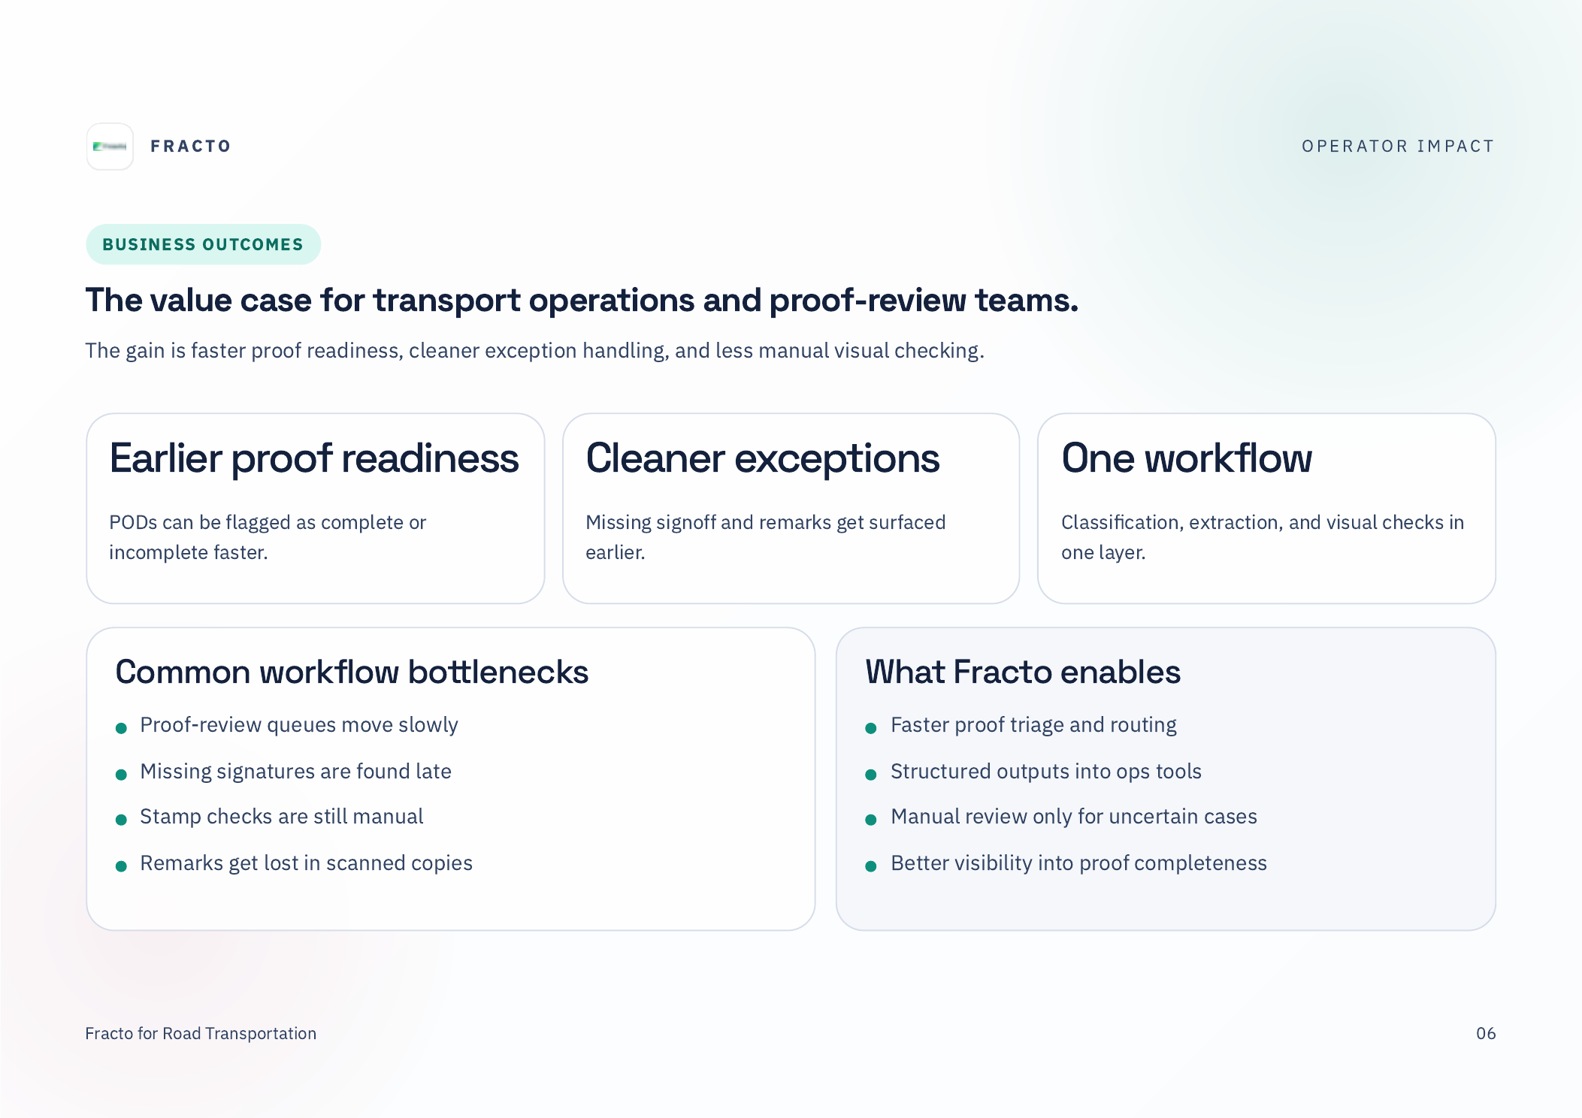
Value case for {{prospect_role}}
Help {{lead_company_name}} improve {{outcome_1}}, {{outcome_2}}, and {{outcome_3}} across {{primary_workflow}}.
{{lead_company_name}}

Slide 7
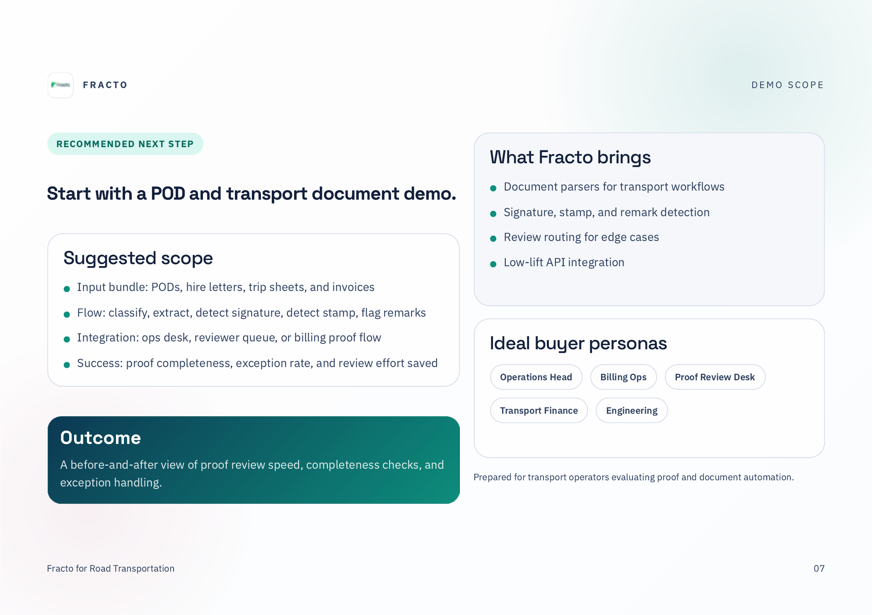
Custom demo scope for {{lead_company_name}}
Input bundle: {{sample_document_types}}
Flow: {{demo_flow}}
Success metric: {{success_metric}}
Integration target: {{integration_target}}
{{lead_company_name}}

Slide 8
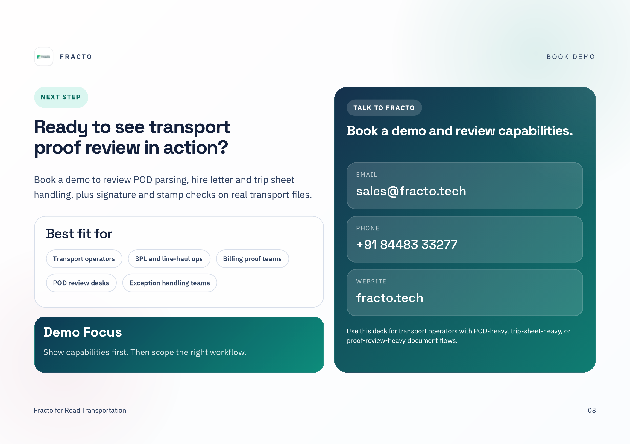
PERSONAL CTA
{{prospect_name}}, want to review this on a few {{lead_company_name}} sample files?
CTA: {{cta_link}}
{{lead_company_name}}

Slide 9
Automation Variable Reference
These tokens are intentionally present as editable PPT text so Fracto workflows can replace them before sending.
{{lead_company_name}}
{{prospect_name}}
{{prospect_role}}
{{segment}}
{{primary_workflow}}
{{secondary_workflow}}
{{pain_point_1}}
{{pain_point_2}}
{{pain_point_3}}
{{use_case_1_title}}
{{use_case_2_title}}
{{use_case_3_title}}
{{review_team}}
{{downstream_system}}
{{outcome_1}}
{{outcome_2}}
{{outcome_3}}
{{sample_document_types}}
{{demo_flow}}
{{success_metric}}
{{integration_target}}
{{cta_link}}
Delete this slide from generated client-facing copies if not needed.

