Slide 1
Road Transportation Deck
AI INFRASTRUCTURE FOR TRANSPORT DOCUMENT OPS
What this changes for {{lead_company_name}}
Automate {{primary_workflow}} for {{lead_company_name}}.
POD ready
Presence checks
Prepared for {{prospect_name}} and the {{lead_company_name}} team. Fracto can classify transport documents, extract key fields, and check whether signatures, stamps, and handwritten remarks are present.
Works on proof-of-delivery and transport movement documents
Detect signature, stamp, and handwritten notes
Ops ready
Faster proofing
- {{sample_document_types}}
- Signature and stamp presence checks
- Handwritten remark detection
- APIs for ops and proof workflows
Structured outputs plus review signals
Find incomplete documents before downstream disputes
PODs
Trip sheet review
Hire letters
Remarks
DL, RC, Aadhaar, PAN
Positioning
Replace manual proof checking with one document layer for {{lead_company_name}}.
Prepared for {{lead_company_name}}
01

Slide 2






Reference Set
TRANSPORT OPERATIONS
Fracto supports document-heavy road transport workflows.
Why this matters for {{lead_company_name}}
For {{lead_company_name}}, the same layer can support POD checks, trip documents, proof readiness, and exception routing.
- High POD and proof document volume
- Manual checks delay billing readiness
- Signatures, stamps, and remarks need review
- Exceptions need faster routing to ops teams
Relevant transport and logistics workflows
What your team can expect
- Cleaner proof review queues
- Earlier incomplete-document flags
- Structured outputs for downstream tools
- Lower manual effort across review teams
Prepared for {{lead_company_name}}
02

Slide 3
Why Transport Ops Break Down
THE OPERATIONAL PROBLEM
Transport document review is still manual, repetitive, and easy to miss.
Typical failure pattern
For {{lead_company_name}}, {{pain_point_1}} can slow down {{primary_workflow}}.
- PODs and trip sheets arrive in mixed quality
- Teams check stamps and signatures by eye
- Handwritten remarks are missed or delayed
- Proof completion slows billing and follow-up
POD
Exceptions
Signoff checks are manual
Handwritten notes get missed
Teams still inspect whether a POD is signed, stamped, or annotated.
Delivery remarks and shortages often sit in handwritten sections.
What operators need instead
- Fast parsing plus visual presence checks
- Flags for missing signoff or missing stamp
- Handwritten remark detection for exceptions
- Review only the uncertain cases
Finance
Scale
Trip sheets and hire docs need structure
Proof queues pile up fast
Core fields still get keyed manually for matching and review.
Backlogs build when every document needs a human visual check.
Prepared for {{lead_company_name}}
03

Slide 4
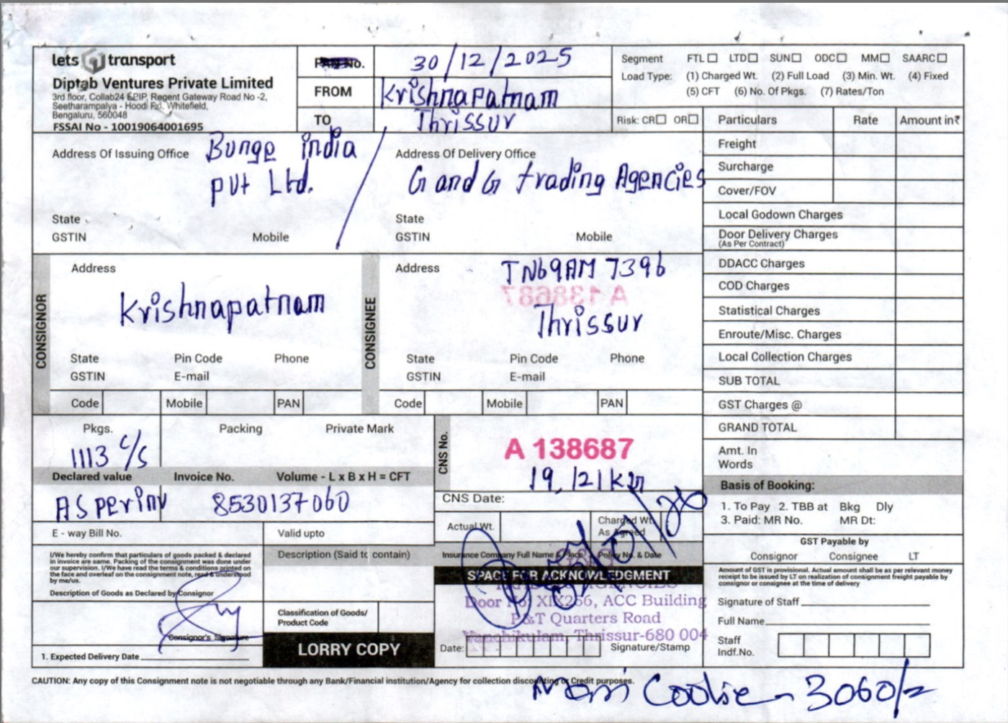
Visual Proof
DOCUMENT IMAGE + EXTRACTION
Visual proof: raw POD image to structured extraction and completeness checks.
Representative transport proof. Fracto keeps the document visible while returning fields, confidence, and visual signoff signals.
Sample POD
Extracted fields
CNS No A138687 | invoice 8530137060 | route Krishnapatnam to Thrissur
Visual checks
Exception readout
Signature present, stamp present, lower acknowledgement area visible
Handwritten remarks detected and routed with the extracted POD record
Structured output
Example source: mixed print + handwriting proof with visible signoff area.
{ document_type: "POD", signature: true, stamp: true, review_status: "ready" }
Prepared for {{lead_company_name}}
04

Slide 5
Workflow Fit
END-TO-END FLOW
Fracto can sit inside the {{lead_company_name}} proof and billing workflow.
01
02
03
04
Capture
>
Classify
>
Extract and Check
>
Route
{{lead_company_name}} uploads {{sample_document_types}} from drivers, hubs, or ops teams.
Each document is identified before the right logic runs.
Fields are extracted and checks run for signatures, stamps, and remarks.
Exceptions route to {{review_team}} while clean files move to {{downstream_system}}.
High-value insertion points
Decision signals
- {{primary_workflow}} desks
- Billing proof checks
- Hub ops and exception handling
- Trip sheet and document matching
- Customer dispute workflows
- Signature present or missing
- Stamp present or missing
- Handwritten remarks detected
- Field confidence and exception flags
Prepared for {{lead_company_name}}
05

Slide 6
Operator Impact
BUSINESS OUTCOMES
The value case for {{prospect_role}} at {{lead_company_name}}.
Help improve {{outcome_1}}, {{outcome_2}}, and {{outcome_3}} across {{primary_workflow}}.
Earlier proof readiness
Cleaner exceptions
One workflow
PODs can be flagged as complete or incomplete faster.
Missing signoff and remarks get surfaced earlier.
Classification, extraction, and visual checks in one layer.
Common workflow bottlenecks
What Fracto enables
- Proof-review queues move slowly
- Missing signatures are found late
- Stamp checks are still manual
- Remarks get lost in scanned copies
- Faster proof triage and routing
- Structured outputs into ops tools
- Manual review only for uncertain cases
- Better visibility into proof completeness
Prepared for {{lead_company_name}}
06

Slide 7
Book Demo
NEXT STEP
{{prospect_name}}, want to review this on a few {{lead_company_name}} sample files?
TALK TO FRACTO
Book a demo to review {{primary_workflow}}, document parsing, signature and stamp checks, plus exception routing on real transport files.
Book a demo and review capabilities.
EMAIL
sales@fracto.tech
Suggested demo scope
PHONE
+91 84483 33277
- Input bundle: {{sample_document_types}}
- Flow: {{demo_flow}}
- Success metric: {{success_metric}}
WEBSITE
fracto.tech
Demo Focus
Next step: review a small {{primary_workflow}} sample set.
Review real files first. Then scope the right workflow.
Prepared for {{lead_company_name}}
07

