Slide 1
Tobacco Cessation Project
Save A million from tobacco
1/16

Slide 2
summary
Who
Why
What
How
When
Dr. Vinayak Prasad
Firsthand Users
Spread Awareness
Content
Internet Presence
Rafat Sarosh
Secondhand Victims
The Raw Truth
Partnering
Gain Support
Azan Sarosh
Arjun Dave
Financial and Environmental Cost
Peer Pressure
Social Media and Outreach
International Campaigns
Summary
Who
Why
What
How
When

Slide 3
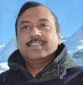
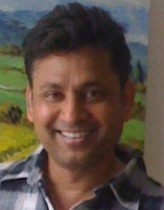
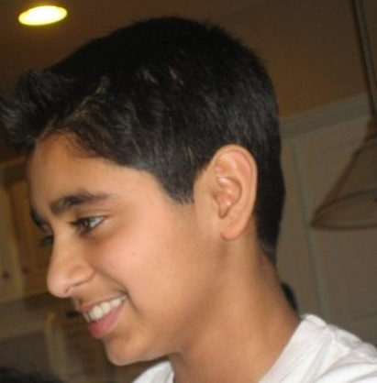
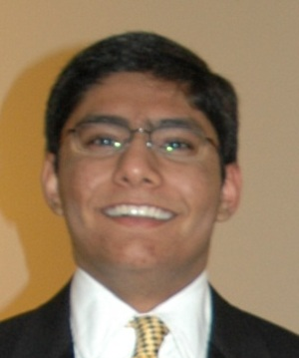
Team members
Dr. Vinayak Prasad
Rafat Sarosh
Azan Sarosh
Arjun Dave
Leader at the WHO’s Tobacco Free Initiative
Development Lead at Microsoft’s Xbox team
Student at Maywood Middle School
Student at Interlake High School
Health
Technology
Design, Youth Outreach
Project Lead
Summary
Who
Why
What
How
When

Slide 4
Tobacco is deadly
Tobacco kills up to half of its users
Currently 5 million people die each year because of tobacco—1 person every 6 seconds
Tobacco caused 100 million deaths in the 20th century, and if trends continue it could cause 1 billion deaths in the 21st century
250 out of the 4000 chemicals in tobacco smoke are known to be harmful, and more than 50 cause cancer
Tobacco causes diseases like cancer, coronary heart disease, and stroke
Worldwide, tobacco use is the second highest risk factor for death
Summary
Who
Why
What
How
When

Slide 5

Tobacco affects non-users
In some countries children from poor households work with tobacco and often develop “green tobacco sickness” from nicotine from wet tobacco leaves
600,000 people die each year because of secondhand smoke. Of these, more than 65% women and children
Summary
Who
Why
What
How
When

Slide 6
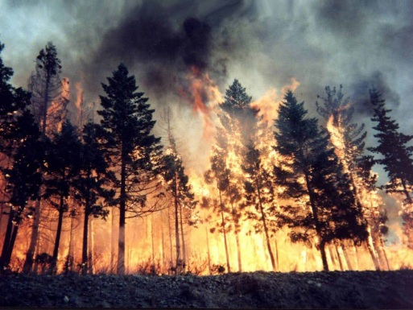
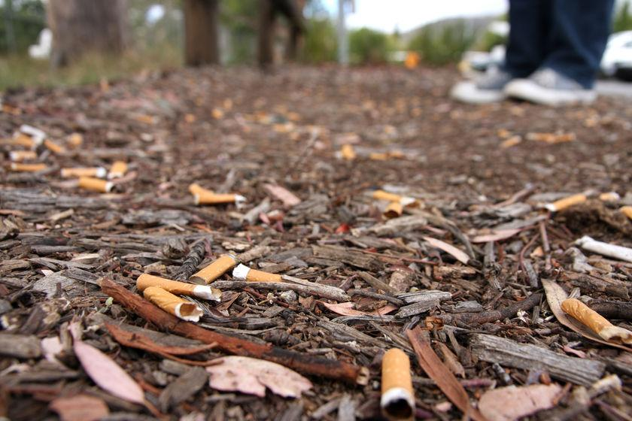
Tobacco costs us and nature
Medical bills cost families thousands of dollars
Insurance premiums rise because of widespread use
Burning cigarettes have been found to have caused wildfires and millions of dollars in property damage
Plastic chewing tobacco pouches and cigarette boxes litter the streets of South Asia
Smoke pollutes the air and cigarette butts litter cities and parks
Summary
Who
Why
What
How
When

Slide 7
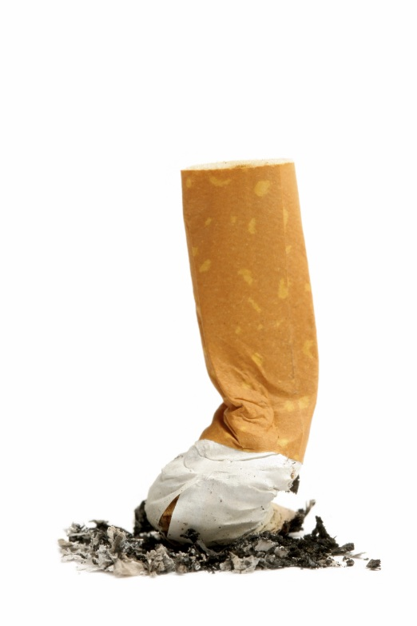
Spread awareness
Show current smokers the negative impacts of tobacco use
Give their peers the tools to help them quit smoking
Summary
Who
Why
What
How
When

Slide 8
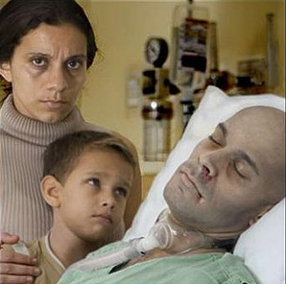
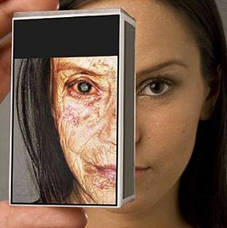
The raw truth
Share the cold facts and faces of tobacco
Share real stories about people affected by tobacco use
Summary
Who
Why
What
How
When

Slide 9

Positive peer pressure
Use social media to make it easier for smokers’ friends to find resources to help others quit
Use social media campaigns to spread the message that smoking is not cool
Summary
Who
Why
What
How
When

Slide 10
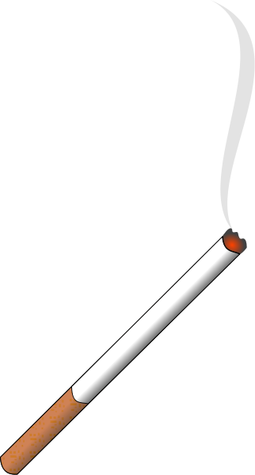
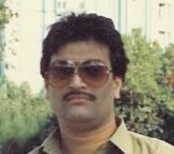
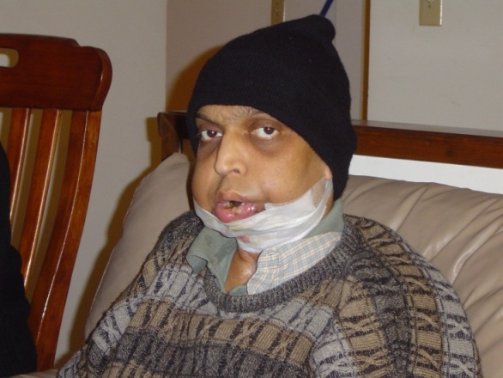
Disseminate knowledge
Include interviews with real patients on how tobacco has affected their lives
Ask teens about their experiences with tobacco and peer pressure
Make it easy for teachers to download presentations to share with their students the effects of tobacco use
Source: www.tobacco-n-cancer.com
Here we follow the story of Mubin and his tragic experience with tobacco.
Summary
Who
Why
What
How
When

Slide 11
Integration
Government and NGO involvement is necessary to generate a comprehensive network of solutions, including
Phone hotlines—speaking to a real person about an addiction to tobacco can help distract from a craving or understand the difficulties of quitting
Text message campaigns—getting alerts about tobacco use helps spread information provides a peer backing to ensure de-addiction
Social media—having an online support group and a place where people can share their stories makes quitting easier
Summary
Who
Why
What
How
When

Slide 12

Partnering
Use clubs in schools to gain youth support
Join forces with corporations to gain funding and support for campaigns within the region
Work with regional governments to enact and enforce tobacco use bans and create campaigns against tobacco use
Summary
Who
Why
What
How
When

Slide 13
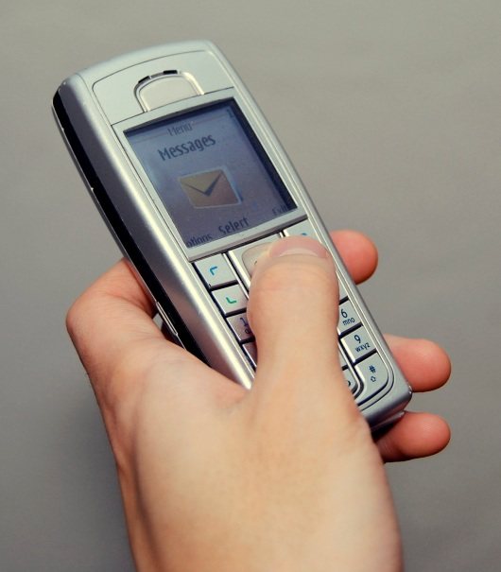

Social MEDIA and outreach
Use services like Facebook and Twitter to reach out to people around the world
Use text messages to inform people about the dangers of using tobacco
Use smartphone applications to track quitting, spread awareness, and gain support
Summary
Who
Why
What
How
When

Slide 14
Timeline
Internet Presence
Fall 2011
Gain Support
Winter 2012
International Campaigns
Create content to share the devastating effects of tobacco use. Share this content through social media campaigns.
Contact corporations to gain funding. Create a network of volunteers to build content and spread the message.
Work with international governments to create campaigns against tobacco use and provide the tools to quit tobacco use.
Summary
Who
Why
What
How
When

Slide 15
How you can help
Spread awareness
Let people know about the dangers of tobacco use
Help the tobacco users around you know about how they are ruining their lives and the lives of their loved ones
Make tobacco uncool
Don’t reinforce the image that smoking or chewing tobacco is special or good
Speak to your local lawmaker
Help pass more comprehensive laws on tobacco sale and use
Join the conversation
Be part of our Facebook group at www.causes.com/causes/299605
Share your thoughts on the challenges and solutions

Slide 16
Contact information
Arjun Dave
Volunteer Intern
arjundave@live.com
Mobile 1 (425) 442 2687
Tel 1 (425) 456 0052
http://www.causes.com/causes/299605
www.who.int/tobacco

