Slide 1
LORONG AI COMMUNITY CREW
GenomicsCopilot
Agentic AI for Variant Interpretation — Reasoning You Can Audit
Ankur Sharma, PhD · Agentic AI & ML Engineer

Slide 2
THE PROBLEM
Sequencing got 10,000× cheaper.
Interpretation didn't.
A single exome can return up to 20,000 raw variants. Clinical filtering narrows that to roughly two dozen that need real expert review — published studies put the median at 22. That review didn't scale with the sequencers. This is a supply problem. It has a software-shaped answer.

Slide 3
NOT A LOOKUP PROBLEM
You can't SQL your way to a diagnosis.
• "Which of these 40 rare variants are even in phenotype-relevant genes?"
• "Conflicting ClinVar entries, moderate CADD score — escalate or downgrade?"
• "SpliceAI predicts a donor loss, but gnomAD shows it in three homozygotes."
• Each weighs conflicting evidence — grounded reasoning, not lookup.

Slide 4
THE SYSTEM
GenomicsCopilot
• In: a VCF file, plus the patient's phenotype as HPO terms
• Out: ranked, explainable variants — full evidence chain, ACMG-lite call, audit trail
• Built on LangGraph. Every run hits live public data — no fixtures, no synthetic scores.

Slide 5
THE DESIGN PRINCIPLE
Agents reason. Pipelines compute.
• Deterministic (code): parse VCF, fetch ClinVar/gnomAD/CADD, apply ACMG rules
• Agentic (LLM): rank variants, write the narrative
• A second LLM fact-checks that narrative against the raw evidence

Slide 6
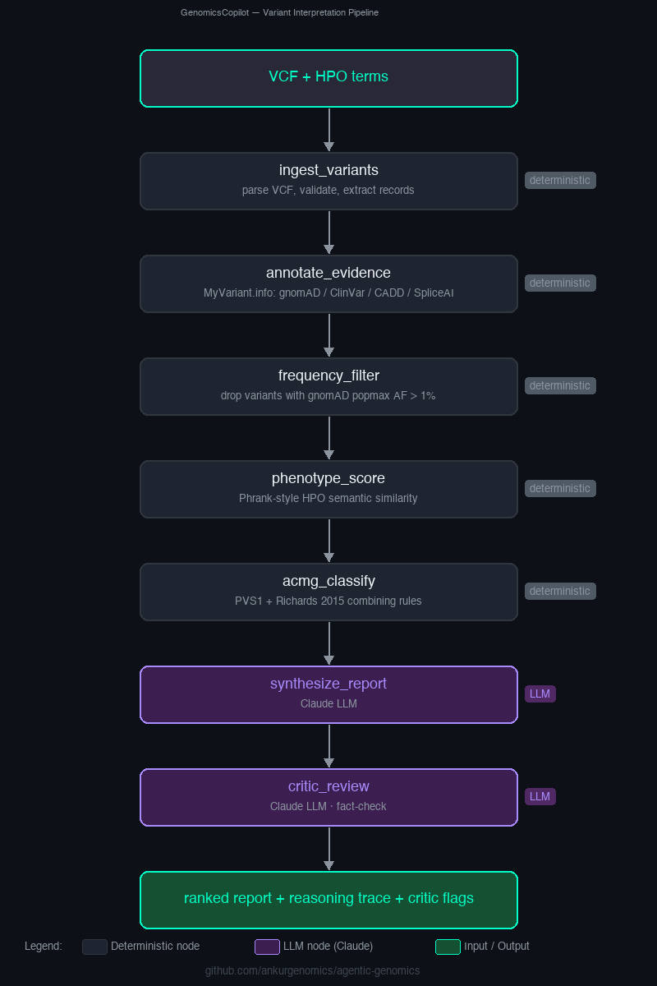
THE PIPELINE
One flow. Seven steps. One audit trail.

Slide 7
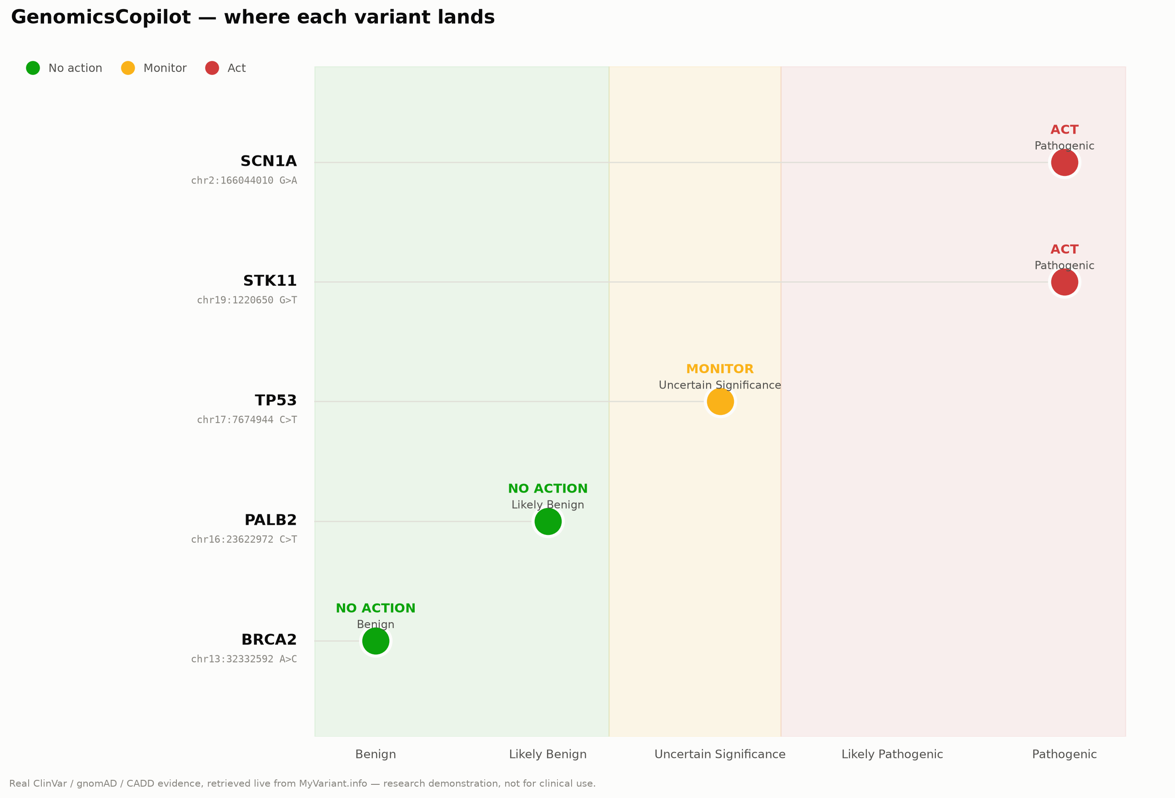
NOT A MOCKUP
This just ran. Live.

Slide 8
ONE VARIANT, FULL CHAIN
SCN1A — chr2:166044010 G>A
ACT · PATHOGENIC
• PVS1 — stop-gain in a gene where loss-of-function is a known disease mechanism
• PM2_Supporting — absent from gnomAD (~800K+ individuals)
• PP5 — ClinVar: Pathogenic, 7 concordant submitters

Slide 9
AND WHEN IT DOESN'T KNOW
TP53 — chr17:7674944 C>T
MONITOR · UNCERTAIN SIGNIFICANCE
Rare, phenotype-relevant, predictors lean deleterious — but ClinVar itself has 8 submitters with no consensus. The system doesn't force a verdict: it reports uncertain, the same honesty a careful human reviewer would show.

Slide 10
THE MOMENT
Two independently-built classification
engines. Same facts. Different calls.
GenomicsCopilot
Pathogenic
Reviewer2 · independent engine · via MCP
Uncertain significance
SCN1A, an epilepsy gene, isn't on Reviewer2's cancer-gene allow-list — an honest, inspectable scope difference between two separately engineered classifiers, surfaced automatically instead of silently averaged away.

Slide 11
WHERE THIS SITS
Not more accurate. More trustworthy.
• Rule-based tools (InterVar, CharGer, Franklin) already classify well
• What's new: a narrative evidence chain per variant, not just a label
• Phenotype-aware ranking a rule table can't weigh
• Honest handling of ambiguity, and a second opinion instead of one unchecked score

Slide 12
BEYOND THIS ROOM
This isn't a genomics pattern.
It's a trust pattern.
Peter's system decides a dose. Yusuke's detects a tumor. Both make judgment calls that matter. The pattern here, a second independent system checking the first, live, isn't specific to genomics — it could sit on top of either of theirs too, or any high-stakes model where a second check adds real value.

Slide 13
THE CLOSING THESIS
Confidently wrong is worse
than honestly unsure.
Healthcare AI's biggest adoption blocker isn't capability, it's trust. Deterministic core. Narrow LLM reasoning surface. Self-fact-checking. Calibrated uncertainty. A template for any domain where being wrong is expensive.

Slide 14
LET'S TALK
Try it yourself. Let's talk.
• Live demo — agentic-genomic-ankursharma.streamlit.app
• Source, MIT licensed — github.com/ankurgenomics/agentic-genomics

