Slide 1
Task Tracker
Application Architecture Overview

Slide 2
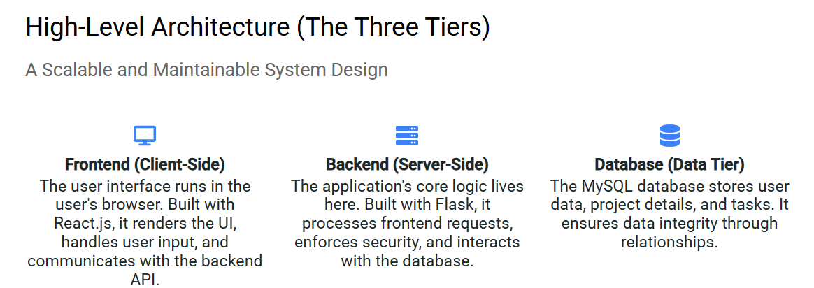

Slide 3
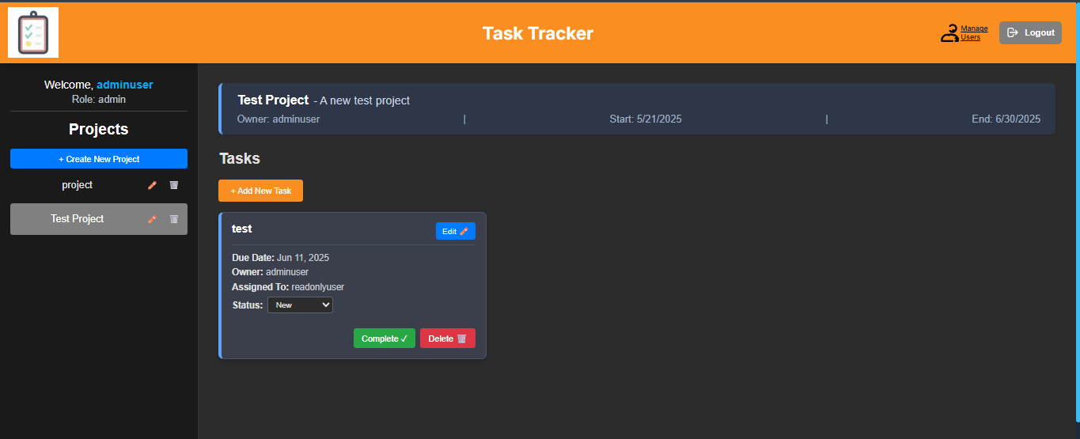
Frontend

Slide 4
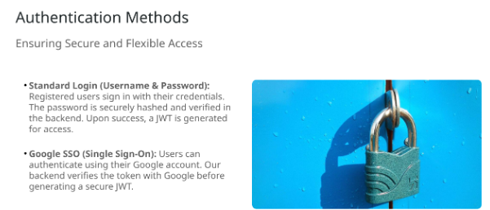

Slide 5
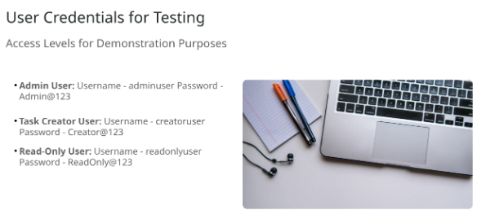

Slide 6
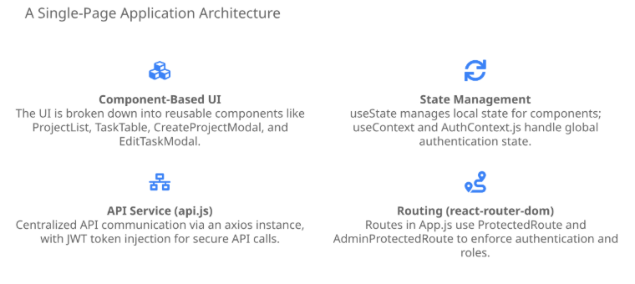

Slide 7
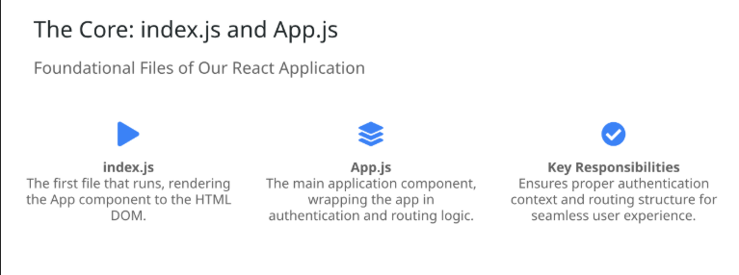
Components

Slide 8
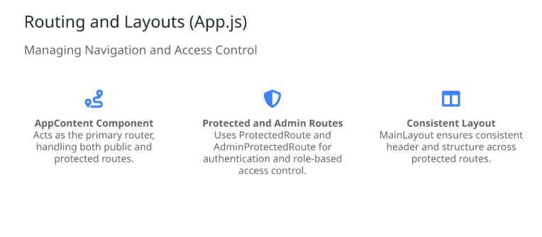

Slide 9
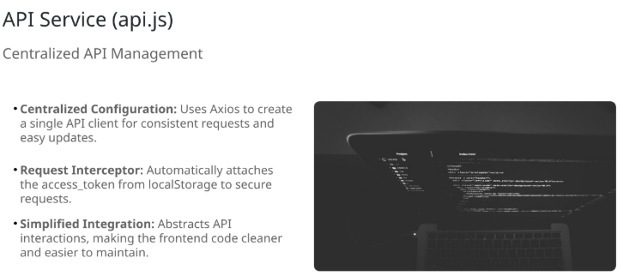

Slide 10
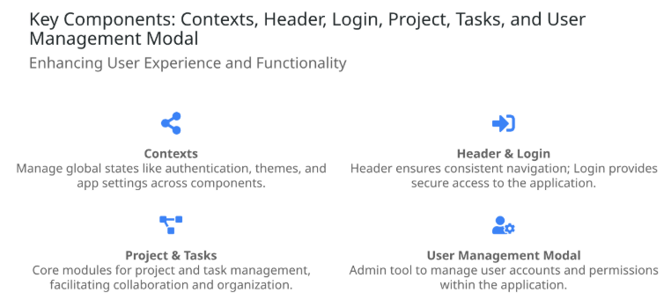

Slide 11
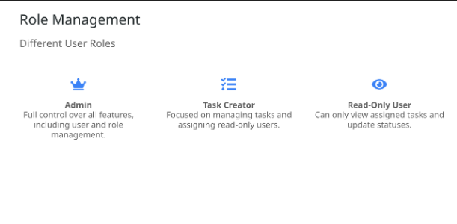

Slide 12
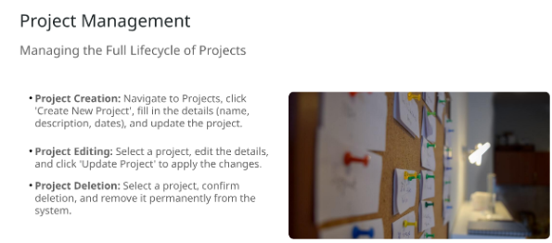

Slide 13
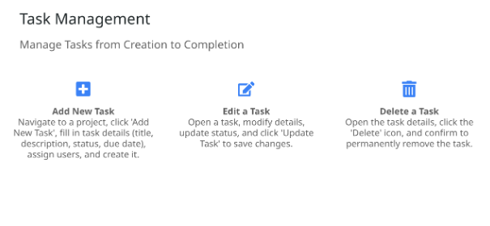

Slide 14
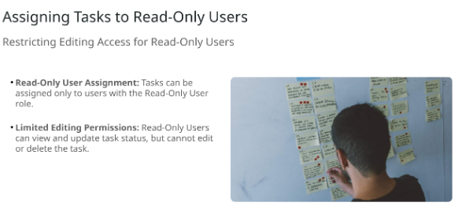

Slide 15
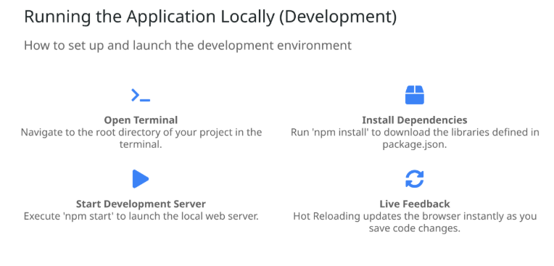

Slide 16
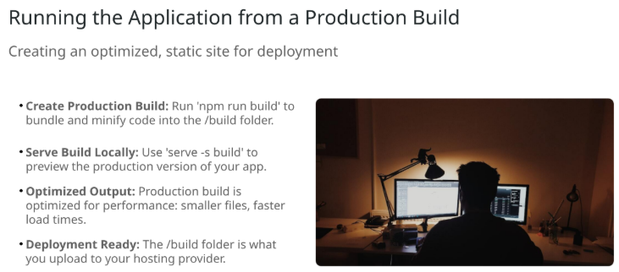

Slide 17
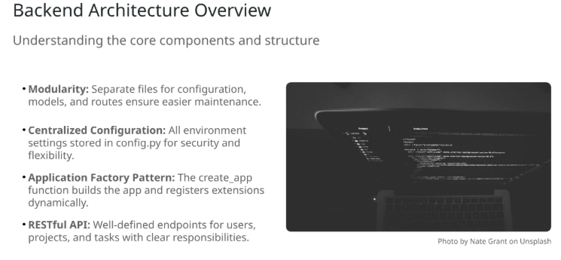

Backend

Slide 18
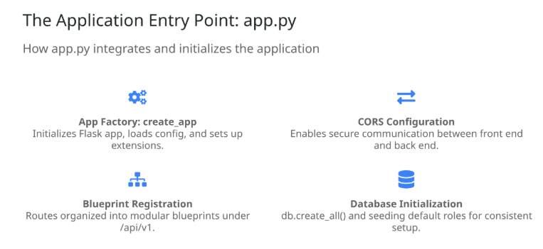

Slide 19
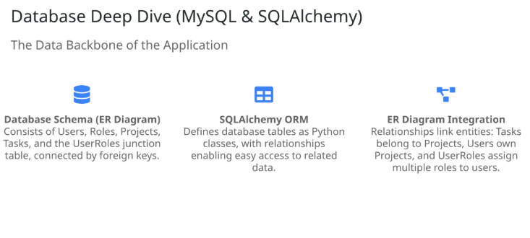

Slide 20
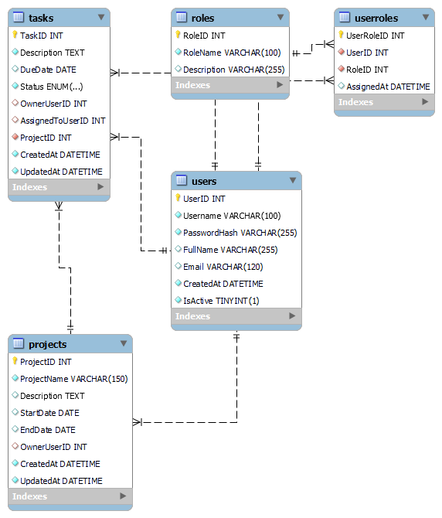
ER Diagram

Slide 21
Running Backend in ec2 server-54.253.182.170
Navigate to the backend project directory path:- cd backend
Activate the virtual environment -source myenv/bin/activate
For testing -python app.py
Run App-nohup python app.py 0.0.0.0:5000 &

Slide 22
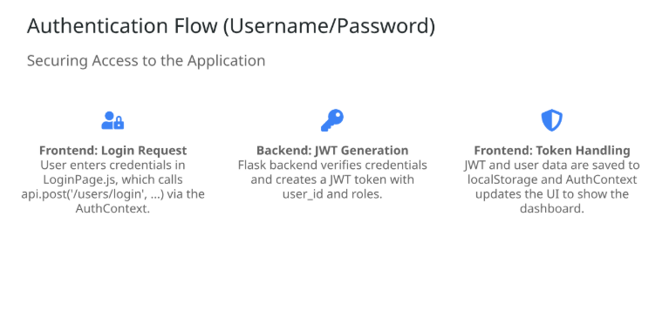

Slide 23
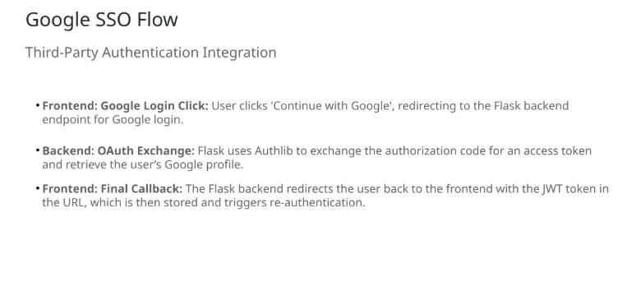

Slide 24
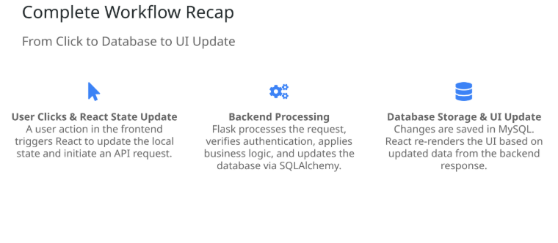

Slide 25
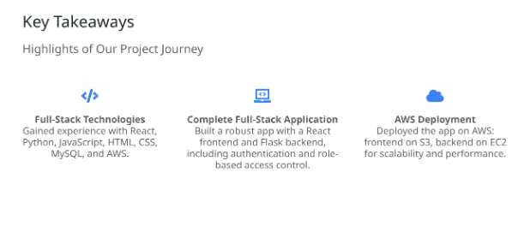

Slide 26


LINKS
/
WEB APP LINK :- http://tasktrack4june.s3-website-ap-southeast-2.amazonaws.com/login
GITHUB REPO :- https://github.com/ankurguglanifzk/fsd.git

Slide 27
Thanks
Ankur Guglani -803837 Senior Application Engineer

