Slide 1
OOPD Project
Food Ordering App
Group 22
Ankur Gupta (MT21113)
Jahnvi Kadia (MT21123)
Mona Singh (MT21053)
Nandha Shivam Niteshkumar (MT21128)

Slide 2
Module 1: Authentication

Slide 3
Registration

Slide 4
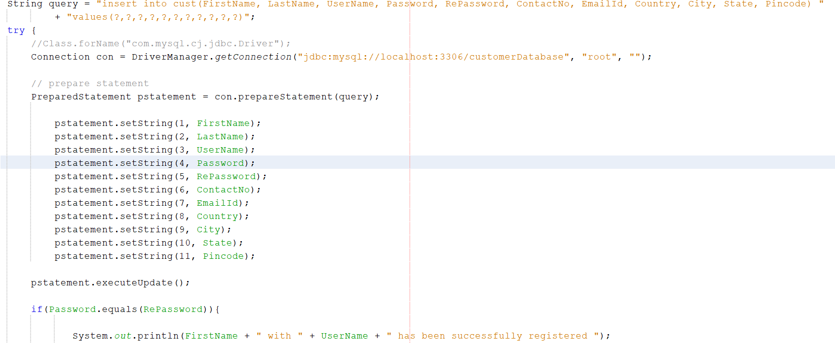
It is used for the registration of the user.

Slide 5
Output of the registered user can be viewed as:

Slide 6
Login

Slide 7
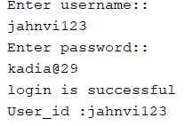
Login is done using username and password. It is logged in only when both the entities are
Rightly given.

Slide 8
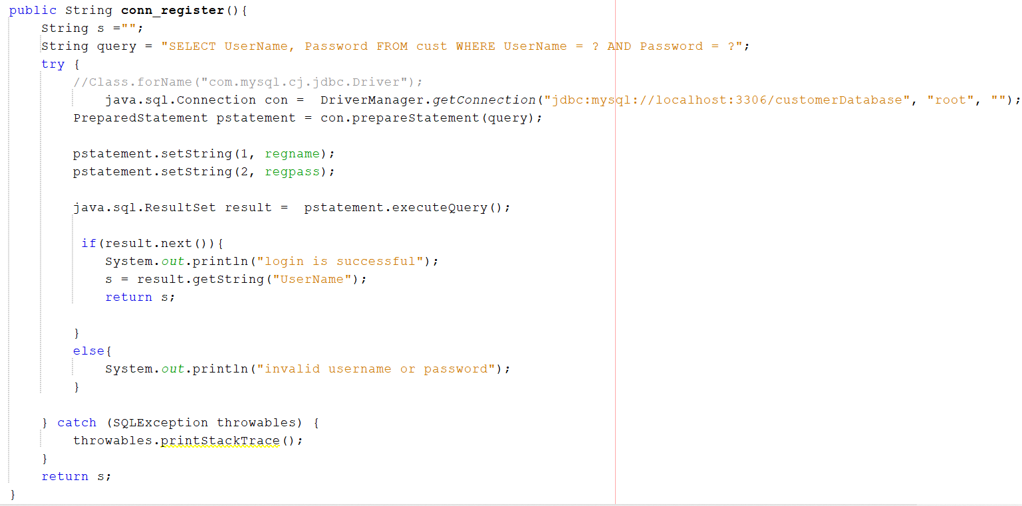
It is used for logging the user who has already been registered.

Slide 9
Validation

Slide 10
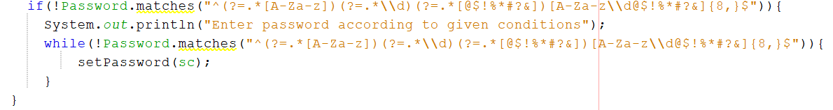
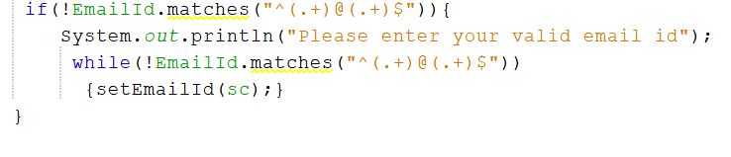
It is used for the validation of the fields that is given to the user as the input during registration. For example,
validation for password and email id is shown below.

Slide 11
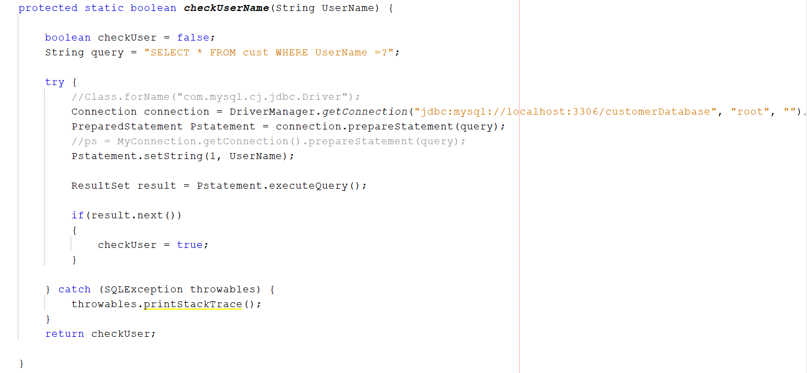
Checking if the username is already registered or not.

Slide 12
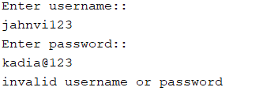
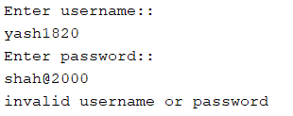
When username or password is wrongly given or when that user is not registered it will display something like this

Slide 13

If the username is already registered it will be displayed like this

Slide 14
OOPD Concepts Used

Slide 15
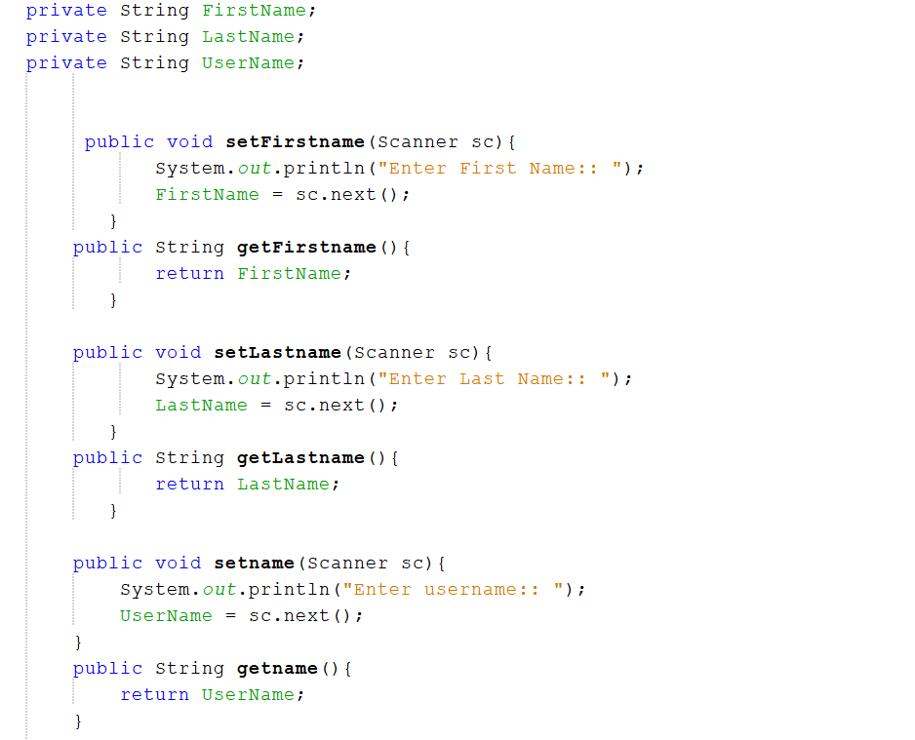
Encapsulation is been used in the following code.

Slide 16
Module 2 : Order Module

Slide 17
Restaurant Class : Overview
We have make a restaurant class which have the following attributes:
RestaurantId : int
RestaurantName : String
State : String
Restaurant class have the following functionality:
Getter and Setter functions of the above data members
ViewRestaurant(String) : int : To view all the nearby restaurants for users particular state. It will fetch the state of the user and will display all the restaurants nearby user’s location.

Slide 18
Item Class : Overview
Item is class used to display the menus of the all restaurants nearby the user. We have extended the item class from restaurant to save the corresponding restaurant id and name. Item class have the following data members:
Item_id : int
Item_name : String;
Price : int ;
Quantity : int
Item class have the following functionality :
ViewItems(int restaurant_id): View the menu of the corresponding restaurant id
Getter and setter functions of all above classes

Slide 19
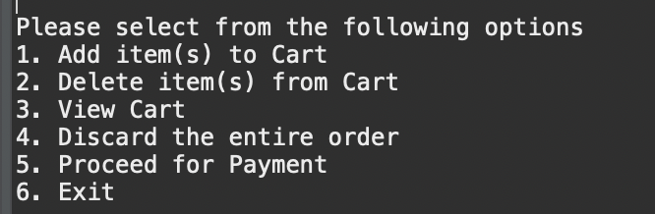
Cart Functionality:
Before placing the items in cart user will be shown the Estimated Time of Arrival from User’s Location to the restaurant menu
After that user have an option to choose from the following options:

Slide 20
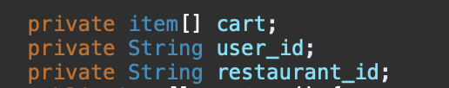
Cart Implementation
Cart have the following data members:
We have the following cart methods :
addToCart(String username,int rest_ID,int item_ID,int q , int price) - To add a particular element in the cart.
displayCart(String, int)
delete_item(String, int, int)
delete_cart_all_items(String, int)

Slide 21
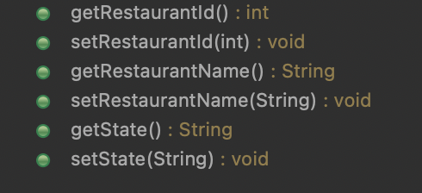

OOPD Concepts Used:
Encapsulation: All the classes including Restaurant, Items and Cart are properly Encapsulated to hide data members. We have made getters and setters functions for each class in Restaurant.
Inheritance: We have inherited Restaurant Class in the corresponding item class to store the item’s corresponding restaurant information.

Slide 22
Module 3: Payment Module

Slide 23
Payment
After the user places an order and proceeds for payment, the base bill is calculated.
If base bill < 100 , Order is not placed
Else, The order is placed
The delivery charge is calculated using the location of the user and the selected restaurant.
Each user has two promo codes:- SAVE50 and SAVE20 and which can be used once
Before proceeding for the payment, the user is asked if they want to apply any promo code
If promo code is applied, the price is discounted
After this the user proceeds for the payment mode

Slide 24
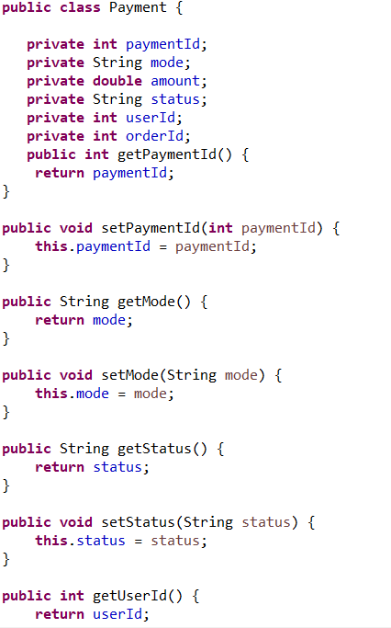
Encapsulation

Slide 25
Payment Mode
4 Different payment Modes implemented
Credit Card
Debit Card
UPI
NetBanking

Slide 26
The user is asked to select the mode of payment
If the details of the selected mode of payment are not stored in the system, It asks the user to first enter the details, and then proceeds with the payment.
After the payment is done, a payment record is generated and the order record is updated with status as “Order Confirmed”.

Slide 27
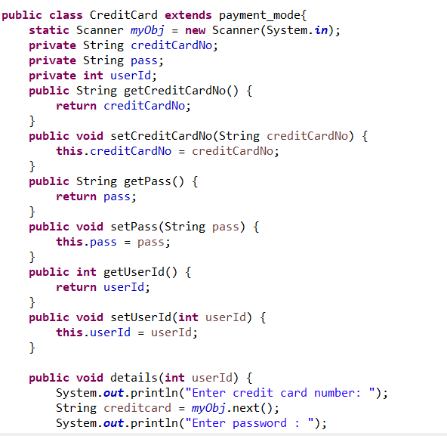
Encapsulation

Slide 28
Inheritence

Slide 29
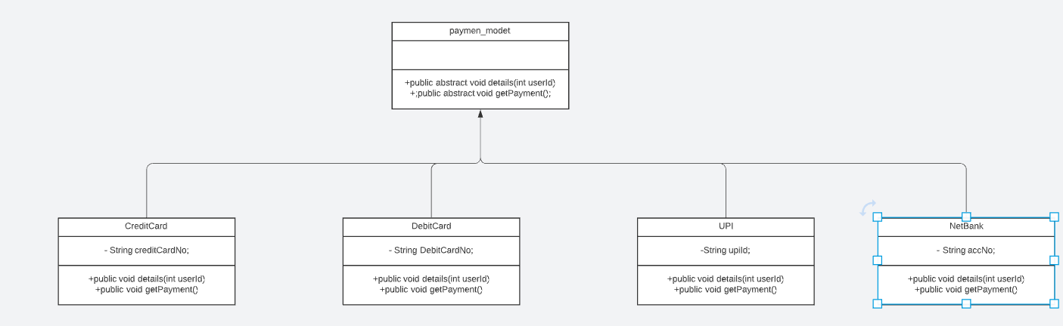

Slide 30
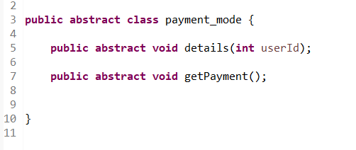
Abstraction

Slide 31
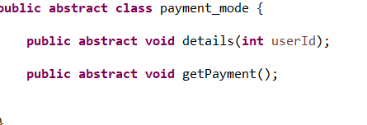

Polymorphism - Method overriding

Slide 32
Tracking Module

Slide 33
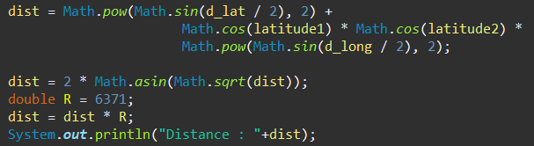
Calculating Distance
CalculateEstimatedDeliveryDistance function calculates the distance between user’s address and restaurants address.
First We are fetching Longitude and latitude coordinates of User and restaurants from the database(We already saved it while singnup).
Now using toRadians() method we are converting all coordinates into radian.
Calculating the distance by the Haversine Formula between two points as shown in the code snippet.

Slide 34
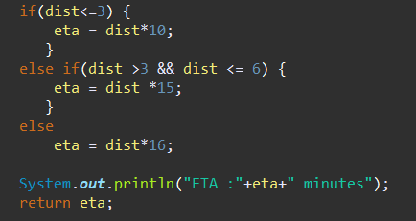
Calculating Estimated Time of arrival
CalculateEstimatedDeliveryTime() method calculates the ETA.
Now depending on the distance we are calculating the ETA for example if distance is <=3 KM then ETA would be dist*10 lke wise depending on the distance our ETA will vary it can be seen in the following snippet.

Slide 35
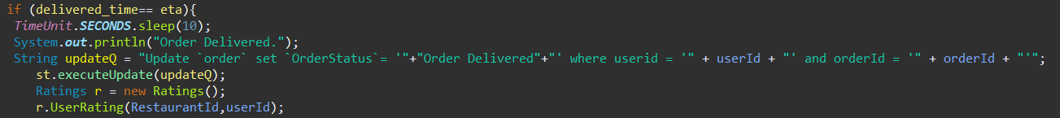
Track Order
After successful payment of the order by user distance and ETA will be displayed on to the screen of the user.
Now for demonstration purpose we are randomly generating delivered time of a order.
Now if delivered time = ETA then after 10 second timer we are marking order as it has been delivered and asks for the rating as we can see in the below snippet.

Slide 36
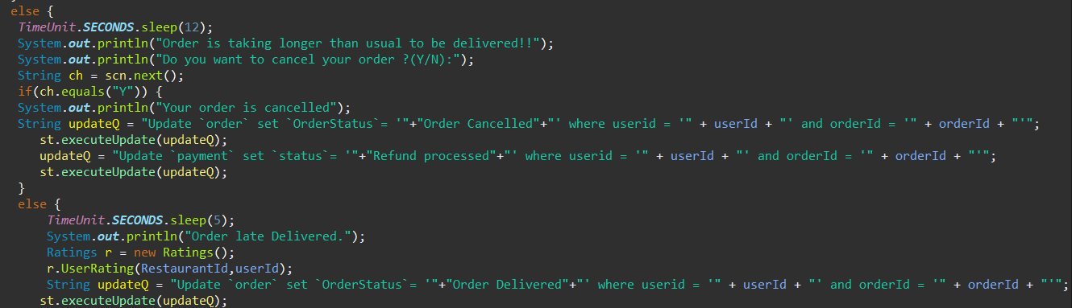
Track Order Cont.
Now if delivered time does not meet ETA then we are giving user option to cancel the order and notifying user that order is taking longer then usual If user wants to still receive order then we will mark the order as it has been late delivered and asks for rating this can be done using the below snippet.

Slide 37
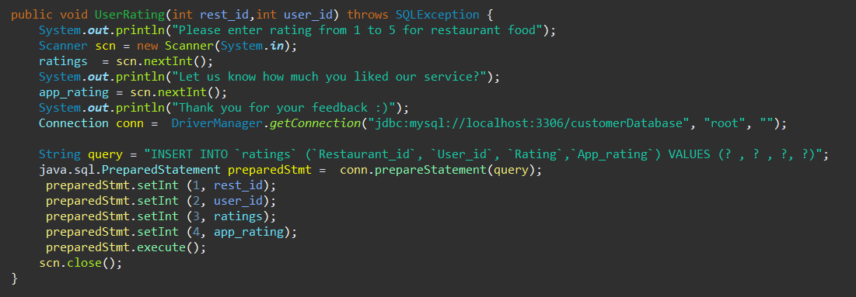
Ratings
After the user receives the order in time or late we are asking user to rate food of that particular restaurant and rate the app as well.
All users ratings can be seen in the admin panel of the SQL under rating table.
Using UserRating() method we are inserting rating of the food and app into database.

Slide 38


OOPD Concept Used in this module
Inheritance: In rating we are inheriting restaurant class in which we are properties of the restaurant class into Ratings class.
Encapsulation: In the rating class we are implementing encapsulation by making attribute ratings and app_rating as private and making getter and setter methods to set and get the values of attribute respectively.

Slide 39


