Slide 1
Payment Fraud Check Demo (PoC)
Integration of PPS, BS, and FCS with Messaging & REST
Ankur Kapila

Slide 2
Agenda
Problem Statement & Objectives
Systems in Scope
Solution
Demo Flow
Technology Stack & Trade-offs
Deployment & Observability
Q&A

Slide 3
Problem Statement
• Bank requires fraud checks before honoring payments
• Ensure traceability, validations, and audit logs
• Two integration approaches: Messaging and REST
• Reusable, demonstrable within 90 minutes

Slide 4
Systems in Scope
Payment Processing System (PPS): Receives payments in JSON, validates, forwards to BS
Broker System (BS): Mediates PPS ↔ FCS, converts JSON ↔ XML
Fraud Check System (FCS): Validates against blacklists, approves/rejects

Slide 5
Assump
Payment Processing System (PPS): Receives payments in JSON, validates, forwards to BS
Broker System (BS): Mediates PPS ↔ FCS, converts JSON ↔ XML
Fraud Check System (FCS): Validates against blacklists, approves/rejects

Slide 6
Solution 1: Messaging (JMS + JSON/XML)
PPS ↔ BS via JMS, JSON
BS ↔ FCS via JMS, XML
External ↔ PPS via REST, JSON

Slide 7
Solution 2: REST + Messaging (JMS + JSON/XML)
PPS ↔ BS via REST, JSON
BS ↔ FCS via JMS, XML
External ↔ PPS via REST, JSON

Slide 8
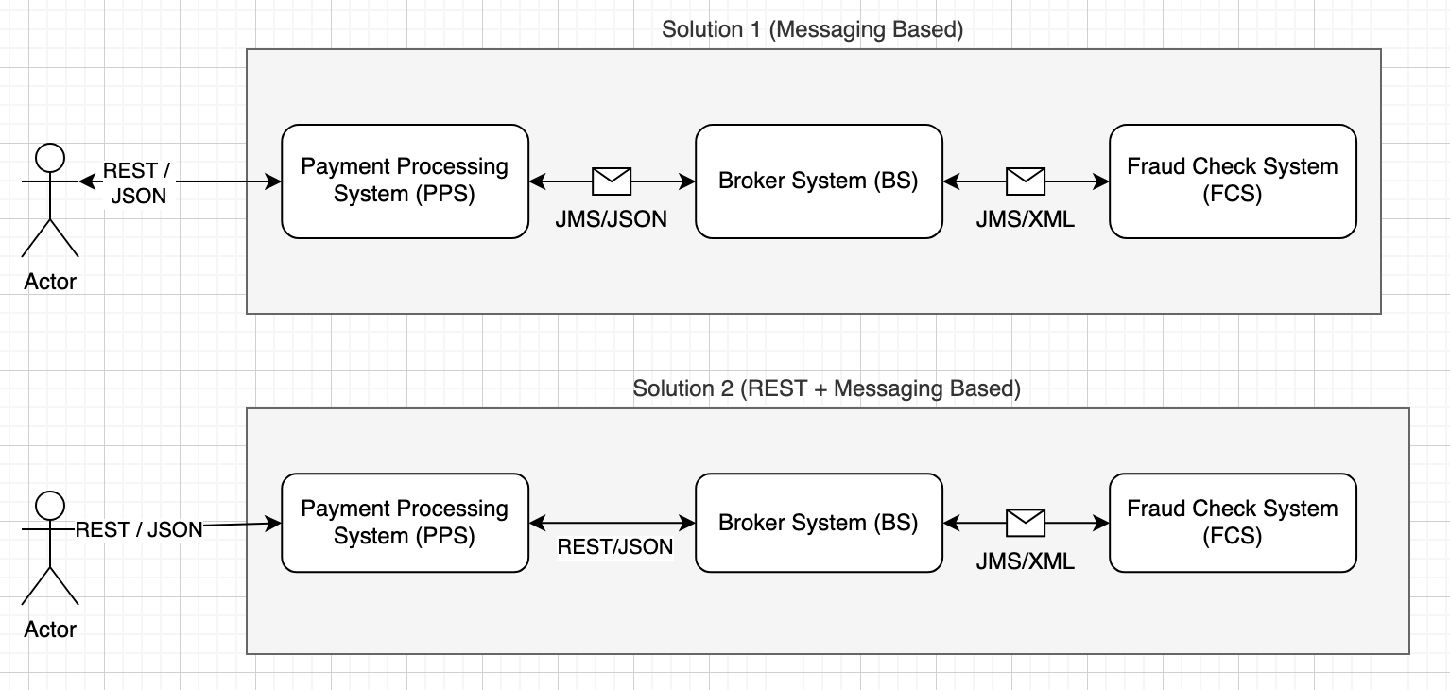
Demo Flow

Slide 9
Technology Stack
Spring Boot / Java 21
Apache Camel
ActiveMQ Artemis (JMS provider)
JSON & XML (Jackson + JAXB)
Spring / Jakarta Validation
Docker Container/Docker Compose
Observability
Open Telemetry (metrics/traces/logs)
Grafana LGTM (Loki, Grafana, Temo, Mirmir)

Slide 10
Technology Selection – Message Queue
Options Considered
ActiveMQ / ActiveMQ Artemis Open-source JMS provider, widely adopted, easy integration with Java and Apache Camel.
RabbitMQ AMQP-based, strong ecosystem, popular in microservices and event-driven architectures.
Kafka Distributed log streaming platform, strong for large-scale event streaming, but higher setup and operational overhead.
Azure Service Bus / AWS SQS (managed cloud options) Reliable, but tied to cloud providers; not ideal for a vendor-neutral PoC.
IBM MQ Enterprise-grade, but heavyweight for a demo and not open-source.
ActiveMQ Artemis
Native JMS support (fits directly with requirement: “use Apache AMQ (or any other open source JMS provider)”

Slide 11
Technology Selection – Observability
Options Considered
Grafana + Prometheus + Loki Most widely used open-source stack for metrics, logs, visualization.
Grafana Cloud (Free tier) Managed option with hosted dashboards and log ingestion.
ELK Stack (Elasticsearch, Logstash, Kibana) Powerful, but heavier footprint, more effort to set up.
OpenTelemetry + Jaeger Strong for tracing, can be integrated into a larger observability setup.
OpenShift built-in monitoring (Prometheus, EFK stack) Nice-to-have option if deployed on OpenShift.
SigNoz / OpenObserve Newer open-source observability platforms with tracing + metrics + logs built-in, simpler setup than ELK.
Paid APM like data dog, new relic and applications insights etc.
Final Choice
Grafana grafana/otel-lgtm
Works well in both local demo and cloud environments.
Batteries included, easy switch to cloud gtafana free trial
Easier to demo flows visually with dashboards.
Easy to leverage Grafana Cloud free trial, reducing setup effort.

Slide 12
Technology Selection – Grafana OTEL LGTM
Component | Purpose / What it Provides
OpenTelemetry Collector | Receives telemetry (metrics, logs, traces) via OTLP (gRPC & HTTP) on default ports (4317, 4318). It acts as data ingestion/processing agent. (Grafana Labs)
Grafana | UI frontend to view dashboards, explore metrics/traces/logs etc. Comes pre-configured with data sources pointing to the other bundled components. (Grafana Labs)
Prometheus | Stores metrics; used for metrics ingestion and querying via PromQL. (Grafana Labs)
Loki | Logs backend; ingestion and querying of logs via LogQL etc. (Grafana Labs)
Tempo | Tracing backend; stores and allows exploring traces collected via OpenTelemetry. (Grafana Labs)
Pyroscope | For continuous profiling (i.e. observing program execution, CPU/memory usage, etc over time) – bundled for profiling data. (GitHub)

Slide 13
Technology Selection – Observability
Unified, vendor-neutral standards
OpenTelemetry (OTel) — spec + SDKs + Collector for traces, metrics, logs (and profiling) with OTLP as the wire protocol; auto-instrumentation for many languages; exports to many backends (Grafana Tempo/Loki/Prometheus, Elastic, Datadog, New Relic, etc.).
Legacy/open standards (trace-centric)
OpenTracing — tracing API (now merged into OTel; maintenance only).
OpenCensus — Google-origin metrics/tracing (merged into OTel; maintenance only).
Zipkin/Brave — classic tracing libs + Zipkin server; great for traces, not unified for metrics/logs.
Backend-specific client libraries/agents
Prometheus client libs — excellent for metrics only; needs a separate story for traces/logs.
Jaeger client libs — tracing only; superseded by OTel in most new builds.
Elastic APM, Datadog, New Relic, Dynatrace agents — easy end-to-end experience, but vendor lock-in, mixed coverage across languages, and switching backends later is costly.
OpenTelemetry
OpenTelemetry for unified, vendor-neutral telemetry with the flexibility of the Collector and OTLP, perfect fit for our Grafana LGTM demo.
Didn’t pick: Legacy APIs (OpenTracing/OpenCensus), single-signal clients (Prometheus-only, Jaeger-only), or vendor agents—either limited scope or introduce lock-in.

Slide 14
Next Steps
Live demo of both solutions
Code walkthrough (reusable components)
Q&A

