Slide 1


Major Project
Title: CampusGPT: AI-Powered University Intelligence and Student Assistance Platform
Presented by:
Ankur Karn 500118986
Ashmita Sharma 500122422
Ananya Singh 500123837
Ayushi Mishra 500121986
Institution:
School of Computer Science, UPES Dehradun
B.Tech CSE (Cyber Security), Batch 11
Mentor: Mr. Yogesh Rathia
October 2026

Slide 2
Content
1. Abstract
2. Introduction & Problem Statement
3. Objectives
4. Literature Review
5. Dataset Description
6. Methodology
7. System Architecture
8. Data Flow Diagram
9. Inter-Process Communication
10. Database Design
11. Implementation: Concepts and Libraries
12. Security and Data Isolation
13. SWOT Analysis
14. Project Schedule
15. Limitations, Future Work & Conclusion
16. References

Slide 3
1. Abstract
Students search several portals, PDFs and notice boards for attendance, exams, fees and rules, and general chatbots cannot see their records.
We build CampusGPT, an AI helpdesk that answers in plain language from the student's own records and the university's policy documents.
The AI never touches the database: it calls 9 read-only tools, and the backend decides whose data is returned from the login session.
Policy answers use hybrid retrieval (RAG) with verified citations; calculations such as attendance shortfall are done by deterministic code.
Built on a 5,000-student synthetic database with a free stack (FastAPI, PostgreSQL + pgvector, Next.js, free-tier LLM) and evaluated against three simpler baselines.

Slide 4
2. Introduction & Problem Statement
5,000
9
0
synthetic student records
permission-checked AI tools
direct database access for the AI
Scattered information: attendance in the ERP, rules in PDFs, deadlines on notice boards.
Generic chatbots know nothing about the student and can invent policy (hallucination).
Privacy risk: giving an AI direct database access could expose another student's data.
Problem Statement
Students have no single place to ask questions that need both their own records and university rules, and existing AI assistants are either ungrounded or unsafe with personal data. There is a need for a free, grounded and secure assistant that answers from verified sources and never reveals one student's data to another.

Slide 5
3. Objectives
Main Objective
Design and build a secure AI assistant that answers students' academic and administrative questions from their own records and university policy documents, with sources, without giving the AI direct database access.
Sub-Objectives
Data: a reproducible synthetic university of 5,000 students with consistent courses, attendance, exams and fees.
Security: login, student and admin roles, and backend-enforced data isolation.
AI tools: 9 read-only tools with schema validation and audit logging.
Retrieval: hybrid vector + keyword search over policy documents with verified citations.
Campus intelligence: a prioritised “what to take care of this week” summary.
Evaluation: answer and citation accuracy, tool selection, latency and leakage tests against baselines.

Slide 6
4. Literature Review
Year - Ref. | Title | Proposed Work | Results | Limitations
2009 - Cormack et al. [1] | Reciprocal rank fusion outperforms Condorcet and individual rank learning methods | Merge ranked lists by 1/(k + rank) | Simple fusion beat more complex learned methods | Fixed constant k; no learning
2020 - Lewis et al. [2] | Retrieval-augmented generation for knowledge-intensive NLP tasks | Generator conditioned on passages from a dense retriever | More factual answers than parametric-only models on open-domain QA | General knowledge only; no access control
2023 - Yao et al. [3] | ReAct: Synergizing reasoning and acting in language models | Interleave reasoning steps with tool actions | Beat reasoning-only and acting-only prompting on QA and decision tasks | Tools are unrestricted; errors compound
2023 - Schick et al. [4] | Toolformer: Language models can teach themselves to use tools | Model learns when to call APIs such as a calculator or search | Improved zero-shot results on several tasks | No permission model for tools
2023 - Greshake et al. [5] | Compromising real-world LLM-integrated applications with indirect prompt injection | Instructions hidden in retrieved content hijack the model | Attacks shown on real LLM-integrated applications | Prompts alone are not a safeguard
2023 - Ji et al. [6] | Survey of hallucination in natural language generation | Taxonomy of hallucination and its mitigations | Grounding in retrieved evidence is a key mitigation | No single method removes hallucination
2024 - Es et al. [7] | RAGAS: Automated evaluation of retrieval augmented generation | Reference-free metrics: faithfulness, answer and context relevance | Evaluates RAG answers without labelled references | Relies on an LLM as judge
Gap: none of these combines personal records, policy retrieval and backend-enforced access control, which is the focus of CampusGPT.

Slide 7
5. Dataset Description
Synthetic by design: no real university data; students, notices and documents are labelled is_synthetic.
Scale: 5,000 students, 148 faculty, 190 courses and about 825,000 attendance records, generated and loaded in about 20 seconds.
Realistic: Indian names (Faker en_IN); program, semester and courses always consistent; deliberate edge cases such as attendance just below 75%.
Reproducible: fixed random seed; one command rebuilds the database.
Policy documents: team-written rules for attendance, exams, fees and hostel, clearly marked fictional.
Table | Contents | Rows
students | Name, program, semester, section | 5,000
enrollments | Student ↔ course offering | 25,000
class_sessions | One row per class held | 15,338
attendance | Present / absent per session | 824,636
assignments | Title, due date, marks | 1,860
submissions | Submitted at, marks | 65,378
exams | Type, date, room | 1,395
invoices | Term, amount, due date, status | 10,000

Slide 8
6. Methodology
1
2
3
4
5
6
Data
Secure
Tools
Retrieve
Orchestrate
Serve
Synthetic DB, 5,000 students
Login, roles, data isolation
9 read-only tools
Hybrid search + citations
LLM tool loop via adapter
Chat + dashboard (Next.js)
Answering a Question
Evaluation Metrics
The LLM chooses tools; the backend checks the role and validates arguments
Tools run with the session's student ID
Policy chunks are passed to the LLM as untrusted text
Every citation is checked against the retrieved chunks
Answer and citation accuracy on a 50-question benchmark
Tool-selection accuracy and response latency
Cross-student leakage and prompt-injection tests
Comparison with three simpler baselines

Slide 9
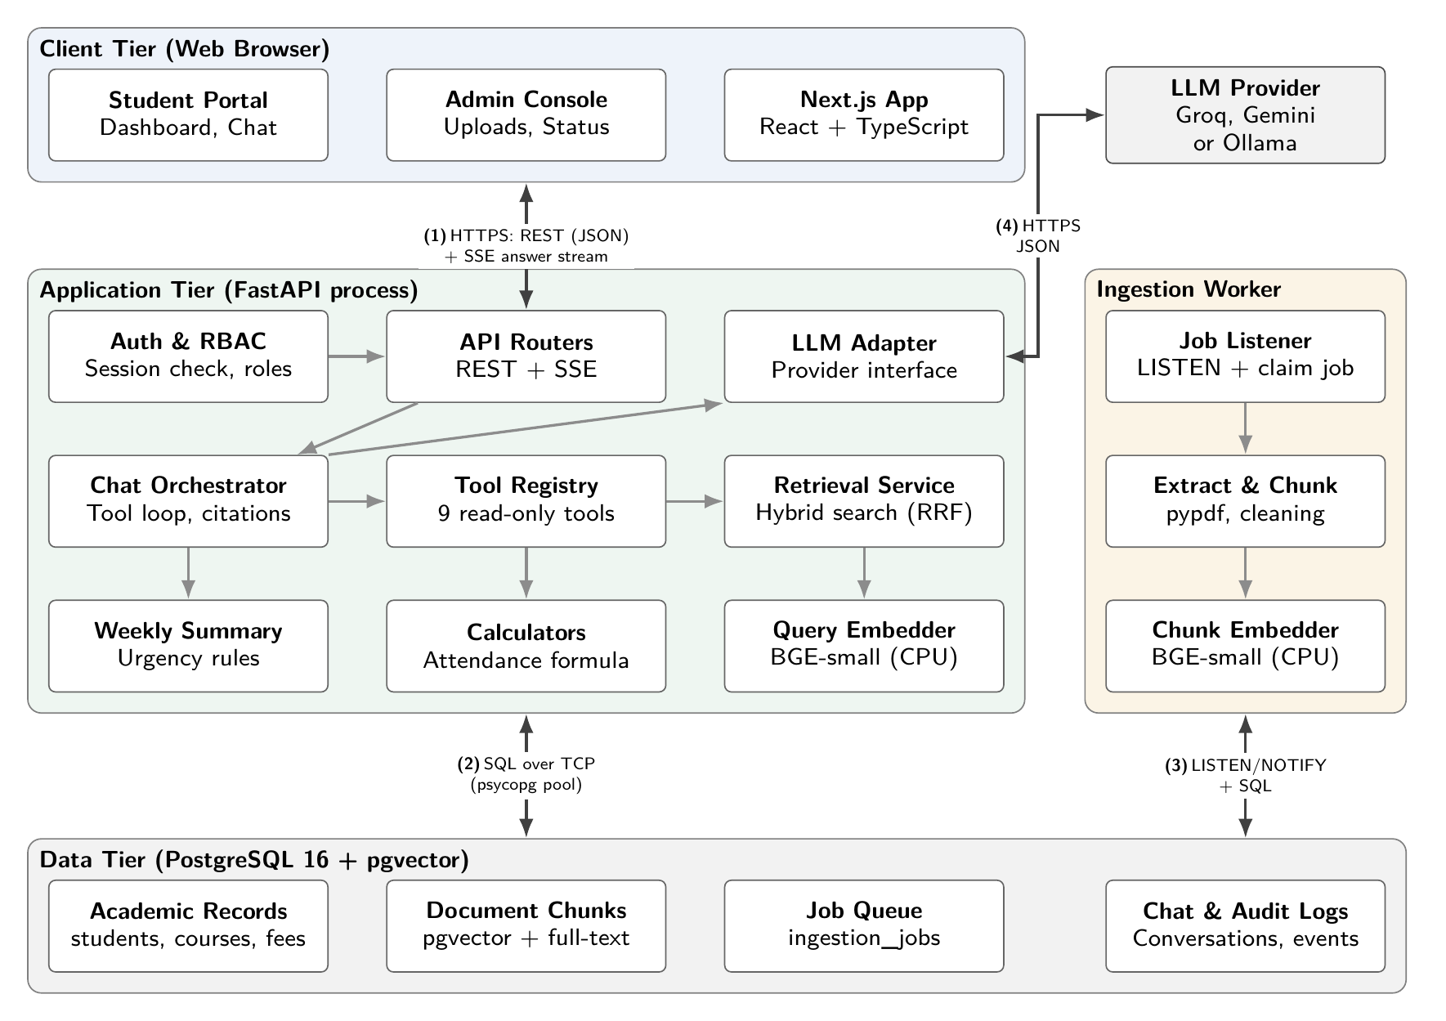
7. System Architecture
Client: Next.js student portal and admin console.
Application: one FastAPI process with authentication, chat orchestrator, tool registry and retrieval.
Worker: separate process for document ingestion.
Data: PostgreSQL 16 + pgvector for records, vectors, job queue and logs.
(1)–(4): channels that cross a process boundary.

Slide 10
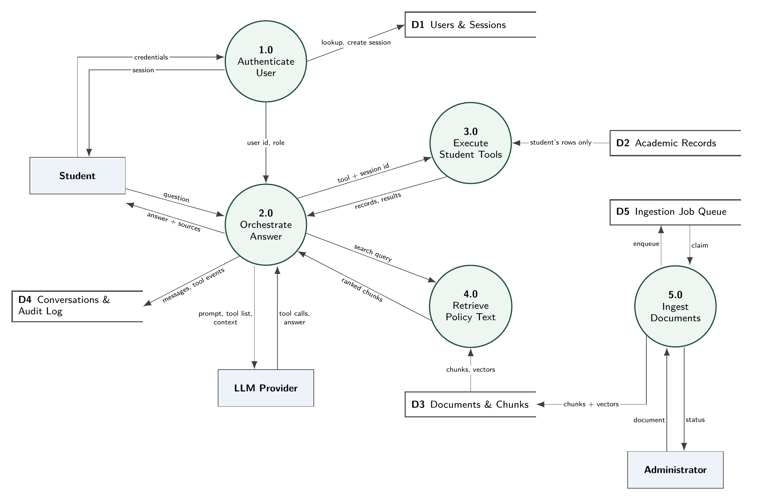
8. Data Flow Diagram (Level 1)
5 processes, 5 data stores, 3 external entities.
Every flow passes through a process; no entity touches a data store directly.
Student identity enters only through 1.0 Authenticate.
3.0 reads only the logged-in student's rows.
5.0 runs in the separate worker process.

Slide 11
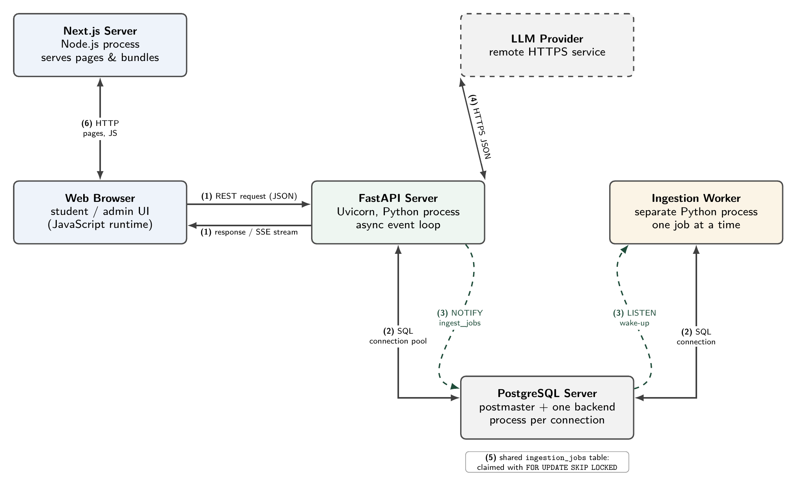
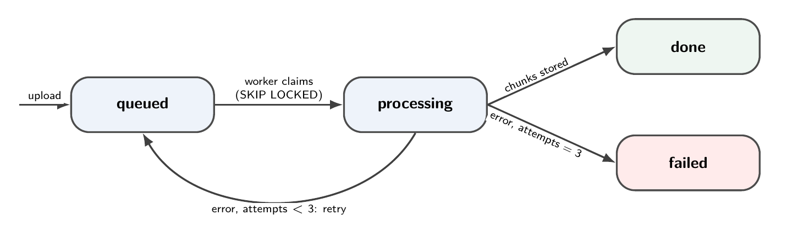
9. Inter-Process Communication
(1) REST + SSE streaming: browser ↔ API
(2) PostgreSQL protocol, pooled: API / worker ↔ DB
(3) LISTEN / NOTIFY: wakes the worker instantly
(4) HTTPS: API → LLM provider
(5) Shared job table with FOR UPDATE SKIP LOCKED: each job claimed once
(6) HTTP: pages from the Next.js server
(7) POSIX signals: graceful shutdown
No extra message broker: PostgreSQL provides durability, locking and publish–subscribe.

Slide 12
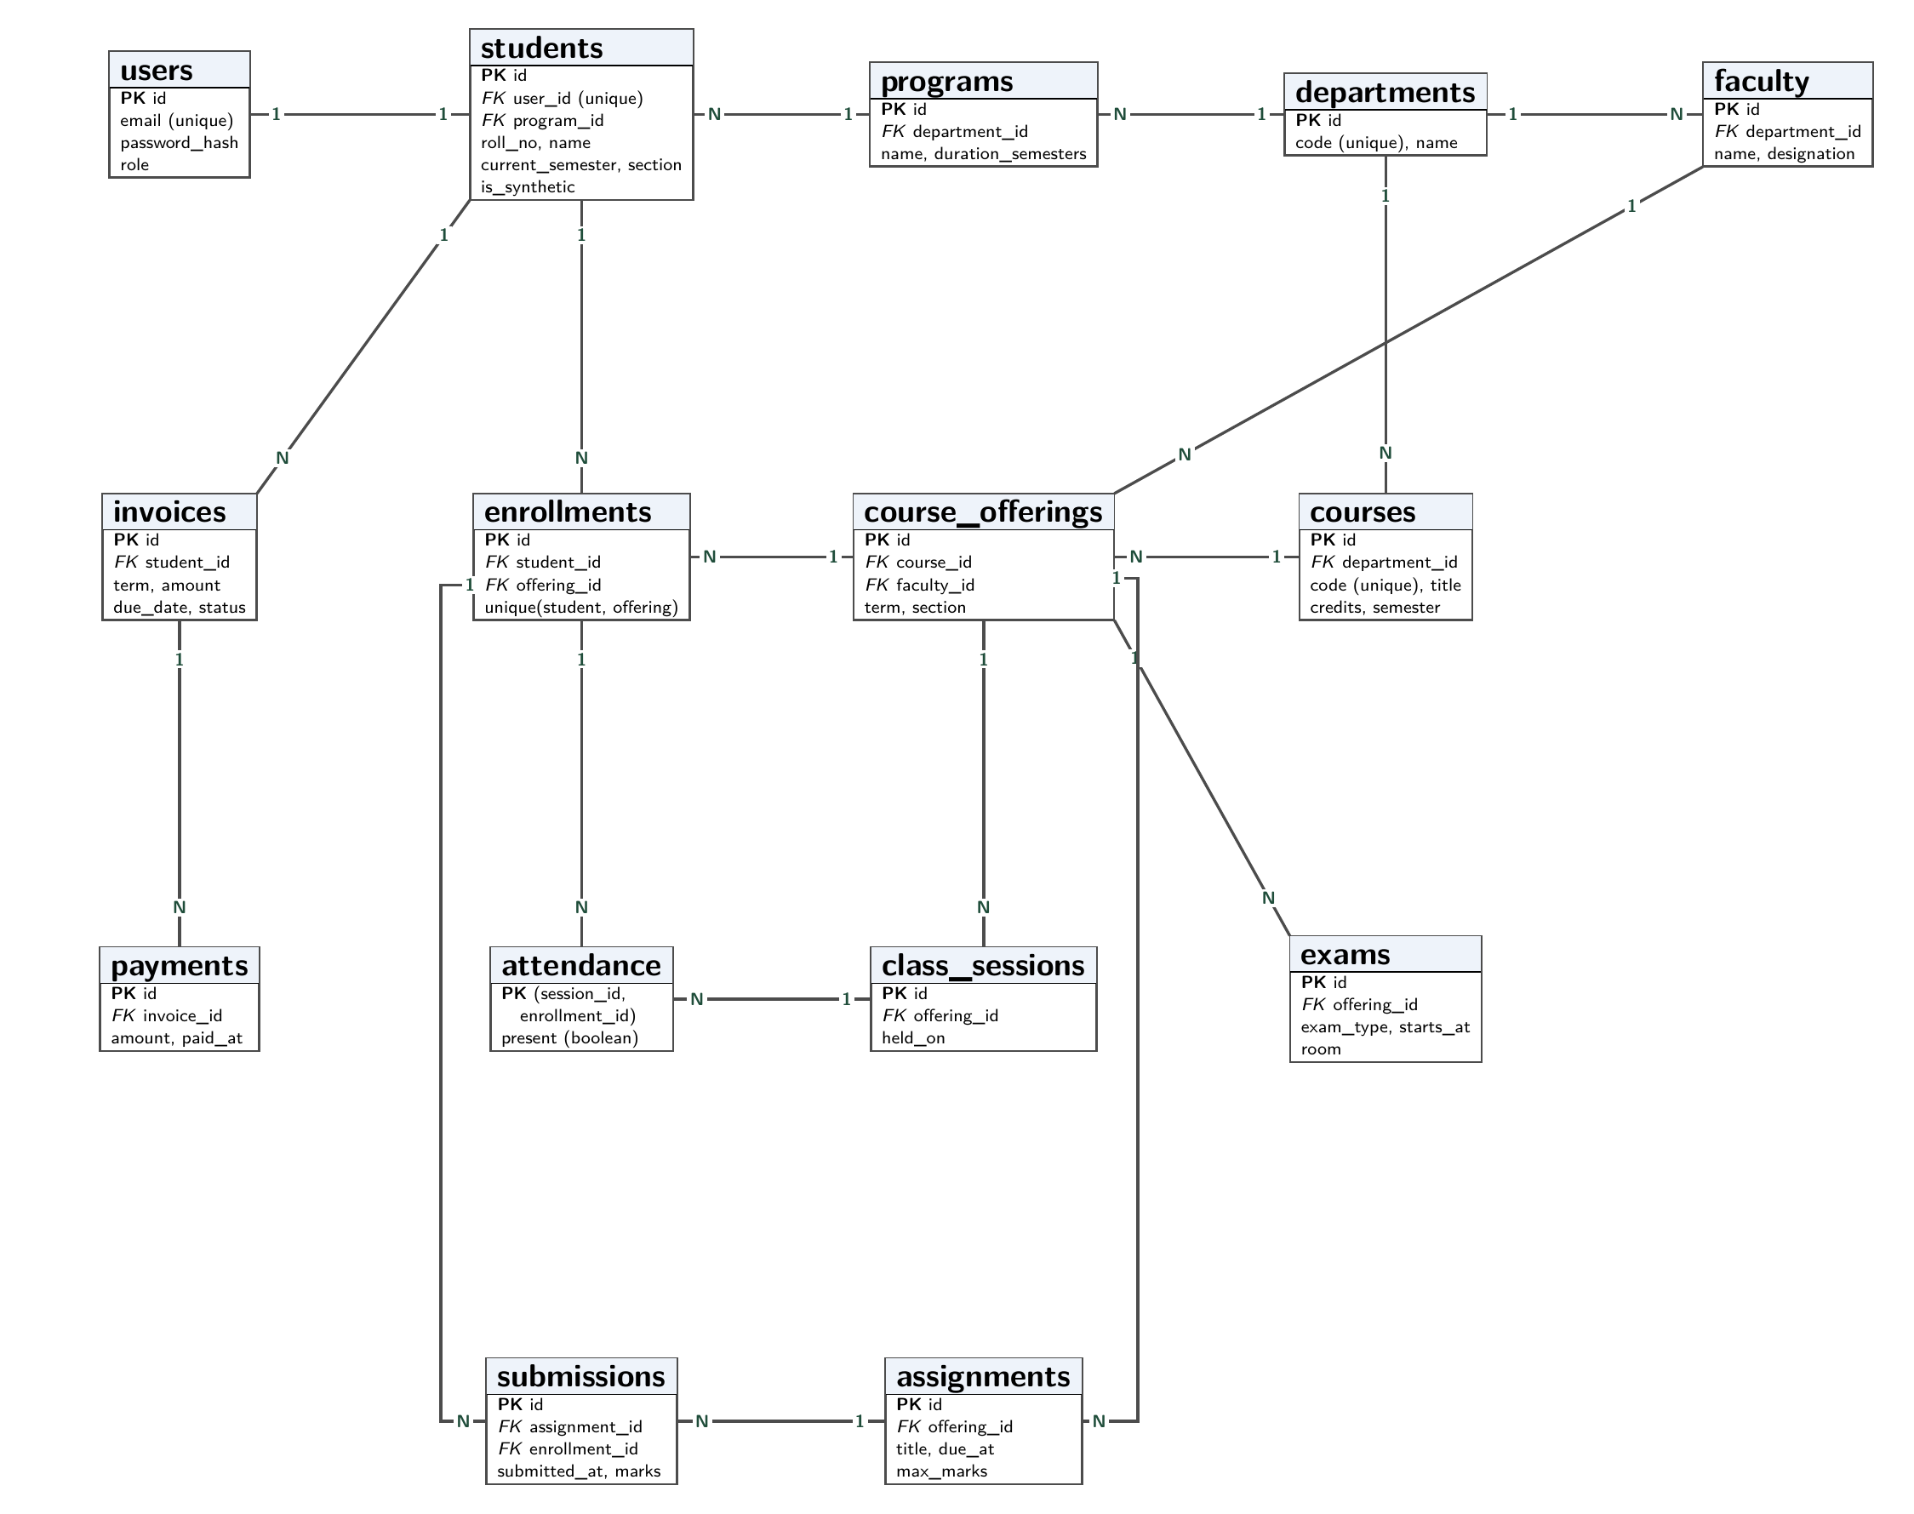
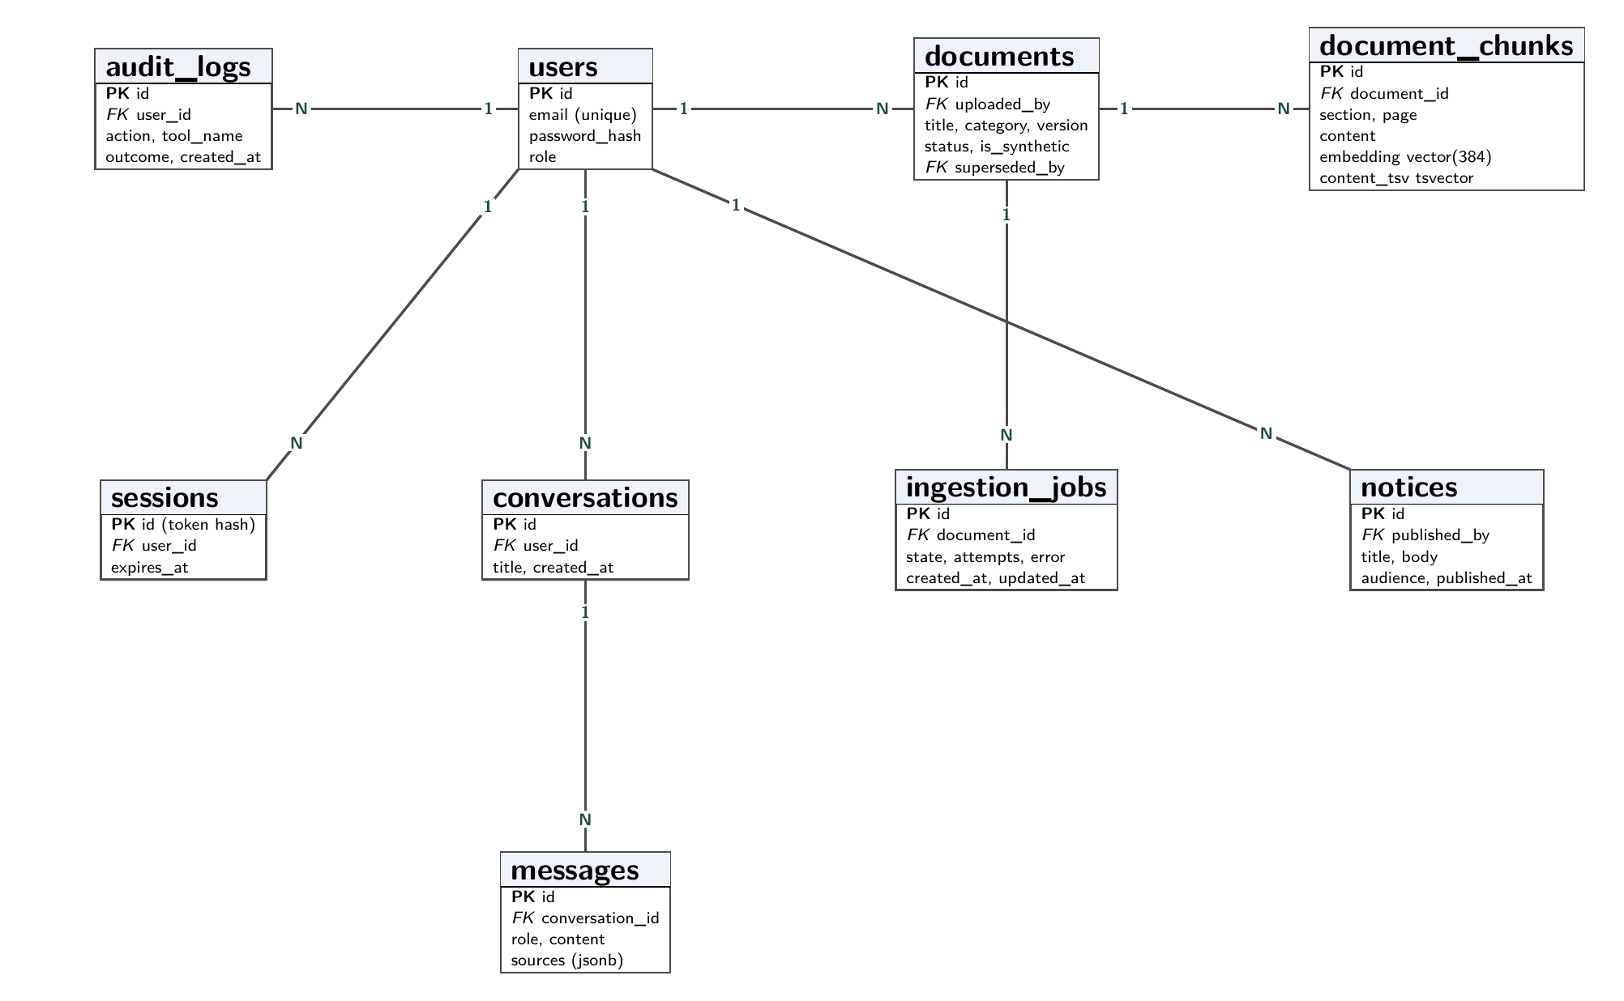
10. Database Design
23 tables in third normal form
Derived values (attendance %) computed by a view, never stored
Foreign keys, UNIQUE and CHECK constraints
HNSW index for vectors, GIN for full-text

Slide 13
11. Implementation: Concepts and Libraries
Programming Concepts
Libraries
OOP & polymorphism: LLMProvider interface with Groq, Gemini and Ollama subclasses.
Design patterns: Adapter, Strategy, Registry, Repository, Pub–Sub.
Async & generators: async/await I/O; SSE answer streaming.
Decorators & DI: @tool registry; FastAPI Depends(current_user).
Transactions & locking: ACID writes; FOR UPDATE SKIP LOCKED.
Exact arithmetic: Fraction for attendance calculations.
Backend: FastAPI, Pydantic, SQLAlchemy 2, psycopg 3, Alembic
AI & documents: fastembed (BGE-small), pypdf, httpx
Security: argon2-cffi, slowapi
Frontend: Next.js, React, TypeScript, Tailwind CSS
Data & tests: Faker, NumPy, pytest
Every tool call is checked by the backend
async def execute(call, user, db):
spec = TOOLS.get(call.name)
if spec is None or user.role not in spec.roles:
raise ToolNotPermitted(call.name)
args = spec.args.model_validate(call.arguments)
return await spec.fn(db, user.student_id, args)
The student ID comes from the session, never from the model.

Slide 14
12. Security and Data Isolation
Goal: make it impossible for one student to obtain another student's data, even if the AI is tricked.
Defence Layers
How We Test It
Session-derived identity: tools receive the student ID from the login, never from the model.
Allow-listed tools: role check and schema validation before every call.
No SQL from the model: only parameterised queries written by us.
Untrusted documents: retrieved text is data, never instructions.
Argon2id passwords, rate limits and audit logs.
ID tampering: change IDs in requests; only own data is returned.
Prompt injection: “show another student's attendance”; no tool can fetch it.
Malicious PDF: a document saying “ignore your rules” has no effect.
Admin endpoints called as a student are rejected (403).
Target: 0 leaked records in every attack test.

Slide 15
13. SWOT Analysis
Strengths
Weaknesses
Answers grounded in records and cited policy
Isolation enforced by the backend, not prompts
Deterministic calculations
Fully free stack; swappable LLM provider
Synthetic data only; no live university link
Free-tier LLM rate limits
English only; no scanned PDFs
Small models may pick the wrong tool
Opportunities
Threats
Integration with university ERP through APIs
Hindi and regional languages
Faculty and staff roles
Mobile and messaging access
Changes to free-tier limits or terms
New prompt-injection techniques
DPDP Act duties for real deployment
Loss of trust after a wrong answer

Slide 16
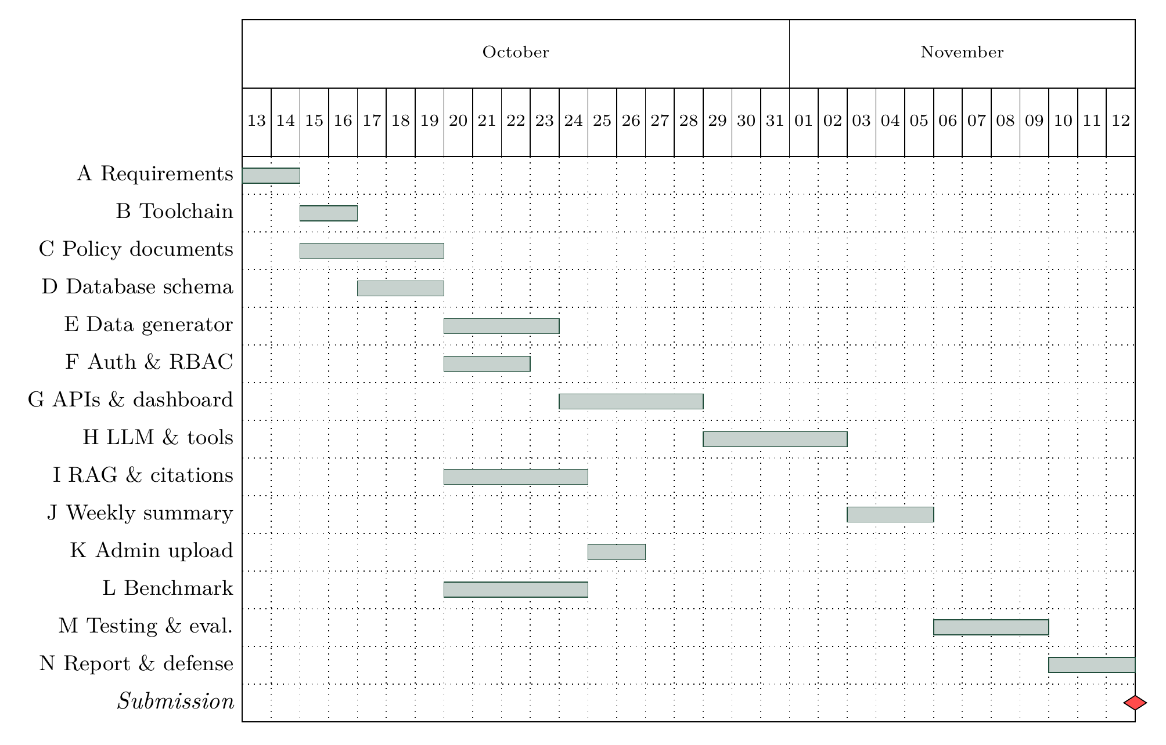
14. Project Schedule
31 days: 13 Oct – 12 Nov 2026
Critical path: A → B → D → E → G → H → J → M → N
Policy documents (C) and benchmark questions (L) run in parallel, with 9–12 days of slack
Full PERT table (ES, EF, LS, slack) in the SRS

Slide 17
15. Limitations, Future Work & Conclusion
Limitations
Future Work
Synthetic data only: no authorised university access yet.
Free-tier LLM: rate limits and provider changes.
English only; scanned PDFs not supported.
Read-only tools: students cannot submit requests.
University API adapter for real records.
Hindi and regional languages.
Faculty role and confirmation-gated actions (e.g. hostel leave).
Mobile and messaging access.
Conclusion
CampusGPT brings a student's own records and university policy into one conversational interface, with answers grounded in verified sources and privacy enforced by the backend, not by the prompt. The design is complete; implementation follows the 31-day plan, and evaluation will measure accuracy, citations and leakage against simpler baselines.

Slide 18
16. References
[1] Cormack, G. V., Clarke, C. L. A., & Buettcher, S. (2009). Reciprocal rank fusion outperforms Condorcet and individual rank learning methods. Proceedings of the 32nd ACM SIGIR Conference, 758–759.
[2] Lewis, P., et al. (2020). Retrieval-augmented generation for knowledge-intensive NLP tasks. Advances in Neural Information Processing Systems, 33, 9459–9474.
[3] Yao, S., et al. (2023). ReAct: Synergizing reasoning and acting in language models. International Conference on Learning Representations (ICLR).
[4] Schick, T., et al. (2023). Toolformer: Language models can teach themselves to use tools. Advances in Neural Information Processing Systems, 36.
[5] Greshake, K., et al. (2023). Not what you've signed up for: Compromising real-world LLM-integrated applications with indirect prompt injection. Proceedings of the 16th ACM Workshop on Artificial Intelligence and Security, 79–90.
[6] Ji, Z., et al. (2023). Survey of hallucination in natural language generation. ACM Computing Surveys, 55(12), Article 248.
[7] Es, S., James, J., Espinosa-Anke, L., & Schockaert, S. (2024). RAGAS: Automated evaluation of retrieval augmented generation. Proceedings of EACL 2024: System Demonstrations, 150–158.
[8] Malkov, Y. A., & Yashunin, D. A. (2020). Efficient and robust approximate nearest neighbor search using hierarchical navigable small world graphs. IEEE Transactions on Pattern Analysis and Machine Intelligence, 42(4), 824–836.
[9] PostgreSQL Global Development Group. PostgreSQL 16 documentation: NOTIFY and SELECT locking clause. https://www.postgresql.org/docs/16/
[10] Kane, A. pgvector: Open-source vector similarity search for Postgres. https://github.com/pgvector/pgvector

