Slide 1

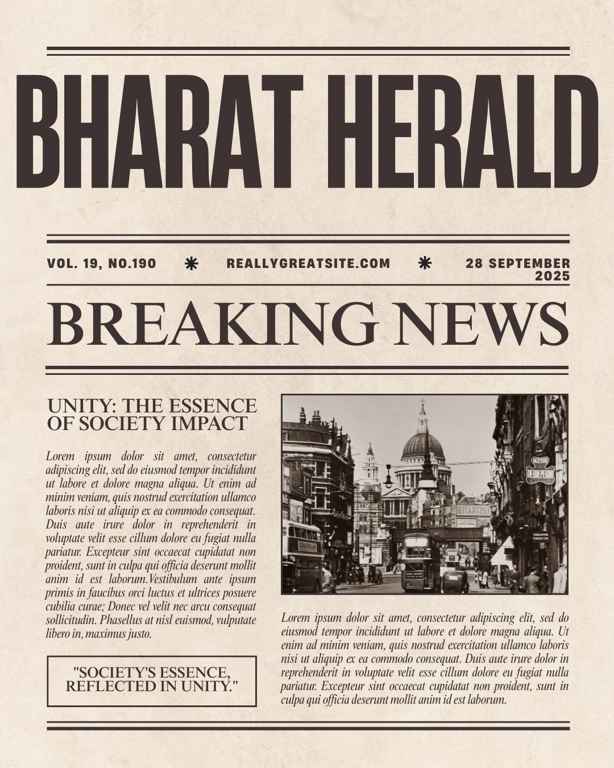

Bharat Hearld Business Insights
Note: 1 USD=88 INR and 1 EURO=100 INR
Presented by
Ankur Katiyar

Slide 2



Problem Statement
Bharat Herald, a legacy newspaper organization with operations across five Indian states
the company once printed over 1.2 million copies daily.
But between 2019 and 2024, print circulation has dropped to under 560,000. The pandemic accelerated a shift toward digital news consumption, and competitors like DigiHindi Post, NewsZilla, and InShorts quickly adapted with mobile-first platforms, WhatsApp delivery models, and subscription bundles. Meanwhile, Bharat Herald’s 2021 e-paper pilot failed due to poor mobile usability and was eventually shelved after financial losses.

Slide 3
Key Insights
Jaipur has highest net circulation and total printed copies.
Print sales are declining every year leading to shrinking of print business.
Patna is the highest ad revenue contributor almost 11 % of the total ad_revenue while Kanpur is lowest showing the lack of advertiser’s trust in kanpur.
Government and real estate have 60 % share in ad revenue category.
Kanpur,Lucknow and Varanasi have highest readiness score.
Lucknow,Bhopal and Patna are best suited for digital transition strategy based on readiness score and engagement % with targeted campaigns and marketing strategjies

Slide 4
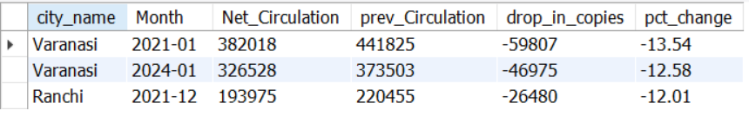
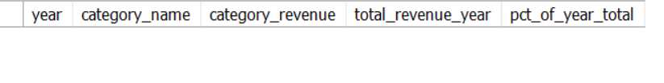
Q1. Generate a report showing the top 3 months (2019–2024) where any city recorded the sharpest month-over-month decline in net_circulation.
Q2. Identify ad categories that contributed > 50% of total yearly ad revenue.
There is no such category which contributes more than 50% in total yearly ad revenue.
Note 1 USD=88 INR and 1 EURO=100 INR

Slide 5
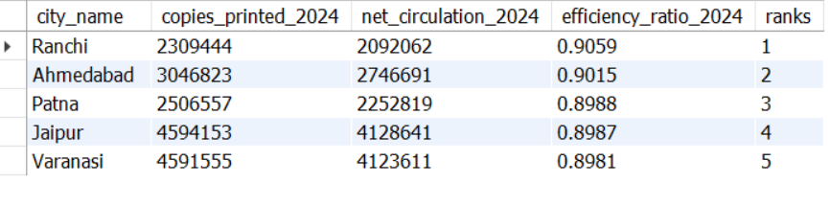
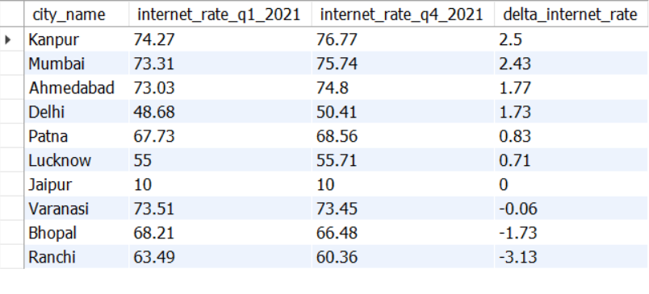
Q3. For 2024, rank cities by print efficiency = net_circulation / copies_printed. Return top 5. .
Q4. For each city, compute the change in internet penetration from Q1-2021 to Q4-2021 and identify the city with the highest improvement.

Slide 6

Q5. Find cities where both net_circulation and ad_revenue decreased every year from 2019 through 2024 (strictly decreasing sequences).
This shows that there has been no single city where there has been declne in both net_circulation and ad_revenue for all years between 2019 to 2024

Slide 7
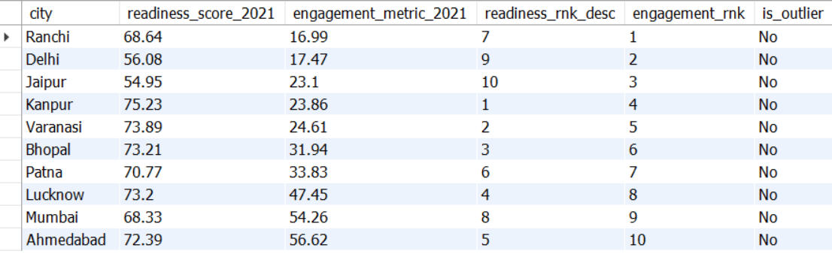
Q6. In 2021, identify the city with the highest digital readiness score but among the bottom 3 in digital pilot engagement.

Slide 8
Recommendations:
Lucknow, Bhopal and Patna are best suited cities for digital transition strategy based on readiness score and engagement %.
While Kanpur being top in readiness score but low engagement % has a room to increase user base with targeted campaigns and user centered marketing strategies.
Phase 1
Launch digital platform in priority cities.
Redesign mobile app and e-paper UI/UX design to make it user friendly.
Launch marketing and awareness campaigns.
Phase 2
Analyse the feedback of the customer.
Increase digital business to more cities.
Introduce subscription based model and loyalty programmes.
Show regional news for better engagement.

Slide 9
Phase 3
Focus on local advertising to increase ad revenue.
Introduce short news based system.
Online surveys to understand users.
AI driven recommendations
Regaining advertisers trust
Advertisers wants better reach and engagement so that their advertisement can succeed. This can happen when users increase . Some more steps can be –
To share net circulation, engagement and number of active users with the advertisers.
To run targeted campaigns.
To share customer feedback.
Lauch short news on whats app /Telegram along with regional column for better reach.
Subscription bundle based news
Bundling is seen as valuable because it offers multiple services (like news, podcasts, and archives) at a discounted rate..
Introducing Pay per Article Monetizes high-performing content and attracts price-sensitive users.
Partnership with Regional Influencers
Local creators speak the language.Their popularity helps in increasing reach and their authenticity builds trust
reshaping Bharat Herald’s image from “top-down media” to “community voice.”

