Slide 2
Project
Data warehousing part 1
Domain:Bike ms

Slide 3
Motivation
Bike MS participants and teams are raising funds to reach the goal – a world free of MS
Who are the donors?
Who are the participants and teams taking part in the event?
What is the total amount of gift fundraised based on the place ,years and teams?

Slide 4
Business questions
1.What industries have had the strongest involvement in Bike MS in the last five years and what occupations were responsible for most of our fundraising?
2.Which are the areas where the outbreak of MS is the most and which are the areas that are donating most?
3.Can we apply those opportunities to specific markets?

Slide 5
Tableau visualization
1.What industries have had the strongest involvement in Bike MS in the last five years and what occupations were responsible for most of our fundraising?

Slide 6
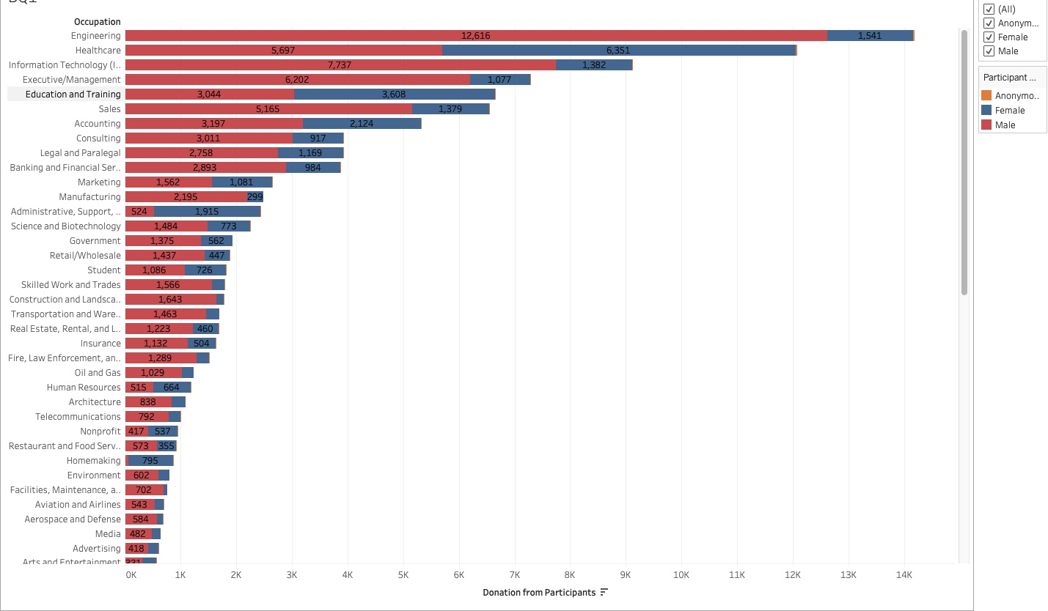
We can see donations from participants based on top occupation and gender.

Slide 7
2. Which are the areas where the outbreak of MS is the most and which are the areas that are donating most?

Slide 8
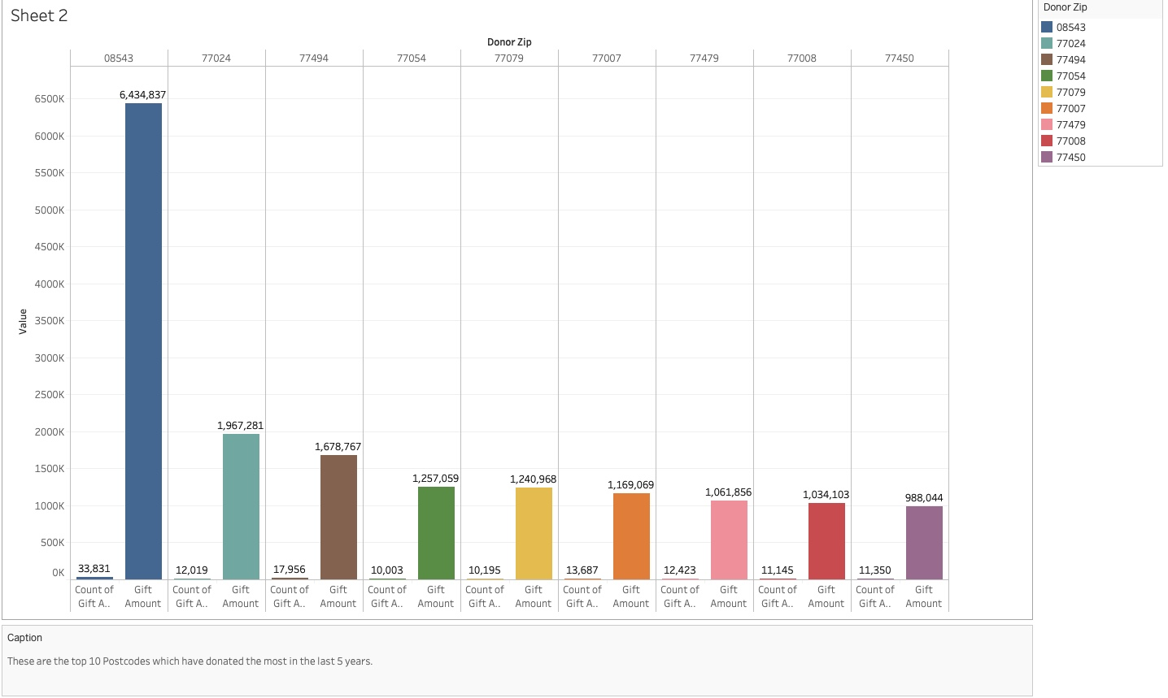
Top 10 Postcodes which have donated the most in the last 5 years

Slide 9
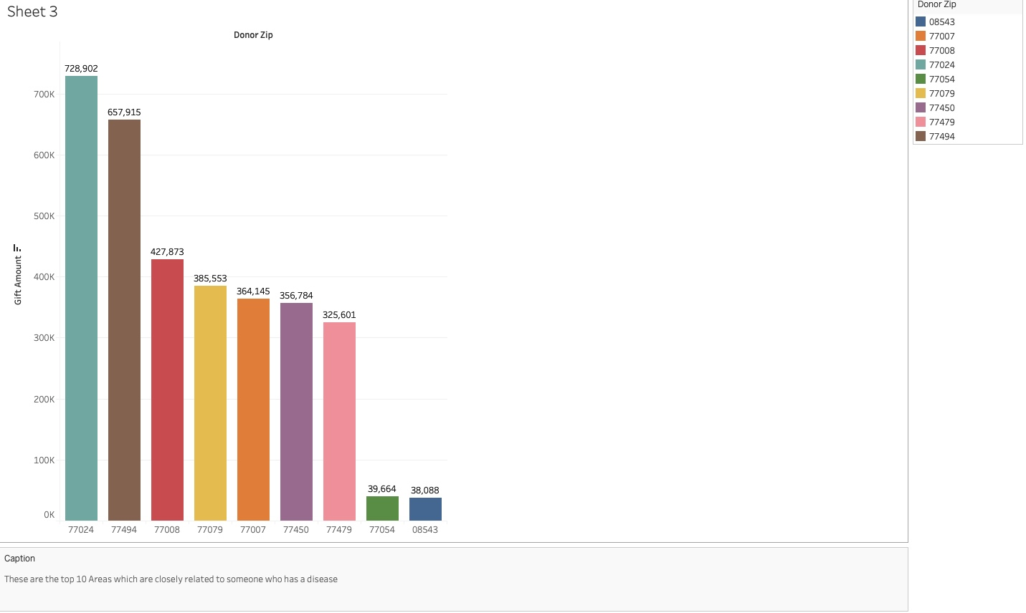
-we wanted to visualize that are the donations related to someone who have a connection with the MS disease?

Slide 10
3.Can we apply those opportunities to specific markets ?
we can see the amount of donations that come from people that are not participant in the event but they just donate based on states and the largest employer.
Texas is the state where the most donations come from.

Slide 11
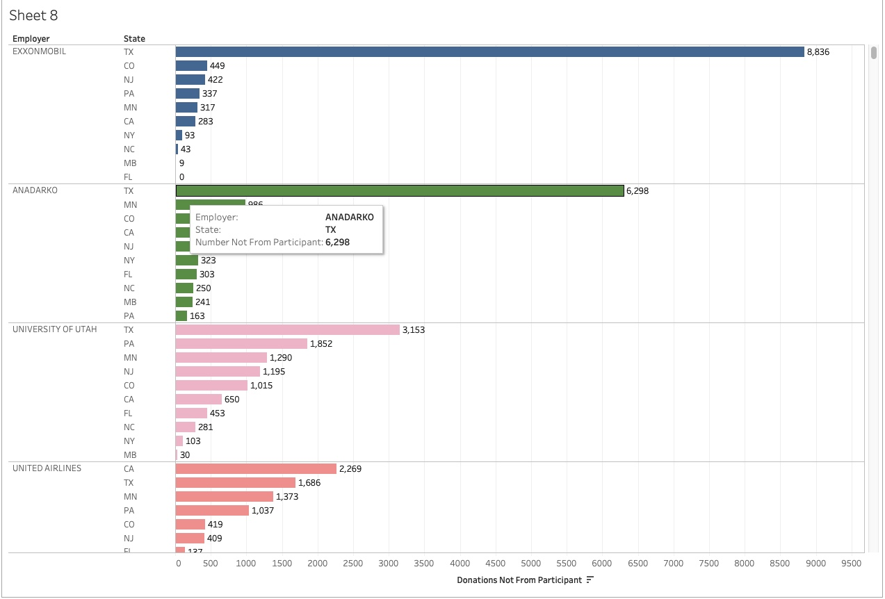

Slide 12
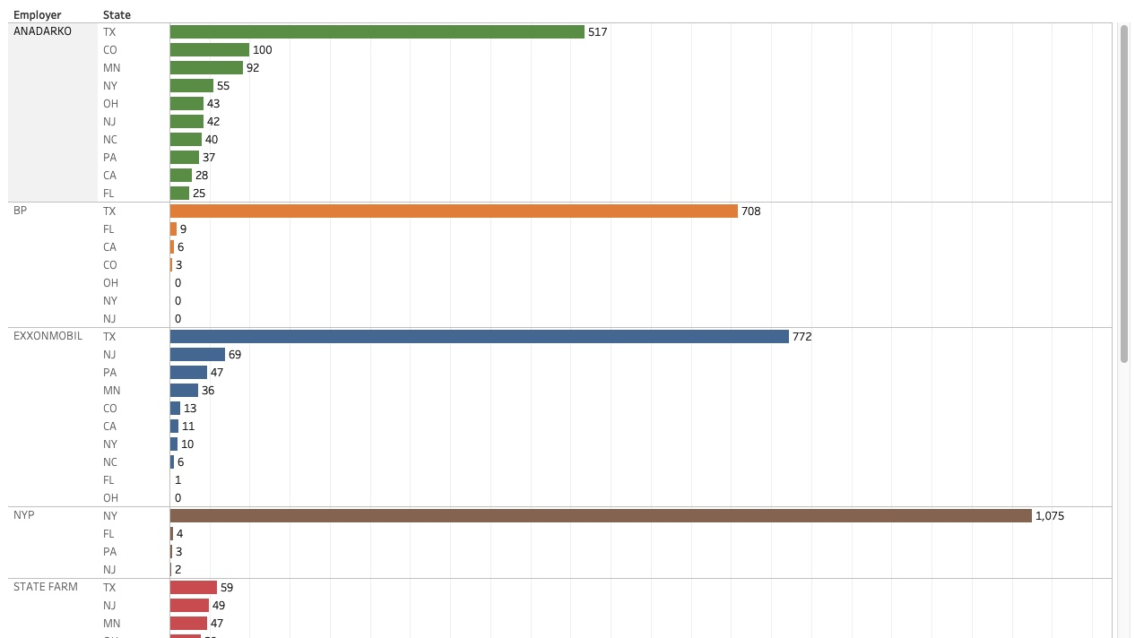

Slide 13
We can safely conclude that ANADARKO and EXXONMOBIL have donated the most in Texas State and we have a lot of opportunities in other states to advertise and market.

Slide 14
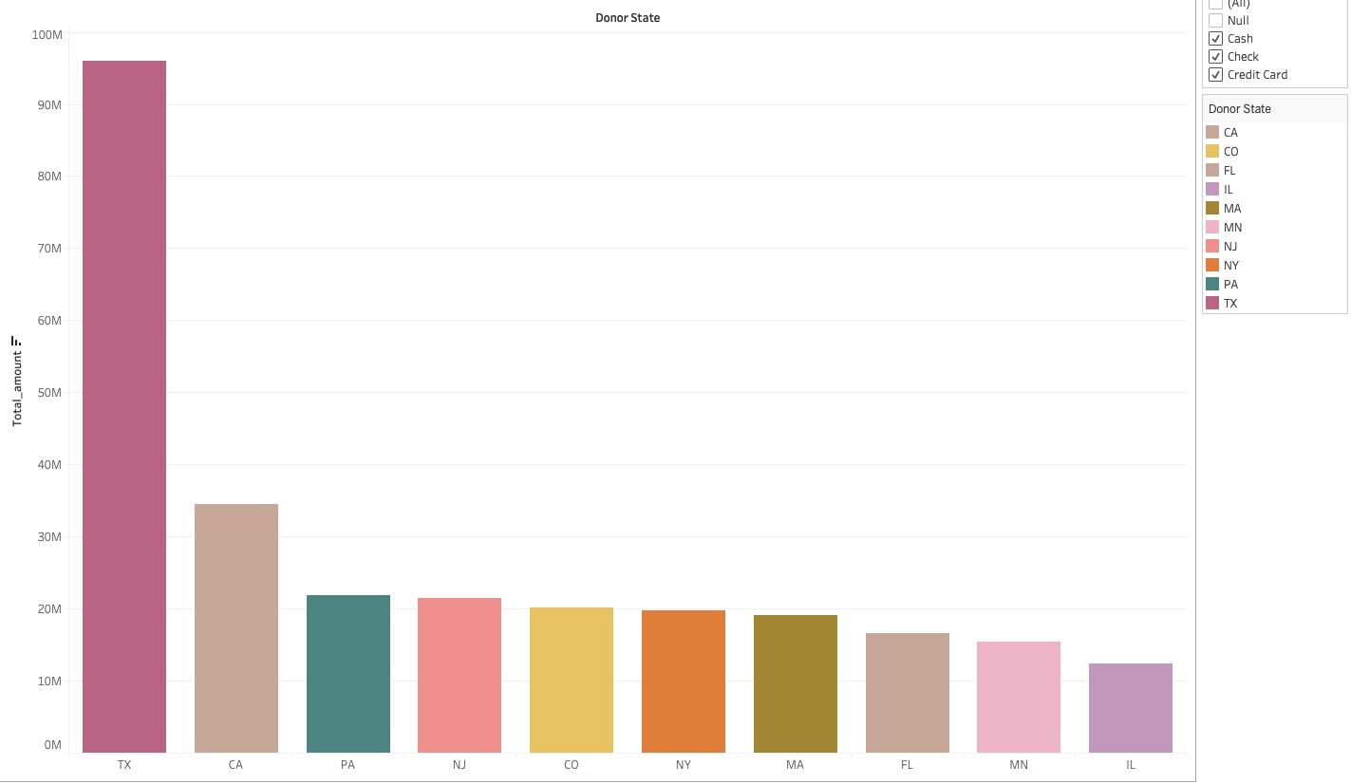

Slide 15
FROM THE PREVIOUS SLIDES, WE CAN SAFELY CONCLUDE THAT TEXAS HAS DONATED THE MOST IN THE PAST YEARS.
WE CAN INVEST THE MONEY TO ADVERTISE ABOUT BIKE MS IN SOME OTHER STATES

Slide 16
4.lets see how the participants have increased/decreased over the years

Slide 17
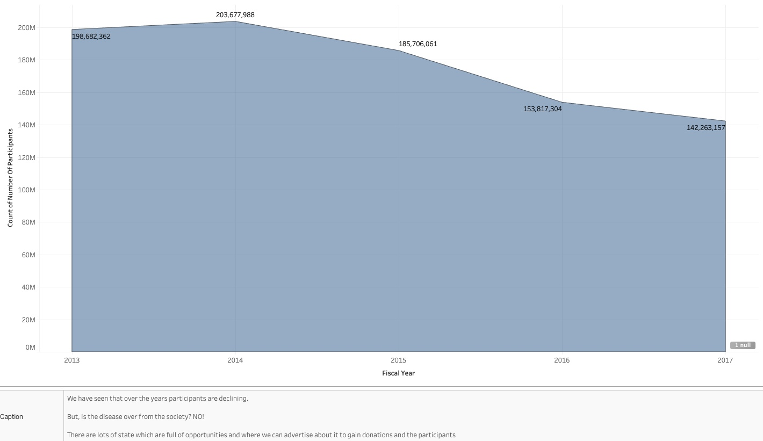

Slide 18
Lets see the total amount of donations over the years

Slide 19
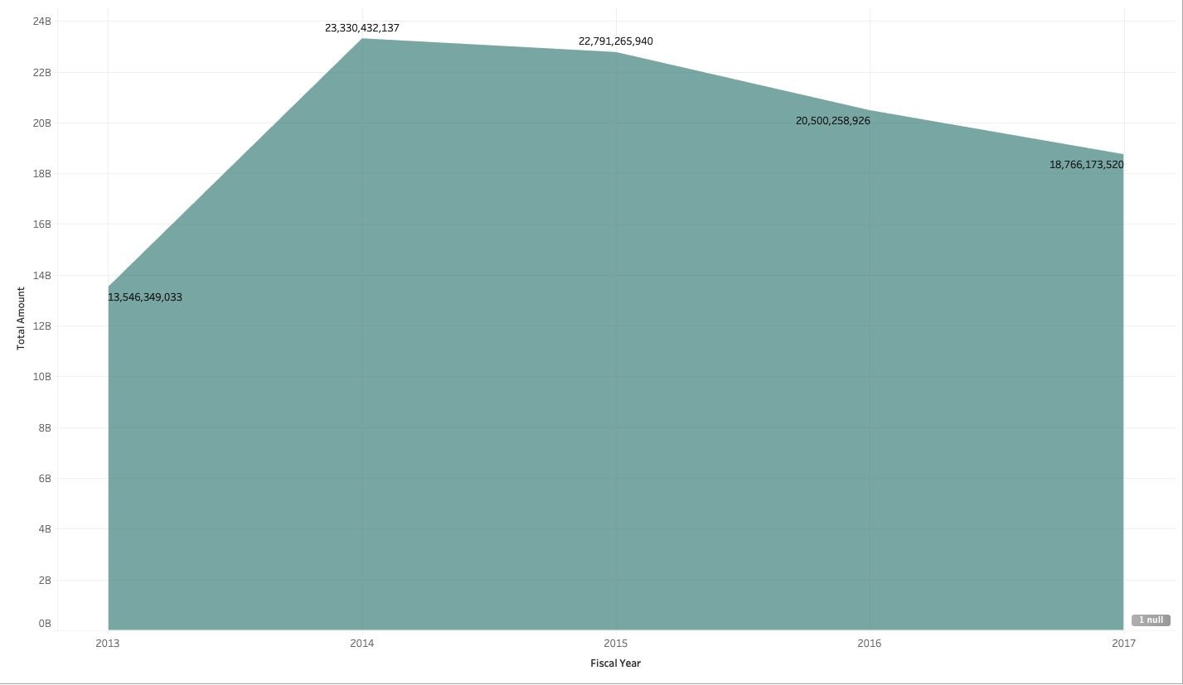

Slide 20
Data profiling and inspection
There are 6 data files:Affiliates,BikeTeams,Donations,Events,National Teams,Participants
We decided to work just in 4 datasets (the most relevant ones related to the scope of the our project) which are: BikeTeams,Donations,Events and Participants
Tools to clean data:Excel,Tableau,PostgreSQL
Identified problems with the data:missing data ,duplication,irrelevant data,
Improvements:Merging data(merging donation datasets from 2013-2017),column transformation.

Slide 21
Conceptual schema-DFM
Fact table: Donation
Dimensions: Year,Donor ,City,Team
Measures: Total Amount, AvgAmount(AVG)
Period:2013-2017

Slide 22
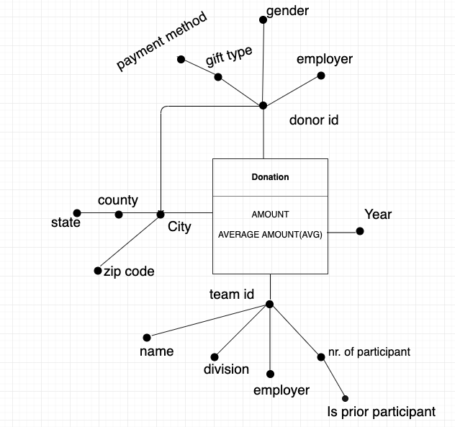
Attribute hiearchies,added measures (amount, avg amount(avg)

Slide 23
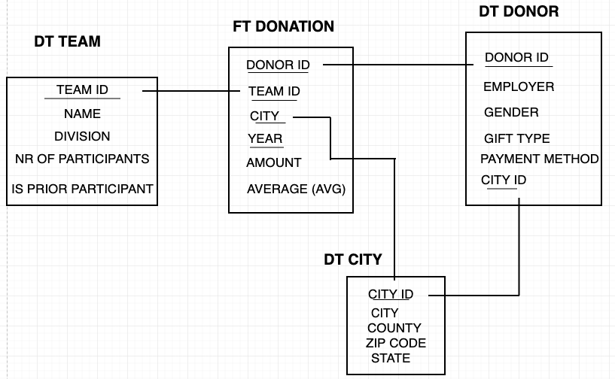
Rolap-Logical schema
FT( fact table),
DT(dimention table),
SHARED HIEARCHIES
STAR SCHEMA

Slide 24
OLAP
Q1. What is the total amount of givings every team(is prior participants)did per year?
Q2. What are the cities and respective states where is done the majority of givings?
Q3.What is the average amount of donations for a particular event in a given year?
Q5.What is the total amount of givings every team did based on their name and number of participants?
Q6 What is the max amount of givings and max average of givings based on donor’s gender per each year?

Slide 25
Postgresql
-Computing rankings and partitioning—fiscal year
Computing cumulative totals ( window framing) -net_transaction_amount
Computing mobile aggregates [window framing]-mobile average

Slide 26
Hive
Perform the same queries as in PostgreSQL
Perform 3 new other queries
H1.What is the total amount of givings done by each team and their respective names in each state ?
H2. Retrieve female donors and total amount of givings per year.
H3. Retrieve the employer who have donated through credit card.

Slide 27
SPARK
Spark dataframes and transformations
We performed OLAP queries and also 5 new queries

Slide 28
Time effort
75 hours
20 hours-understandanding and cleaning data
10 hours- dfm,rolap,queries
25 hours-hive and spark
10 hours-tableau visualization
10 hours-preparing text file and presentation

Slide 29
Thank you
Worked by:
Ankur Kumar Xhesilda Qoshi

