Slide 1
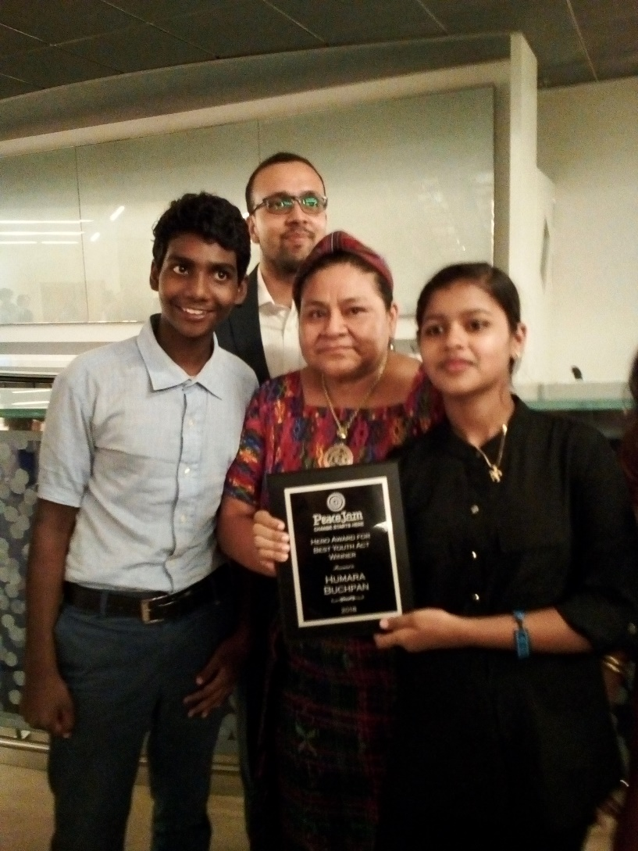

HUMARA BACHPAN CAMPAIGN
On Urban95
International Award winning
National Campaign on Safe & Healthy environment for young children living in urban poverty

Slide 2
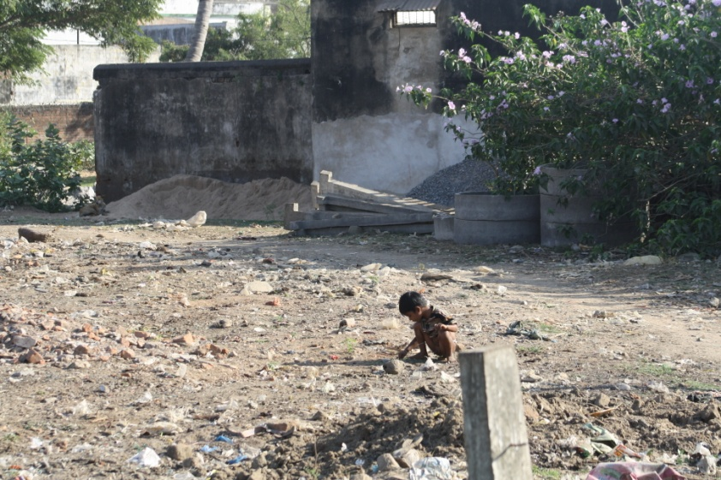
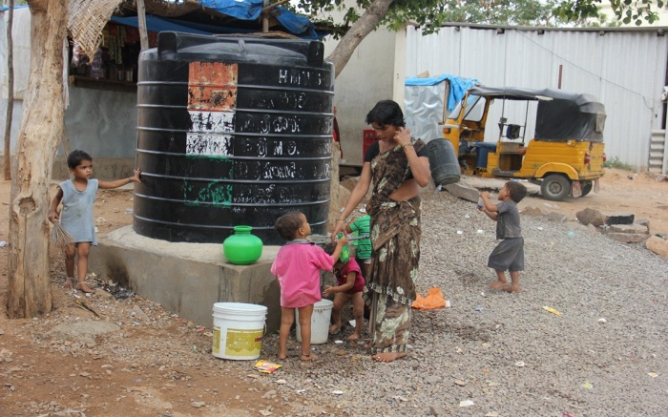
India Scenario
41.2 million children reside in urban areas
Children aged 0-6 constitute 11.45% of the total urban population
17.73 million have no access to tap water in cities
53 % children covered by Anganwadi centers
47.1% children are underweight
54.2 % children are stunted
23 million children below the age of 14 at the risk from poor sanitation.
8 million at the risk from poor water supply.
50 million people defecate in the open every day

Slide 3
Genesis
National campaign that started in November, 2012. Emerged out of a need to have a platform for children and youth to have their voices heard and make them active participants in planning and shaping their cities
Organize 33,000 child advocates in 330 slums across 11 Indian cities who will work with other children, parents and community members to conduct advocacy leading to better basic services and infrastructure and, as a result, improvements in the health and safety of children under 5
Objective

Slide 4
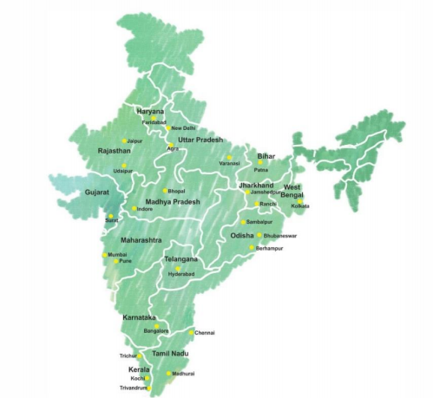

Our Presence

Slide 5






Our Reach
577
27217
2814
612
Current Status
189
12,514
1,565
397
2015 - 2016
Slums
Child Club Members
Child Club
Leaders
AWCs

Slide 6
Why Urban 95
Early childhood is the peak moment of lifetime brain development of children which affects their later years
A child‘s brain forms 700 neural connections every second
Young Children are affected by all aspects of city life be it housing, healthcare, water and sanitation, recreational spaces and transport

Slide 7
Campaign’s intervention on ECE
At community level
1. Understanding the situation
Identifying children aged 0-6 years through social maps
Identifying the availability of early childhood care and development services
2. Creating Awareness on early childhood and brain development
Create awareness among parents
Engagement on Nutrition day – Health camps for children aged 0-6 years
Training on early childhood and brain development to Anganwadi workers

Slide 8
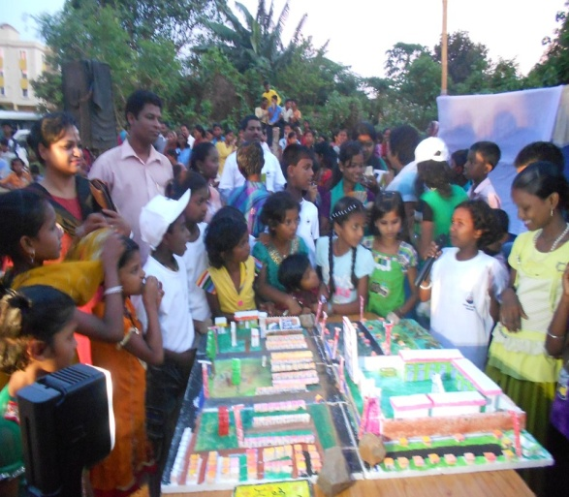
Campaign’s intervention on ECE
At the Government level
Raising the issue before government officials
Advocating for early childhood care and development
Submitting our plans to the government authorities

Slide 9
Campaign’s intervention on ECE
Major Changes
Construction of Anganwadi centers in Bhopal
Upgrading of centres in OUAT and Damana Hata slums of Bhubaneswar
Behavioural and attitudinal changes among anganwadi teachers and parents

Slide 10
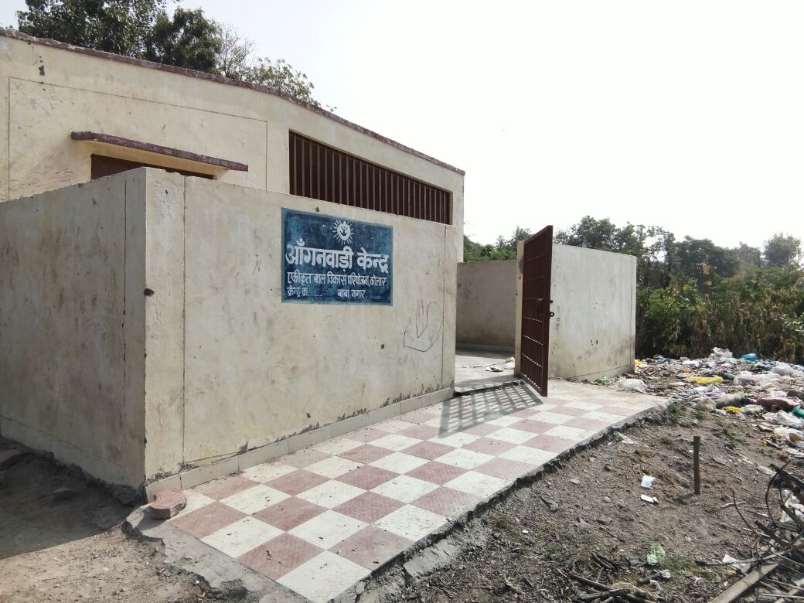
Anganwadi center in Bhopal

Slide 11
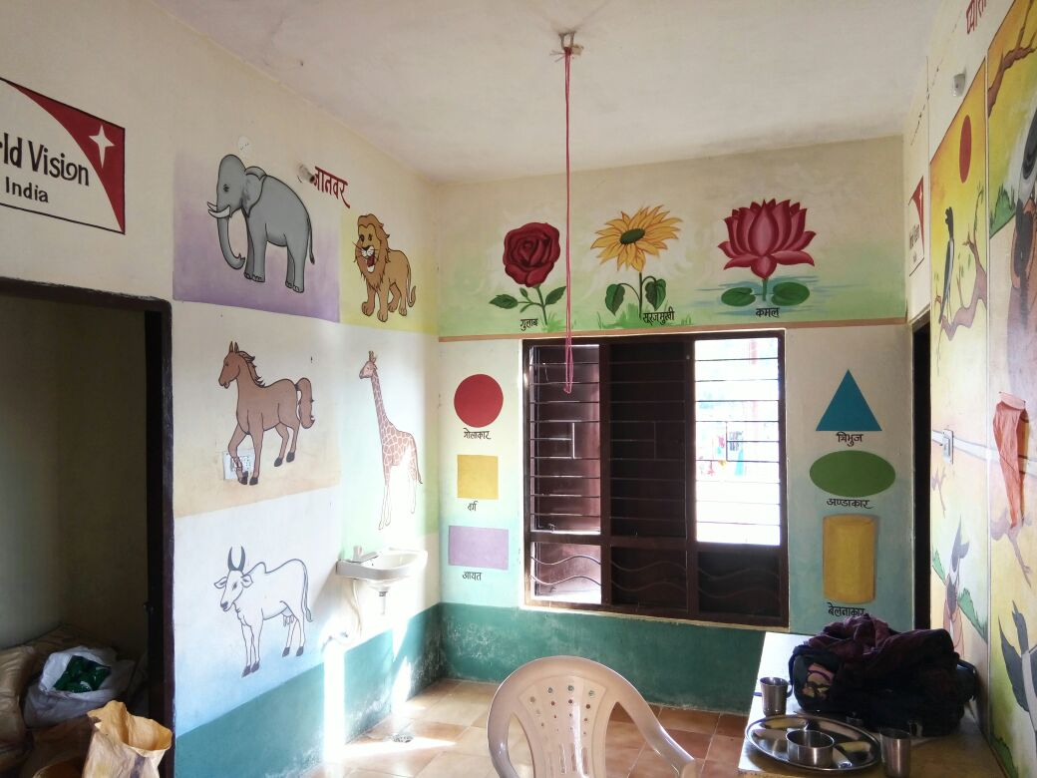
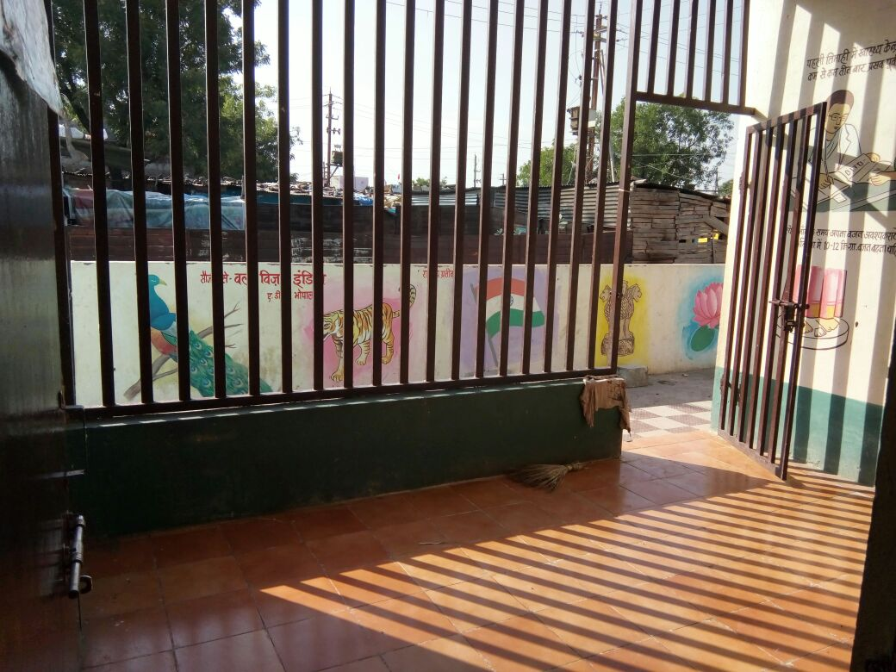
Anganwadi center in Bhopal

Slide 12
Therefore, the choices city leaders make will have a direct impact on how the process of child development unfolds and the kind of contribution the children can make to India’s prosperity
THANK YOU!

Slide 13
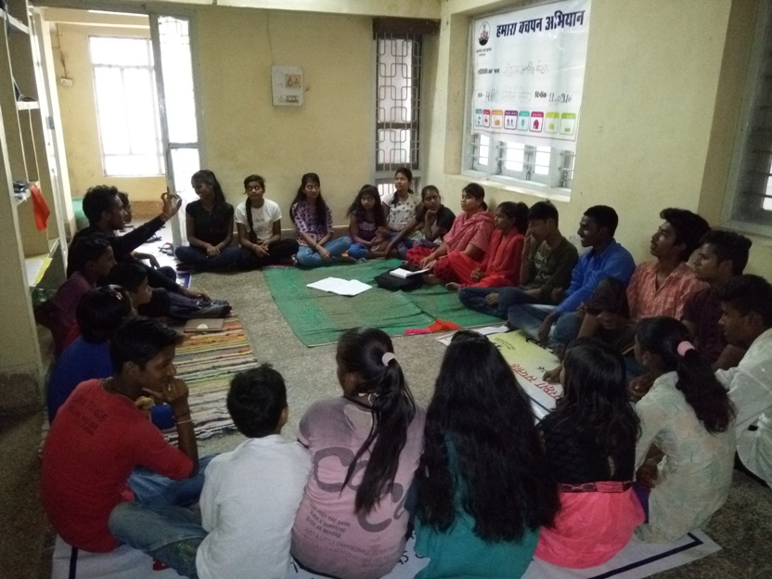
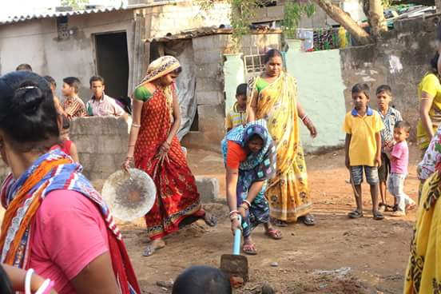
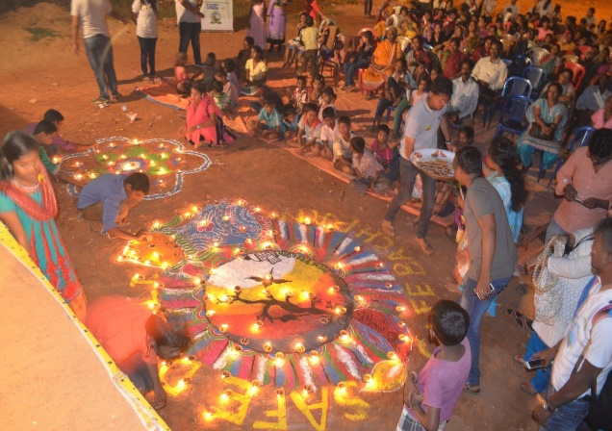
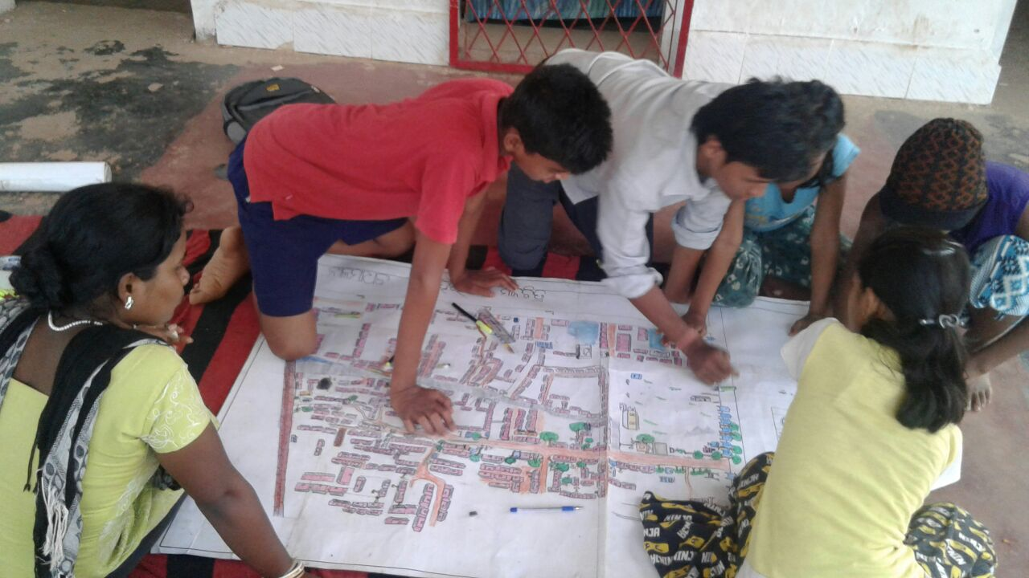
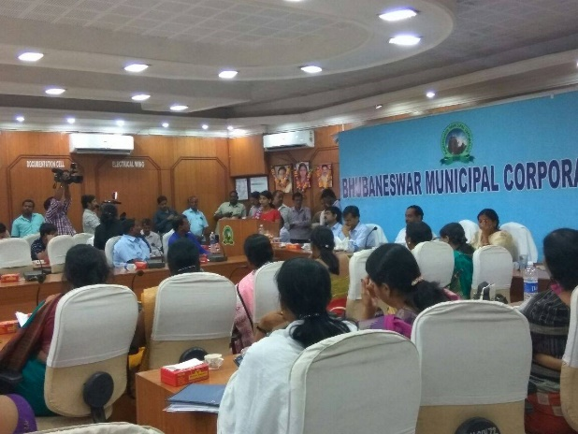
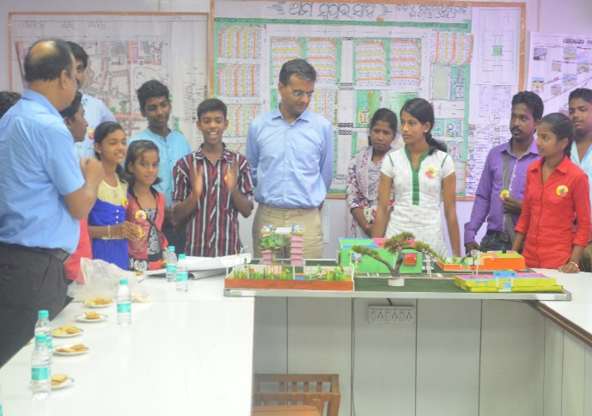
Our work in pictures…
Child Club Meeting
Cleanliness Drive
Safe Diwali, Safe Bachpan
Child leaders explaining their dream neighbourhood to BDA Chairman, Bhubaneswar
Children led planning
Children presenting at BMC

